Slide 1



Global Lead Paint Elimination
IPEN Campaign and Lessons Learned

Slide 2
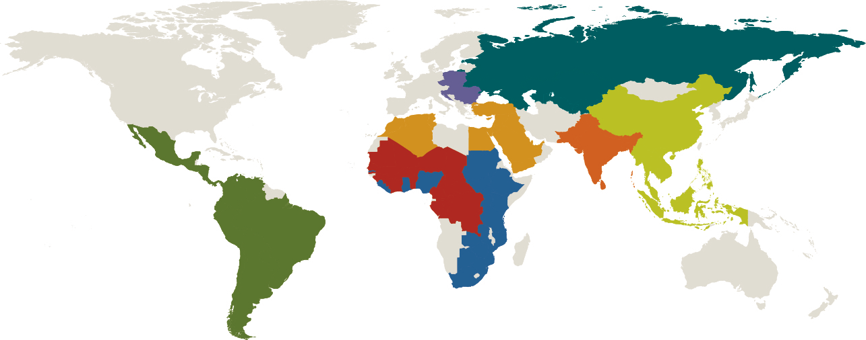
About IPEN
IPEN -A Global NGO Network
500 NGOs in more than 100 Countries working on
Persistent Organic Pollutants
Toxic Metals: (e.g. Lead and Mercury)
Chemical Safety (SAICM)
www.ipen.org

Slide 3
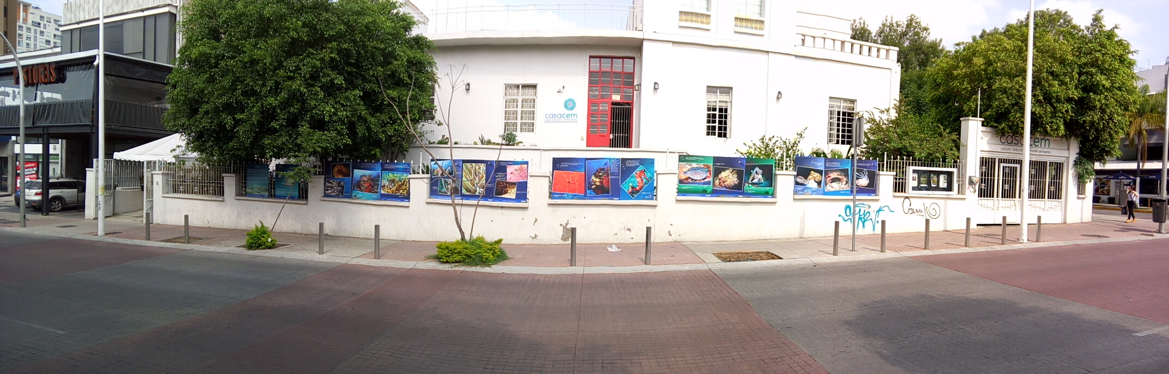
About Casa Cem
Casa Cem
Mexican NGO, IPEN member since 2016
Since 2007, our organization has been working on projects concerning waste and chemicals education, communication, management, research, public policy and safe environment human rights legal defense.

Slide 4
Role of civil society
IPEN´s Global Campaign
IPEN´s global lead paint elimination campaign initiated in 2008 by bringing data on lead paint sold in developing countries to international attention
CSOs important stakeholders
  generating data and making the issue a public issue of concern
  Reaching out informally to industry and policy makers to discuss actions that can be taken and gather support
  Representing consumer safety and right to know
www.ipen.org

Slide 5
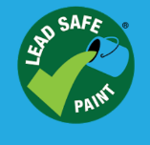
IPEN Campaign Components
IPEN´s Global Campaign
Global Activities
- Advisory Council of The Global Alliance to Eliminate Lead Paint
- Policy Interventions at e.g. SAICM
Examples of National/Regional Activities
- Paint Studies
Media campaigns
Outreach to manufacturers and policy makers
- Stakeholder Alliances
- Third-party certification
www.ipen.org

Slide 6
Campaign Results
IPEN´s Global Campaign
New lead paint standards and regulations enacted or pending in more than 12 countries in Asia and Africa since 2011
Data on lead paint is now available in 55 countries
Major paint producers eliminating lead paint
Decision maker engagement nationally, regionally and internationally
The world’s first voluntary, third-party lead paint certification program is now in place. www.leadsafepaint.org
www.ipen.org

Slide 7
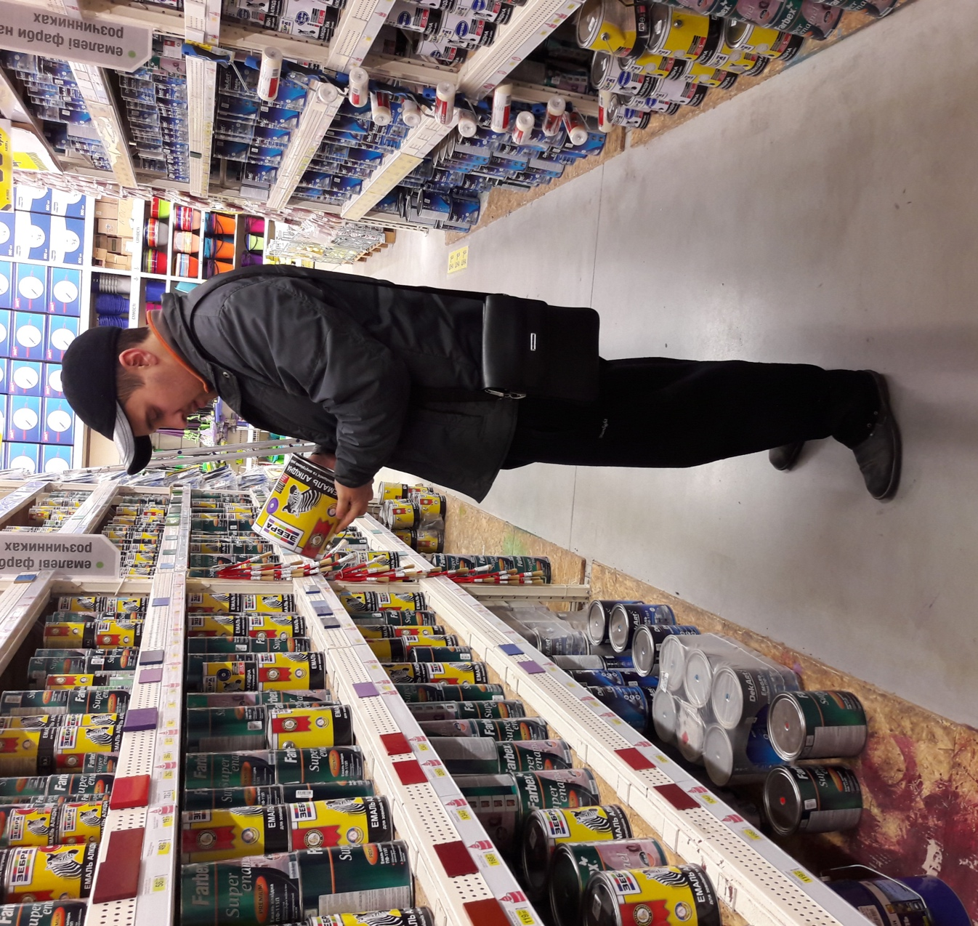
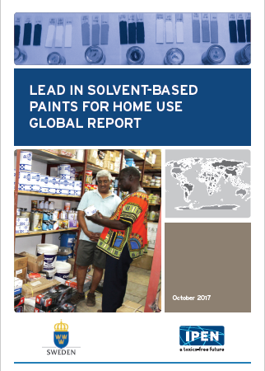
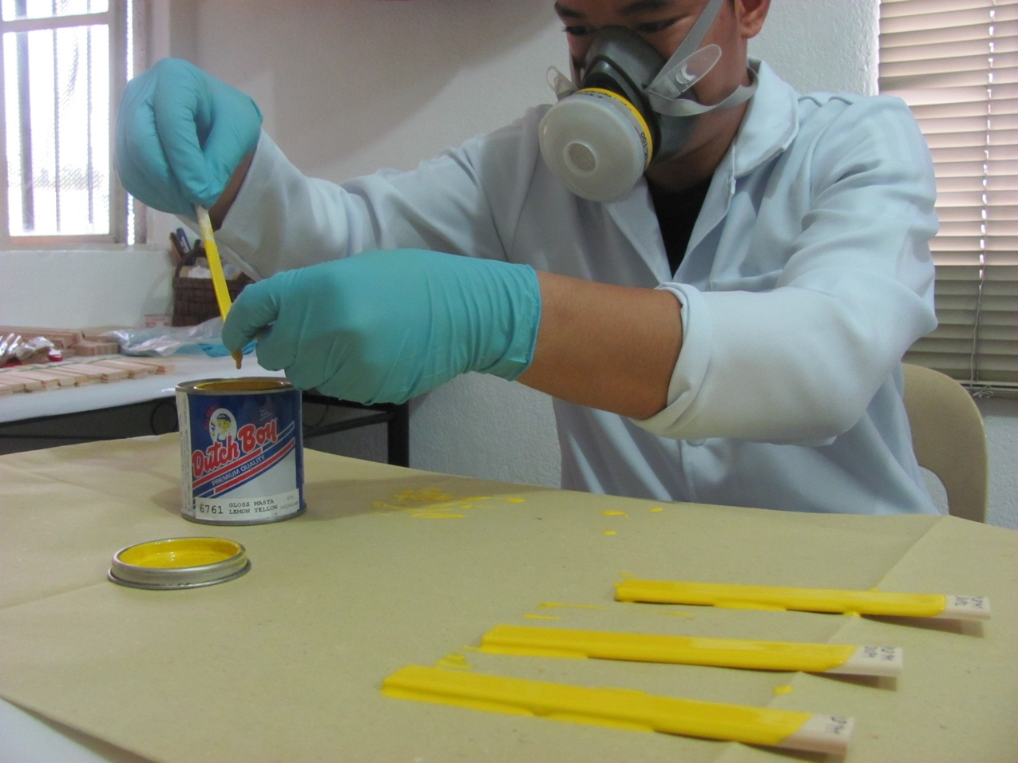
Paint studies
Scientific studies on lead in paint available on the market for home use
Summarized in national reports, and in 2017 a global report.
www.ipen.org

Slide 8
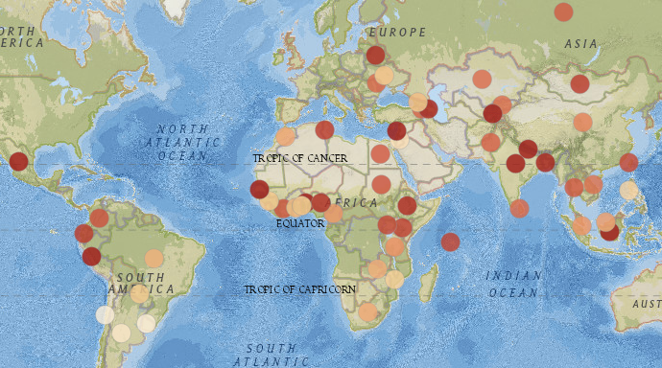
Data available in 55 countries
http://www.ipen.org/projects/eliminating-lead-paint/lead-levels-paint-around-world
www.ipen.org
Notes:
Different colors of dots are for Percent of Paints Containing Lead over 90 ppm or 600 ppm. Dark red is above 80%.

Slide 9
Data available in LAC region
Paint studies
Country | % > 90 ppm | Highest Lead Level | No. sampled paints | Study Year
Argentina | 14 | 100,000 | 42 | 2017
Brazil | 35 | 59,000 | 20 | 2014
Chile | 4 | 1,100 | 23 | 2013
Colombia | 72 | 250,000 | 39 | 2016
Ecuador | 70 | N/A | 10 | 2009
Mexico | 100 | 164,000 | 20 | 2009
Paraguay | 27 | 169,000 | 15 | 2015
Peru | 90 | N/A | 10 | 2009
Uruguay | 0 | 63 | 30 | 2013
www.ipen.org
Notes:
Different colors of dots are for Percent of Paints Containing Lead over 90 ppm or 600 ppm. Dark red is above 80%.

Slide 10
Data -Key lessons learned
Paint studies
In countries where no (enforced) lead paint regulation was in place, lead paint was available to buy for home use
Scientifically sound data from competent labs using internationally recognized methods important for reliability
Data creates incentive for manufacturers to change and for governments to enact regulations
www.ipen.org

Slide 11
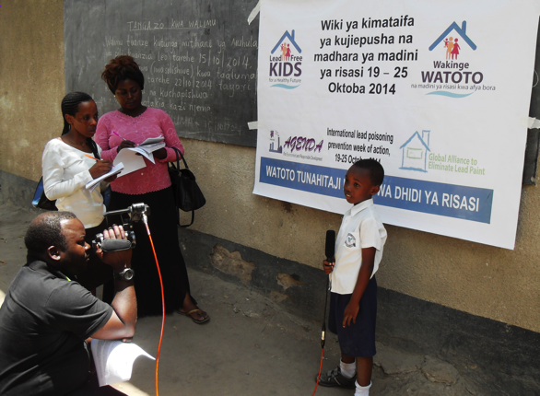


Outreach and awareness
Increase public awareness
change consumer behavior
make lead paint national issue of concern
Build support for laws
www.ipen.org

Slide 12
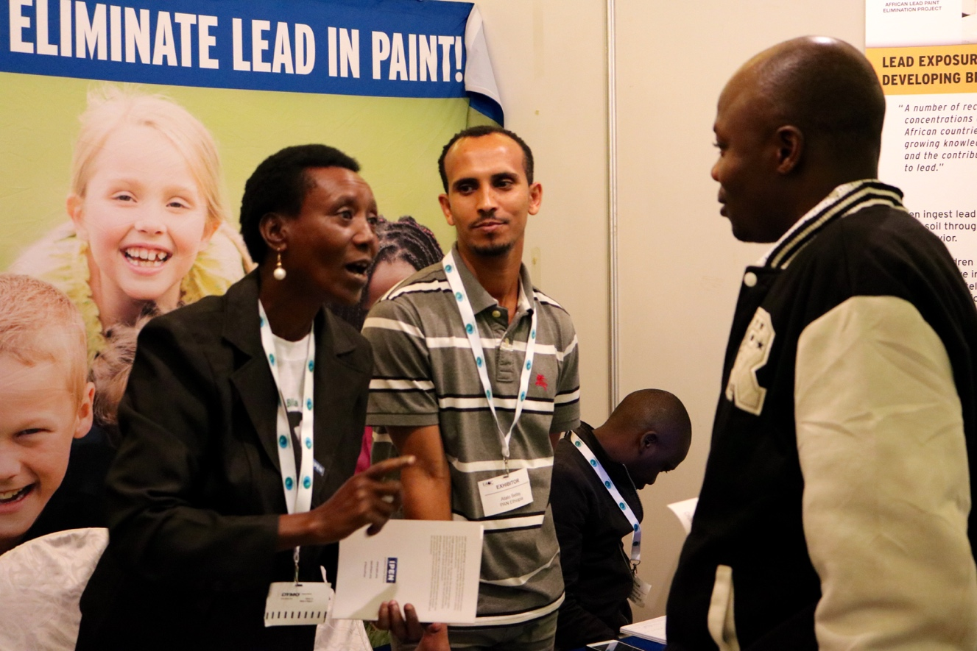
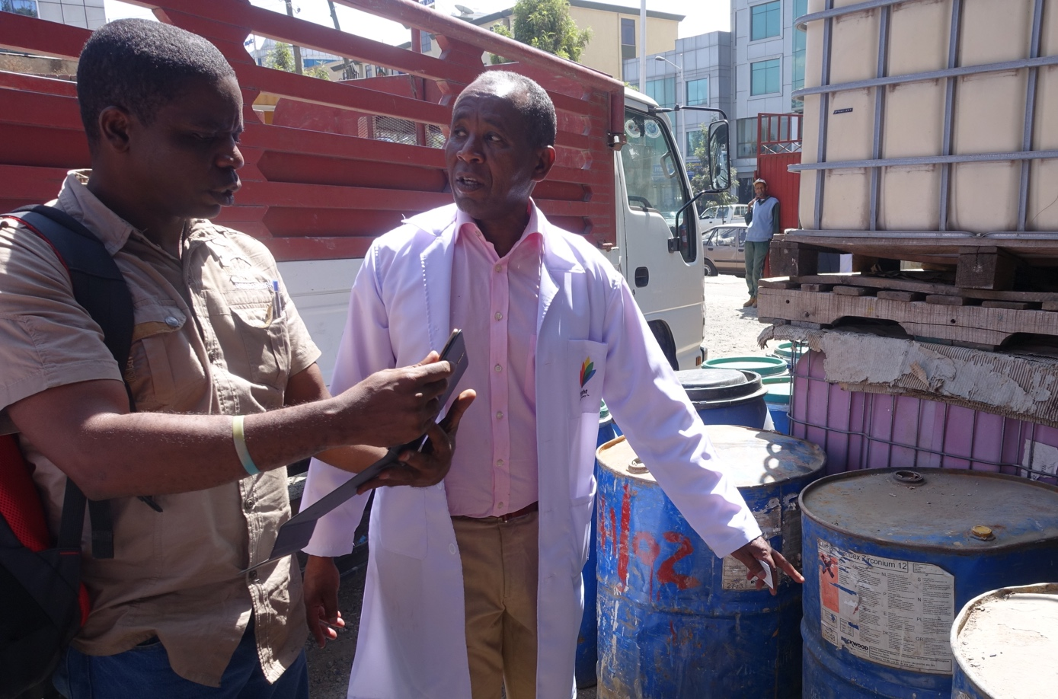
Outreach and awareness
Increase manufacturer awareness
Encourage change to lead-free paint production
Build support and find champions for lead paint laws
Understanding obstacles and ways to facilitate change
www.ipen.org

Slide 13
Outreach to Manufacturers
- Key lessons learned
Outreach and awareness
Unawareness about hazards of lead paint major problem
Manufacturers can be great champions for change
Main obstacles to change: access to raw materials and advice on reformulation
Leaded paint ingredients can be cost-effectively replaced by selecting the right mix of alternatives
Lead-free alternatives available for all uses
www.ipen.org

Slide 14
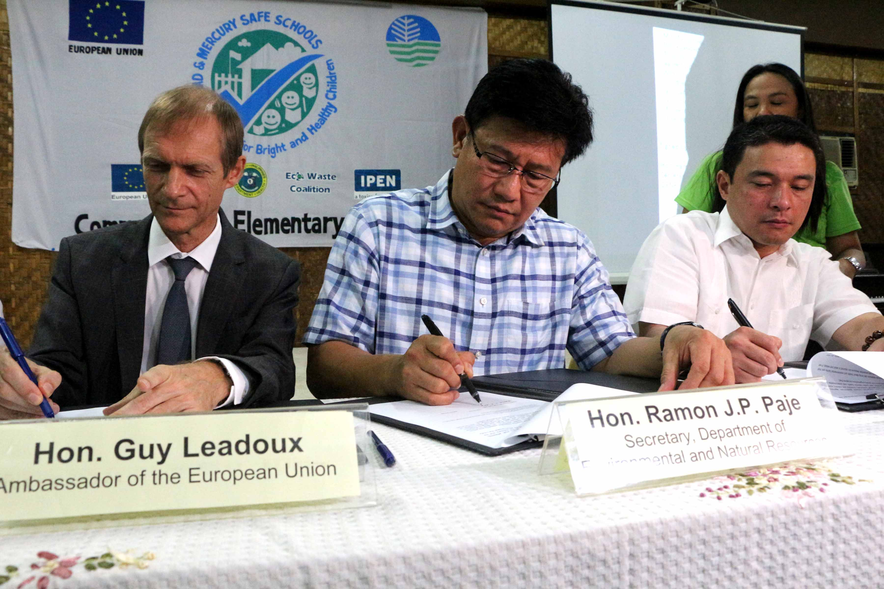
Outreach and awareness
Increase awareness about hazards of lead paint
Provide information on country situation and find country champions
Promote enactment of lead paint laws
Understanding obstacles and ways to facilitate change
www.ipen.org

Slide 15
Outreach to Policy makers
- Key lessons learned
Outreach and awareness
Many policy makers unaware about hazards of lead paint
Chemicals often low priority
Support from manufacturers, civil society and other stakeholders, creates room and incentive for policy makers to act
www.ipen.org

Slide 16
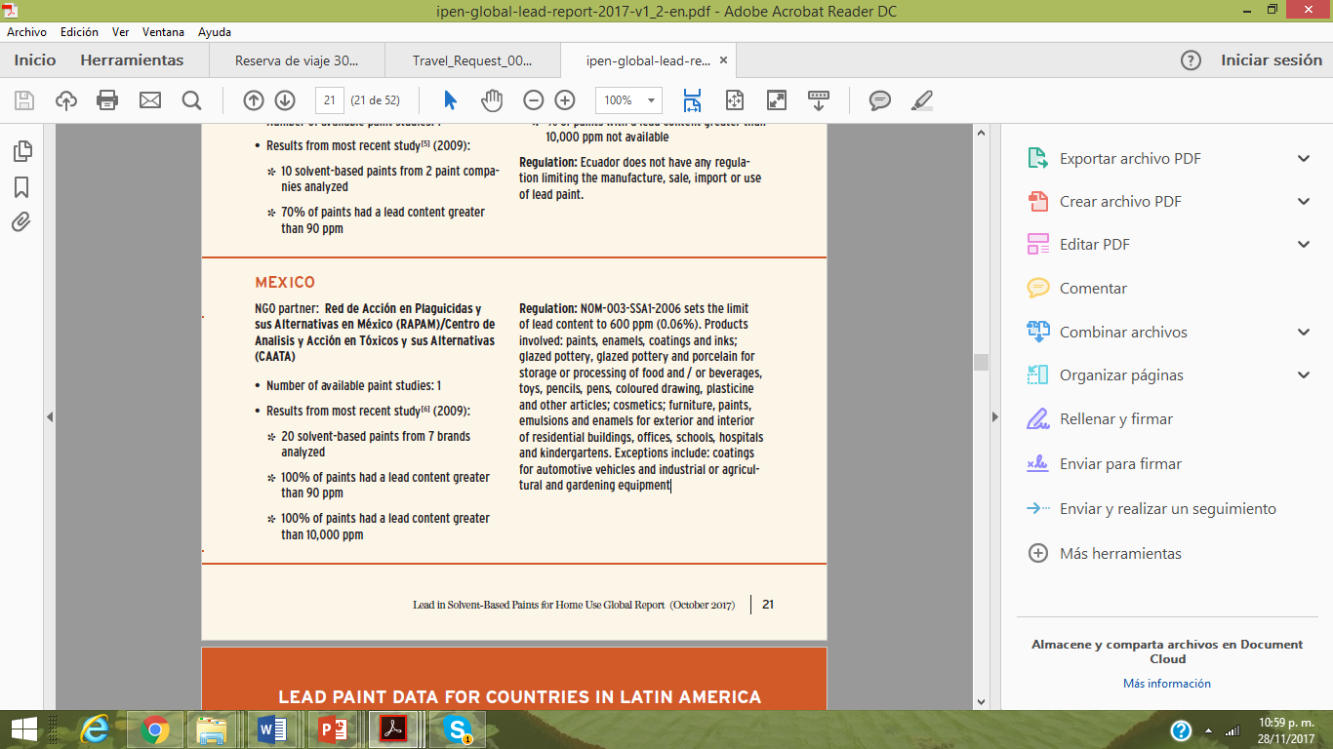
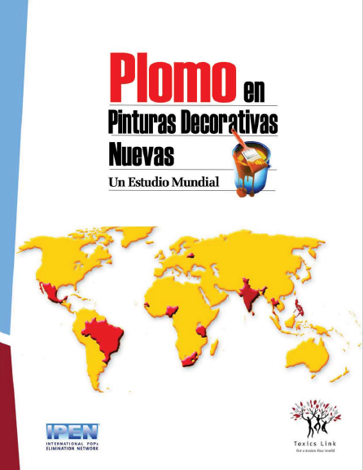
Country situation and activities in Mexico
Mexico
www.ipen.org

Slide 17
Mexican legislation
Mexico
hydrochloric acid
hydrochloric acid
NOM 004 SSA1 2013
The use of lead compounds should be avoided in paints, enamels, coatings, emulsions and inks. The maximum lead limits allowed are:
NOM 252 SSA1 2011
Toys and school articles - including paint in toys- 90mg/kg of bioavailable lead (hydrochloric acid solution leachate).
www.ipen.org

Slide 18
Mexican legislation
Mexico
NOM 231 SSA1 2002
Limits for soluble lead in glazed pottery, ceramic, porcelain articles. ( in a solution of 4% acetic acid)
trial method.
Non compliant articles should hold the label “not for food or drink use - this product contains lead”
Sampling method described in norm however does not say who should perform the sampling nor how should it be enforced.
 | Capacidad | Na,b | Criterio de aceptación | Límite máximo permisible
 |  |  |  | Pb mg/L | Cd mg/L
Piezas planas | No aplica | 4 | Promedio | 2.00 | 0.50
Piezas huecas pequeñas | < a 1.1 L | 4 | Todas las piezas | 2.00 | 0.50
Piezas huecas grandes | > a 1.1 L | 4 | Todas las piezas | 1.00 | 0.25
Piezas huecas para almacenar | > a 3 L | 4 | Todas las piezas | 0.50 | 0.25
Tazas y tarros | No aplica | 4 | Todas las piezas | 0.50 | 0.25
Piezas para procesar alimentos y/o bebidas | No aplica | 4 | Todas las piezas | 0.50 | 0.05
a Es el número de piezas a las que se les aplicará la prueba. b En caso de que la muestra (cuatro piezas) exceda el 25 % de la producción anual de esa pieza suelta específica, se analizará una pieza.
www.ipen.org

Slide 19
Mexican legislation
Mexico
NOM 003 SSA1 2006 (amended 2010)
Labeling for leaded products.
(Leaded product: total lead content over 600ppm)
“Its use is forbidden in toys, articles that can be taken to the mouth, articles for home use, school articles, interior paint for homes, restaurants, play areas and schools.”
“Contains lead compounds, solvents and toxic chemicals its prolonged or frequent contact or inhalation causes serious health damage.”
www.ipen.org

Slide 20
Mexican legislation
Mexico
5 years lapse to finish up non- compliant stocks ( may 2019)
Still need to work on:
Establishing a clear legal limit on total lead content in paint ( shift from soluble lead)
Lowering the limit to 90 ppm for all uses.
surveillance and enforcement
Setting up penalties and fines
www.ipen.org

Slide 21
Country situation and activities in Mexico
Mexico
New ongoing study:
Survey of existing national laws, regulations, standards on lead limits in paint and glaze for low temperature pottery and ceramics.
Overview of the paint and glaze industry in Mexico
Interviews with key stakeholders.
Survey of the brands of solvent-based paint sold for non-industrial use in the country.
Sample analysis for paint.
National report publication.
Reach out to policy makers, and key stakeholders to share results.
www.ipen.org

Slide 22
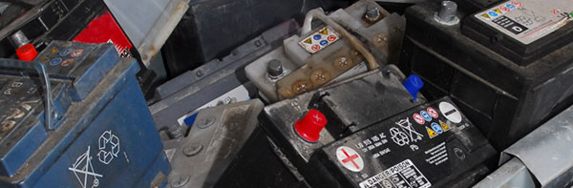
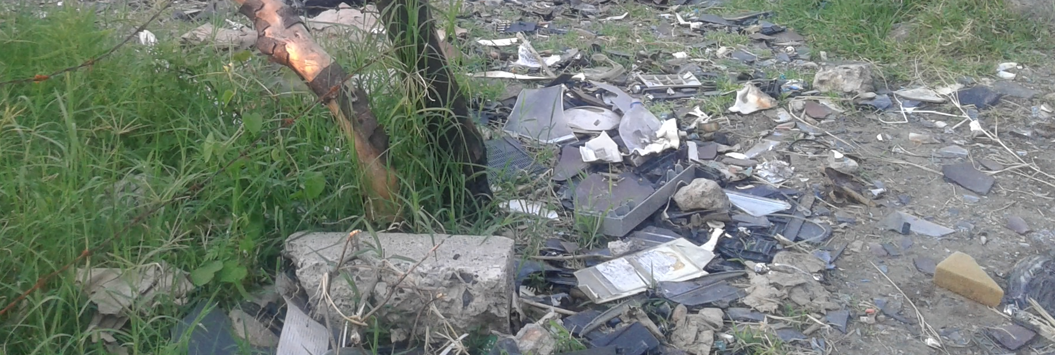
Remediation?
Informal dismantling of lead acid batteries - contaminated sites.
Informal dismantling of CRT´s - contaminated sites.
www.ipen.org

Slide 23



or prevention?
Lead free gasoline
Lead free paint
www.ipen.org

Slide 24

Thank You! schavez@casacem.org

