Slide 1
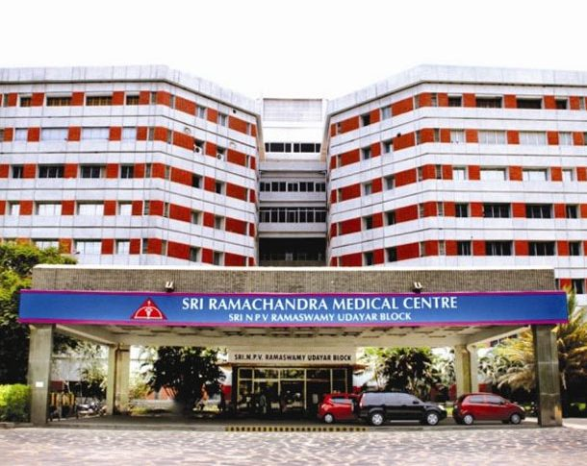
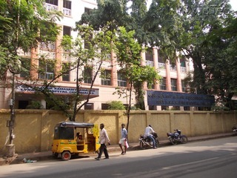
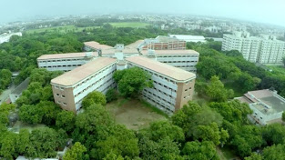

GEF Funded WHO-UNEP Workshop on the project ‘Developing a Global Monitoring Plan for Exposure to and Environmental Concentration of Mercury’
13 – 14 February 2018 at Rome, Italy
GOVT. RSRM LYING IN HOSPITAL, CHENNAI, INDIA
Sri Ramachandra Medical Centre, CHENNAI, INDIA
SRMC&RI (DU), CHENNAI, INDIA
Dr. Krishnendu Mukhopadhyay
Professor: EHE, SRMC&RI (DU), Chennai
National Coordinator: WHO-UNEP HBM Project
INDIA

Slide 2






POSITIVE EXPERIENCE OF IMPLEMENTING MERCURY HBM SURVEY
GEF Funded WHO-UNEP Workshop on the project ‘Developing a Global Monitoring Plan for Exposure to and Environmental Concentration of Mercury’
POSIVE EXPERIENCES SHARED BY THE PARTICIPATING COUNTRIES:
GHANA (Edith Clarke)
INDIA (Krishnendu Mukhopadhyay)
KYRGYZ REPUBLIC (Ainash Sharshenova)
MONGOLIA (Davaadorj Rendoo)
RUSSIAN FEDERATION (Irina Ilchenko)
PRESENTER
13 – 14 February 2018, Rome, Italy

Slide 3
POSITIVE EXPERIENCE OF IMPLEMENTING MERCURY HBM SURVEY…………
Easy tasks
GHANA:
Study staff were content for the opportunity to learn about ill effects of mercury and education on preventive measures
INDIA:
Appointment for discussion with allied state govt. machineries, govt. hospital administration, institutional support by Sri Ramachandra University, catalytic actions of two training programs conducted, trained field staff, consent from participants
KYRGYZ REPUBLIC:
Receipt of a package from WHO through the WHO Country Office in Kyrgyzstan with expenditure and reference materials. Quick and convenient.
MONGOLIA:
Paperwork
RUSSIAN FEDERATION
Big amount of fresh tasty fish
13 – 14 February 2018, Rome, Italy

Slide 4
POSITIVE EXPERIENCE OF IMPLEMENTING MERCURY HBM SURVEY…………
Benefits of project implementation
GHANA:
Generating interest of scientific community in human toxicological analysis. Feel-good factor for study team for the opportunity to be involved in such an important study.
Creation of awareness not only among common local people but also among state bureaucracy; Understanding the need for public Health Risk Assessment data on Mercury in India; Motivation towards ratification in Minamata Convention; Opening a network for better knowledge and transfer of learning
INDIA:
KYRGYZ REPUBLIC:
Samples were analyzed in the leading centers of the world using modern equipment; accuracy of the results of the analysis on mercury in biomatrix and high confidence in them. Data will be in demand when considering the problem of mercury pollution.
MONGOLIA:
Being first survey in Mongolia in terms of prenatal Hg exposure, the protocols and scientific
reports will be good references for researchers. Enhanced awareness among local medical providers and study participants, Quality improvement of Lab staff.
RUSSIAN FEDERATION
Beautiful Nature
13 – 14 February 2018, Rome, Italy

Slide 5
POSITIVE EXPERIENCE OF IMPLEMENTING MERCURY HBM SURVEY…………
Positive emotional component
GHANA:
For some women who took part, myth about taboo surrounding donating of hair was broken.
Even they have lot of cultural prejudices for cutting hair during child birth, selected participants and their family members have broken the myth for this study.
INDIA:
KYRGYZ REPUBLIC:
Acquaintance with researchers from different countries of the world, exchange of experience. The WHO/UNEP project has strengthened cooperation (for example, the training in Slovenia is led by Prof. Milena Horvat).
MONGOLIA:
Not significant
RUSSIAN FEDERATION
Work for wonderful newborns in maternities
13 – 14 February 2018, Rome, Italy

Slide 6
POSITIVE EXPERIENCE OF IMPLEMENTING MERCURY HBM SURVEY…………
Funny Story!!!
GHANA:
------
Not significant
INDIA:
KYRGYZ REPUBLIC:
Winter, frost, evening, after work from the hospital Aidarken could not leave to the hotel of the city of Kadamzhai, there is no transport. A relative of the doctor helped.
MONGOLIA:
One story to getting samples from interprovincial bus station
RUSSIAN FEDERATION
----------------
13 – 14 February 2018, Rome, Italy

Slide 7
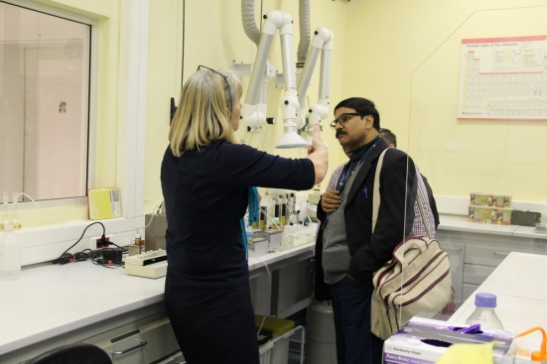
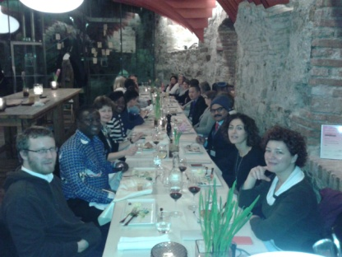
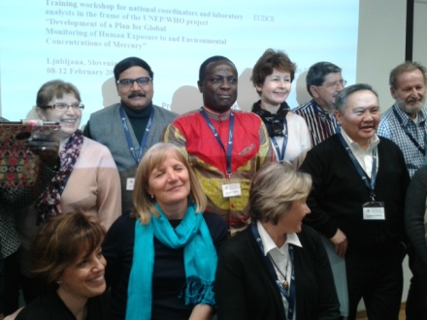
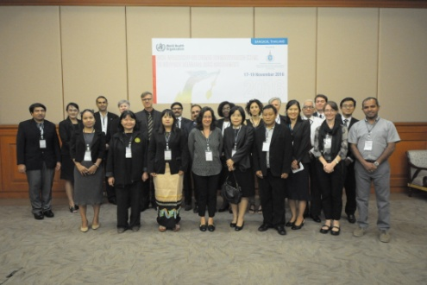
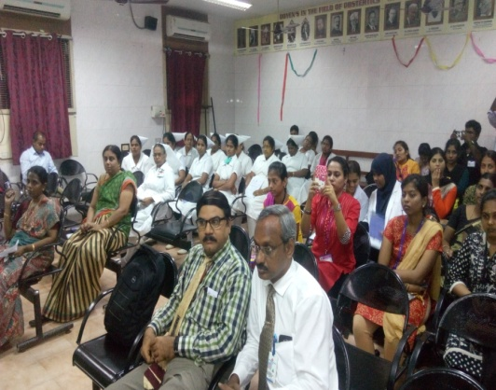
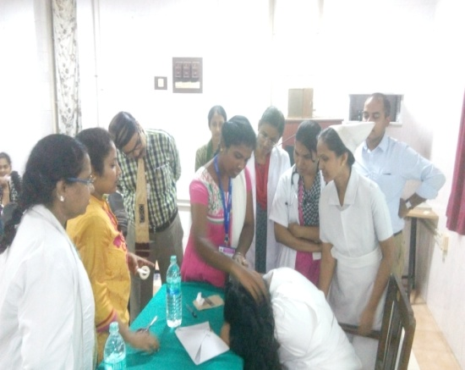
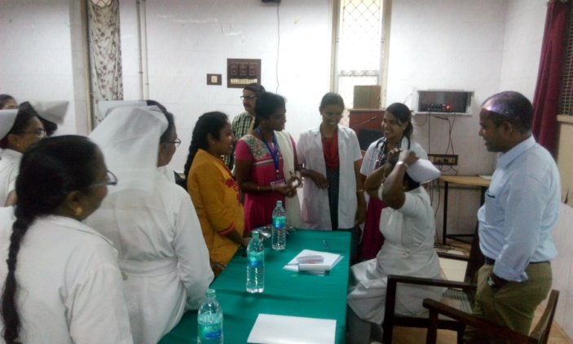
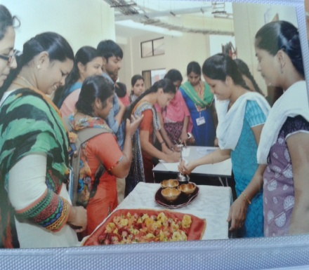
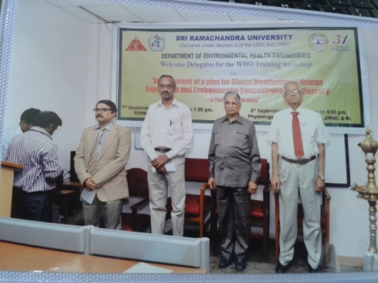
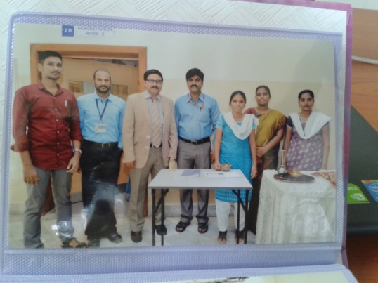
LET’S HAVE A FEW SWEET MEMORIES BACK
THANKS

