Slide 1
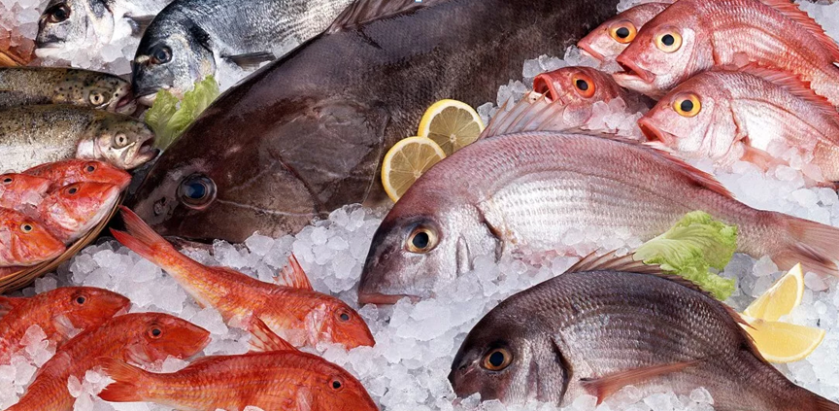
Fish contamination monitoring
Dept. of Food Safety and Zoonoses (FOS)
http://www.who.int/foodsafety/en/

Slide 2
Overall objectives
To monitor fish contamination as one of the main source for human exposure to MeHg
To collect data for fish monitoring in a way that will assist in modelling relationship with human exposure
To observe trends for MeHg concentration in the environment related to mitigation measures and other parameters e.g. climate change.

Slide 3
Main difficulties
Huge variability in fish contribution to human exposure
  Variability in the amount of fish consumed within different dietary patterns
  Variability of fish species consumed across countries
  Variability of MeHg concentration even within a considered fish specie.
Limited knowledge of consumers regarding consumed fish species

Slide 4
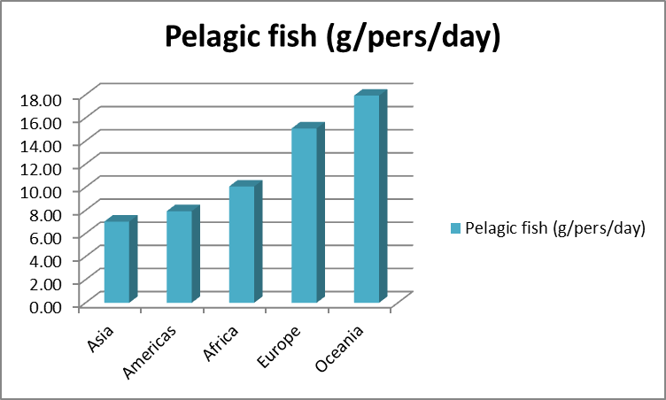
Variability in fish consumption

Slide 5
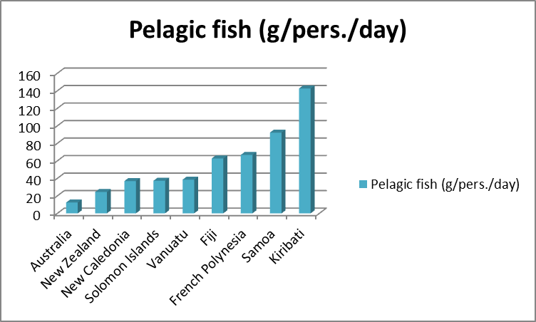
Variability in fish consumption

Slide 6
Variability in fish contamination
* n= 1075

Slide 7
Criteria for national monitoring
Fish species abundant and commonly captured
Fish frequently consumed
Fish highly contaminated
Sampling over a wide range of sizes

Slide 8
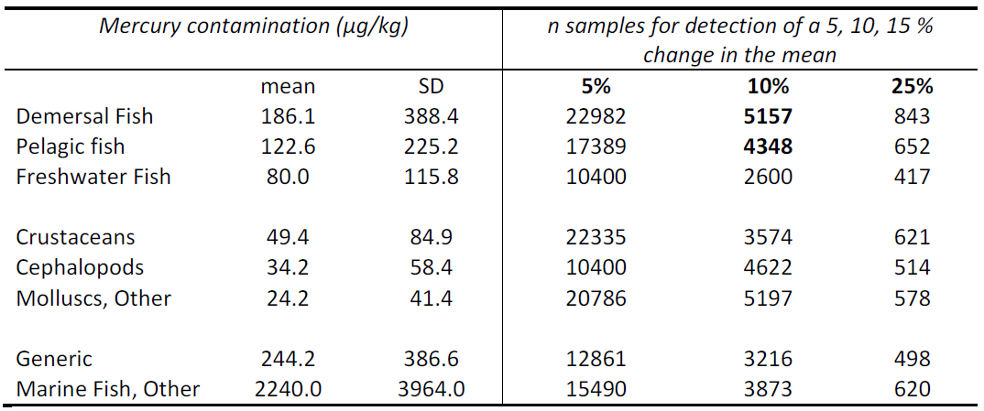
Estimates of the number of samples for detection of a change in mercury contamination
Target: 80% power and 95% confidence

Slide 9
Information to be collected
Fish specie (scientific name, common english name, fish group)
Weight (kg), Length (cm) of the fish
Location of sampling
Date of sampling
Portion analyzed (e.g. fillet)
Analytical method
Limits of quantification (LODs, LOQs)
Mercury concentration (μg/kg)

Slide 10
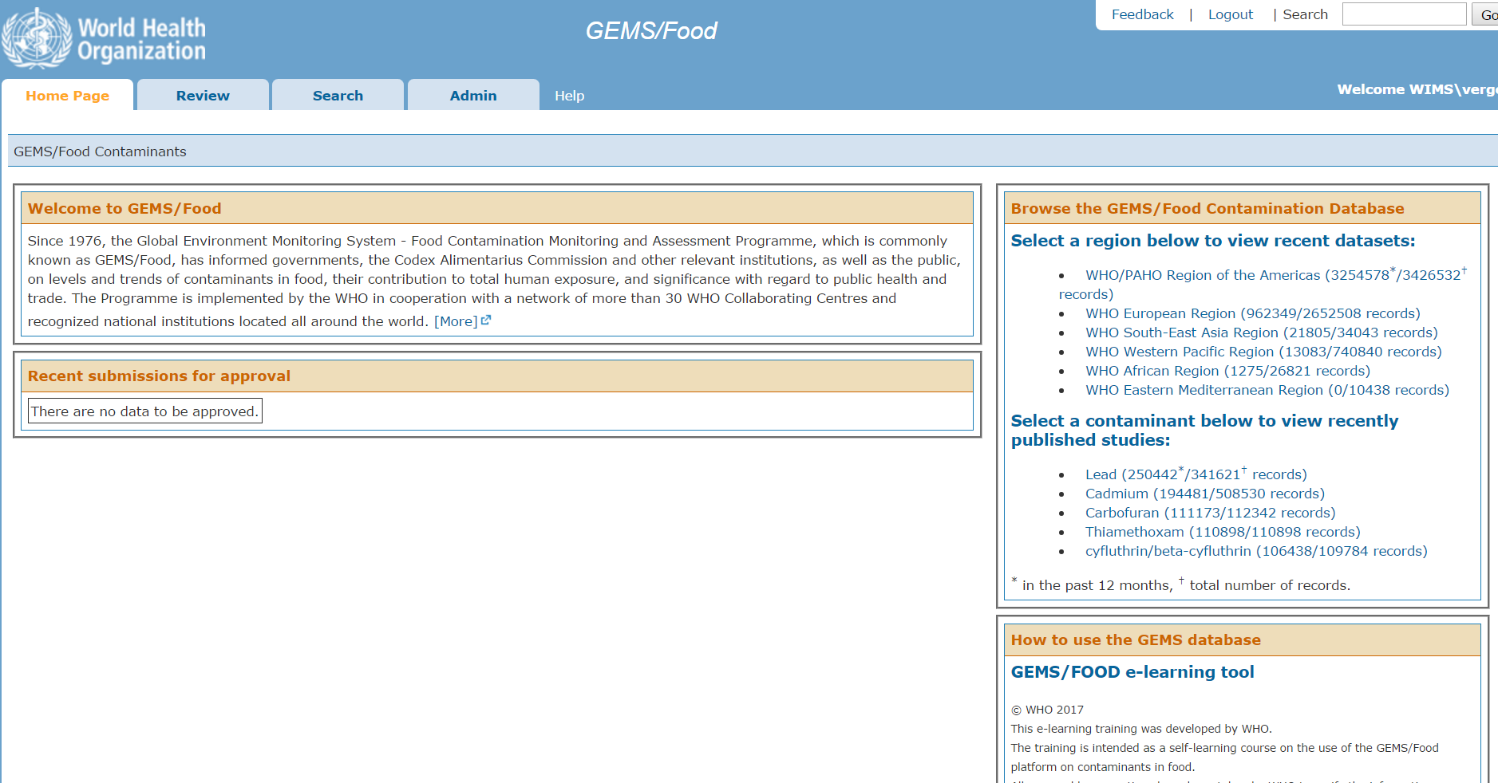
Proposed platform to collect fish monitoring data
https://extranet.who.int/gemsfood/

Slide 11
Conclusions of the Codex Alimentarius
The Committee agreed to establish MLs for:
  Tuna as a group (subspecies of tuna taken into account should be indicated),
  alfonsino,
  kingfish/amberjack,
  marlin,
  shark,
  dogfish
  swordfish.
The Committee noted that MLs should be accompanied by monitoring plans.

