Slide 1
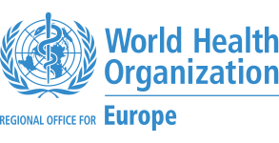
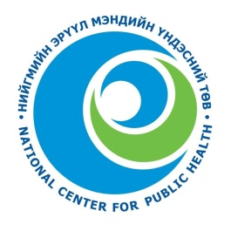

Mercury analyses: approaches, methods and capacity needs
Davaadorj Rendoo, MD, MSc
Head, Epidemiology and Emergency Operations Unit
National Center for Public Health
Mongolian National Coordinator

Slide 2
Mercury analysis: approaches
Mercury analysis
In laboratories in one-two selected OECD countries
Use capacities of national laboratories where possible
Project Goal: strengthen the capacity for mercury analysis in humans and the environment to accurately determine their concentrations globally.
Notes:
Two approaches to organizing the mercury analysis were discussed since the project planning: centralized (to select one-two laboratories in OECD countries and ship all samples collected in the national surveys) and decentralized (in the national laboratories). Given the project objective – to support development of national capacities for mercury HBM – the second approach has been selected and further actions were planned to implement it.

Slide 3

Building analytical capacities and quality control
Mirror analysis (20 samples of each matrix) from China, India, Kyrgyzstan, Mongolia – National Center for Minamata Disease, Japan;
20 hair samples from Costa Rica –Carlos III Institute of Health, Spain
Intercounty comparison – Japan-China; China-Russian Federation
Selection of laboratories at the stage of selection of pilot countries
Seven national laboratories in all pilot countries
Training of laboratory analysist in Jozef Stefan Institute, Slovenia
Six laboratories were presented
Proficiency test (organized by Jozef Stefan Institute, Slovenia
Three countries confirmed credibility in the first round
Four countries performed the mercury analysis at the national level
Trouble-shooting visit an invited expert – confirmation of credibility
Workplace in Jozef Stefan Institute for the national analysts who performed analysis
Shipment of samples to RECETOX
Analysis in national laboratories

Slide 4
Critical points for QC/QA
Laboratory accreditation (e.g. MNS ISO/IEC 17025:2007 in Mongolia)
Interlaboratory comparison analyzes at national and international level on a regular basis
Dedicated staff
Cooperation with leading centers and scientists
Use of reagents recommended by WHO in SOPs; high blanks and higher limit of detection are consequence of high Hg levels in distilled water and chemicals used; use of Milli-Q water deionizing system and chemicals of Suprapur grade will greatly lower the limit of detection for liquid human samples
Adequate quantity of Certified Reference Materials; after every set of samples CRMs of similar matrices and concentration range have to be analyzed
Strict control of samples transported from hospitals

Slide 5
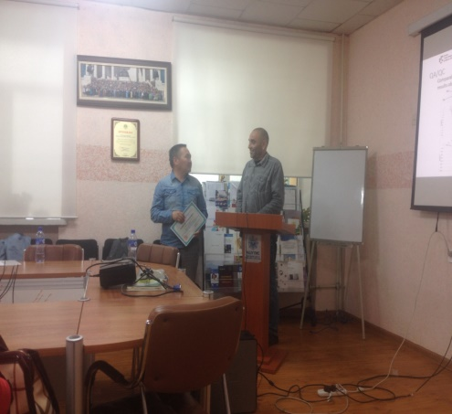
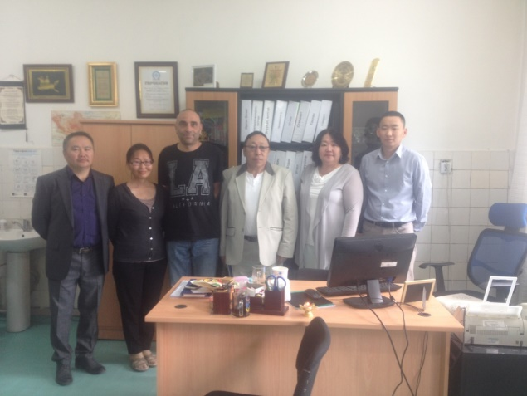
Joze Kotnik, PhD, Research scientist, Department of Environmental Sciences, Institute of Jozef Stefan Institute, Ljubljana, Slovenia
Dr Joze Kotnik is giving lecture to the lab analysts
Dr Joze Kotnik with Environmental Health and Toxicology Center’s specialists

Slide 6
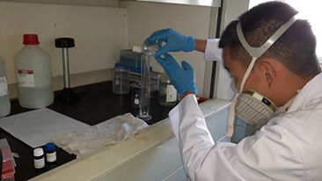
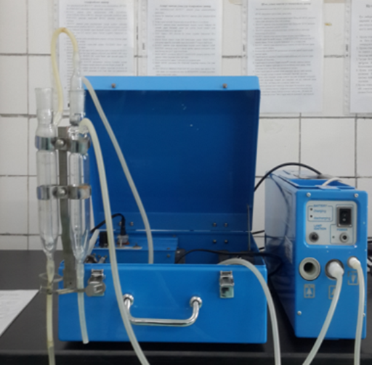
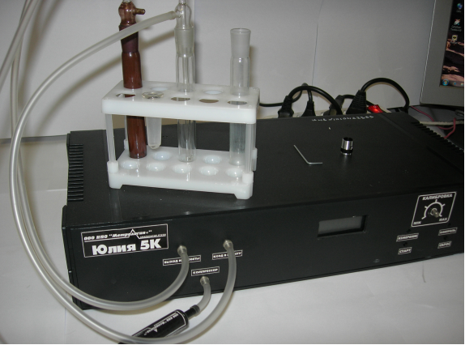
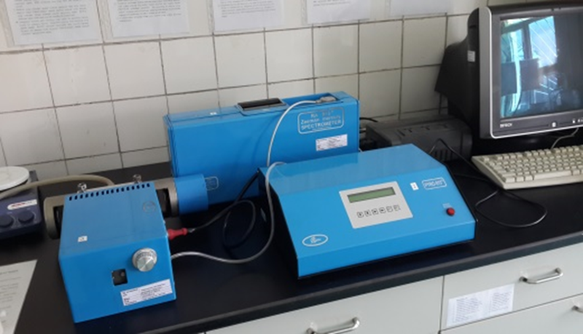
Analytical method
WHO SOPs:
methods based on acid digestion followed by cold vapour atomic absorption spectroscopy (CVAAS), cold vapour atomic fluorescence spectroscopy (CVAFS) and/or inductively coupled plasma mass spectrometry (ICPMS); and
methods based on thermal decomposition and CVAAS
E.g. China (hair), Mongolia (blood, urine):
RA-915+ Hg analyzer coupled with the PYRO-915+ attachment (Lumex) using thermal decomposition and Zeeman atomic absorption spectrometry

Slide 7
Lessons learned
There is a need to utilize more pure chemicals (HNO3, HCIO4, H2SO4)
Sample collection, storage and transportation procedures has been crucial
Selection of laboratory at national level is critical
Any method with low LOD is acceptable; quality control is the most important to get reliable rezults

