Slide 1
Ethical and cultural consideration, ethical committees approval
Rigoberto Blanco, Costa Rica

Slide 2
Survey protocol approval is an obligation: WHO and national
To protect the life, health, interest, welfare and dignity of the participants in a health research, in which humans are the objects of study.
Ethical considerations prevail over the interest of science, of interests economic or commercial.
All health research in which human beings participate must respond to a human rights approach.
It is a legal matter, which must be met under penalty of committing a crime if the requirements are not met
WHO: International ethical guidelines for health-related research involving humans. Geneva: Council for International Organizations of Medical Sciences; 2016 (http://www.cioms.ch/index.php/12-newsflash/403-new-cioms-international-ethical-guidelince-now-available, accessed 18 May 2017)
Countries: national legislation (specific approach in each participating country)

Slide 3
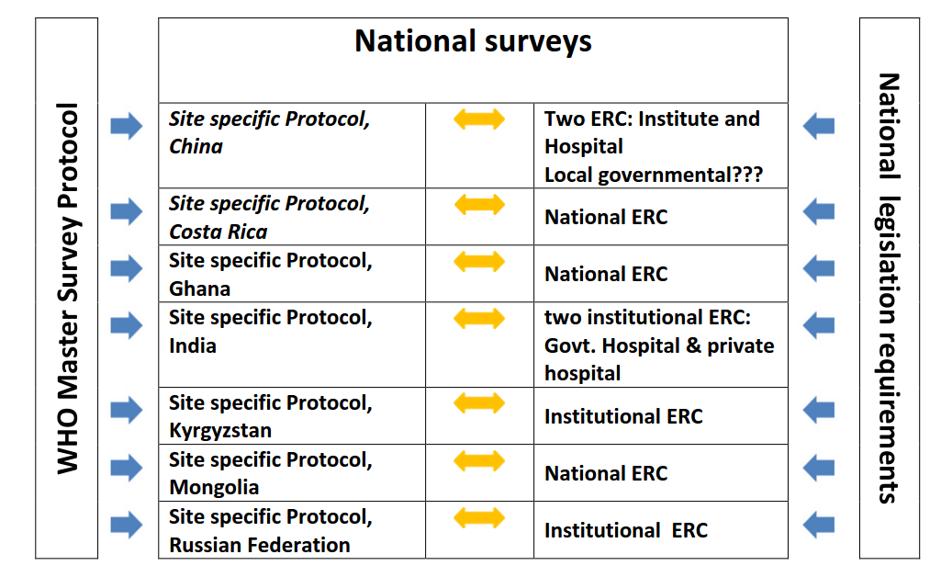

Complexity of the procedure

Slide 4
Complexity of the procedure
Many actors are involved in approval process at national level:
INSTITUTION(s)
HOSPITALS
GOVERNMENT (MoH)
EXPERTS
ETHICS COMMITEES
The approval of the research protocol by the Bioethics Committee implies a slow process that can take months due to
the bureaucracy that surrounds the whole process,
the fact that it is a linear process: you can not skip stages, or perform them in a parallel
The regulations require that they be carried out one by one, since some omissions can be considered as crimes or severe deficiencies that invalidate the project

Slide 5
The most critical elements of the survey design: ethical considerations
Target populations: scientific ground of why certain population groups were targeted
Selection of hospitals – what criteria were applied
Timing of contacting women: during prenatal visit/entering hospitals; criteria for exemptions
Medical follow up – what is planned to be done and how we will manage “high-concentrations” women
Medical staff in hospitals – who can be recruited and how to avoid conflict of interests
Non-invasive methods only (cord blood sampling only ex-utero)

Slide 6
The most critical elements of the survey design: ethical considerations
Communication plan (at all stages of the survey starting from planning)
Community involvement plan (at all stages of the survey)
Language (plain language, very careful messages incl. about mercury toxicity)
How much time the survey will take from women and intimacy
Biobanking

Slide 7
Approval of bioethical protocol by Bioethical Commitee
The approval of the protocol depends on:
formal aspects, aspects of substance,
compliance with legal requirements,
the payment of royalties,
the scientific structure of the work,
the statistical design of the project,
the protection of the rights of the subjects under study,
of a clear description of the use of financial resources,
the demonstration of the knowledge of the participants, and the theoretical and practical aspects of bioethics in human experiments.

Slide 8
Biological Samples
The use of the biological samples obtained is prohibited for purposes not contemplated and approved in the consent informed, the law and other applicable regulations.
Biological samples can only be moved abroad, if justified in accordance with scientific objectives, the criteria research technicians or because of the technological limitations of the country.
In the case of studies with a multicenter design, where optimal is to standardize the methodology and the reports of the exams laboratory, in accordance with the scientific objectives, the transfer of samples to a laboratory abroad (material transfer agreement).

