Slide 1





Workshop “Elements to consider when designing a Global Monitoring Plan for Mercury”
13 – 14 February 2018, Rome, Italy
Title: Elements toward a global Monitoring Plan for Mercury
Jacquline Alvarez
Victor Estellano
Santiago Riera
UN Environment, Chemicals and Health Branch

Slide 2

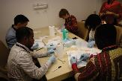
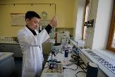
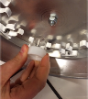
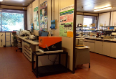




Elements toward a global Monitoring Plan for Mercury
Objectives:
To harmonize approaches for monitoring mercury in humans and the environment.
To strengthen the capacity for mercury analysis in humans and the environment to accurately determine their concentrations globally.
The intent of the project is also to foster coordination and synergies between programs, and to ensure that adequate laboratory capacity is available in each region in order to provide accurate and comparable data on human exposure to and environmental concentrations of mercury.
Workshop “Elements to consider when designing a Global Monitoring Plan for Mercury”
13 – 14 February 2018, Rome, Italy

Slide 3
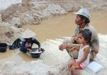

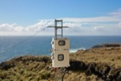


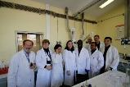
Title: Elements toward a global Monitoring Plan for Mercury
COMPONENT 1 - Review of existing information on human exposure to and environmental concentrations of mercury
COMPONENT 2 - Development of a monitoring plan on presence of mercury in ambient air
COMPONENT 3 - Development of a monitoring plan on human exposure to mercury
Workshop “Elements to consider when designing a Global Monitoring Plan for Mercury”
13 – 14 February 2018, Rome, Italy

Slide 4
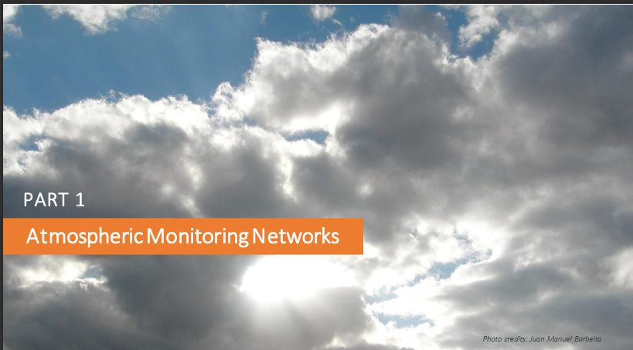

Slide 5
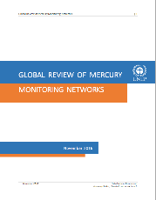
Global Review of Mercury Monitoring Networks
November 2016
The review compiles and synthesizes available information on exiting monitoring networks.
i) Atmospheric monitoring Networks
ii) Human biomonitoring Networks
iii) Biota monitoring Networks
Highlights gaps in the coverage and scope
Provides basis for further coordination and cooperation
Contributes to better understand existing efforts
It does not assess the networks or initiatives
It does not include water/soil or other relevant media
Workshop “Elements to consider when designing a Global Monitoring Plan for Mercury”
13 – 14 February 2018, Rome, Italy

Slide 6
Global Review of Mercury Monitoring Networks
PART 1 – Atmospheric Monitoring Networks
Type of matrix: air, human and biota
Scope of the monitoring effort: global, regional, national /local
Several national networks identified through a survey:
Canadian, Australian, Japan, Republic of Korea, Vietnam, Taiwan,
Brazil, UK, Hungary, Poland, Andorra, Austria, Romania and EU.
Six global networks actively engaged in atmospheric mercury monitoring:
GMOS, European Monitoring and Evaluation Programme (EMEP), National Atmospheric Deposition Programme (NADP), Asia- Pacific Mercury Monitoring Network (APMMN), The Artic Monitoring and Assessment Programme (AMAP), and The European Pollutant Release and Transfer Register (E-PRTR)
Workshop “Elements to consider when designing a Global Monitoring Plan for Mercury”
13 – 14 February 2018, Rome, Italy

Slide 7
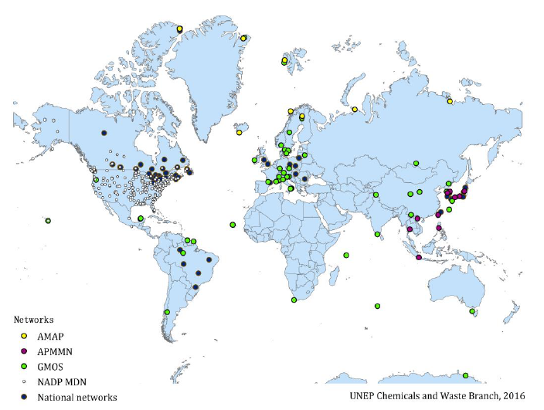
Global Review of Mercury Monitoring Networks
PART 1 – Atmospheric Monitoring Networks
Workshop “Elements to consider when designing a Global Monitoring Plan for Mercury”
13 – 14 February 2018, Rome, Italy

Slide 8
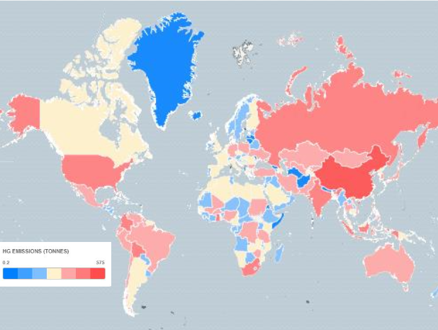
Global mercury emissions by country (in tons)
data source: UNEP, Technical Background Report for the
Global Mercury Assessment 2013)

Slide 9
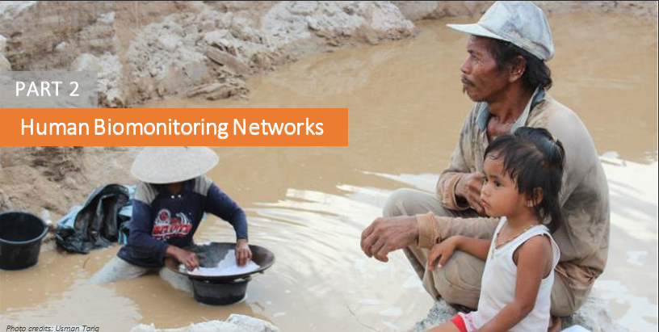

Slide 10
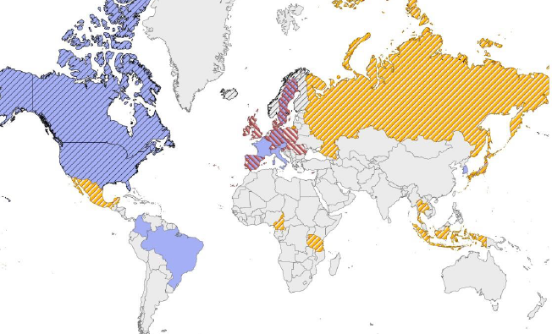

Global Review of Mercury Monitoring Networks
PART 2 – Human Biomonitoring Networks
National networks in Europe, North America, Asia and South America.
Three regional network: GFC MMP, DEMO-COPHES and AMAP
Workshop “Elements to consider when designing a Global Monitoring Plan for Mercury”
13 – 14 February 2018, Rome, Italy

Slide 11
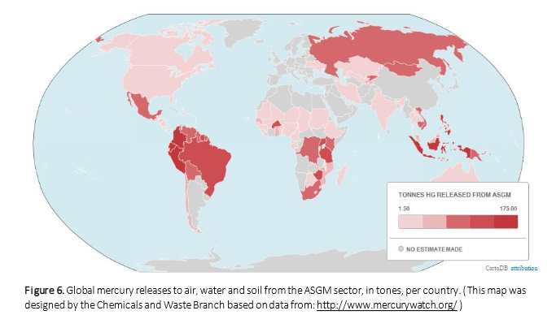

Slide 12
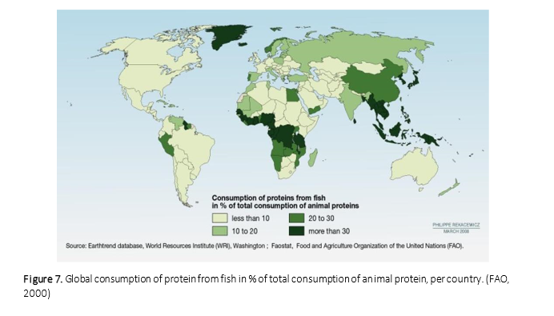

Slide 13
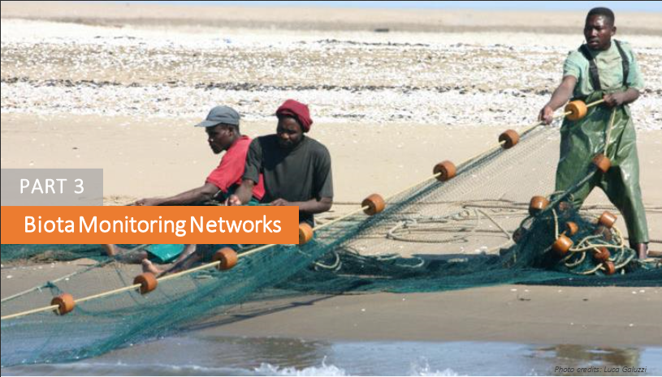

Slide 14
Global Review of Mercury Monitoring Networks
PART 3 – Biota Monitoring Networks
National networks:
EU initiative, Norway, Sweden, Spain, UK, Poland Canada, USA, Japan,
Republic of Korea, Colombia and Brazil.
Global or regional networks:
GFC MMP, IESB Group, AMAP, OSPAR, HELCOM, ICES, ICP Waters.
Global Biotic Mercury Synthesis (GBMS) database.
Workshop “Elements to consider when designing a Global Monitoring Plan for Mercury”
13 – 14 February 2018, Rome, Italy

Slide 15
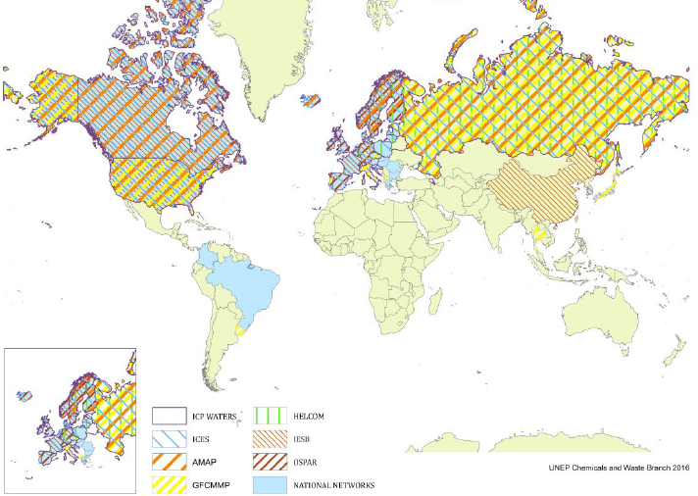
Global Review of Mercury Monitoring Networks
PART 3 – Biota Monitoring Networks
Workshop “Elements to consider when designing a Global Monitoring Plan for Mercury”
13 – 14 February 2018, Rome, Italy

Slide 16
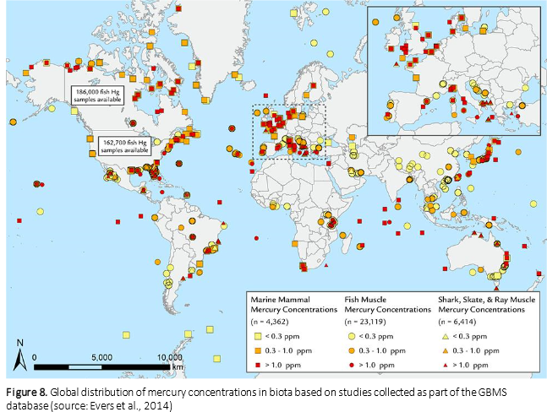

Slide 17
Global Review of Mercury Monitoring Networks
Highlights
Some regions with the highest mercury emissions into the atmosphere (i.e. Asia, Latin America, and Africa) also those regions where atmospheric monitoring stations are scarce or information on existing monitoring initiatives is not well documented.
There is a particularly global lack of monitoring mercury levels in humans and seafood.
There are efforts to enhance monitoring networks at global (e.g. GMOS, or DEMO-COPHES), regional and local (e.g. the GBMS database) levels.
Atmospheric mercury Monitoring
Asia relatively few monitoring activities (exception Japan and Korea)
Africa little coverage, lacking national an international networks
Same from countries from Latin America and the Caribbean (exception Brazil)
Workshop “Elements to consider when designing a Global Monitoring Plan for Mercury”
13 – 14 February 2018, Rome, Italy

Slide 18
Global Review of Mercury Monitoring Networks
Highlights
Human Biomonitoring Mercury
Existing regional and national surveys not sufficient to provide geographically balanced information on HBM.
Efforts initiated at national and regional level in Latin America, Africa, Asia and Australian, Oceania. However limited to local studies carried out primarily by the scientific community.
Biota Monitoring
Limited geographical coverage of national Environment Specimen Bank (ESB) and other national networks. Lack of activities in major parts of Latin America and Caribbean (exception of Brazil and Colombia), and Africa, Australia – Oceania and Asia (exception Japan and Korea).
Workshop “Elements to consider when designing a Global Monitoring Plan for Mercury”
13 – 14 February 2018, Rome, Italy

Slide 19
Worldwide Capacity to Analyze Mercury
Objectives:
Identify laboratories worldwide that perform mercury analysis
Collect information about:
  Capacities, equipment, matrices analysed, procedures used to identify and quantify mercury species in biotic, abiotic and humans matrices.
  Accreditations and quality management systems (QA/QC).
Workshop “Elements to consider when designing a Global Monitoring Plan for Mercury”
13 – 14 February 2018, Rome, Italy

Slide 20
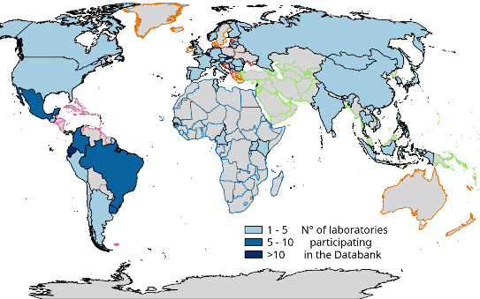
Worldwide Capacity to Analyze Mercury
A total of 210 laboratories from 57 countries submitted the questionnaire
Total laboratories included in the map = the 185 labs
Number of Laboratories
per UN regions
Workshop “Elements to consider when designing a Global Monitoring Plan for Mercury”
13 – 14 February 2018, Rome, Italy

Slide 21
Worldwide Capacity to Analyze Mercury
The chart shows percentage of laboratories performing the sampling of each matrix.
Workshop “Elements to consider when designing a Global Monitoring Plan for Mercury”
13 – 14 February 2018, Rome, Italy

Slide 22
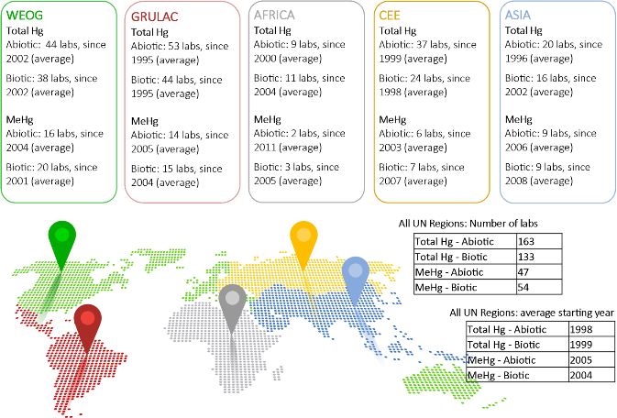
Worldwide Capacity to Analyze Mercury
Number of laboratories having experience with mercury analysis and average starting year
Workshop “Elements to consider when designing a Global Monitoring Plan for Mercury”
13 – 14 February 2018, Rome, Italy

Slide 23
Worldwide Capacity to Analyze Mercury
Number of laboratories having QC and/or QA mechanisms in place
 | QC system | QA program | Responsible person QA/QC
Yes | 182 | 152 | 177
No | 2 | 31 | 6
No answer | 1 | 2 | 2
Total answers | 185 | 185 | 185
Participation in international intercomparisons and interest with a UNEP interlaboratory assessment
 | Participation in international intercomparisons | Interest with a UN Environment interlaboratory assessment
Yes | 146 | 172
No | 37 | 11
No answer | 2 | 2
Total answers | 185 | 185
Workshop “Elements to consider when designing a Global Monitoring Plan for Mercury”
13 – 14 February 2018, Rome, Italy

Slide 24
Worldwide Capacity to Analyze Mercury
Highlights
Provide information on the laboratories and countries capacities to analyse mercury and their geographical distribution
Better describe these laboratories in terms of status (public, private, research centre), number of staff, and services to external clients;
Insight on the sampling capacities of these laboratories and to find out which matrices are mostly sampled or ignored;
Understand how experience with Hg analysis is distributed between them including sample preparation procedures and the analytical techniques.
A web-accessible databank, will be established, the databank will be a similar and linked to the POPs Laboratory Databank.
Workshop “Elements to consider when designing a Global Monitoring Plan for Mercury”
13 – 14 February 2018, Rome, Italy

Slide 25
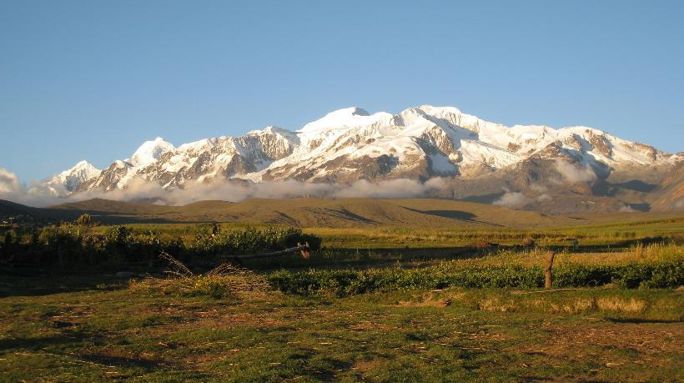
Title: Elements toward a global Monitoring Plan for Mercury
Thank you for your attention!
Workshop “Elements to consider when designing a Global Monitoring Plan for Mercury”
13 – 14 February 2018, Rome, Italy

