Slide 1



GMP Data Warehouse: current data content and functionalities
Kateřina Šebková on behalf of the GMP DWH development team
Research Centre for Toxic Compounds in the Environment (RECETOX)
Faculty of Science, Masaryk University, Brno, Czech Republic
and Stockholm Convention Regional Centre in the Czech Republic (SCRC)
&
Institute of Biostatistics and Analyses
Masaryk University, Brno, Czech Republic
Midterm regional workshop for GMP2 project in Asia 2018, Ulaanbaatar, Mongolia, 8-10 August 2018

Slide 2

Outline
Why do we have GMP data warehouse (GMP DWH)?
Principles beyond GMP DWH
How to access GMP DWH?
What is its current content - global information on POP levels
OBJECTIVE: provide additional information on a tool for global POPs data access and on its functionalities and use to countries in Asia region

Slide 3
SCENE SETTING
POPs monitoring embedded in the Stockholm Convention text (art 16 and 15)
regional/global POPs monitoring reports serve as one of the key inputs for assessing effectiveness of the Stockholm Convention (follow up of the BRS presentation)
Two sets of the Global Monitoring Plan regional reports (2008 and 2014) - approved by COP4 (2009) and COP6 (2015) available online: http://chm.pops.int/Programmes/GlobalMonitoringPlan/MonitoringReports/tabid/525/Default.aspx
but no harmonization of reports (content) and more user friendly tool suitable for 21st century existed in 2011 - BRS requested support to develop an electronic tool to SCRC Czech Republic RECETOX in 2011 and the first proposal was prepared in 2012 and refined further to be inaugurated in 2013 at the COP6 in Geneva.

Slide 4

Scene Setting
Objective of the GMP Data Warehouse:
Collection, storage, analysis, and visualization of GMP data on POP levels as required by the Stockholm Convention on POPs
Put global data on POPs together
Support to ROGs and GCG in compilation of regional/global monitoring reports
Online presentation of GMP data publicly available 24/7
Useful to countries
allow for data collection from heterogeneous sources
also allow input from existing international and national monitoring programmes

Slide 5
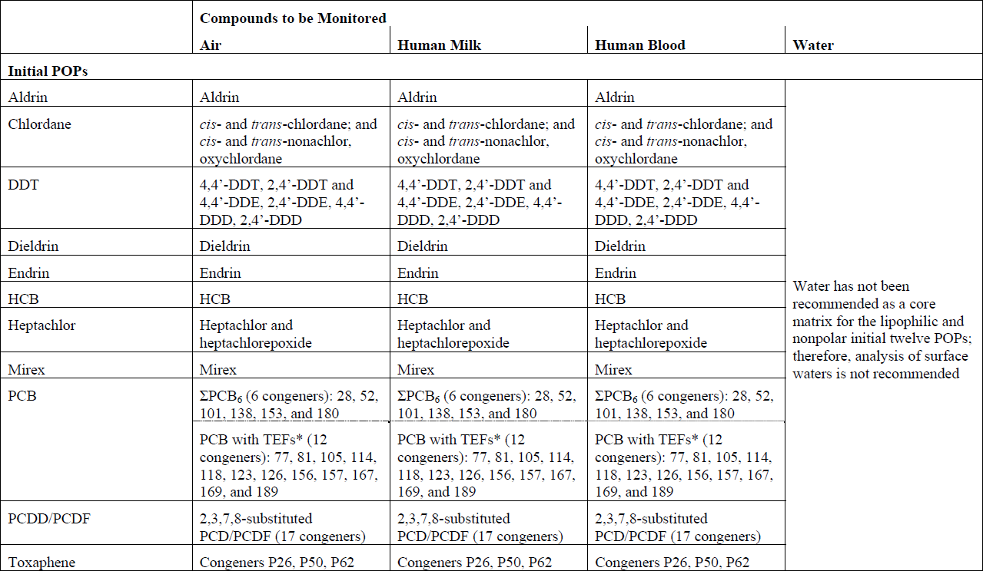
Global monitoring plan for POPs
Substances to be monitored
GMP Guidance, chapter 2.2. table 2.2.

Slide 6
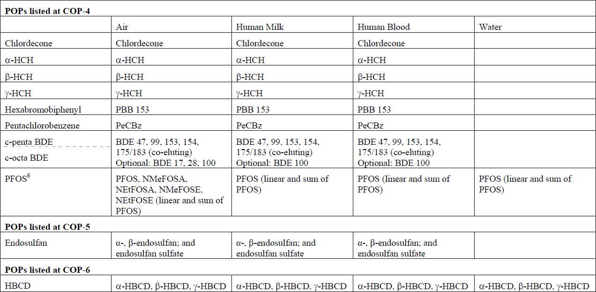
Global monitoring plan for POPs
Substances to be monitored
GMP Guidance, chapter 2.2. table 2.2.
POPs listed at COP7: Hexachlorobutadiene, PCN, Pentachlorophenol
COP8: SCCPs, deca-BDE
+ candidate chemicals considered - dicofol, PFOA, PFHxS

Slide 7
GMP Data Warehouse
Principles:
Electronic data collection
  Data providers
    identified by ROGs
  Data reported as:
    Annually aggregated
    Primary (and later aggregated in GMP DWH)
Standardized parametric data structure (next slide)

Slide 8
Data structure
All items grouped into 3 hierarchical sections:

Slide 9
GMP DWH data structure
PCB 153 was monitored at the Košetice station in 2013. 26 values were collected by means of air-active sampling. Median value was 1.457 pg/m³, mean value 1.633 pg/m³, maximum concentration reached 4.382 pg/m³.
Air-active monitoring of PCB 153 at the Košetice station was performed in 2013. Median of the total 26 values was 1.457 pg/m³. Mean value was higher and reached 1.633 pg/m³.
Site | Year | Parameter | N | Mean | Median | Minimum | Maximum | Unit
Košetice | 2013 | PCB 153 | 26 | 1.633 | 1.457 | 0.506 | 4.382 | pg/m³

Slide 10
Data structure – air - code lists
Site Site ID (number) Site name (text) Longitude (number) Latitude (number) Region (code list) Country (code list) Site type (code list) Potential source type (code list) | Sampling attributes Year (number) Start of sampling (number) End of sampling (number) Type of sampling (code list) Type of passive sampling (code list) Recalculation (code list) Calibration description (text) Monitoring programme/network (text) | Measurement Chemical – group (code list) Parameter (code list) Method (code list) LOQ (number) No. of values (number)^{A} No. under LoQ (number)^{A} Value (number)^{P} Value (mean) (number)^{A} Value (median) (number)^{A} Minimum (number)^{A} Maximum (number)^{A} 5th percentile (number)^{A} 95th percentile (number)^{A} SD (number)^{A} Laboratory (text)
A – the item is valid for aggregated data reporting only
P – the item is valid for primary data reporting only

Slide 11



How to access
GMP DWH is implemented fully on-line and accessible via Internet
Standard web browsers (Internet Explorer, Mozilla Firefox, Google Chrome)
– recent versions highly recommended!

Slide 12
GMP DWH – where to start
Web portal
Information on GMP
System documentation
http://www.pops-gmp.org/
Data repository
Authorised access
Data import, processing, validation
Data approval
Data visualization (after publication of regional reports)
Public access (since COP-7, 2015)
Descriptive statistic analysis
Time trends assessment
http://visualization.pops-gmp.org/2014/

Slide 13
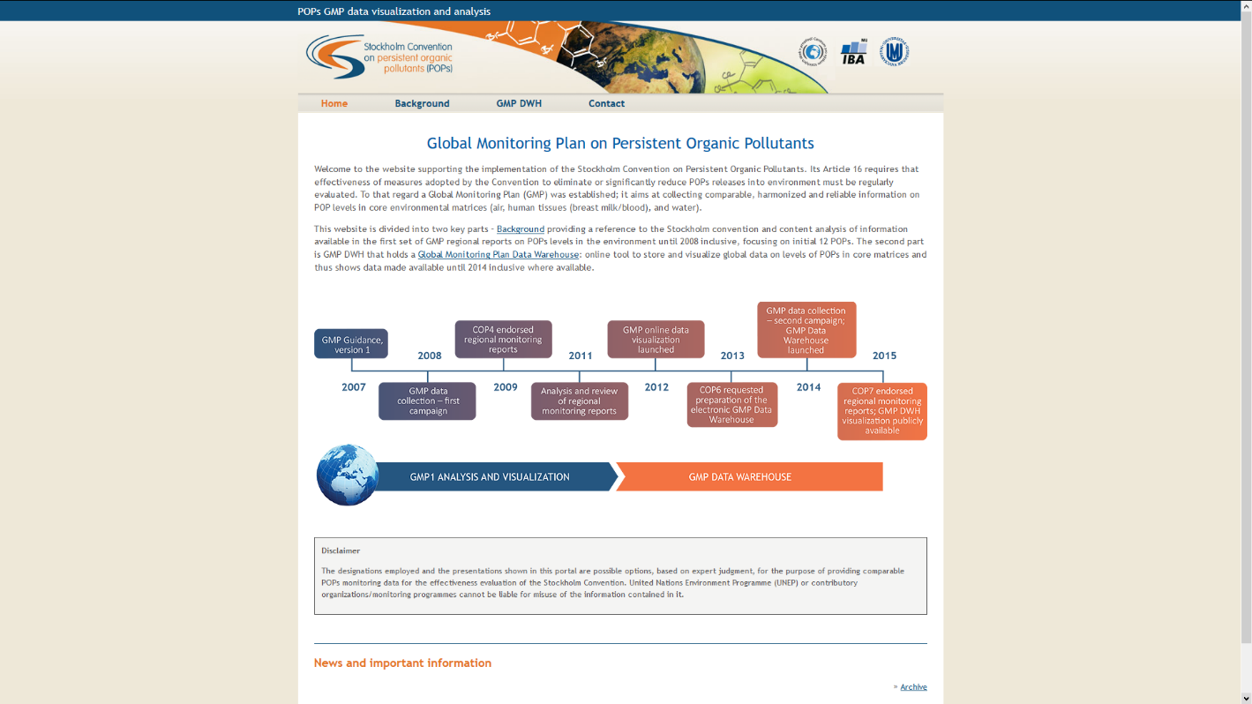
GMP DWH – web portal
http://www.pops-gmp.org

Slide 14
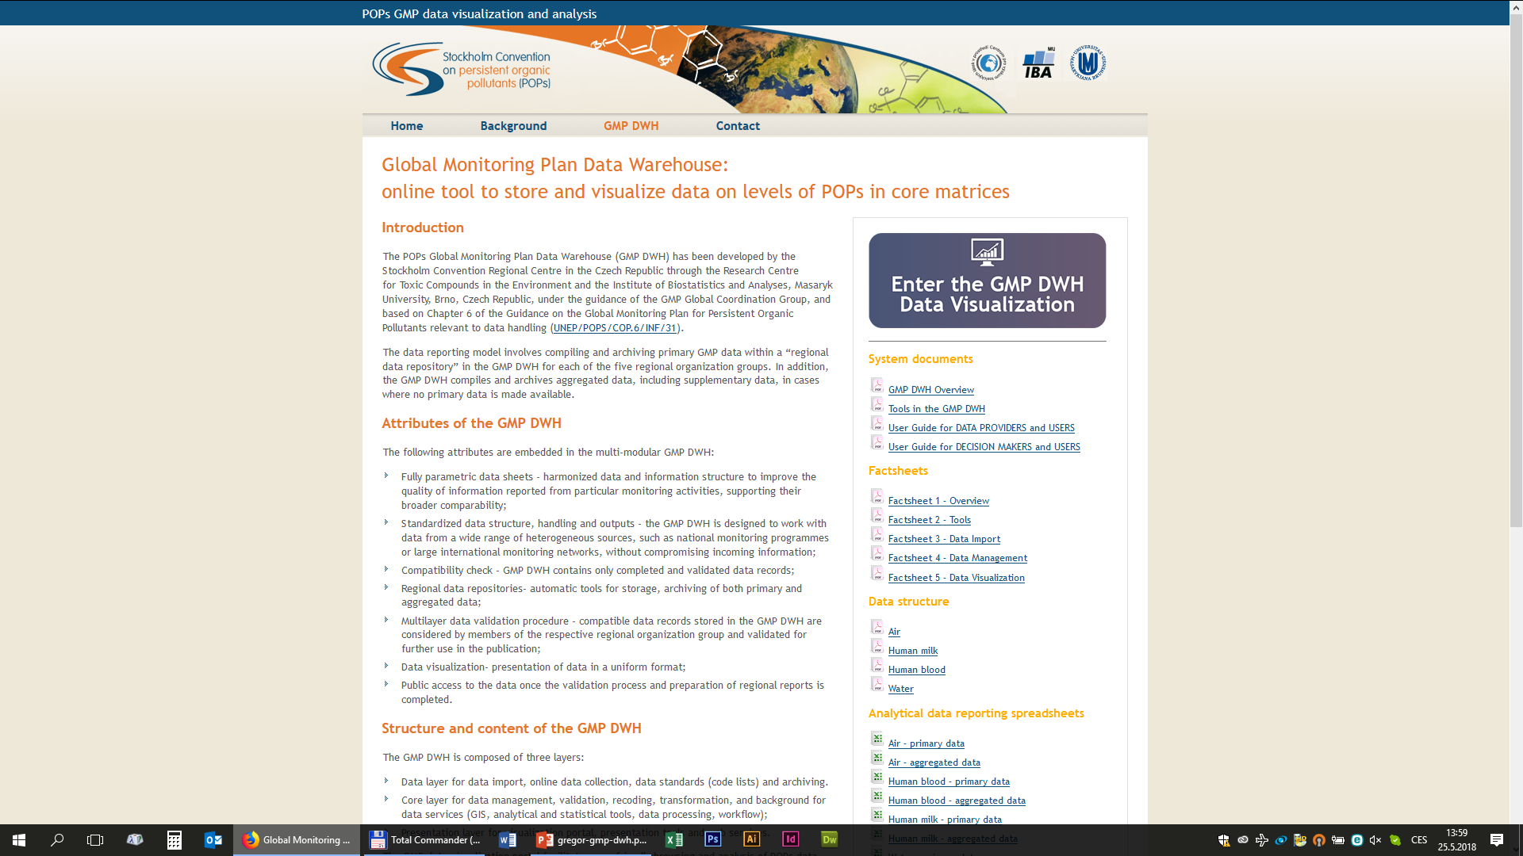
GMP DWH – web portal
http://www.pops-gmp.org/dwh

Slide 15
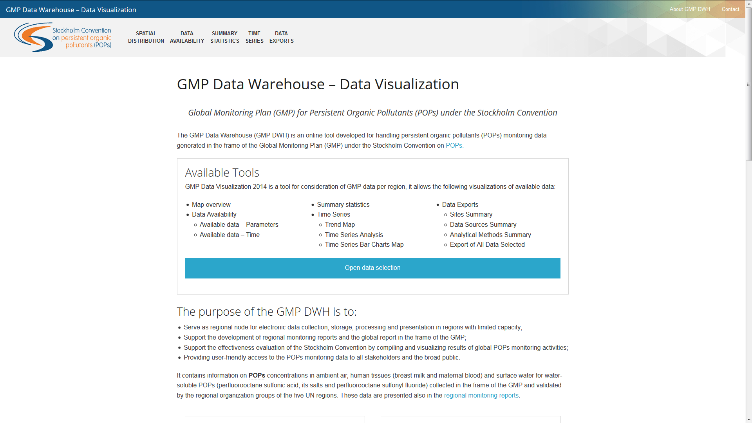
Data visualization
http://visualization.pops-gmp.org/2014/
Available tools:
Spatial distribution
Data availability
Summary statistics
Time series
Data exports

Slide 16
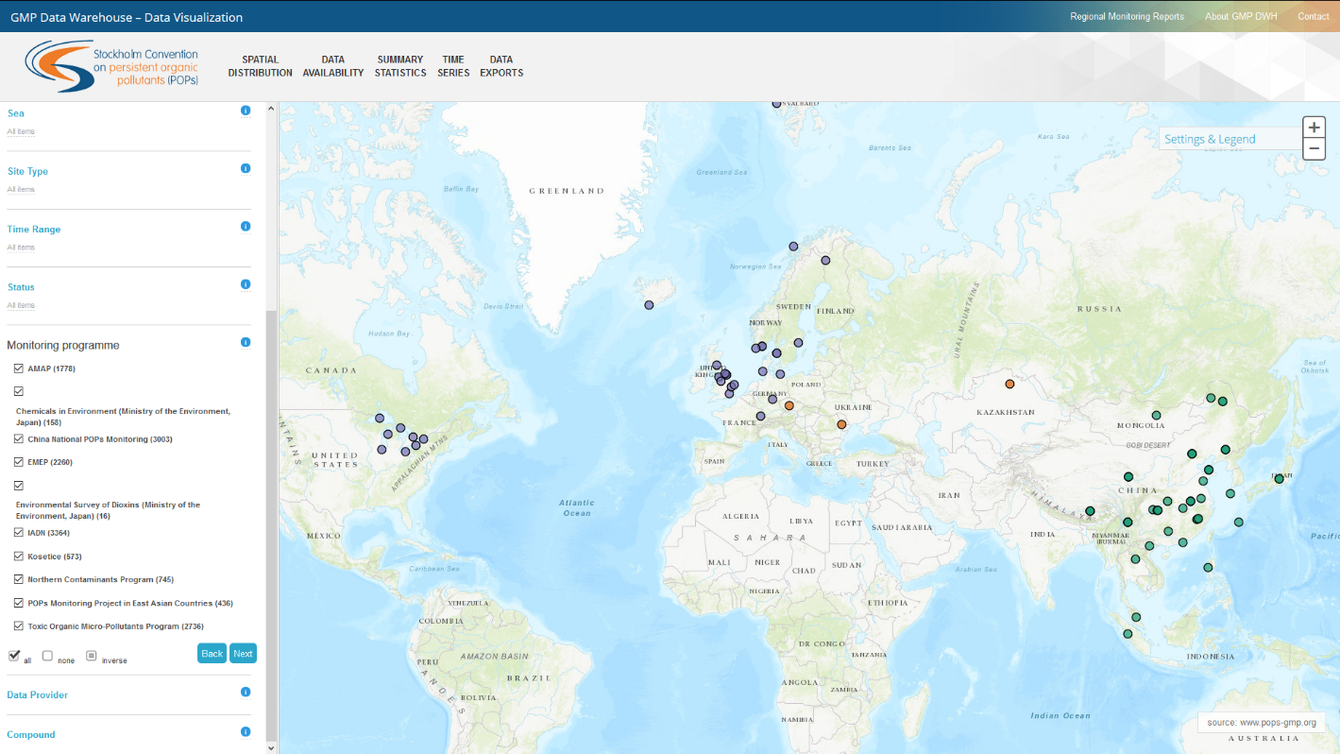
Step-by-step data selection

Slide 17
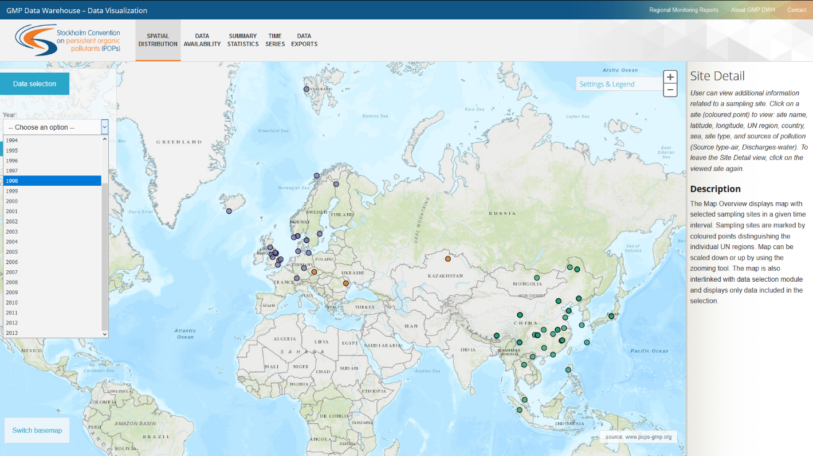
Spatial distribution

Slide 18
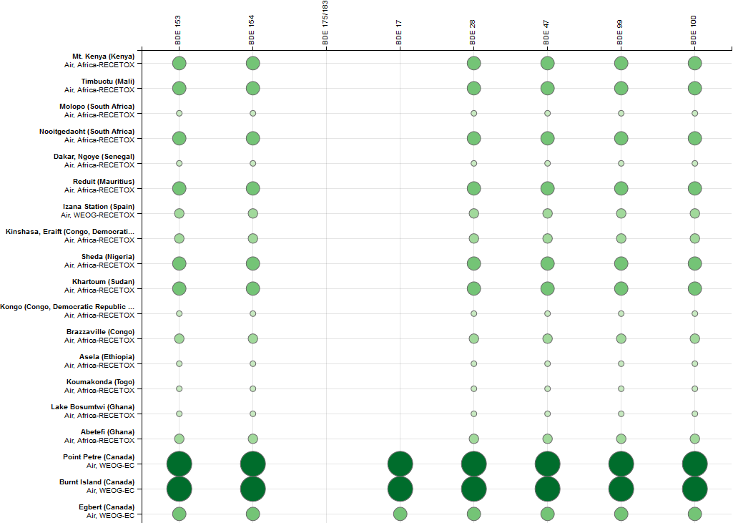
Data availability

Slide 19
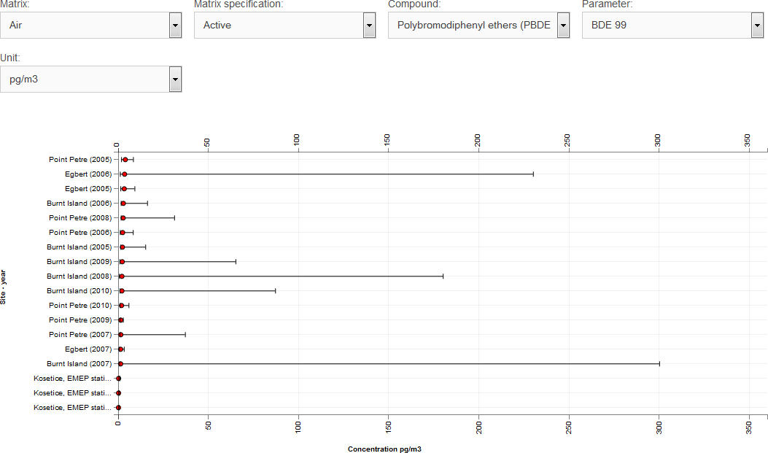
Summary statistics

Slide 20
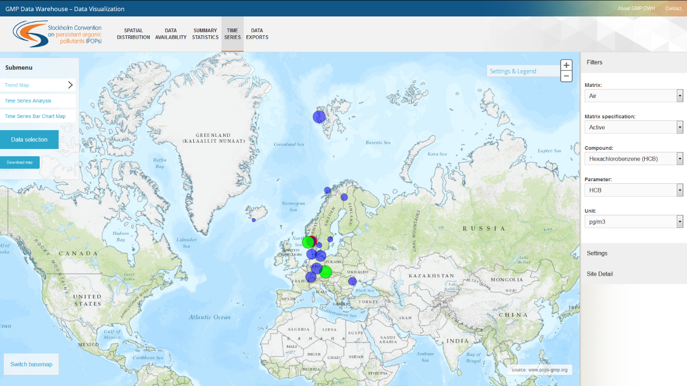
Time trends

Slide 21
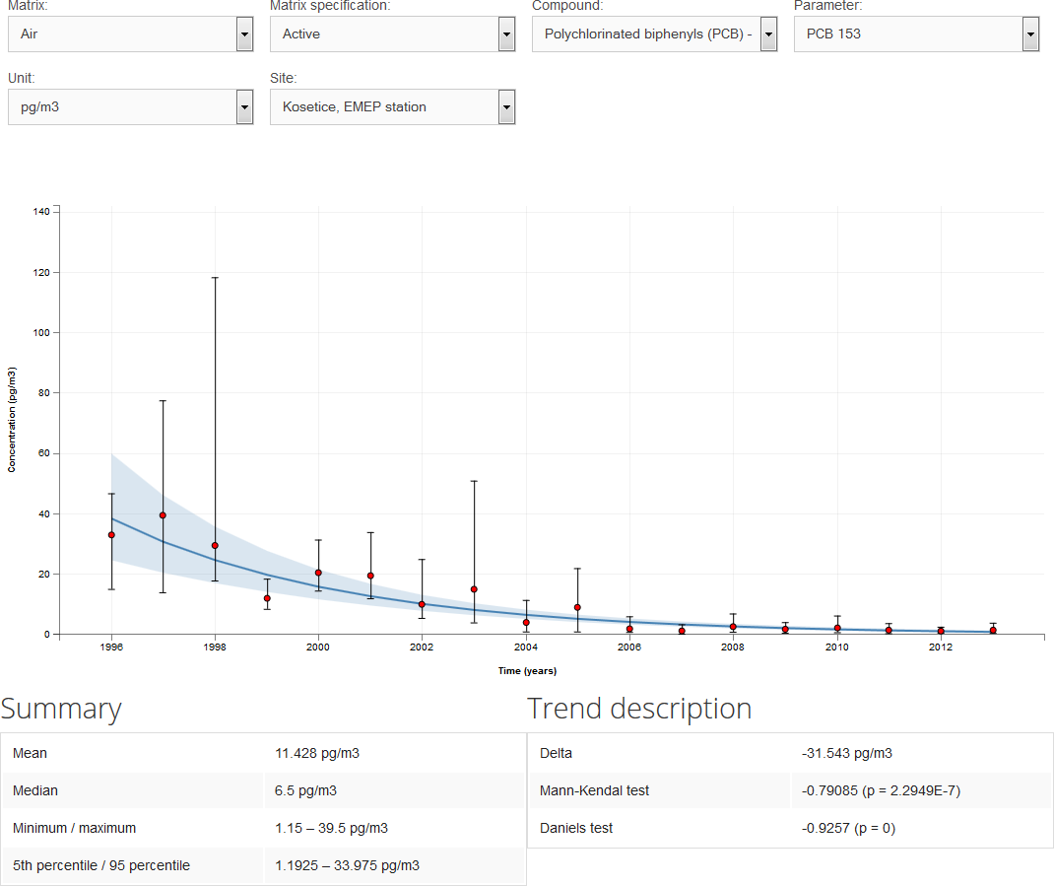
Time trends

Slide 22
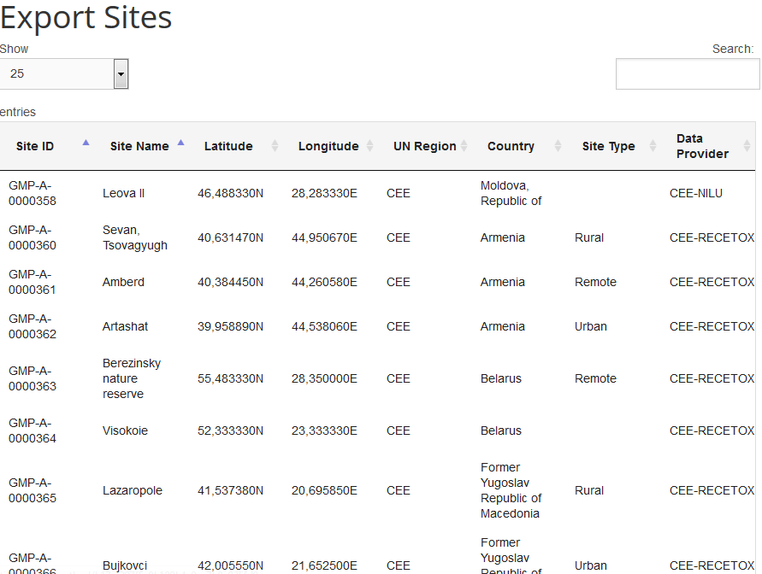
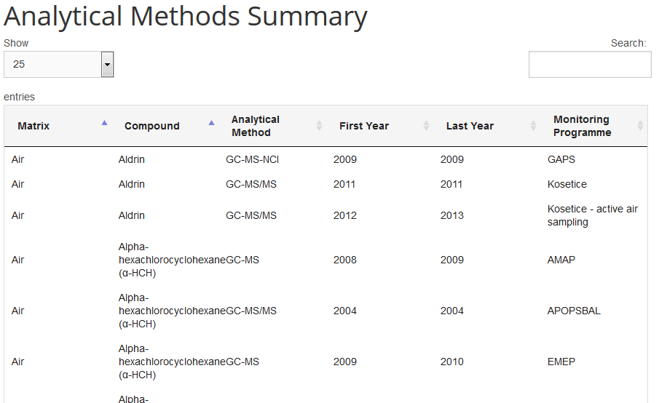
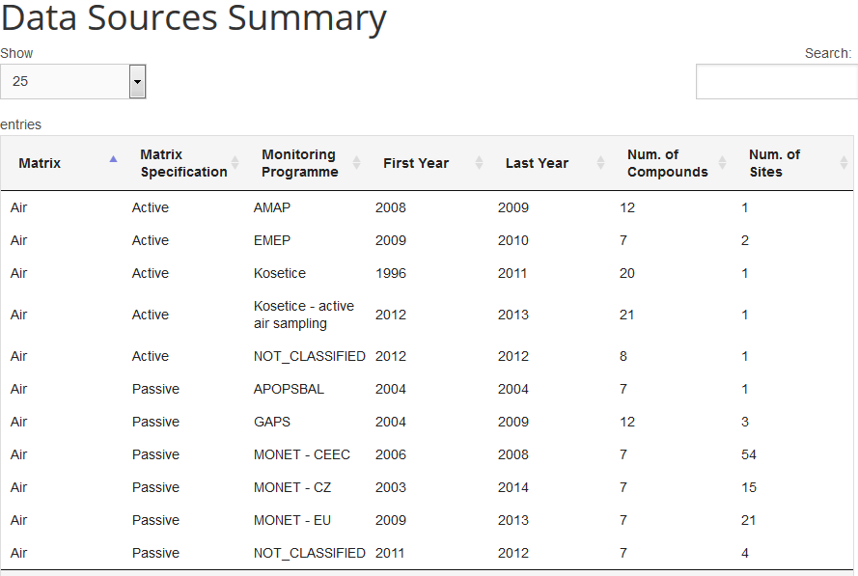
Data exports
Suitable for: Chapter 4.2

Slide 23
Data exports
Figures and maps – exports to PNG
Data – exports to CSV
(for further processing in MS Excel and other software)

Slide 24
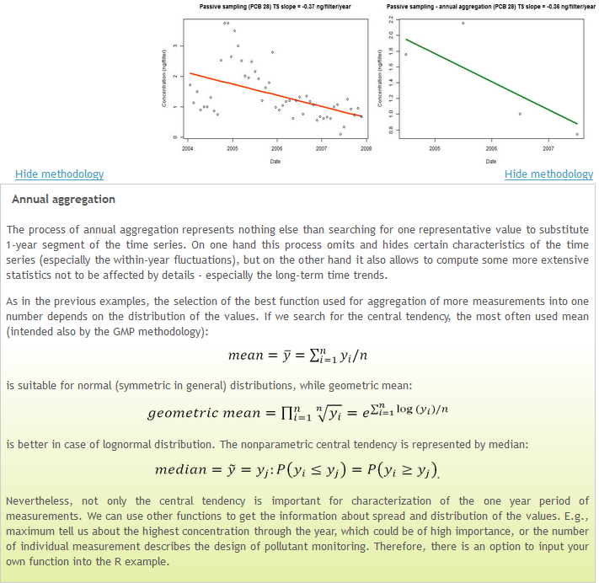
Statistical and analytical tools
Background on functionalities
R package
Data aggregation
Trend assessment
Find more at: http://www.genasis.cz/time-series/

Slide 25
Current GMP DWH content
mirrors POPs data shown in the most recent GMP regional reports (published for COP7 in 2015)
global data in GMP core matrices
until 2014 where possible and provided
REMINDER: data are annually aggregated!

Slide 26
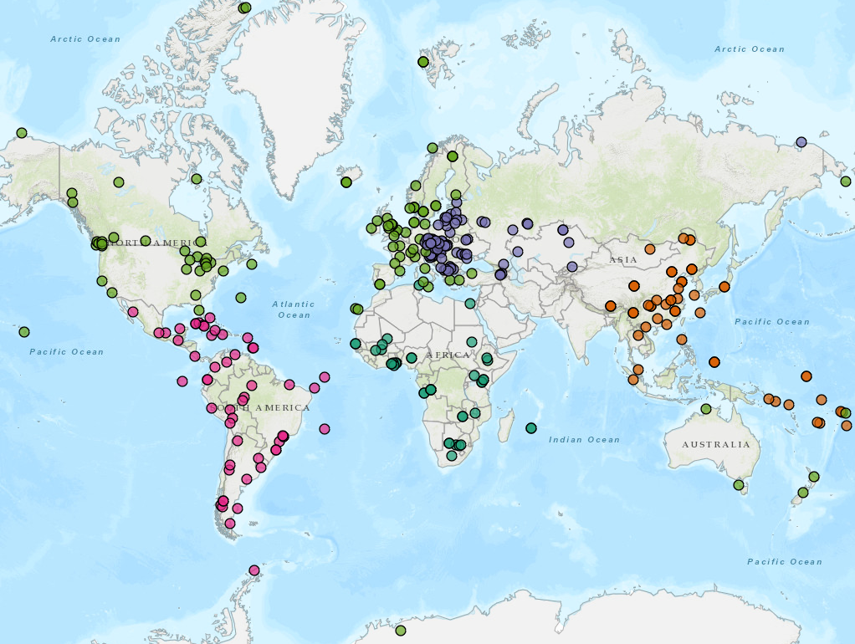
What is in GMP DWH : Sites – air

Slide 27
Sites – air in GMP DWH
Monitoring programme | Africa | Asia & Pac. | CEE | GRULAC | WEOG | Total
AMAP |  |  | 1 |  | 4 | 5
EMEP |  |  | 2 |  | 16 | 18
Dioxins Survey (Japan) |  | 1 |  |  |  | 1
GAPS | 7 |  | 3 | 14 | 42 | 66
GAPS-GRULAC |  |  |  | 11 |  | 11
GMP UNEP | 11 | 14 |  | 16 |  | 41
Chemicals Environ. (Japan) |  | 1 |  |  |  | 1
China Nat. POPs Monitor. |  | 37 |  |  |  | 37
IADN |  |  |  |  | 5 | 5
Košetice |  |  | 1 |  |  | 1
LAPAN |  |  |  | 13 |  | 13
MONET | 23 |  | 76 |  | 23 | 122
Northern Contam. Program |  |  |  |  | 1 | 1
POPs East Asia |  | 8 |  |  |  | 8
TOMPS |  |  |  |  | 8 | 8
Total | 41 | 61 | 83 | 54 | 99 | 338
Year | Africa | Asia & Pac. | CEE | GRULAC | WEOG | Total
1990 |  |  |  |  | 1 | 1
1991 |  |  |  |  | 4 | 4
1992 |  |  |  |  | 7 | 7
1993 |  |  |  |  | 8 | 8
1994 |  |  |  |  | 9 | 9
1995 |  |  |  |  | 12 | 12
1996 |  |  | 1 |  | 13 | 14
1997 |  | 1 | 1 |  | 14 | 16
1998 |  | 2 | 1 |  | 14 | 17
1999 |  | 2 | 1 |  | 13 | 16
2000 |  | 2 | 1 |  | 14 | 17
2001 |  | 2 | 1 |  | 14 | 17
2002 |  | 2 | 1 |  | 14 | 17
2003 |  | 2 | 1 |  | 16 | 19
2004 |  | 2 | 5 |  | 23 | 30
2005 | 4 | 2 | 7 | 9 | 45 | 67
2006 | 4 | 2 | 37 | 6 | 43 | 92
2007 | 2 | 12 | 42 | 5 | 52 | 113
2008 | 18 | 21 | 29 |  | 25 | 93
2009 | 3 | 5 | 39 | 7 | 79 | 133
2010 | 24 | 22 | 36 | 24 | 46 | 152
2011 | 21 | 15 | 32 | 31 | 35 | 134
2012 | 8 | 12 | 31 | 13 | 29 | 93
2013 | 2 | 5 | 22 | 1 | 14 | 44
2014 |  |  | 9 |  |  | 9

Slide 28
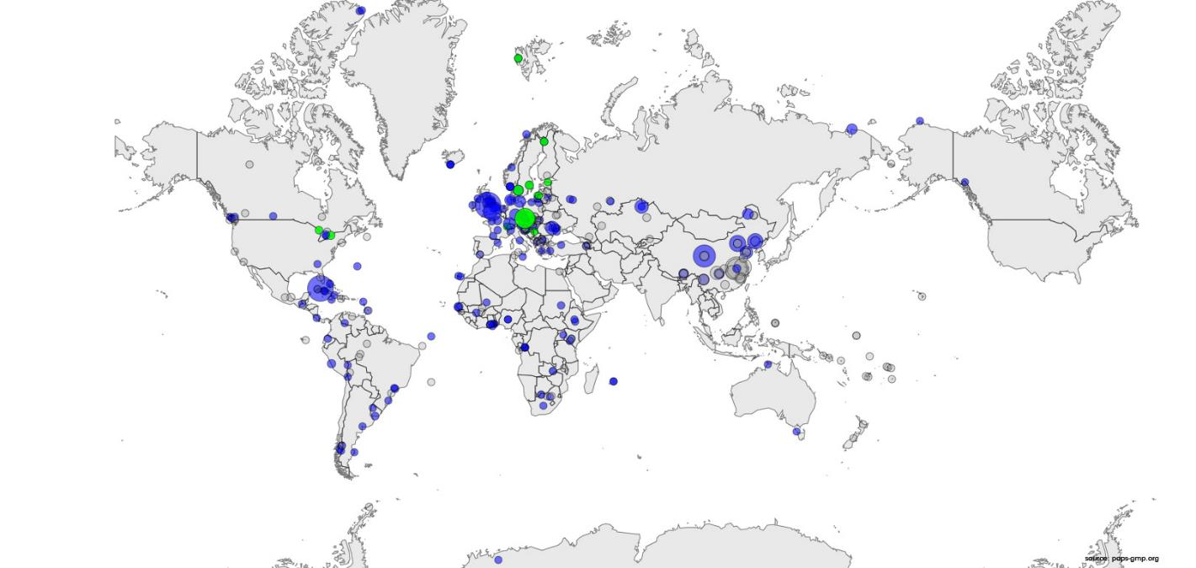
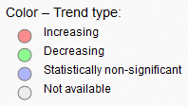
Example – PCB 153 (air)
Air
Time series | Africa | Asia & Pac. | CEE | GRULAC | WEOG | Total
≥ 10 years | 0 | 0 | 5 | 0 | 7 | 12
7–9 year | 0 | 0 | 12 | 0 | 7 | 19
4–6 years | 5 | 0 | 15 | 0 | 23 | 43
2–3 years | 21 | 9 | 11 | 27 | 33 | 101

Slide 29
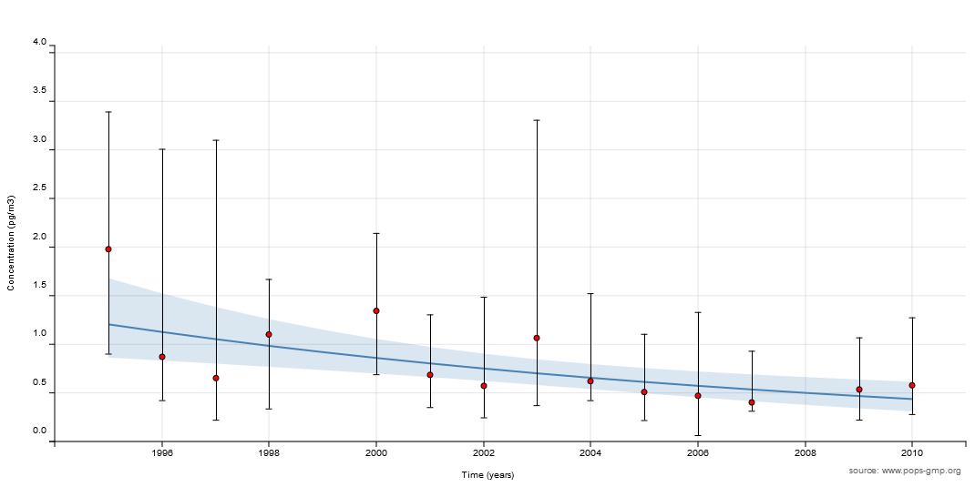
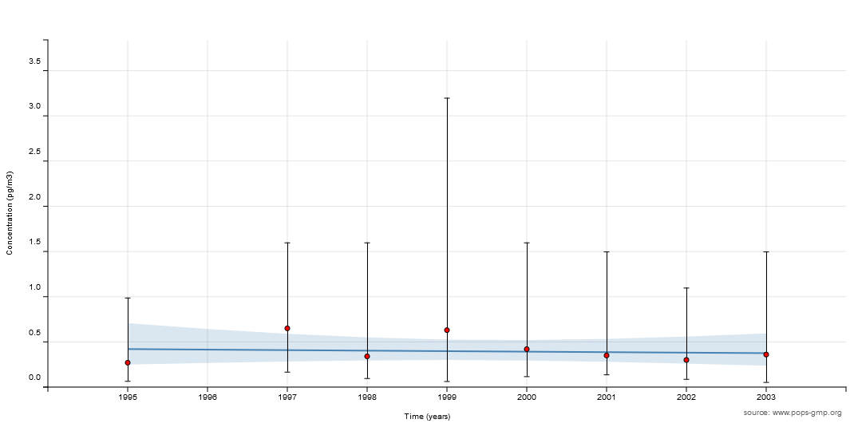
Example – PCB 153 (air)
Aspvreten (SWE)
Egbert (CAN)

Slide 30
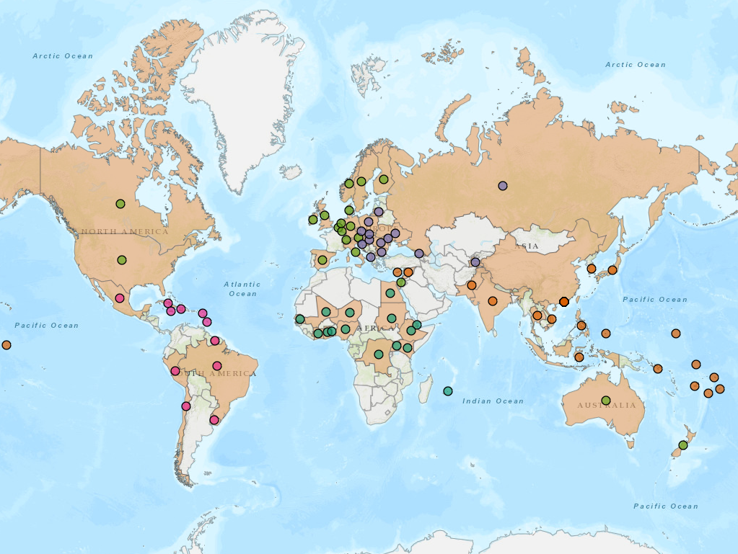
Countries – human milk

Slide 31
Countries – human milk
Monitoring programme | Africa | Asia & Pac. | CEE | GRULAC | WEOG | Total
GMP UNEP | 15 | 20 | 14 | 11 | 19 | 79
China Nat. POPs Monitor. |  | 27 |  |  |  | 27
Total | 15 | 47 | 14 | 11 | 19 | 106
Year | Africa | Asia & Pac. | CEE | GRULAC | WEOG | Total
1987 |  | 4 | 3 |  | 12 | 19
1992 |  | 1 | 8 |  | 8 | 17
2000 |  |  |  |  | 1 | 1
2001 | 1 |  | 8 | 1 | 7 | 17
2002 | 1 | 3 | 1 |  | 6 | 11
2003 |  |  |  |  | 1 | 1
2004 |  |  |  | 1 |  | 1
2006 | 1 | 3 | 3 |  | 3 | 10
2007 |  | 23 |  |  | 2 | 25
2008 | 1 | 2 |  | 2 |  | 5
2009 | 7 | 3 | 4 | 1 | 1 | 16
2010 | 2 |  |  | 1 | 3 | 6
2011 | 2 | 36 |  | 6 | 1 | 45
2012 | 1 |  |  | 2 | 1 | 4
2014 |  |  | 2 |  | 1 | 3

Slide 32
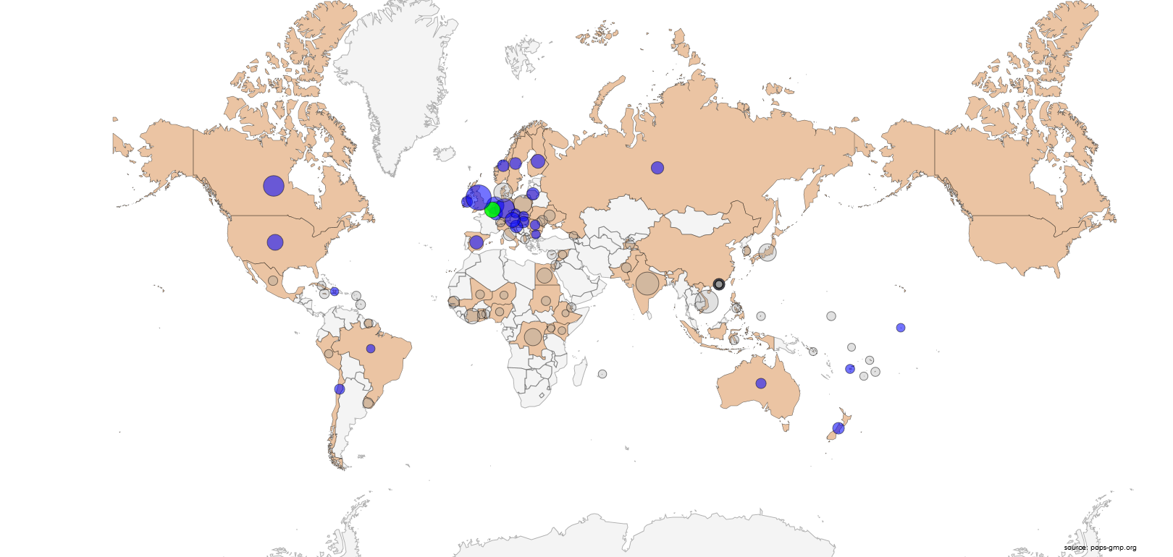
Example – PCDDs WHO 2005 TEQ UB
Time series | Africa | Asia & Pac. | CEE | GRULAC | WEOG | Total
5 years | 0 | 0 | 0 | 0 | 1 | 1
4 years | 0 | 0 | 1 | 0 | 2 | 3
3 years | 0 | 2 | 4 | 0 | 5 | 11
2 years | 0 | 1 | 3 | 3 | 7 | 14

Slide 33
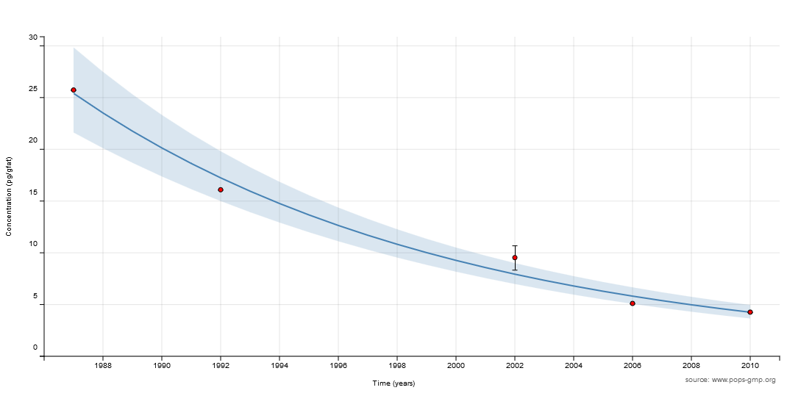
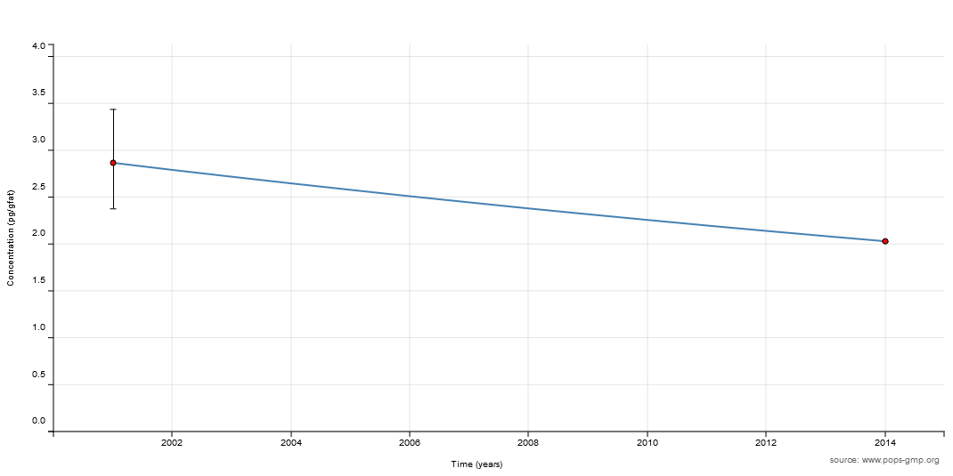
Example – PCDDs WHO 2005 TEQ UB
Belgium
Bulgaria

Slide 34
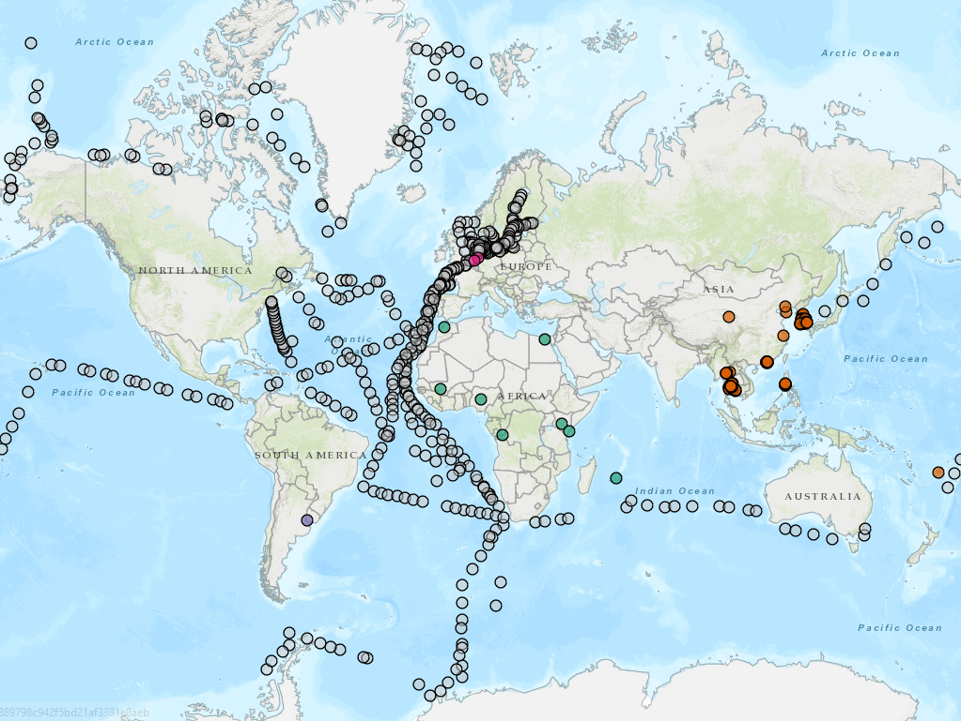
Sites – water

Slide 35
THANK YOU FOR YOUR KIND ATTENTION
www.pops-gmp.org
GMP DWH HELP DESK: gregor@iba.muni.cz
general requests for cooperation: sebkova@recetox.muni.cz

Slide 36
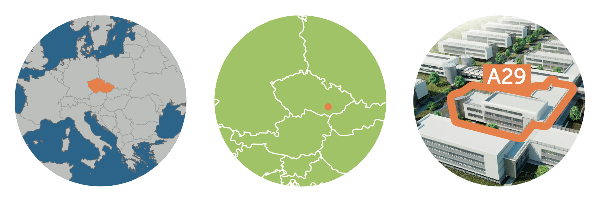
About RECETOX in brief
RECETOX is leading Czech research institute covering a broad range of basic and applied research on toxic compounds in the environment and their effect on human health.
Functions of RECETOX:
Research activities
Education programmes
Open-Access Research Infrastructure
Science to Policy and Society platforms (National Centre for Toxic Compounds, Stockholm Convention Regional Centre for Capacity Building and the Transfer of Technology)
Application of research results (spin-off ENANTIS, collaborative and contractual research)
Research Centre for Toxic Compounds in the Environment
(RECETOX)
Faculty of Science
Masaryk University
Brno, Czech Republic

Slide 37

RESEARCH at RECETOX
RECETOX targets research and education in cross-cutting area of Environment and Health. Our high quality interdisciplinary research combines chemical, biological, environmental and epidemiological approaches supported by state of the art facilities.
Research Programmes
Environmental Chemistry and Modelling
Environmental Toxicology
Organic Photochemistry and Supramolecular Chemistry
Protein Engineering
RECETOX Research Infrastructure
Trace Analytical Laboratories
Data repositories and information systems
Population studies

Slide 38
Our research focus and tools

Slide 39
RECETOX Research Infrastructure
The RECETOX Research Infrastructure (RI) is a single-sited research facility, which supports the implementation of interdisciplinary research projects and conducts
the analyses of a broad range of anthropogenic and natural toxins in environmental or biological matrices,
operation of long term environmental and population studies, and
development of complex software tools for management, analysis, interpretation, and visualization of available data.
Core Facilities of the RECETOX RI:
Trace Analytical Laboratories
Cohort studies
Data repositories and information systems
The infrastructure is equipped with state-of-the-art facilities, possesses excellent expertise and provides access to facilities, services and training to the international research community, collaborators and other partners in the open-access mode.

Slide 40
EDUCATION
The RECETOX provides education in interesting disciplines that are on the cutting edge of scientific disciplines such as chemistry, biology, mathematics, statistics, or epidemiology.
Accredited educational programs:
Environment and Health (bachelor's and master's program)
Mathematical Biology and Biomedicine (bachelor's and master's program)
Environmental Chemistry and Ecotoxicology (doctoral programs).
Emphasize on: development of theoretical knowledge, practical skills and applications of results.
Our students are involved in research projects and can take part in international internships at prestigious research institutes and universities in Europe and North America.

Slide 41
RECETOX milestones
1983
Established at Faculty of Science, Masaryk University as the “Department of Formation and Protection of the Environment”
2001
Partnerships with UNEP/UNIDO initiated (inventories of persistent chemicals on the regional and continental scale)
2006
National Centre for Persistent Organic Pollutants established at RECETOX based on agreement with Czech Ministry of Environment
2009
RECETOX endorsed as Stockholm Convention Regional Centre for Capacity Building and the Transfer of Technology
New facilities build from the European Structural and Investment Funds. RECETOX Research Infrastructure is running in Open Access mode and included in Czech Roadmap of Large Infrastructures for R&D&I
2010
2012
ELSPAC cohort study relocated to RECETOX
2014
Trace Analytical Laboratories accredited and Global monitoring plan data warehouse developed based on GENASIS
2016
Three major EU projects acquired (HMB4EU, ERA-Planet, ICARUS) – out of 14 H2020 & FP7 in total
2017
H2020 TEAMING project and two ESIF projects granted

Slide 42
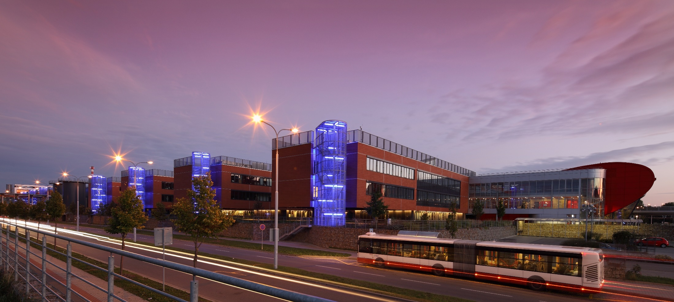
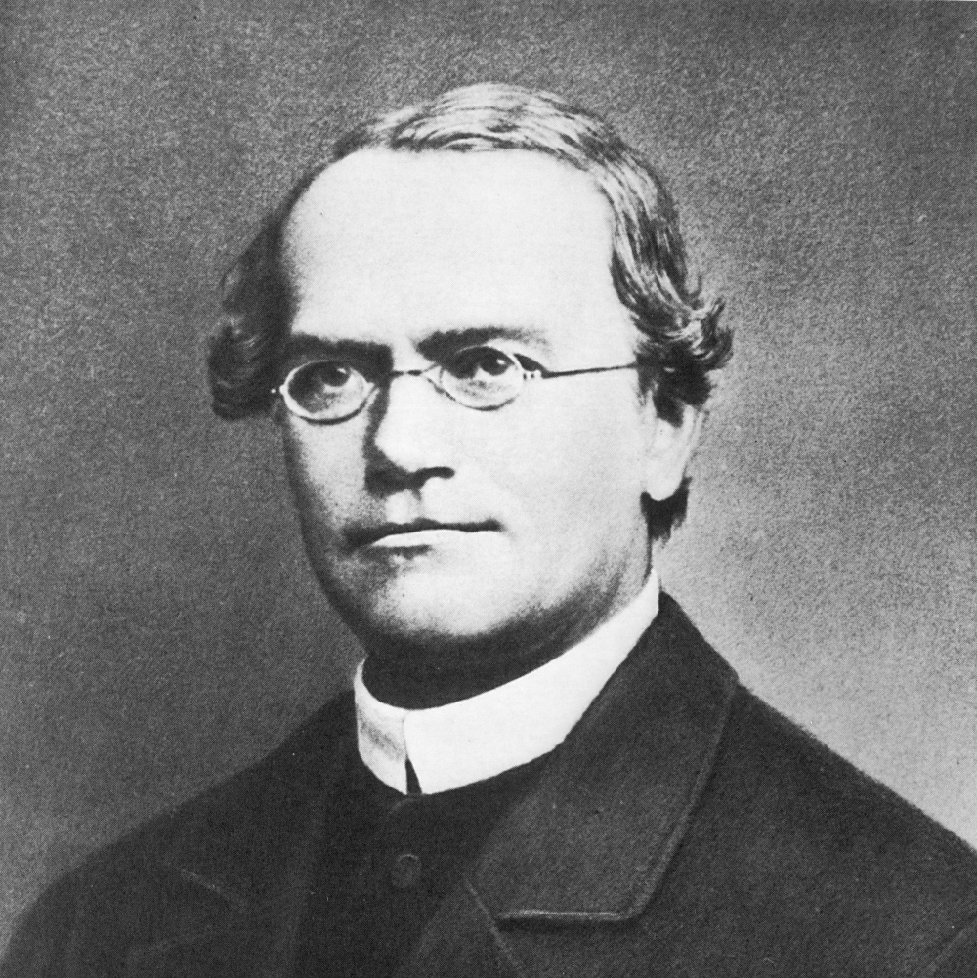
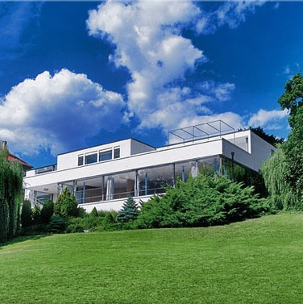


BRNO, the Czech Republic
BRNO, city for life
science
architecture
history
culture
Notes:
The second largest city in the Czech Republic with 400 000 inhabitants. Political, industrial and business centre of South Moravia.
Important infrastructure hub (railway, highway, air).
City with a strong historical tradition – established in 11th century, Legal support for the development of the city came with the large and small privileges that were conferred upon the city in 1243 by Václav I, King of Bohemia.
University center with 85 000 students.
Home of the supreme bodies of the Czech judiciary.
Home of the Brno Exhibition Centre.
Heritage sights (Tugendhat Villa – UNESCO).
Beautiful natural environment.
MUNI
220 accredited degree programmes in Czech and various foreign languages
36,000 studies
7,000 international studies
19,200 lifelong learning participants
3,300 doctoral candidates
8,500 graduates per year
57,000 entrance applications submitted in 2016

