Slide 1
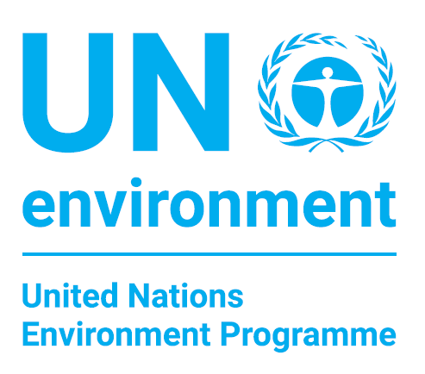

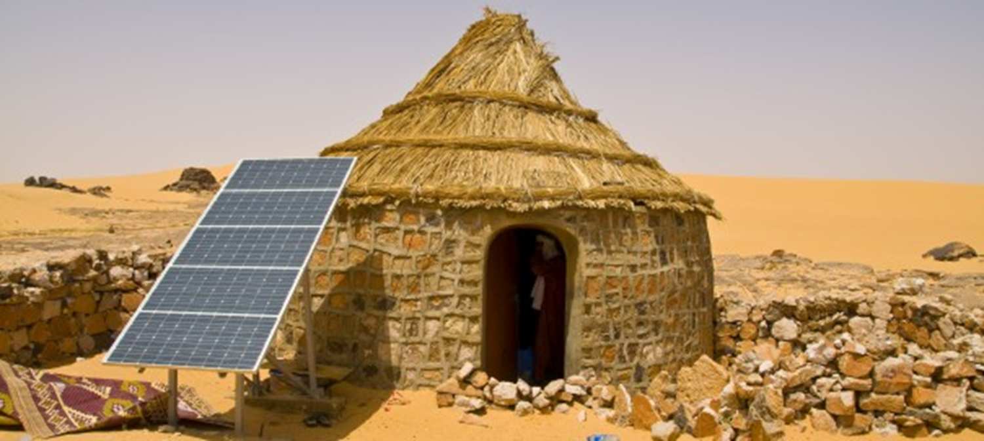

Climate Change
Programme Performance Review
January – June 2018
Supporting the move towards climate-resilient and
low emission development

Slide 2
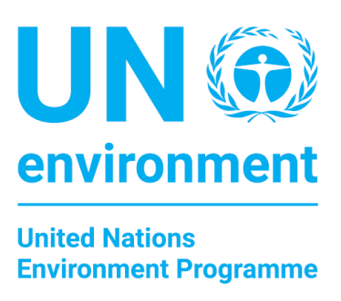

Overview of presentation
Medium Term Strategy 2018-2021
2030 vision aligned to SDGs
Overall strategic direction
Programme of work
2018-2019
First biennial plan -
6 Month Performance
Programme of work
2020-2021
Second biennial plan - revisions design
Notes:
The objective of UN Environment Programme’s work in climate change is:
To support countries to increasingly make the transition to low-emission economic development, and enhance their adaptation and resilience to climate change
And the three Excepted Accomplishments are:
(a) Countries increasingly advance their national adaptation plans which integrate ecosystem-based adaptation (Climate resilience),
(b) Countries increasingly adopt and/or implement low greenhouse gas emission development strategies and invest in clean technologies (Low emission pathways),
(c) Countries increasingly adopt and implement forest-friendly policies and measures that deliver quantifiable emissions reductions as well as social and environmental benefits (REDD+ i.e. Reducing Emissions from Deforestation and Forest Degradation, as well as conservation, sustainable management of forests and enhancement of forest carbon stocks).
UN Environment Programme’s work on climate change is designed to support the delivery of the Paris Agreement (UNFCCC) and Agenda 2030 and the Sustainable Development Goals (SDGs):
- Climate resilience: SDG 1.5, 2.4, 13
- Low emissions: SDG 7.2, 7.3, 9, 13
- REDD+: SDG 6.6, 13.2, 15
Resolutions:
UNEA 1/8 - Ecosystem-based adaptation (fully aligned with PoW)
UNEA 2/6 - Supporting the Paris Agreement (fully aligned with PoW)
UNEA 3/5 - Investing in innovative environmental solutions for accelerating the implementation of the Sustainable Development Goals (Fully aligned with PoW)

Slide 3

MTS 2018-2021
key changes since 2014-2017
SDGs and Paris Agreement
Increased focus on finance
Growth in partnerships
EA(a) Adaptation
    Institutional arrangements to coordinate adaptation plans
    Technical capacity on ecosystem-based adaptation
    Access to adaptation finance
EA (b) Mitigation
    Progress on low emission strategies
    Mitigation finance
EA (c) REDD+
    Investments in forests
    Social and environmental benefits
Notes:
A key difference between the 2014-2017 Mid-Term Strategy and the MTS 2018-2021 is the alignment with the 2030 Agenda for Sustainable Development (SDGs) and the Paris Agreement. At the time of writting the 2018-2021 MTS, we were able to alogn with goals and targets for the 2030 Agenda and the Paris Agreement Articles but neither had any specific indicators yet (proposed to be incorporated in 2020-2021 Programme of Work).
In comparison with the Perogramme of Work 2016-2017, the 2018-2019 Programme of Work aligns more with the text, in both the Agenda 2030 and the Paris Agreement, on adaptation, mitigation and REDD+. While the Expected Accomplishments have largely stayed the same we have seven completely new indicators for the 2018-2019 Programme of Work period. Note: As all indicators for 2018-2019 are new a direct comparison with the indicators in 2016-2017 Programme of Work cannot be made nor can the 2016-2017 numbers be used as baselines.
A key lesson learned from the 2014-2017 Mid-Term Strategy was the need for addressing access to finance as a bottle neck for progress under each of our Expected Accomplishments. Thus all Expected Accomplishment have an indicator on finance in the 2018-2019 (and draft PoW 2020-2021).
Our support is increasingly delivered through partnerships where we have either convened the partnership, provided a secretariat for the partnership or act as a member.
PoW 2018-2019 Indicators:
Expected Accomplishment A
Indicator: a)(i) Increase in the number of countries supported by UNEP with institutional arrangements in place to coordinate national adaptation plans
Indicator: a)(ii) Increase in the number of countries that have technical capacity to integrate ecosystem-based management into national adaptation plans
Indicator: a)(ii) Increase in the number of countries that are ready to access or that have accessed climate change adaptation finance to implement adaptation plans
Expected Accomplishment B
Indicator: b)(i) Increase in the number of countries supported by UNEP that make progress in adopting and/or implementing low greenhouse gas emission development plans, strategies and/or policies (similarity to 2016-2017)
Indicator: b)(ii) Increase in climate finance invested by countries or institutions for clean energy, energy efficiency and/or amount of decarbonized assets (similarity to 2016-2017)
Expected Accomplishment C
Indicator: c)(i) Increase in the number of countries that have secured finance, including performance-based finance, for the implementation of REDD-plus policies and measures
Indicator: c)(ii) Increase in the number of countries that demonstrate quantifiable social and environmental (non-carbon) benefits generated through the implementation of policies and measures

Slide 4
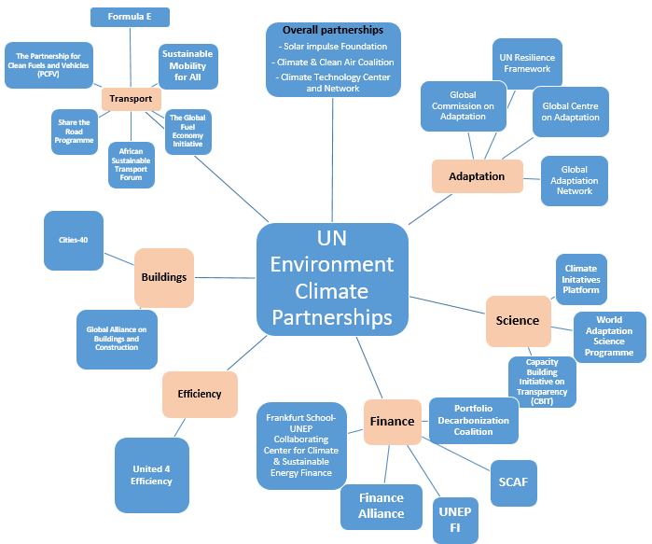
Notes:
Examples of some of our partnership

Slide 5


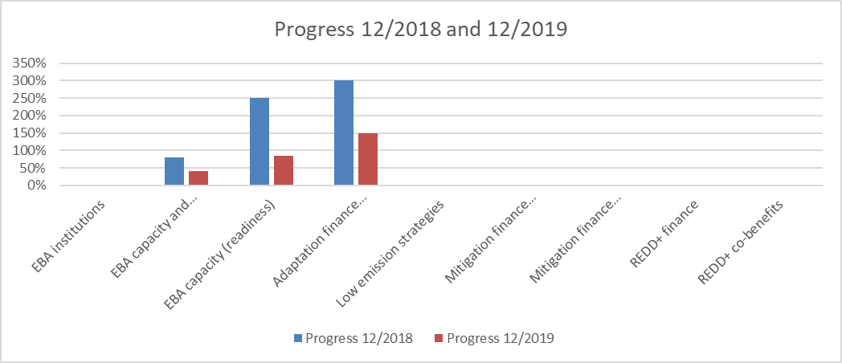
Overview of progress
(June 2018)
EBA: Ecosystems based Adaptation
Notes:
Performance on 2018-2019 Programme of Work indicators.
Still missing data on baselines and progress as large part of the extra-budgetary portfolio has not reported back yet, for example, the Global Environment Facility project reports become available in November/December of each year. Based on indicative results for our adaptation portfolio, we have progressed well, especially on adaptation finance, and we are on good track to exceed our targets (un-validated data).
Note: the 2018-2019 Programme of Work has seven indicators but 9 Units of Measures, therefore the chart above presents nine elements.

Slide 6
Adaptation work moving well
Type of proposal | Proposals submitted to GCF |  | Proposals Approved by GCF |  | Total Funds received from GCF
 | No of proposals | Total budget size (mUSD) | No of proposals | Total budget size (mUSD) | No of proposals | Total budget size (mUSD)
Readiness | 33 | 14.1 | 20 | 6.8 | 16 | 3.1
National Adaptation Plans (NAPs) | 21 | 48.4 | 7 | 20.6 | 6 | 4.3
Concept Notes | 9
Project Preparation Facility | 7 | 5.5
Full Funding Proposals | 7 | 162.9 | 1 | 20.6 | 1 | 6.5
Total | 77 | 230.9 | 28 | 48.0 | 23 | 13.9
Notes:
High confidence about successful delivery of adaptation targets by end of 2019. This slide provides an overview of the growing Green Climate Fund portfolio.
Resolutions:
UNEA 1/8 - Ecosystem-based adaptation
UNEA 2/6 - Supporting the Paris Agreement
UNEA 3/5 - Investing in innovative environmental solutions for accelerating the implementation of the Sustainable Development Goals

Slide 7





Mitigation portfolio
~50 countries being supported to decarbonize
Mitigation finance
  GCF readiness support to 9 countries
  Seed Capital Assistance Facility
  Mediterranean Investment Facility
PDC members with +800 billion
Increasing focus on energy efficiency
Notes:
Under our Expected Accomplishment on Mitigation we have two indicators focused on design and implementation of low emission strategies as well as finance and investments in decarbonizing our economies.
Indicator 1 (design and implementation of strategies): UN Environment and its partners are supporting more than 50 countries to design, finance and implement policies, standards and plans for renewable energy, energy efficiency and technology advancement. The indicator target of achieving progress in 35 countries is likely to be achieved.
Our mitigation portfolio includes work to support energy efficiency implementation, including lighting, appliances, transport, and district energy. Through this work, we are working toward Sustainable Development Goal 7.3, to double the global rate of improvement in energy efficiency by 2030. We contribute to the energy efficiency goal of the Sustainable Energy for All Initiative through its Global Energy Efficiency Accelerator Platform
Indicator 2 (finance for decarbonization): The investment target is divided up in two: (a) Dollar amount invested by countries or institutions for clean energy, energy efficiency and (b) Dollar amount of decarbonized assets. Progress on both indicators are difficult to only attribute to UN Environment Programme but our key intervention are done through initiatives such as the Seed Capital Assistance Facility, the Mediterranean Finance Facility as well as our partnerships with UNEP Finance Initiative and Frankfurt School of Economics.
Current activities include: The UN Environment/UNDP/WRI GCF readiness project, operating since 2014 and is ending in December 2018. The programme builds the capacity of nine selected countries (Benin, Colombia, El Salvador, Fiji, Ghana, Kenya, Nepal, the Philippines, Uzbekistan) to access the Green Climate Fund and to plan for, manage, disburse and monitor climate finance, with a focus on enabling direct access to climate finance. To-date the programme has:
helped National Designated Authorities to establish the required participatory decision making processes and define roles and responsibilities vis-a-vis the GCF in the form of GCF engagement strategies, prioritization processes and NDA Operations Manuals.
Furthermore, we have supported NDAs in identifying potential candidates for direct access accreditation, which resulted in 18 institutions/organizations preparing their GCF accreditation application – 14 submitted (stage I completeness check), 6 (stage II review and board approval), 2 accredited: Fiji Dvpt Bank and NEMA (Kenya). All 9 partner countries are developing GCF concept notes and proposals from their prioritized project concepts, 11 proposals are fully supported (4 full proposals submitted to date) and more than 30 concept notes and proposals submitted to NDAs were technically reviewed by the experts hired by the programme.
Further, we have raised awareness of local financial institutions and private sector actors on climate finance opportunities. E.g. in Colombia, the Programme has provided technical and financial support for the National Climate Change System’s initiative, “Innovative Financing Pilot Projects.”, seeking to engage investors and generate public-private investment schemes.
Creating Enabling conditions and promotion of renewable energy and energy efficiency investments
Seed Capital Assistance Facility
The project is now at mid-implementation stage, and is undergoing its mid-term evaluation. The facility supports investment funds for early stage development of renewable energy projects and ventures in frontier markets in Asia and Africa. It offers various forms of support including supporting individual projects to reach commercial project finance stage (pre-construction). As of June 2018, the facility directly supported 10 renewable energy projects located in Cambodia, Indonesia, Kenya, Nigeria, Rwanda, Tanzania, and Vietnam.
SCAF also supports the establishment of new actors in the clean energy private equity sphere. It reached a first successful achievement with Ethiopian SME fund, Zoscales, getting to its first fund close late 2017.
Decarbonization of assets: UN Environment Programme’s key effort to decarbonise investments are through the Portfolio Decarbonization Coalition which now convenes 32 investors overseeing the gradual decarbonization of a total of more than USD 800 billion in assets under management (AUM). This has dramatically surpassed the Coalition’s original target of USD 100 billion by 2015 by a factor of 8. Portfolio decarbonization means investors systemically integrate carbon-related information, such as fossil-fuel-derived revenues, into portfolio design and capital allocation, signaling that climate change, and the corporate response to it, will be critical to shareholder value and investor interests going forward. UN Environment’s Finance Initiative is a co-founder of the Portfolio Decarbonization Coalition.
Resolutions:
UNEA 2/6 - Supporting the Paris Agreement
UNEA 3/5 - Investing in innovative environmental solutions for accelerating the implementation of the Sustainable Development Goals

Slide 8
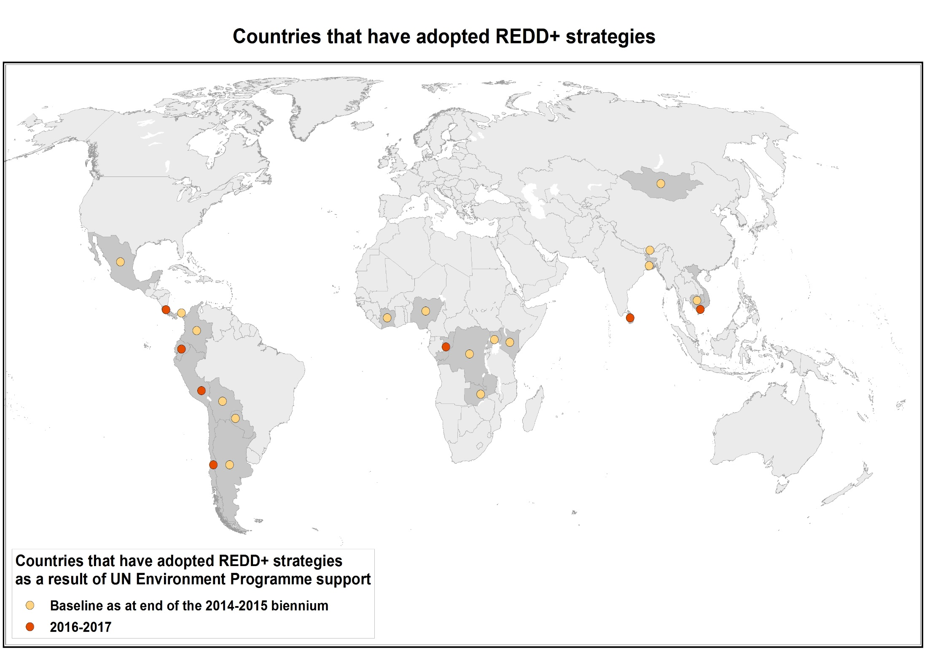




Moving landscape finance commitments to
investments (REDD+)
Countries progress on REDD+
$11 billion in private sector investment commitment
first project deal ($95million) in Indonesia
Notes:
Under the Excepted Accomplishment on REDD+ we have increased our focus on securing finance for sustainable land management and to that extent introduced a new indicator on secured finance. UN Environment Programme’s target for 2018-2019 is to support 20 countries to access REDD+ and sustainable landscape management finance.
Our pipeline of Green Climate Fund projects, The Tropical Landscape Finance Facility and our collaboration with BNP Paribas and Radobank are all key initiatives to secure tangible finance. While its too early to say if we will meet our target of 20 countries, our pipeline of projects and investment objects is sufficiently broad to deliver tangible investments in 20 countries if all reach fruition by 2019.
The UN-REDD programme has for several years also supported countries to include multiple benefits in their efforts to reduce emissions from deforestation and work ahs progressed sufficiently that this has been included as an indicator in the 2018-2019 Programme of Work results framework. Our target to support 45 countries to generate social and environmental benefits from REDD+ and landscape interventions is however unlikely to be met during the biennium as we have not received support request from a sufficient amount of countries to meet the set target. Based on our activity portfolio we are more likely to achieve progress in 20-30 countries. For example, the UN-REDD Programme support to 18 countries (Argentina, Chile, Colombia, Costa Rica, Côte d’Ivoire, Ecuador, Honduras, Liberia, Mexico, Mongolia, Myanmar, Nigeria, Panama, Papua New Guinea, Peru, Sri Lanka, Viet Nam and Zambia).
Furthermore, UN Environment Programme brings in an environmental and social impact framework for the ‘Forest Protection and Sustainable Agriculture’ Partnership (set up by UN Environment and Rabobank) which will advance multiple benefits as part of the landscape investment work stream. A final draft was ready in June 2018 and we aim to have it approved ahead of the launch of the fund in Q4 2018.
Resolutions:
UNEA 1/8 - Ecosystem-based adaptation
UNEA 2/6 - Supporting the Paris Agreement
UNEA 3/5 - Investing in innovative environmental solutions for accelerating the implementation of the Sustainable Development Goals

Slide 9
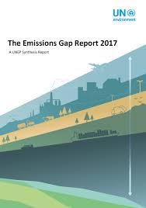
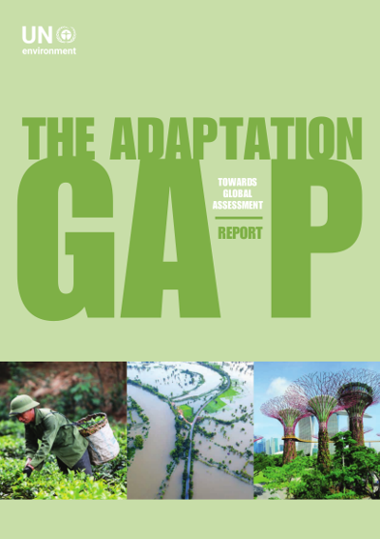

Enabling support
Transparency
  National communications
  GHG inventories
  Strategies and plans
Knowledge
  Gap Reports
  Partnerships
Notes:
In addition to the indicators under the three expected accomplishments, UN Environment Programme provides support to several countries on the overall enabling framework for measurable and transparent climate action. This area of work, while it is not directly measured through indicators, support the achievement of our indicators as well as the delivery of the higher level objective on climate change.
Our support includes, assistance to developing country Parties under the UN Framework Convention on Climate Change to produce and submit national communications and biennial update reports to the Climate Convention. The UN Environment Programme, as an Implementing Agency of the Global Environment Facility, is currently supporting eighty-two (82) countries to prepare their national communications and biennial update reports. These reports present a wealth of climate relevant information to the Conference of Parties and strengthen national capacities in producing, assessing and using this information for policy making. In light of the Paris Agreement, the UN Environment Programme is following the climate negotiations at the international level to ensure we provide the necessary support for countries to transition to the enhanced transparency framework under the Paris Agreement.
Our flagship reports, e.g., Adaptation Gap Report and Emission Gap Report are also a direct input to the climate negotiations and stock-taking exercises under the Climate Convention as well as basis for knowledge sharing on efforts by non-state actors.
Two examples of UN Environment Programme supported partnerships that build know-how are the Global Center on Climate Adaptation and the World Adaptation Science and Policy Programme. The Global Commission on Adaptation, which is in the making, will also accelerate adaptation by raising the visibility of the adaptation and focusing on innovative solutions.
Resolutions:
UNEA 1/8 - Ecosystem-based adaptation
UNEA 2/6 - Supporting the Paris Agreement
UNEA 3/5 - Investing in innovative environmental solutions for accelerating the implementation of the Sustainable Development Goals

Slide 10
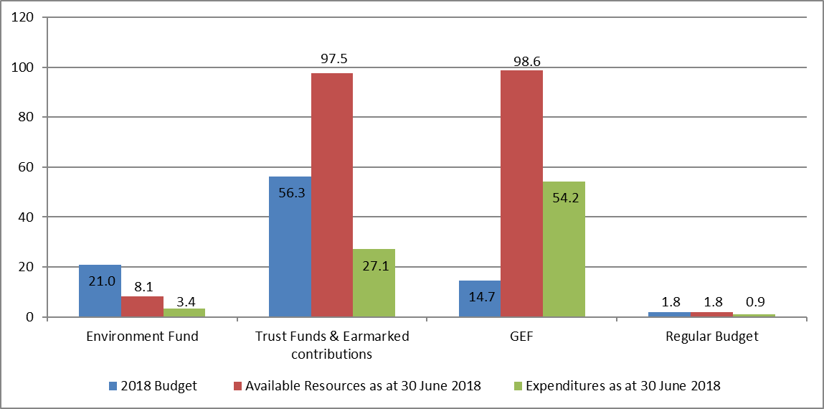
Funding 2018-2019
Notes:
The Climate Change Subprogramme receives the smallest percentage of core resources and is to 92% dependant on extra-budgetary resources. This presents some problems in programme planning. We have a good pipeline of projects but major concerns on the reduction of climate finance under the Global Environment Facility. This element of high dependency on extra-budgetary funds also guides the allocation of UN Environment Programme core resources. We, for example, we use core resources to foster partnerships that can deliver wider results and we invest staff time and core activity funds in shaping the extra-budgetary income and building up new work streams for example landscape finance. Furthermore, core resources are also used for flagship reports, such as the Emission Gap Report, and enabling conditions, such as, measuring adaptation impacts.
As in previous years we see a higher than budgeted availability of resources for Trust Funds, Ear-marked contributions and GEF as these are multi year income

Slide 11
Challenges and opportunities
IPCC 1.5 degree report
  Carbon pricing
Nationally Determined Contributions still do not add up to emission reductions sufficient with 1.5-2 degrees
Decrease in climate finance from Global Environment Facility 7
Effects of climate change is regularly felt across the world and needed solutions are available, in use and economical
2018-2020 increased climate focus
Notes:
This slide summarizes the challenges and opportunities we are facing in the implementation of the climate change portfolio:
Challenges:
The collective ambition of the world is not sufficient to maintain climate change within the 1.5-2 degrees range.
Opportunities
Increase frequency of climate change impacts and availability of tested and economically feasible solutions leave limited room for in-action
Next 30 months will see increased climate focus and a UN Environment Programme Campaign will be central to our communication effort
The focus on climate change is increasing as evident by e.g., the Climate Action Summit in California, Secretary General’s Climate Summit 2019, #RiseforClimate
Increase in Green Climate Fund finance
The Sub-progamme is likely to maintain the highest leverage ratio (1:12.5)

Slide 12

Questions & Discussion
Programme Lead Director
Ms. Monika McDavette
Ecosystems Division
UN Environment Programme Nairobi
Office Tel: +254 – 2076 24782
monika.macdevette@un.org
Programme Coordinator
Mr. Niklas Hagelberg
Ecosystems Division
UN Environment Programme Nairobi
Office Tel: +254 – 2076 24840
niklas.hagelberg@un.org

