Slide 1


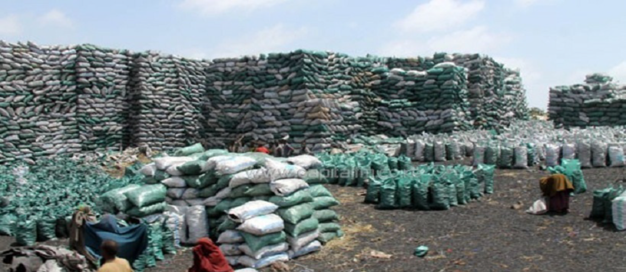
Resilience to
Disasters and Conflicts
Programme Performance Review
January to June 2018

Slide 2

January-June 2018: Major natural disasters and industrial accidents in 10 countries
China, Guatemala, Indonesia, Japan, Kenya, Madagscar, Mongolia, Papua New Guinea, Somalia and the Philippines
Notes:
In many parts of the world, ongoing conflicts, natural disasters and industrial accidents are affecting millions of people.
Between January and June 2018, 10 countries experienced “major”* natural disasters, industrial accidents or “complex” disasters (mixed events with technological hazards exacerbated by natural events).
By “major” natural disaster we are referring to events that have affected in excess of 100,000 people during the time period according to the International Disaster Database (www.emdat.be): China, Guatemala, Indonesia, Japan, Kenya, Madagascar, Mongolia, Papua New Guinea, Somalia and the Philippines.
* Photo Papua New Guinea Earthquake, © REUTERS/ FRANCIS AMBROSE

Slide 3
January - June 2018: Major conflicts in 17 countries
Notes:
Conflicts in countries have specific environmental impacts.
Between January and June 2018, 17 countries experienced “major”* ongoing conflicts. During this period, UN Environment carried out risk reduction or response and recovery work in six of these countries: Afghanistan, Iraq, Nigeria, Somalia, South Sudan and Sudan.
By “major” conflict we are referring to conflicts with in excess of 1,000 ‘battle deaths’ in 2017: Afghanistan, Central African Republic, Democratic Republic of Congo, Egypt, Ethiopia, Iraq, Libya, Mali, Mexico, Myanmar, Nigeria, the Philippines, Somalia, South Sudan, Sudan, Syria and Yemen.

Slide 4
Overview of Project Portfolio 2018 - 2021
by Expected Accomplishment
Expected Accomplishment A
Risk Reduction
Expected Accomplishment B
Response
Expected Accomplishment C
Recovery
Ecosystem based Disaster Risk Reduction
Risk Reduction for Industrial Accidents
Climate Change Security Risks
Natural resources and fragility
Addressing the root causes of environmental displacement
Environmental Emergency Readiness and Response
Post-crisis Environmental Assessments
Environment in Humanitarian Action, including Disaster Waste Management
Environmental peacebuilding
Country recovery programmes
Notes:
UN Environment’s Resilience to Disasters and Conflicts programme works in three broad areas.
The first is to encourage best practice environmental management in ways that reduces the risks and eventual impacts of natural hazards, industrial accidents and armed conflict. The second is to assess and respond to the environmental impacts of crises. The third is to assist countries in recovery from such events by putting appropriate environmental policies and institutions back in place.
UN Environment’s Disasters and Conflicts programme is relevant to the achievement of all 17 SDGs, as external shocks such as natural disasters, industrial accidents and especially armed conflict have proven to be extremely powerful ‘brakes’ on development and progress (“Conflict is development in reverse” was the memorable phrase used by the World Bank). However, the organization in particular aims to deliver on SDGs 1 (poverty), 11 (cities), 13 (climate action) and 16 (peace).

Slide 5
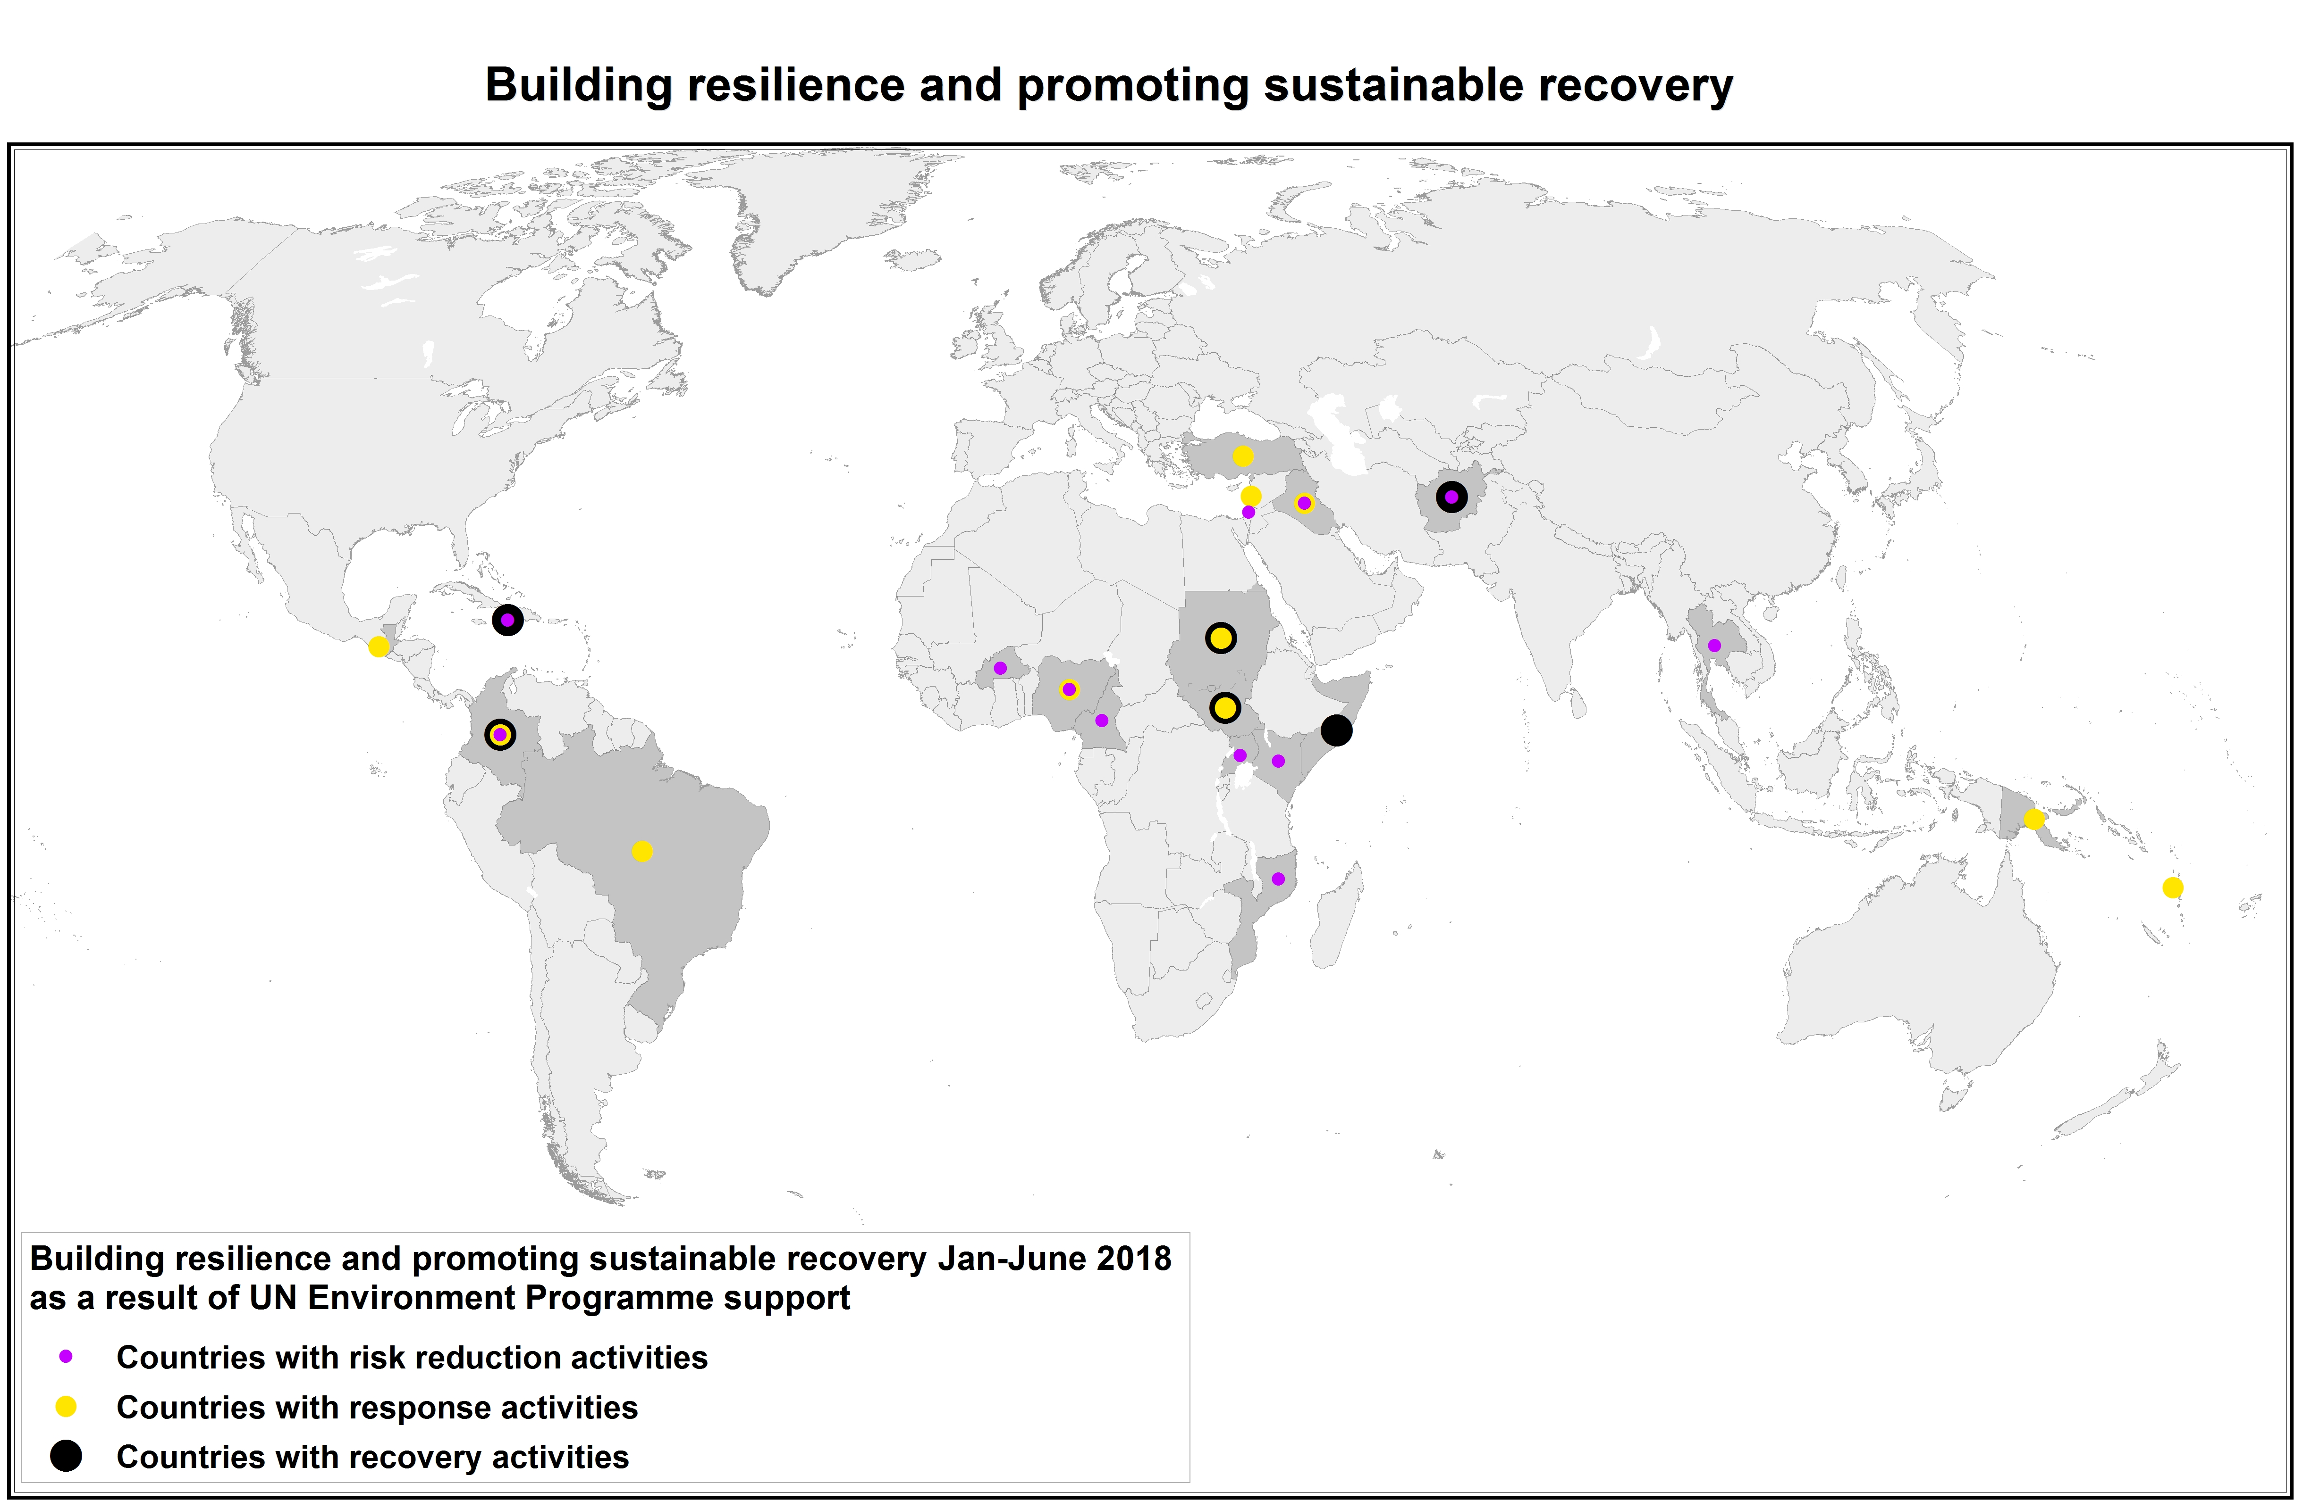
January -June 2018 Progress
Notes:
UN Environment supported 11 countries to reduce the risks of natural disasters, industrial accidents and conflicts between January and June 2018: Afghanistan, Burkina Faso, Cameroon, Colombia, Haiti, Iraq, Kenya, Mozambique, Nigeria, Thailand and Uganda. This included training on risk reduction and management in oil and gas production for Kenya and Uganda, emergency preparedness and response for local communities near industrial areas in Colombia (APELL), and the development of a conflict risk output in a Global Environment Facility project in the Bakassi peninsula area of Cameroon.
Meanwhile, at the global level, UN Environment has been generating guidelines, policies and evidence on the value of ecosystem-based solutions for disaster risk reduction (DRR) and the importance of integrating environment perspectives in UN policies, trainings and programmes on risk management and reduction. Since 2010 UN Environment has helped to shape 11 programmes, 14 policies and 10 trainings among UN and international partners.
For example, UN Environment contributed to a pioneering Massive Open Online Course (MOOC) on Environmental Security and Sustaining Peace developed by the SDG Academy in New York. Other partners included the Environmental Law Institute, the Environmental Peacebuilding Association, and the Universities of Columbia, Duke and California at Irvine. The course was held for eight weeks from March to May 2018 and had 9,895 participants from 170 countries enrol. A total of 30,564 unique visitors from 198 countries also viewed the MOOC web page demonstrating a global reach in marketing efforts. The MOOC attracted a diverse group of participants from all of the main stakeholder groups including NGOs (19%), Private sector (18%), Government (13%), International Organizations (10%), Academic (9%) and others. It also included an excellent gender distribution, with 53% women and 47% men. Over 90% of the participants surveyed found the course to be relevant, valuable and high quality. The next offering of the MOOC will be held in February 2019.
UN Environment works to help countries respond to after natural disasters, industrial accidents and armed conflict. We aim to help countries identify environmental risks and assess environmental priorities during and after natural disasters, industrial accidents and conflict and recommends actions to mitigate the environmental impacts of crises.
UN Environment supports countries emerging from crisis as they seek to put in place critical environmental policies, plans and institutions as part of a wider recovery process. Between January and June 2018, UN Environment had such programmes in place in six countries: Afghanistan, Colombia, Haiti, Somalia and South Sudan, Sudan.
One indicator to measure progress of our work is the extent to which UN Environment meets requests for assistance from governments and UN Country Teams in the event of environmental emergencies. During the reporting period UN Environment received 4 such requests (from Colombia (x 2), Papua New Guinea, and Brazil). This translates to a 100% response rate, which is above the 90% target we had set.

Slide 6

FINANCIAL OVERVIEW

Slide 7
Challenges (and Opportunities)
Staff safety and security
Reduced Environment Fund
Funding risk reduction work
Partnership
Notes:
The lower than expected resources from the Environment Fund has hit the organization’s work on disasters and conflicts particularly hard. This is because many of the activities conducted under this programme are reactive and unplannable, given that we can not always predict where the next natural disaster may strike, or the next conflict may begin.
Our post-crisis recovery programmes attract the majority of extra-budgetary funding, and they frequently also deliver results to other sub-programmes.
Historically, it has proven to be much harder to generate significant resources to support our work on risk reduction, which as a consequence does not proceed at the global scale that we think is necessary. It has also been difficult to generate sufficient resources to facilitate our work on response to crisis and environmental emergencies, which is inherently more difficult to plan around and fund raise for.
Our partnerships are both a challenge and an opportunity. This subprogramme is especially reliant on strong partnerships, with UN Country Teams, with the Department of Political Affairs, with the Department of Peacekeeping Operations and so on. These partnerships are absolutely critical in terms of our ability to influence change and represent a huge opportunity for UN Environment to expand and improve its impact. Yet, they also can constrain our options and complicate planning.

Slide 8
Questions & Discussion
Programme Ag. Lead Director
Mr Gary Lewis
Policy & Programme Division
UN Environment Programme Nairobi
Gary.lewis@un.org

