Slide 1



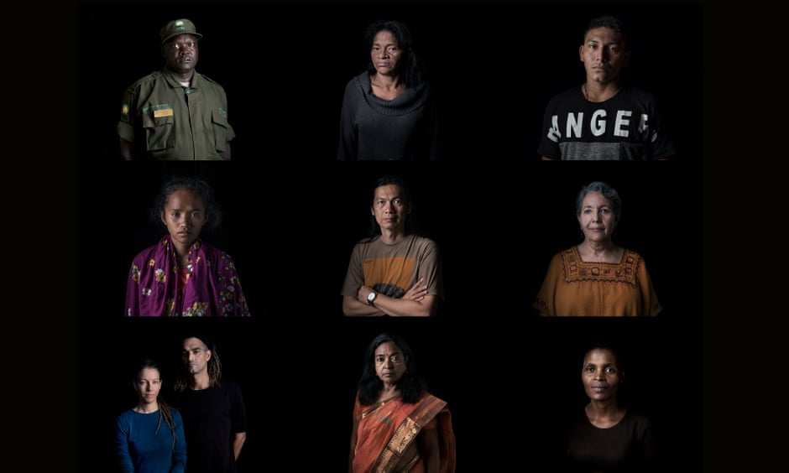

Environmental Governance
Programme Performance Review
January - June 2018

Slide 2


Subprogramme Objectives
Objective: Policy coherence and strong legal and institutional frameworks increasingly achieve environmental goals in the context of sustainable development
Environmental issues are handled in an inclusive, sustainable and coherent manner, based on integrated policy and effective norms and institutions at all levels of governance
2030
impact
Expected accomplishment A
The international community increasingly converges on common and integrated approaches to achieve environmental objectives and implement the 2030 Agenda for Sustainable Development
Expected accomplishment B
Institutional capacities and policy and/or legal frameworks enhanced to achieve internationally agreed environmental goals, including the 2030 Agenda for Sustainable Development and its Sustainable Development Goals
Medium Term Strategy 2018–2021

Slide 3
2018-19 Programme of Work Indicators
Indicators and project portfolio
Project portfolio 2018-21
B(ii) Embedding environment in sustainable development planning
A(i) Uptake of environmental policy issues at global and regional levels
A(ii) Coherent implementation of multilateral environmental agreements
A(iii) International instruments/cooperation
B(i) Stronger institutional capacity & legal frameworks
B(iii) Partnerships for the global environmental goals
International environmental governance
1. Environment Management Group
2. Greening the Blue Initiatives:
Sustainable United Nations
REACT
3. Governance of environment and natural resources
Multilateral environmental agreements
4.Environmental treaties programme:
Biodiversity synergies
ACP MEA capacity building
5. Collective intelligence for environmental governance (inforMEA)
Environmental law
6. Addressing environmental priorities through the law:
Montevideo programme, support to intergovernmental negotiations, technical legal assistance
Environmental Rights
Environmental Crime/enforcement
Implementation of SDGs
7. Poverty-Environment Action for SDGs
8. Environmental dimension of SDGs (including UNDAF & regional ministerial fora)
9. Strengthening institutions in Caribbean Biological Corridor
Partnerships
10. Faith and environment initiative
All projects contribute to this indicator
GEF
Biosafety Clearing House Mechanisms
Nagoya Protocol Implementation

Slide 4
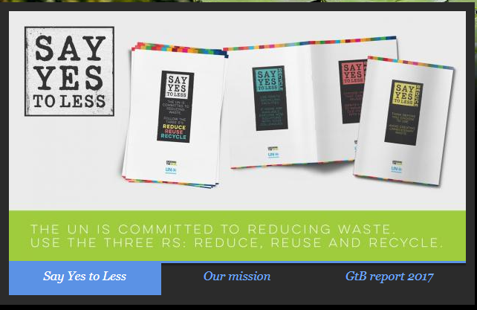
Highlights January - June 2018
(i) Uptake of environmental policy issues at global and regional levels
(ii) Coherent implementation of multilateral environmental agreements
Expected accomplishment A
The international community increasingly converges on common and integrated approaches to achieve environmental objectives and implement the 2030 Agenda for Sustainable Development
Environment management group action.
Progress in greening the UN
Contribution to High-level Political Forum 2018
Integrated implementation of SDGs
Continued collaboration with Biodiversity secretariats
(UNEA Resolutions 2/2, 2/5, 2/17, and 3/3)
Notes:
Environment management group establishes e-waste coalition, revitalizes discussions on biodiversity, initiates efforts to green Humanitarian Action.
Progress in greening the UN:
“Say yes to less” campaign & waste management guidance
Action on single use plastics in over 10 UN compounds
Toolkit for implementation of Environmental management systems for UN entities
Contributions to High-level Political Forum & capacities enhanced on integrated implementation of SDGs
Continued collaboration with Biodiversity secretariats to foster synergies, including for stronger evidence base, communication and capacity building

Slide 5
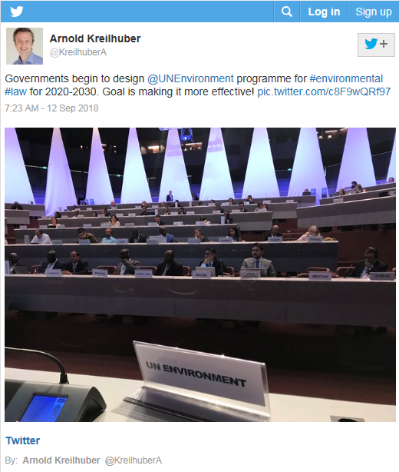
Progress January-June 2018
Expected accomplishment A
The international community increasingly converges on common and integrated approaches to achieve environmental objectives and implement the 2030 Agenda for Sustainable Development
(iii) International instruments/
cooperation
Regional Agreement on Access to Information, Public Participation and Justice in Environmental Matters in Latin America and the Caribbean (Escazú Agreement) (UNEA Resolution 2/25)
Progressive development of environmental law:
Montevideo Programme IV assessed
Country-led discussions toward a possible new global programme for submission to UNEA4 (UNEA Resolution 2/19)

Slide 6
Highlights January-June 2018
Expected Accomplishment B
Institutional capacities and policy and/or legal frameworks enhanced to achieve internationally agreed environmental goals, including the 2030 Agenda for Sustainable Development
Stronger institutional capacity & legal frameworks
Strengthen national legislation on climate and wildlife (six countries)
Environmental law, knowledge and capacities
Strengthening enforcement capacities for trade-related MEAs
MEAs implementation capacities strengthened
Environmental Rights Initiative launched
Executive
Parliamentarians
Judiciary
Enforcement
Civil society
(UNEA Resolutions 1/3 and 2/14; 2/19; 2/16 and 2/17)
Notes:
Initiated support to countries to strengthen national legislation on climate and wildlife (six countries)
Environmental law, knowledge and capacities strengthened
Guidance and knowledge products (EIA legislation, Legislators guide on Environmental Law-making for SDGs)
Regional initiatives for judiciary and prosecutors (Asia and the Pacific, Africa, Bhutan and China)
Strengthening enforcement capacities for trade related MEAs through Green Customs Initiative and Asia Regional Enforcement Network (new green customs guide, fund mobilization efforts)
MEAs implementation capacities strengthened (capacity building in ACP countries; African Elephant Fund; GEF funded biosafety clearinghouse and access and benefit sharing)
Environmental Rights Initiative launched; media engagement and public outreach

Slide 7
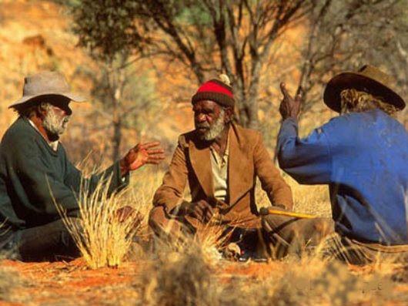
Highlights January-June 2018
Expected accomplishment B
Institutional capacities and policy and/or legal frameworks enhanced to achieve internationally agreed environmental goals, including the 2030 Agenda for Sustainable Development and its Sustainable Development Goals
Embedding environment in sustainable development planning
Partnerships for the global environmental goals
Continued engagement with UN country teams in all regions.
Coherent Implementation of the Environmental Dimension of the Sustainable Development Goals and monitoring and reporting capacities (Bangladesh, Burkina Faso, Colombia, Guyana).
Poverty Environment Action for Sustainable Development Goals (2018-2022) launched.
(UNEA Resolution 2/5)
Confidentiality information (if required)
Page number (all in Roboto Regular 9 pt)
Notes:
Continued engagement with UN country teams in all regions: Five new frameworks completed, more underway.
Support to four countries (Bangladesh, Burkina Faso, Colombia, Guyana) to promote the Coherent Implementation of the Environmental Dimension of the Sustainable Development Goals and monitoring and reporting capacities.
New programme Poverty Environment Action for Sustainable Development Goals (2018-2022) launched (full programmes in eight countries, technical assistance to broader set of countries).

Slide 8

FINANCIAL OVERVIEW
January – June 2018

Slide 9
Challenges and opportunities:
Lessons from the first 6 months of implementation
Steady and predictable resources
Better position environmental priorities at country level, with UN reform.
Synergies and coherence in MEAs implementation
More effective environmental law development and implementation (UNEA Resolution 2/19, for submission to UNEA4)
National support to strengthening SDG planning, implementation and monitoring
Project portfolio developed for 2018-21 may evolve to reflect the above and further lessons learned through first biennium implementation
Notes:
Steady and predictable availability of resources necessary to implement the core of the programme to enable strategic, long-term efforts
Opportunity to better position environmental priorities at country level, including for better environmental management of common premises, with UN reform. This requires upscaling of current efforts and injection of additional resources
Synergies and coherence in MEAs implementation a win-win for better impact and efficiency: however, limited resources available for promotion of synergies at country level
Opportunities for more effective environmental law development and implementation through a more result-oriented, needs-responsive, closely monitored and country driven global programme (UNEA Resolution 2/19, for submission to UNEA4)
National support to strengthening SDG planning, implementation and monitoring only available to limited countries and should be replicated and upscaled for greater impact
Project portfolio developed for 2018-21 may evolve to reflect the above and
further lessons learned through first biennium implementation

Slide 10
Questions & Discussion
Programme Lead Director
Ms. Elizabeth Mrema
Law Division
UN Environment Programme Nairobi
monika.macdevette@un.org
Programme Coordinator
Ms. Cristina Zucca
Law Division
UN Environment Programme Nairobi
cristina.zucca@un.org

