Slide 1

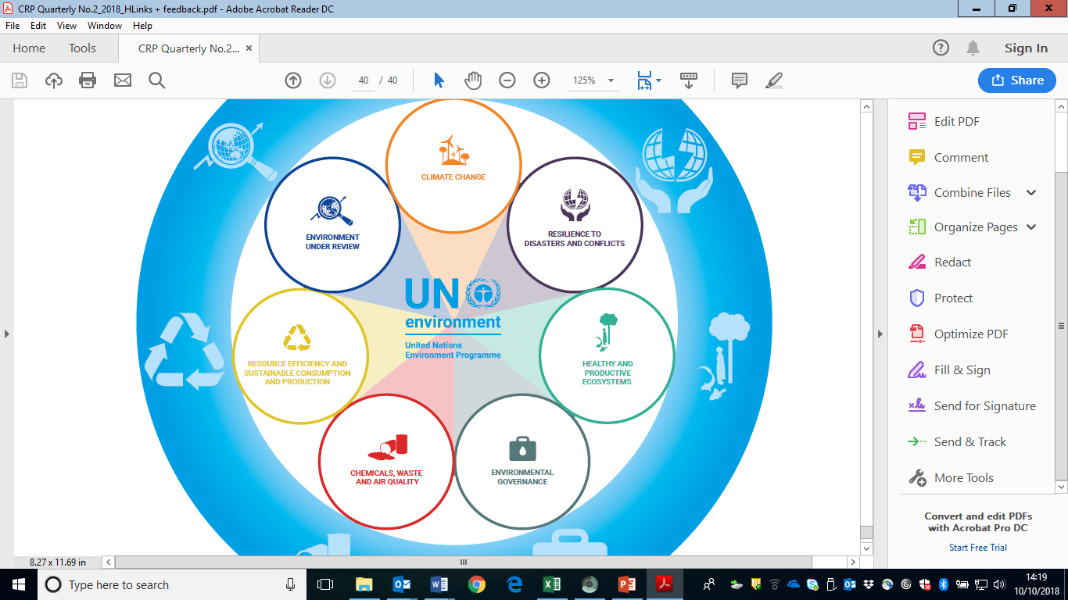
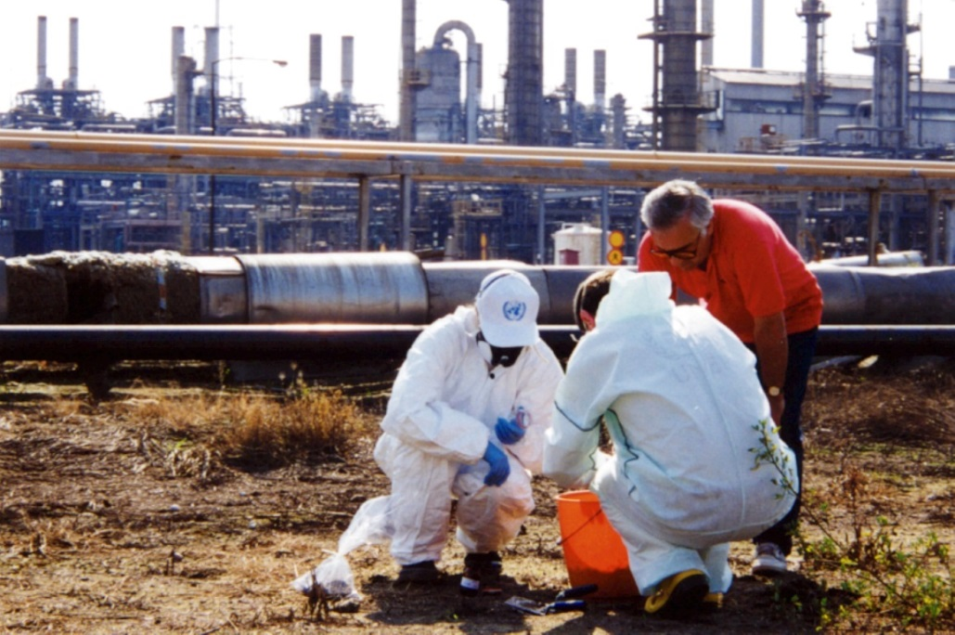
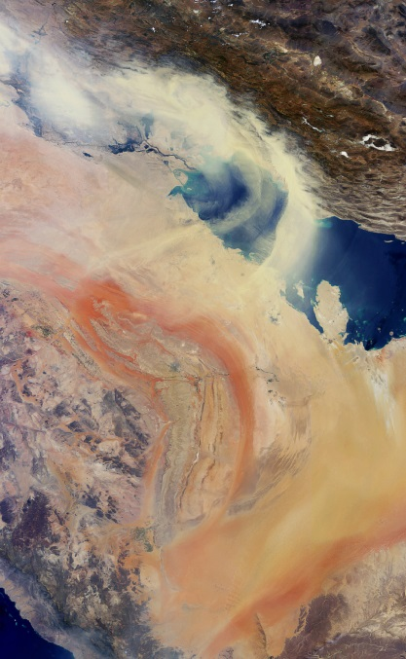
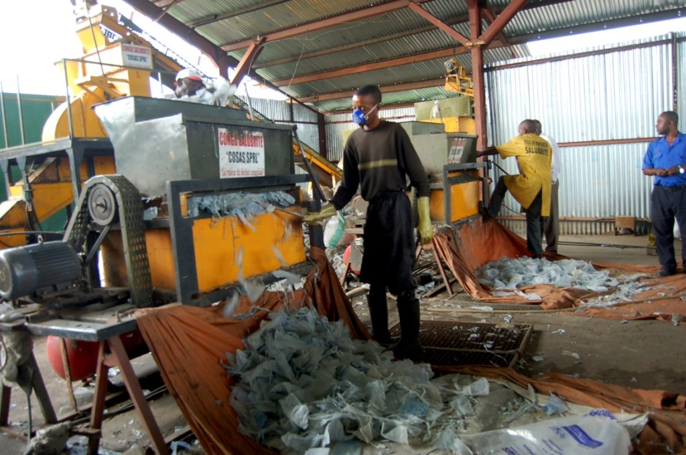

Chemicals, Waste and Air Quality
Programme Performance Report
January – June 2018
Sound management of chemicals and waste and improved air quality for a healthier environment and
better health for all

Slide 2

2018-2019 Indicators
  EA(a) Chemicals
    Chemicals management policies, strategies, legislation or action plans
    Private sector action on improving chemicals management
    Civil society action on improving chemicals management
  EA(b) Waste
    Waste prevention and sound management policies and good practices by governments
    Private sector action on waste prevention and sound waste management
    Civil society action to enhance prevention and waste management
  EA (c) Air Quality
    National emission inventories and air quality assessments
    Policies, standards, and legal, regulatory, fiscal and institutional frameworks and mechanisms
    Awareness raising and access to data

Slide 3







Chemicals
New Global Environment Facility funding support for the Strategic Approach on International Chemicals Management (SAICM)
~24 countries supported in institutional strengthening to implement Multilateral Environmental Agreements and SAICM
New ratifications of the Minamata Convention on Mercury and the Kigali Amendment

Slide 4
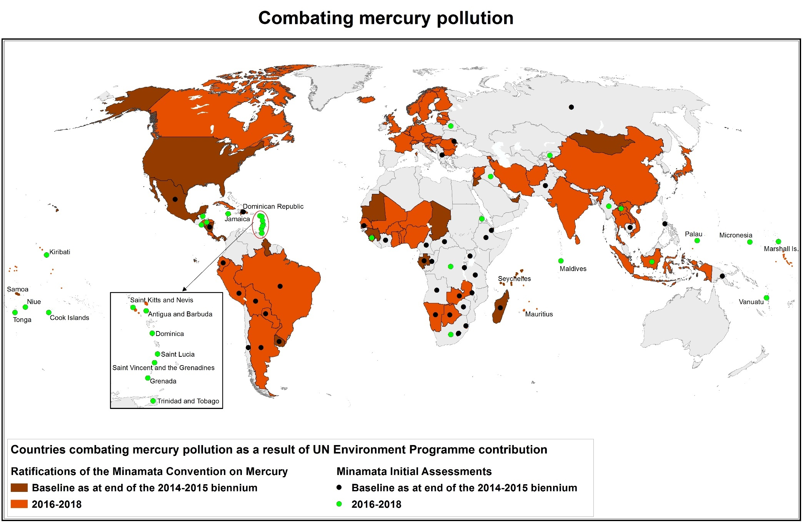
Combating Mercury Pollution

Slide 5
Waste
Regional Waste Management Outlooks launched
1st meeting of the Ad-hoc Expert Group on Marine Litter and Microplastics (May 2018)
Support to national and sub-national governments in designing waste management strategies

Slide 6
Air Quality
Consolidating work: Development of a UN Environment Air Quality programme
Strengthened collaboration with the Climate and Clean Air Coalition
Capacity development support to address air pollution in a number of African countries

Slide 7
UNEA-3 Resolutions
3/4 Environment and health
3/6 Managing soil pollution to achieve Sustainable Development
3/7 Marine litter and microplastics
3/8 Preventing and reducing air pollution to improve air quality globally
3/9 Eliminating exposure to lead paint and promoting environmentally sound management of waste lead-acid batteries
3/10 Addressing water pollution to protect and restore water-related ecosystem

Slide 8
Challenges and Opportunities
Challenges:
High dependency on extra-budgetary resources benefiting certain topics more than others
Tracking impact: step up methodology and data work for key SDG indicators (e.g. for 14.1.1 on marine pollution)
Opportunities:
Momentum around pollution created by UNEA-3 and likely to be sustained by UNEA-4
More integrated approach towards chemicals, waste and air quality issues
Increased collaboration around the topic of environment and health/ strategic partnerships
Beyond 2020 process and new findings 2nd Global Chemicals Outlook

Slide 9
Financial Overview
January – June 2018

Slide 10
2020-2021 Programme of Work
Alignment to Sustainable Development Goal Indicators at both impact and expected accomplishment level
Overview of relevant resolutions that will partly or in full be delivered through the Chemicals, Waste and Air Quality programme
Improvement of some indicators under expected accomplishments
Strategy updated to better reflect corporate priorities such as pollution, including of the marine environment, and respond to new mandates given by the 3rd UN Environment Assembly

Slide 11
Questions & Discussion
Subprogramme Lead Director
Ms. Ligia Noronha
Economy Division
UN Environment Programme Nairobi
ligia.noronha@un.org
Subprogramme Coordinator
Ms. Tessa Goverse
Economy Division
UN Environment Programme Nairobi
goverse@un.org

