Slide 1




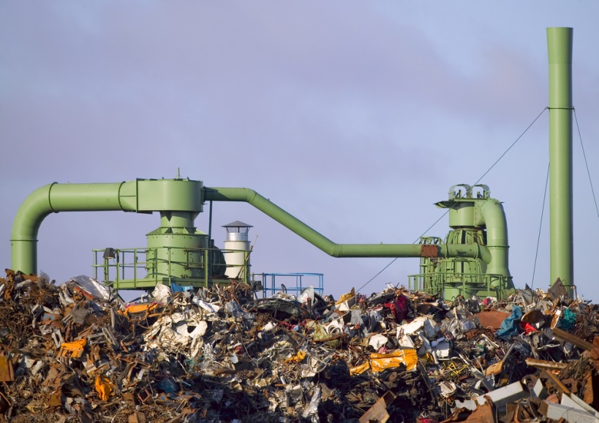

Resource Efficiency
Programme Performance Report
January – June 2018
Notes:
The Objective of the Resource Efficiency Programme is to promote and support the transition towards Inclusive Green Economies for Sustainable Development. This goal is achieved through decoupling economic growth from unsustainable resource use and environmental impact while improving human well-being.
The Programme has three main pillars of work:
The first pillar is focused on creating an enabling policy environment to support countries’ transition to inclusive green economy or similar pathways. The aim is to support the adoption and implementation of these polices that can come in the form of green national development strategies and plans and/or Sustainable Consumption and Production action plans. The envisaged impact is increased resource efficiency which is directly linked to
Sustainable Development Goal 12, Sustainable Consumption and Production, targets: 12. 1 [10 Year Framework of Programmes on Sustainable Consumption and Production implementation], 12.2 [sustainable management of natural resources], 12 a [strengthen countries’ scientific and technological capacity to adopt sustainable consumption and production patterns]
Sustainable Development Goal 8, Sustainable, Sustained and Inclusive Economy Growth, target: 8.4 [improve global resource efficiency and sustainable consumption and production]
Sustainable Development Goal 11: Sustainable Cities, target: 11 b [Integrated policies for resource efficiency]
Sustainable Development Goal 17: Global Partnerships, target: 17.9 [develop measurements of progress on sustainable development that complement gross domestic product]
2. The second pillar supports the private sector in adopting more sustainable management practices with the overall goal to increase investments in sustainable and green economies, such as through decarbonization of investments but also through the introduction of cleaner production methods throughout value chains in key sectors. Key Sustainable Development Goals that are linked to this pillar are:
Sustainable Development Goal 8, Sustainable, Sustained and Inclusive Economy Growth, target: 8.4 [improve global resource efficiency and sustainable consumption and production], 8.8 [Implement policies to promote sustainable tourism that creates jobs and promotes local culture and products]
Sustainable Development Goal 9: Industry, Innovation and Infrastructure, target: 9.5 [upgrade the technological capabilities of industrial sectors, encouraging innovation]
Sustainable Development Goal 12, Sustainable Consumption and Production, targets: 12.6 [companies adopt sustainable practices and integrate sustainability information into to reporting cycle], 12 a [strengthen countries’ scientific and technological capacity to adopt sustainable consumption and production patterns], 12 b [promote sustainable tourism that creates jobs]
Sustainable Development Goal 11: Sustainable Cities, target: 11 c [building sustainable and resilient buildings]
3. The third pillar of work focusses on the promotion of sustainable lifestyles with the aim to have sustainable lifestyles and consumption patterns fully adopted. Relevant Sustainable Development Goals include:
Sustainable Development Goal 12, Sustainable Consumption and Production, targets: 12. 1 [10 Year Framework of Programmes on Sustainable Consumption and Production implementation], 12.3 [half global food waste by 2030], 12.7 [Sustainable Public Procurement], 12.8 [information and awareness for sustainable development and lifestyle]
Sustainable Development Goal 4: Quality Education, target: 4.7 [Knowledge and Skills for Sustainable Lifestyles
1

Slide 2



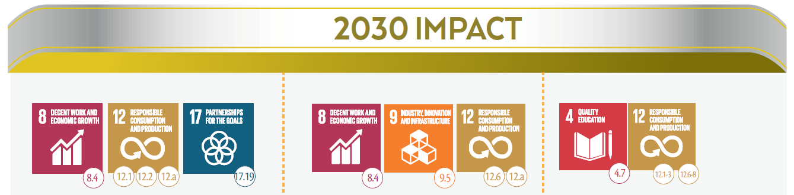
Resource Efficiency in support of the Sustainable Development Goals
“ Countries transition to sustainable development through multiple pathways, including green economy and trade, and the adoption of sustainable consumption and production patterns, increasingly decoupling economic growth from unsustainable resource use and environmental impact while improving human well being.”
Sustainable development pathways are adopted and implemented
Businesses, public and private, adopt more sustainable practices
Sustainable lifestyles and consumption patterns are increasingly adopted

Slide 3
Expected Accomplishment A
Enabling
Environment
Expected Accomplishment B
Sustainability in
Businesses
Overview of Portfolio
Focus Areas by Expected Accomplishment
Expected Accomplishment C
Lifestyles and
Consumption
Green Economy Research and Modelling
One Planet Network
Regional Programmes to promote Sustainable Consumption and Production
Partnership for Action on Green Economy
Environment and Trade Hub
Resource Efficient Cities
Sustainable Finance: UN Environment Finance Initiative
Circular Economy
Sustainability Reporting
Eco-innovation
Resource Efficient and Cleaner Production
Sustainable Tourism
Buildings & Construction
Sustainable Food Systems
Sustainable Lifestyles and Education
Food Waste
Sustainability Campaigns
Consumer Information & Eco-labeling
Sustainable Public Procurement
Behavioral Change
Science-Policy Interface:
International Resource Panel - Green Growth Knowledge Platform - Life-Cycle Approaches

Slide 4




Green Economy and Sustainable Consumption and Production Pathways are Adopted
Expected Accomplishment A: Enabling Policy Environment
5 countries joined in 2018: Argentina, India, Indonesia, Guatemala and Kazakhstan
Reports on SDG 12 at the High Level Political Forum
Adopts a New strategy : “One Plan for One Planet” 2018-2022 strategy launched in May
Establishes One Planet Multi-Partner Trust Fund for Sustainable Development Goal 12

Slide 5
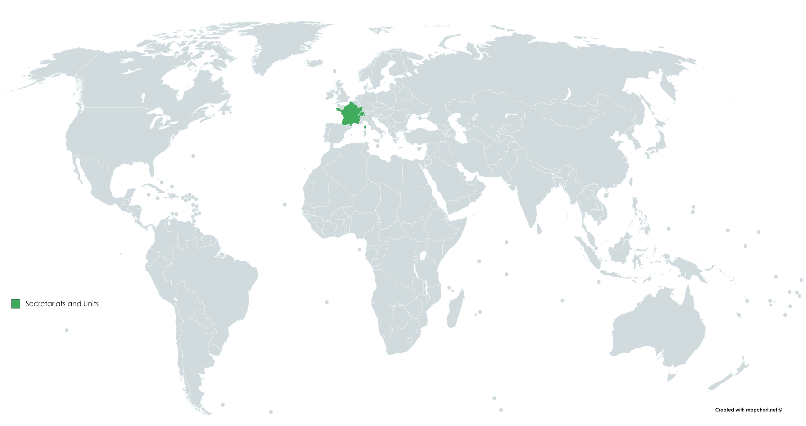






Cross-cutting Initiatives:
Sustainable Consumption and Production,
Green Economy and Green Finance Initiatives
supported by UN Environment Programme
10-Year Framework of Programmes on
Sustainable Consumption & Production Patterns: projects
Finance Initiative (UNEP FI): members in countries
Finance Initiative (UNEP FI): trainings
National Action Plans for Sustainable Consumption and Production
Partnership for Action on Green Economy
Switching to more sustainable consumption & production patterns (SWITCH)
Note: This map features a selection of projects and initiatives under the area of decoupling, but is not a comprehensive list.
.

Slide 6
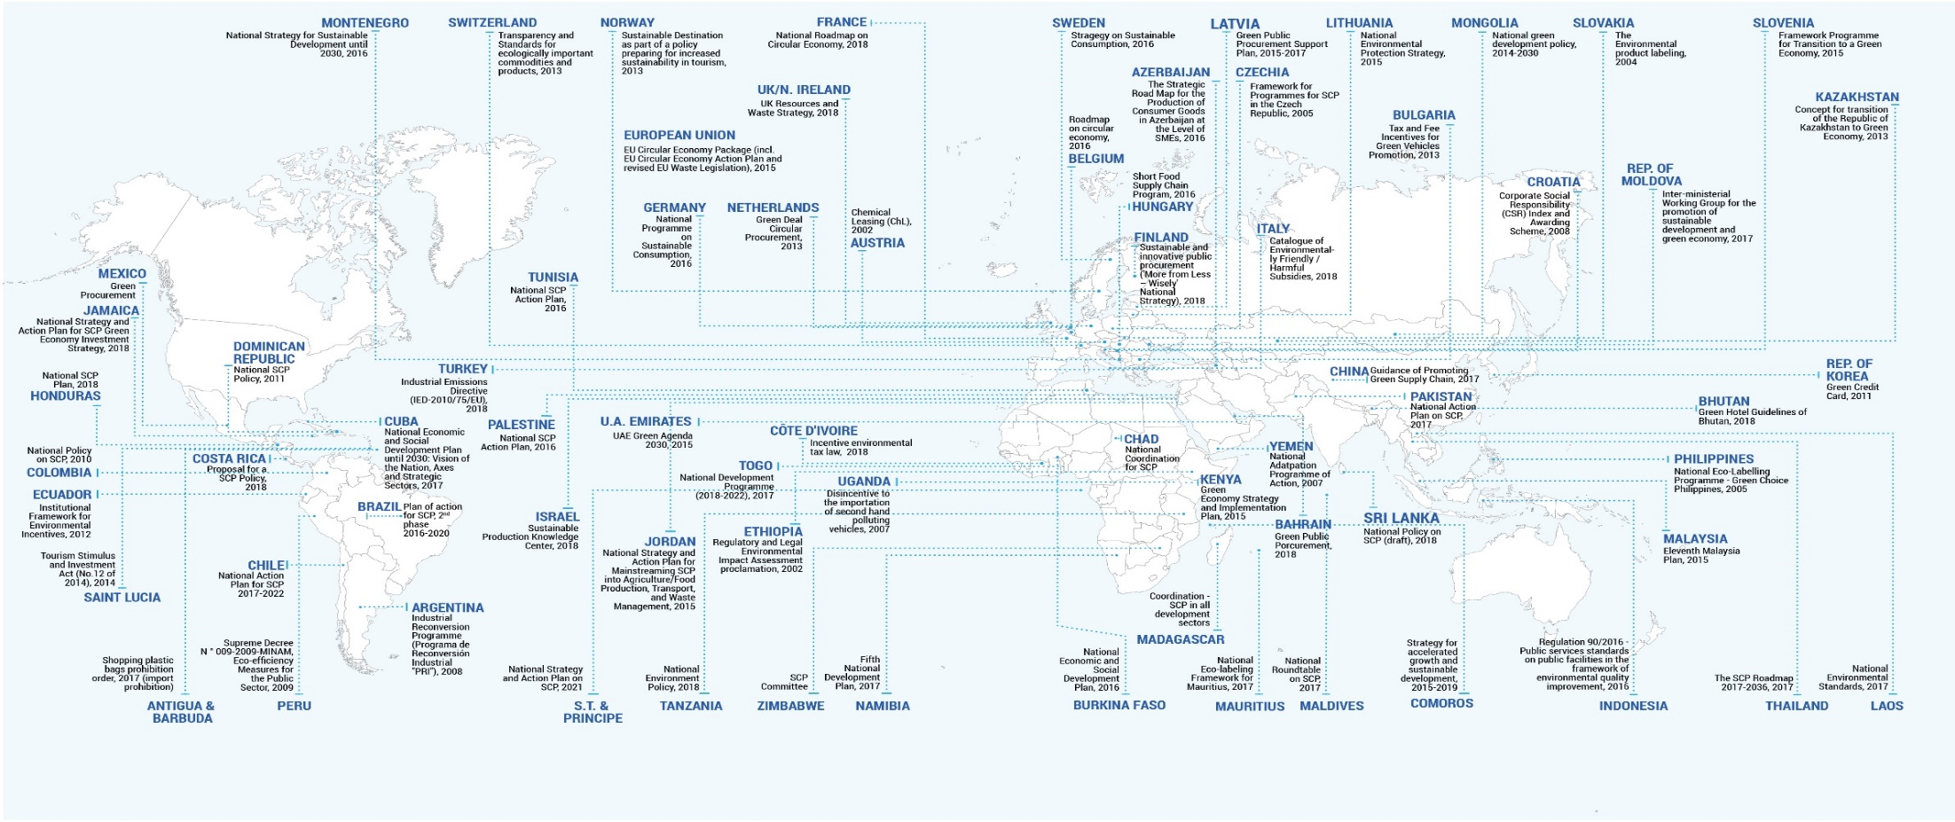

Change is underway on Sustainable Consumption and Production (SCP)
71 countries that already reported on SDG 12.1
Source: Pilot reporting on SDG 12.1.1 featured in 2018 in the
One Planet Network mid-term magazine Five Years In: The One Planet Network 2012-2017 page 26 - 27

Slide 7


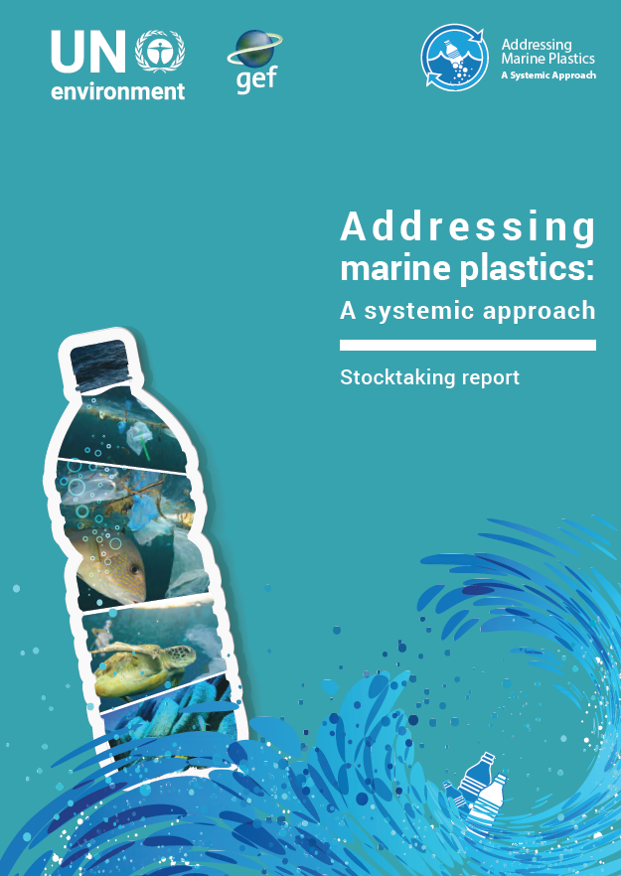
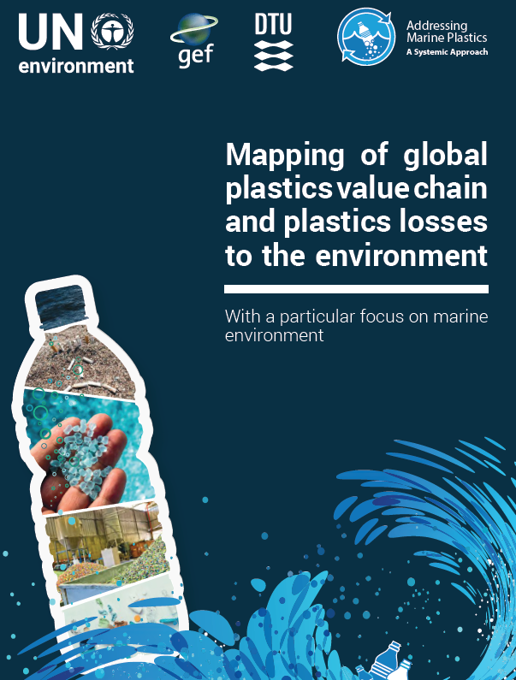
Science and Knowledge in support of resource efficiency is provided
The International Resource Panel support for:
G20 resource efficiency dialogue
UNEA 4 advance preparations through Global Resource Outlook
Deepened understanding of Value retention processes in the circular economy, draft report
Supporting decision making with science-based life cycle approaches in key sectors such as plastics:

Slide 8






Businesses adopt more sustainable practices
15 financial institutions and Insurers have adopted sustainable finance practices
5 countries have adopted national processes and frameworks that mainstream sustainable finance
Global Plastics Platform launched with the European Union
Reporting now against 5 indicators:
Life-Cycle Thinking based decision making
Adoption of Sustainable Finance Principles
Sustainable Tourism Policies
Sustainable Management Practices
Sustainable Buildings and Construction
Expected Accomplishment B: Sustainability in Businesses
8

Slide 9
Sustainable Lifestyles and Consumption advanced
Sustainable public procurement policies - 4 additional countries by end of 2018
Sustainable lifestyles awareness campaigns - 7 additional Countries
Product sustainability Information guidelines - 5 capacity development events organized
Food waste - methodology to measure food waste under development - 7 countries started measuring at national level
Reporting against 3 indicators:
Sustainable public procurement
Sustainable lifestyles campaigns and outreach
Food waste
Expected Accomplishment C: Sustainable Lifestyles & Consumption
9

Slide 10
UN Environment Assembly Resolutions
2/8. Sustainable Consumption and Production
10 Year Framework of Programmes on Sustainable Consumption and Production Patterns, secretariat
Monitoring SDG targets, indicators
Capacity development, standard setting
Networking at regional, national, sub national levels
Scientific reports
Progress to date
Multi-Partner Trust Fund
One Planet Network as core implementation network launched
SDG 12 reporting during High Level Political Forum in July 2018
Monitoring & Evaluation Framework
International Resource Panel reports
Challenges
Reporting by member states voluntary
Additional resources needed to support upscaling

Slide 11
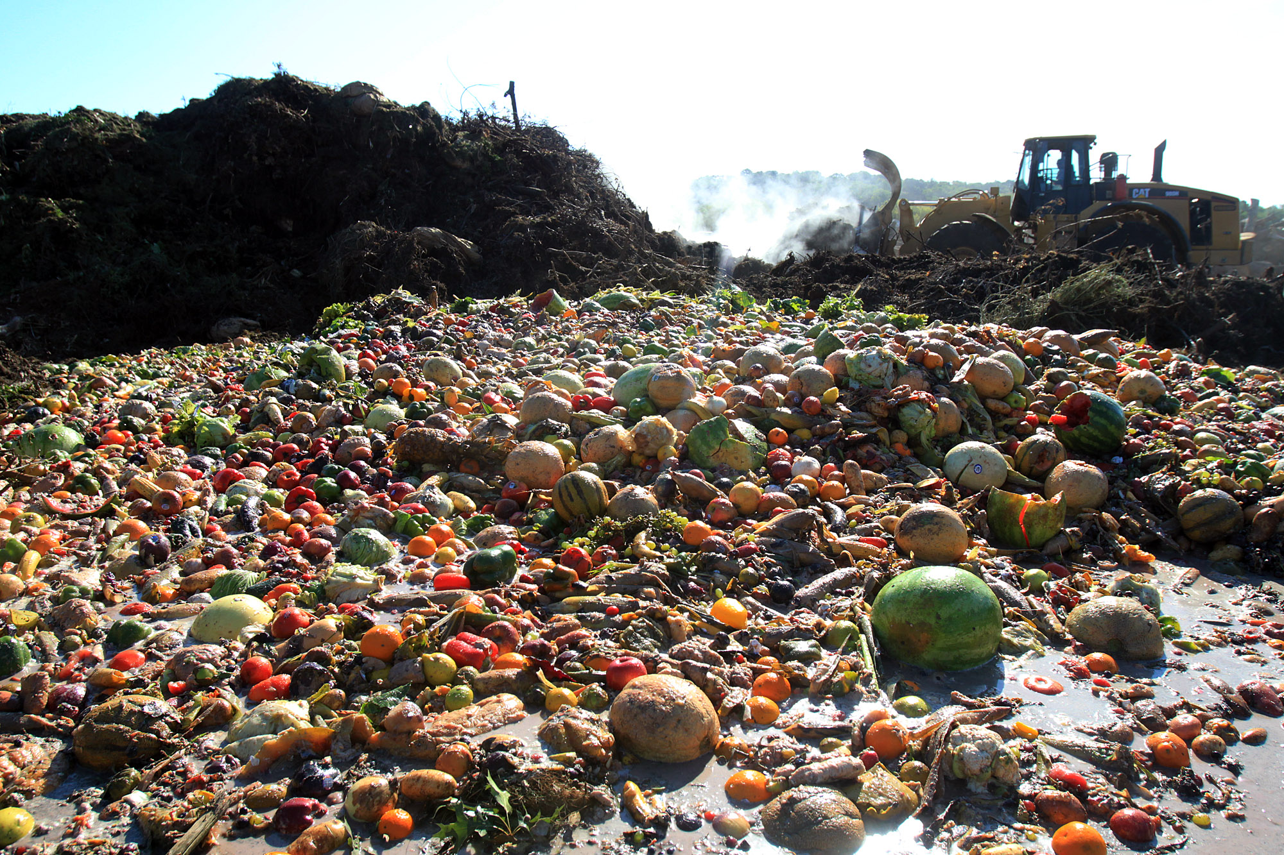
UN Environment Assembly
Resolutions
2/9. Prevention, reduction and reuse of food waste
Sustainable Development Goal 12, target 12.3
Champions 12.3
UN-wide coherence on food loss and waste
Capacity development and implementation support
Progress to date
12.3 Food Waste Indicator methodology being developed by UN Environment, UN Food and Agriculture Organization and other key global partners To be completed in early 2019
Regional capacity development and reporting tools being developed
Awareness raising at global events such as the High Level Political Forum, July 2019
Challenges
Additional resources required
Challenging for countries to invest in measurement

Slide 12
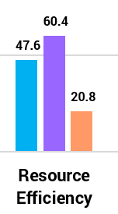
January - June 2018 Expenditure
Annual budget (2018): 47.6 m
Expenditure (June 2018): 20.8 m
Expenditure ratio: 44 %

Slide 13
Opportunities and Challenges
Opportunities
  Mainstream Resource efficiency, circular economy and sustainable consumption & production for system-wide transformation
  Cleaner Planet needs sustainable lifestyles and consumption
  High level engagement with G7 and G20 Groups
  Sustainable consumption and production is part of the Theme of 4th session of UN Environment Assembly
Challenges
  Finance, leadership, technologies

Slide 14
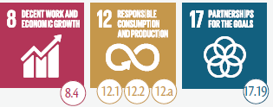
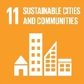
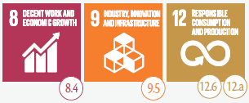
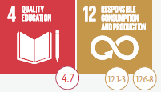
Increased energy, material and resource efficiency
Increased investment in sustainable economies
Lifestyles and Consumption are Sustainable
Inclusive Green Economy , Sustainable Trade, and Sustainable Consumption and Production policies and plans are implemented
Businesses invest in sustainable management practices and technologies
Sustainable lifestyles and consumptions patters are increasingly adopted
Stable economic conditions conducive to Sustainable Development
Regions, Countries and Cities adopt and implement Green Economy Pathways
Business adopt and implement sustainable management practices
Countries, Businesses and Individuals adopt sustainable consumption patterns and lifestyles
Sustainable Consumption and Production integral and integrative component of Sustainable Development Agenda
Continued support for UNEP Medium Term Strategy & Resource Efficiency Programme of Work
Strong agency capacity
Increased investments in green technologies
Clear UN Environment mandate on Sustainable Consumption and Production and Inclusive Green Economy
Public & Private sector commitment to implement Sustainable Development Agenda
Scientific Assessments
Tools, methods, standards
Outreach, awareness raising and information campaigns
Delivery platforms including effective regional outreach
Economic, trade and fiscal policy research, analysis and methodologies
Platforms for finance sector engagement
Sustainable Lifestyles Curricula and Massive Open Online Courses
Multi-stakeholder partnerships and platforms
Capacity Development
Capacity Development
Capacity Development and policy support
Support to green technology finance and investment
Research, methods, tools, polices and standards
Key
Intermediate States
Expected Accomplishments
Drivers
= Linkages
2030 Impacts
Key Deliverables
Assumptions

Slide 15
2020 - 2021 Programme of Work
Greater alignment to Sustainable Development Goal Indicators
Rationalization of some indicators under expected accomplishment b) from 5 indicators to 2
  One indicator on sustainable finance
  One indicator capturing adoption of sustainable business practices across other sectors
Strategy updated to make it more focused on green finance and economy, sustainable cities and sustainable lifestyles
Greater integration of the different resource efficiency agendas

Slide 16
Contact Us
Programme Lead Director
Ms. Ligia Noronha
Director, Economy Division
UN Environment Programme Nairobi
Email: ligia.noronha@un.org
Programme Coordinator
Mr. Dirk Wagener
Economy Division
UN Environment Programme
Nairobi
Email: dirk.wagener@un.org
Notes:
Here are our contact details. In case you have questions beyond our discussion today, please feel free to contact us any time. We always appreciate the opportunity for further engagement.

