Slide 1
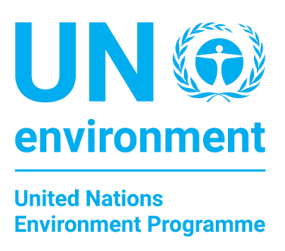


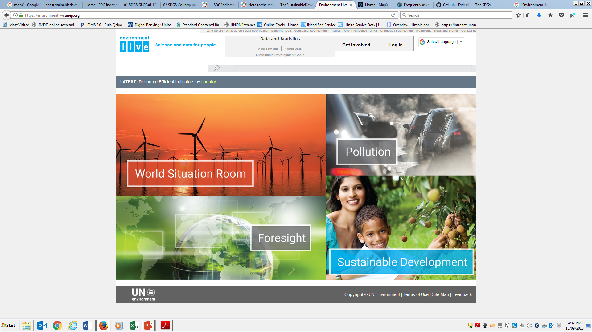

Environment under Review
Programme Performance Review
January – June 2018
Notes:
1

Slide 2
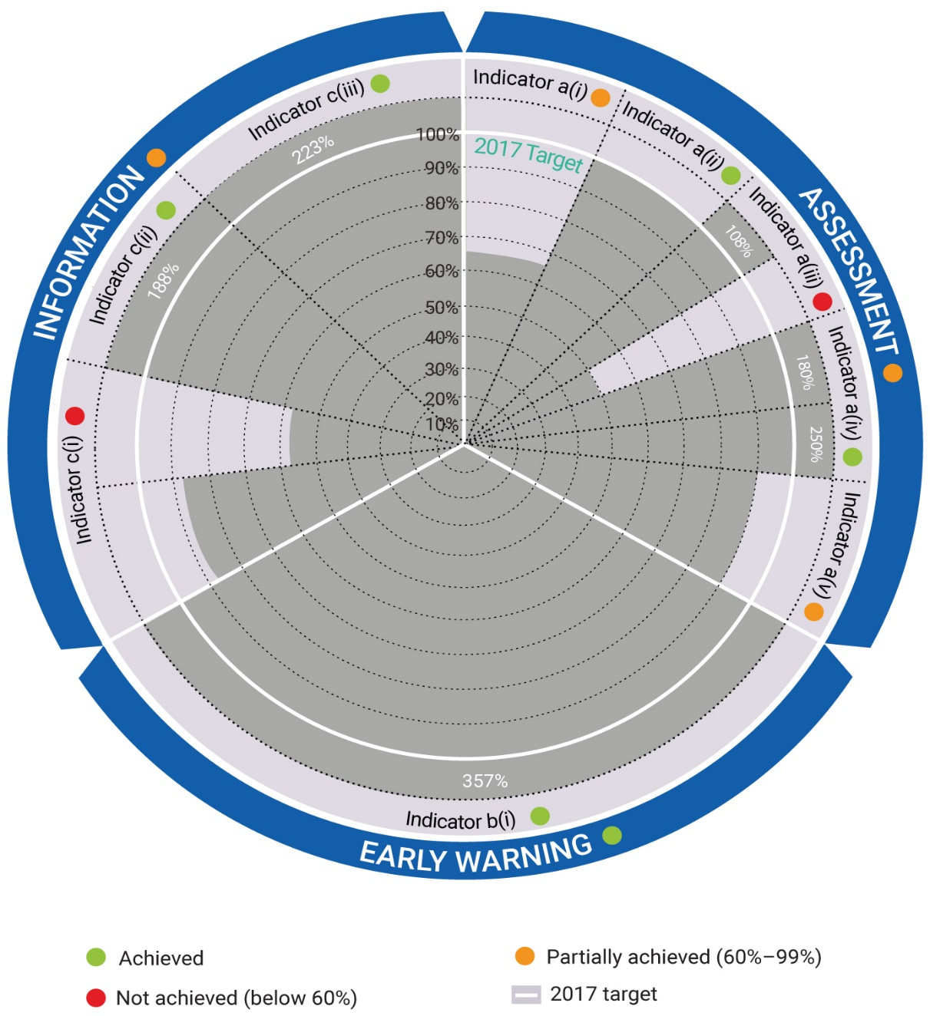
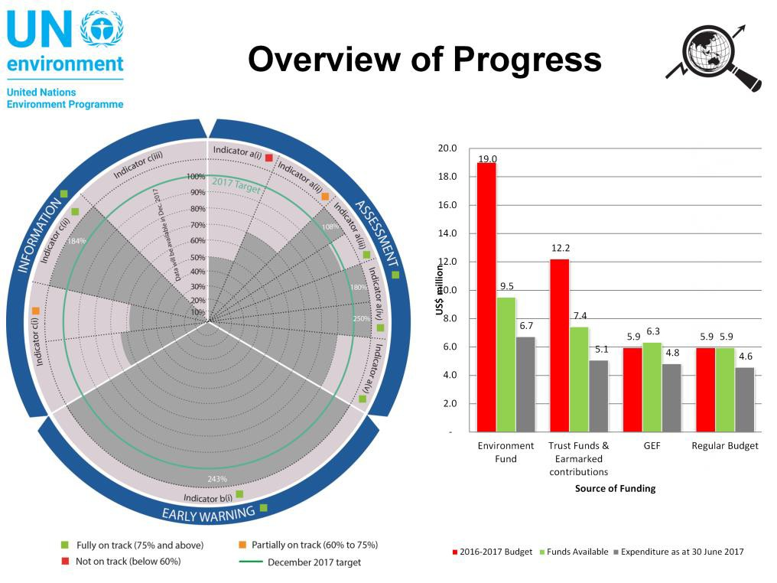
2016 - 2017 Progress towards achieving the Expected Accomplishments
2

Slide 3
Institutionalizing evidence-based policymaking
Governments and other stakeholders are empowered with
assessments and data and information to deliver the environmental dimension
of sustainable development
i
ii
iii
Number of SDG indicators for which UN Environment is Custodian Agency, for which UN Environment reports data to the Global SDG Database
Number of countries reporting on the environmental dimension of SDGs through shared environmental information systems with country-level data made discoverable through UNEP
Strengthening of the science-policy interface by countries based on the use of data, information and policy analysis
Number of indicators to measure the environmental dimension of sustainable development made through UNEP Live that are disaggregated by vulnerable groups, especially by gender, geography and age
Number of relevant global, regional and national forums and institutions using data on environmental trends identified through UNEP for environmental assessment, early warning on emerging issues and/or facilitation of policy action
Accessibility and ease of use of UNEP environmental information through open platforms measured against internationally recognized standards for open access to information
iv
v
vi
Notes:
Moving forward, we have an overarching objective towards institutionalizing evidence-based policymaking

Slide 4




Progress January – June 2018:
The development of SDG methods and capacity development
UN Environment data reporting for SDG Global Database and the yearly progress report on SDGs:
2016: Data reported for 7 indicators
8.4.1, 8.4.2, 12.2.1, 12.2.2, 14.5.1, 15.1.2, 15.4.1
2017: Data reported for 8 indicators
8.4.1, 8.4.2, 12.2.1, 12.2.2, 12.4.1, 14.5.1, 15.1.2, 15.4.1
2018: Data reported for 12 indicators
6.3.2, 6.5.1, 6.6.1, 8.4.1, 8.4.2, 12.1.1, 12.2.1, 12.2.2, 12.4.1, 14.5.1, 15.1.2, 15.4.1
i
SDGs Method Development
In 2018, 6.3.2 and 6.6.1 were reclassified from Tier III to Tier II
Goal 6 statistical methodologies developed and piloted in countries in partnership with UN-Water, the National Aeronautics and Space Administration, the European Space Agency, the EU Joint Research Centre and Google

Slide 5

Progress January – June 2018:
Reporting on environmental dimension of SDGs
UN Environment works closely with countries to increase their capacity on data collection for the SDG Indicators
ii
Countries reporting on the environmental dimension of SDGs
In 2017- 2018 countries are increasingly reporting on SDG data and is reflected in the SDG Index and Dashboards Report*
*http://www.sdgindex.org/assets/files/2018/02%20SDGS%20Country%20profiles%20edition%20WEB%20V3%20180718.pdf

Slide 6
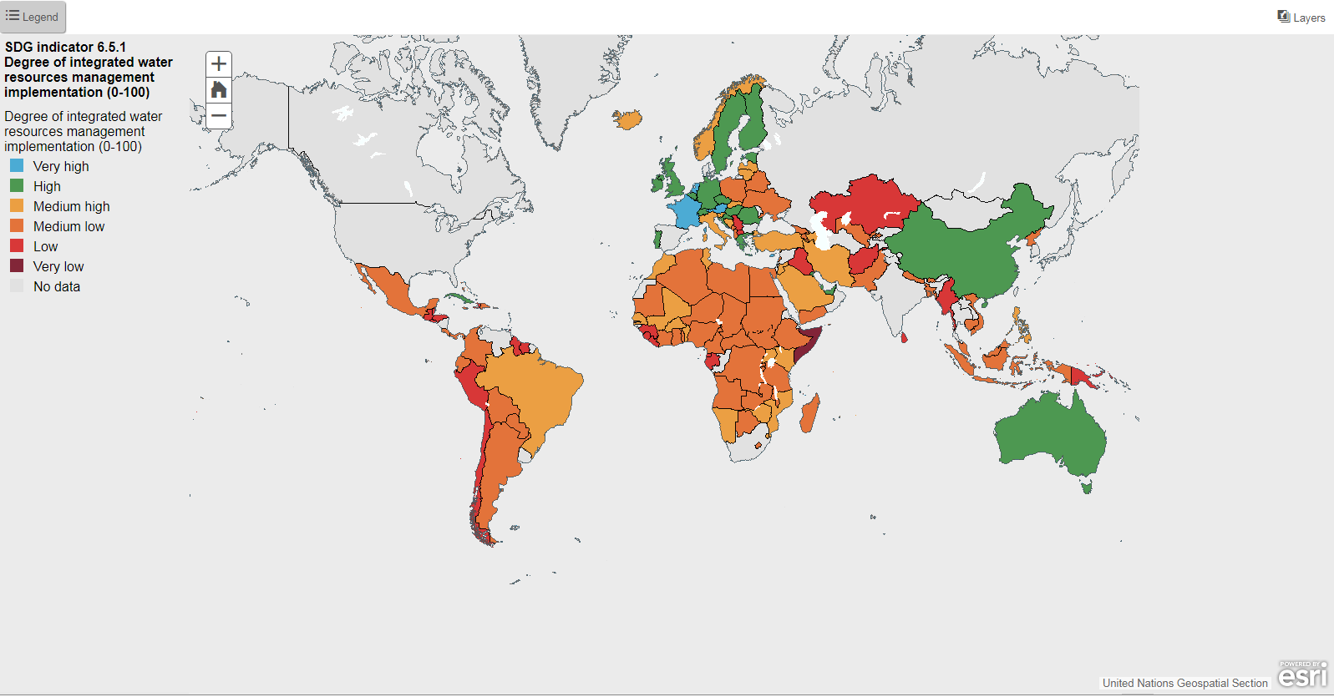
Progress January – June 2018:
Visual: Reporting on environmental dimension of SDGs
SDG Indicator 6.6.1 Degree of integrated water resource management implementation
*http://www.sdgindex.org/assets/files/2018/02%20SDGS%20Country%20profiles%20edition%20WEB%20V3%20180718.pdf

Slide 7
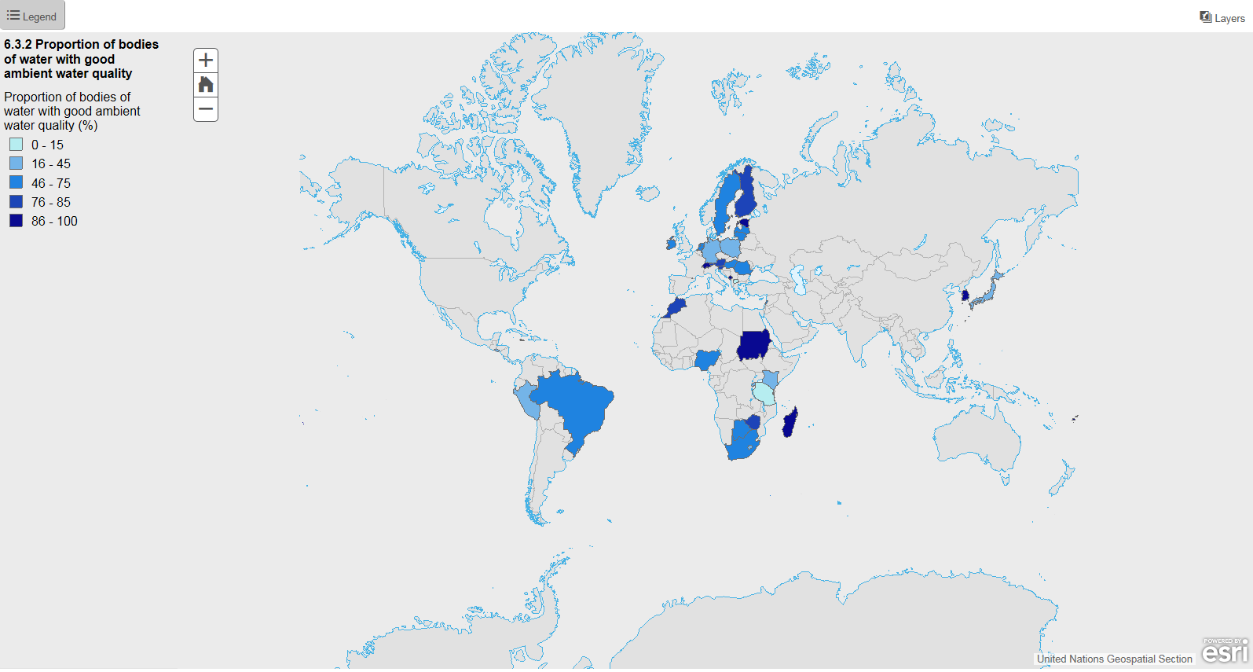
Progress January – June 2018:
Visual: Reporting on environmental dimension of SDGs
SDG Indicator 6.3.2 Proportion of bodies of water with good ambient water quality
*http://www.sdgindex.org/assets/files/2018/02%20SDGS%20Country%20profiles%20edition%20WEB%20V3%20180718.pdf

Slide 8
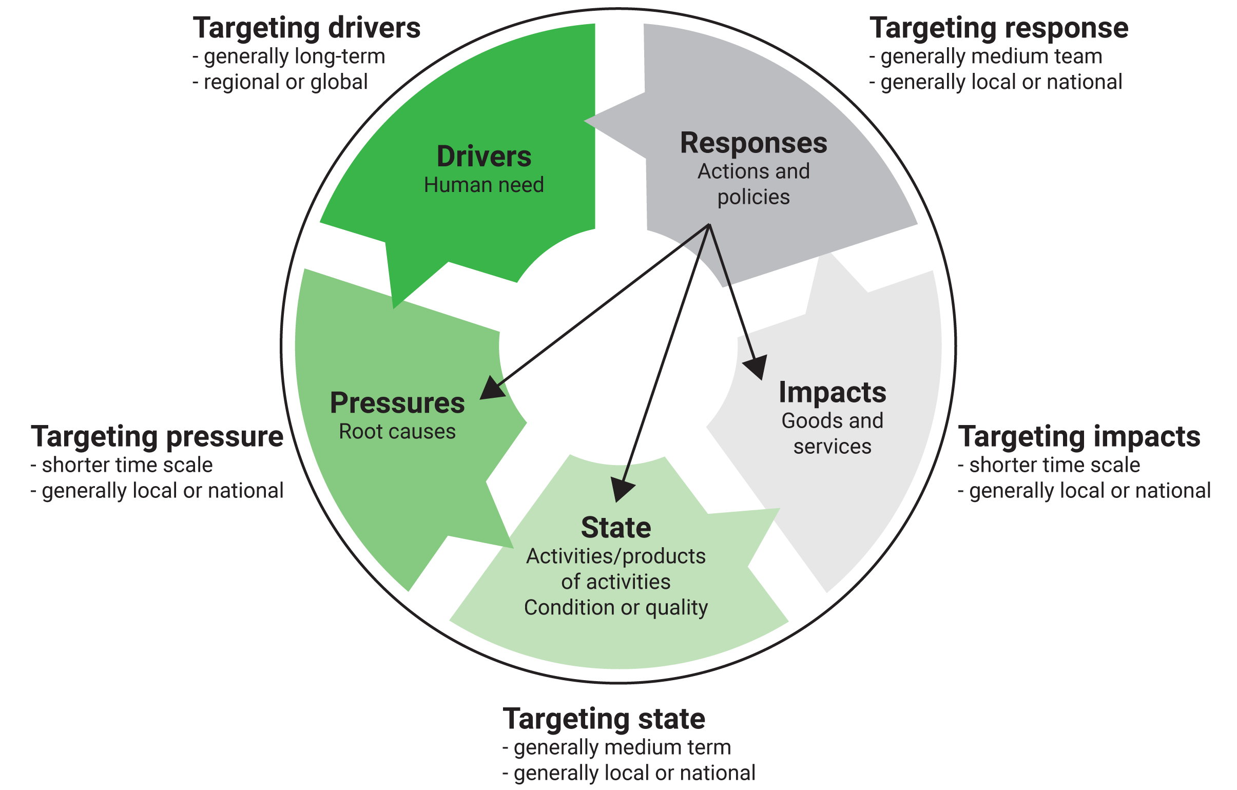






Progress January – June 2018:
Evidence-based policymaking
Evidence-based policymaking informed by robust data and assessments fully integrates the environmental dimension of SDGs, resulting in innovative ways to adhere to the planets’ ecological limits.
iii
Strengthening of the science-policy interface
The UN Science-Policy-Business Forum on the Environment is a showcase for vetted ‘green solutions’ that are, driven by advances in science and technology, which is an incubator of great ideas and initiatives and an accelerator of action towards a more sustainable future through a set of high-powered annual events and consultations, 100% Self-financed
Climate
Renewables
SDSs

Slide 9
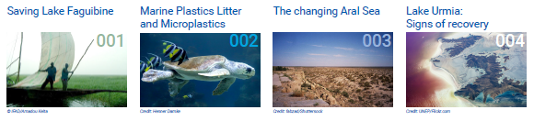
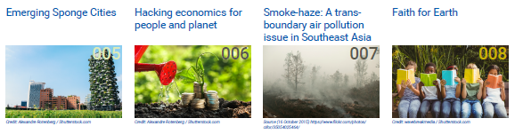
Progress January – June 2018:
Evidence-based policymaking
FORESIGHT: Strengthening of the science-policy interface by countries based on the use of data, information and policy analysis.
The UN Environment Foresight Briefs are published by UN Environment to, among others, highlight a hotspot of environmental change, feature an emerging science topic, or discuss a contemporary environmental issue. The public is thus provided with the opportunity to find out what is happening to their changing environment and the consequences of everyday choices, and to think about future directions for policy. Nine briefs have been produced so far.
Notes:
Environmental policies at the global, regional and country levels depend on the timely and reliable availability of useful and integrated geospatial, earth observation and remote sensing, real-time satellite imagery data, information and knowledge. However, the availability of data is not sufficient. Big Data supports Environmental Foresight for analysis of data, mapping trends, creating scenarios and identifying emerging issues on a permanent basis, at the frontier of Environmental knowledge. Foresight provides a systemic process, to highlight a hotspot of environmental change, to feature an emerging science topic or provide early warning for identifying the future environmental trends.

Slide 10
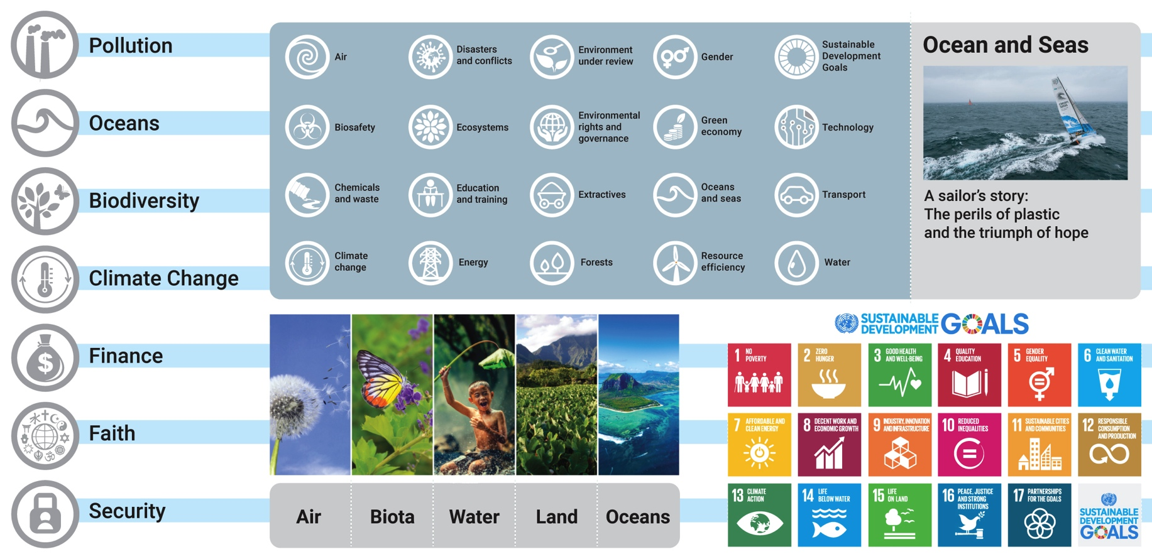
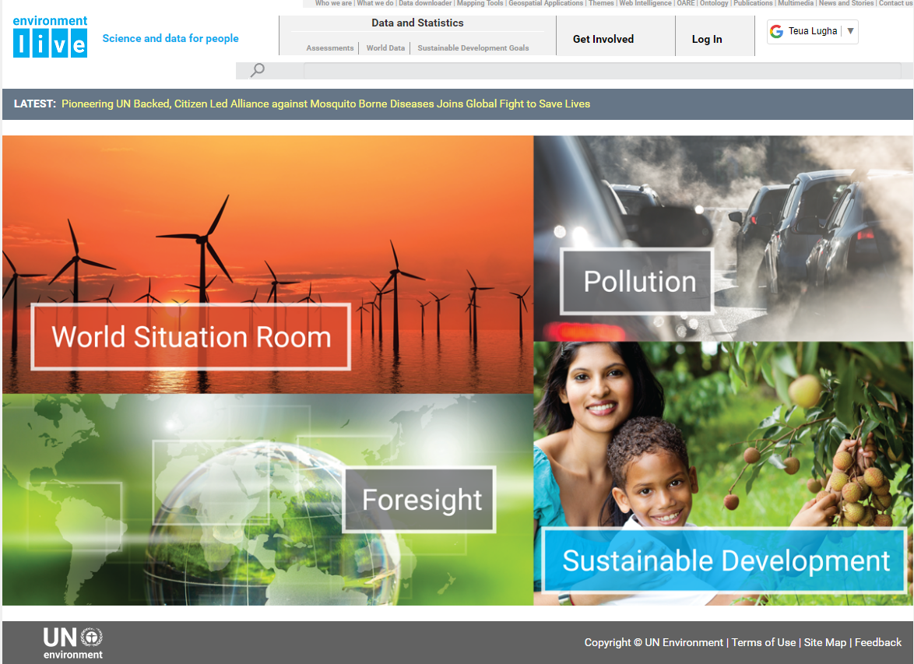
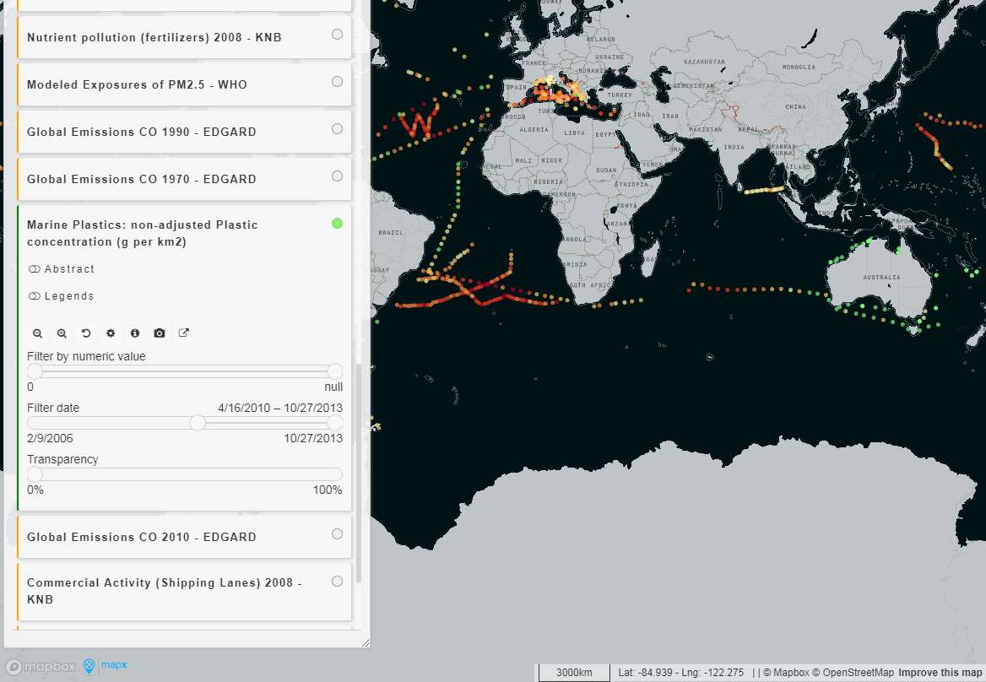
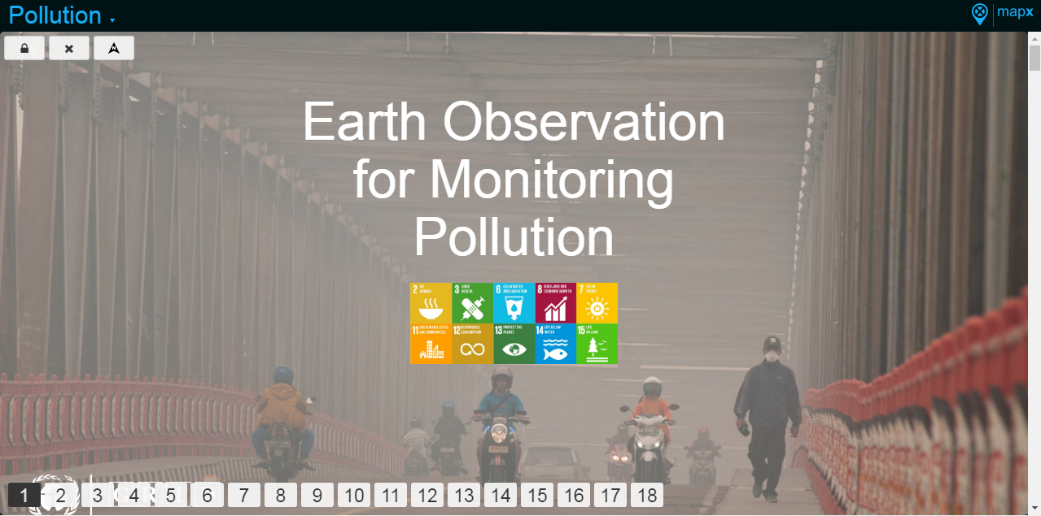
Progress January – June 2018:
Big Data on the Environment Initiative
Environment Live and link to SDG indicators and Global Monitoring
IV
Sustainable Consumption and Production
Number of indicators to measure the environmental dimension of sustainable development made through Environment Live
Pollution
World Environment Situation Room
Interactive platform to monitor and share live data on number of issues through:
  Pollution, …
  Foresight
  SDG mapping
  Global Environmental Monitoring

Slide 11
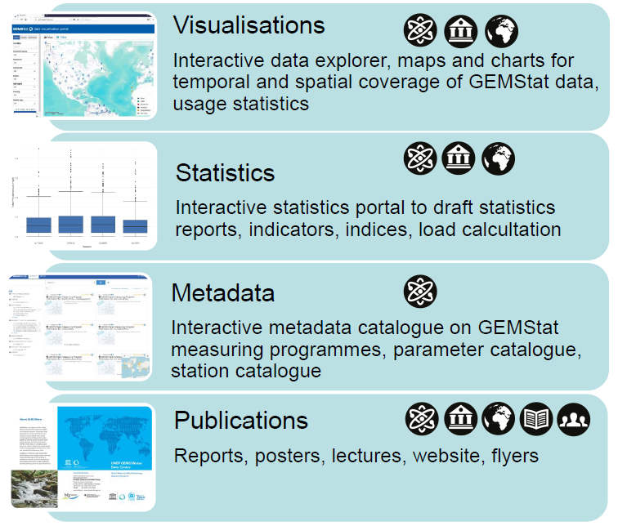

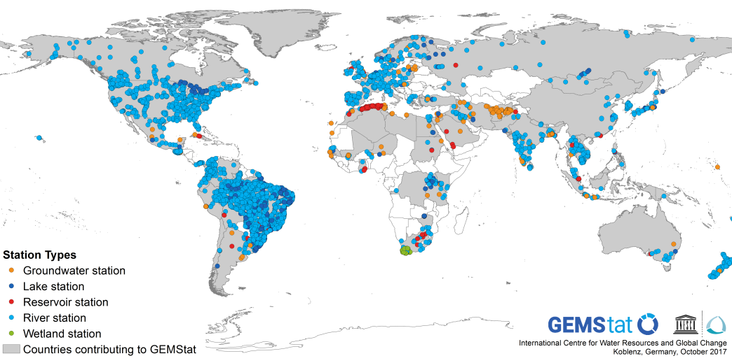
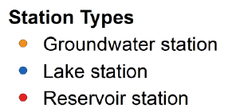
Progress January – June 2018:
Global Environmental Monitoring
Over 4600 stations
(>4 million samples) in 75 countries with the longest time series since 1965.

Slide 12
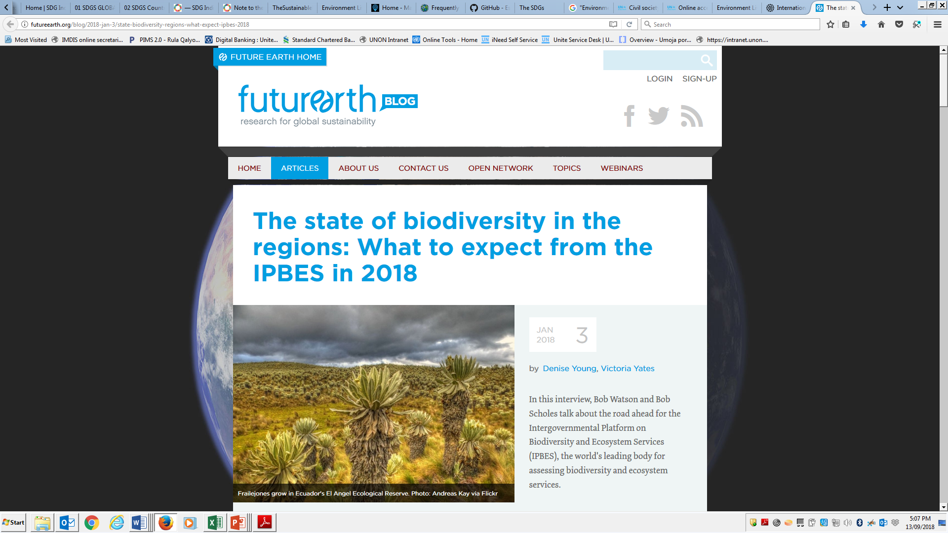
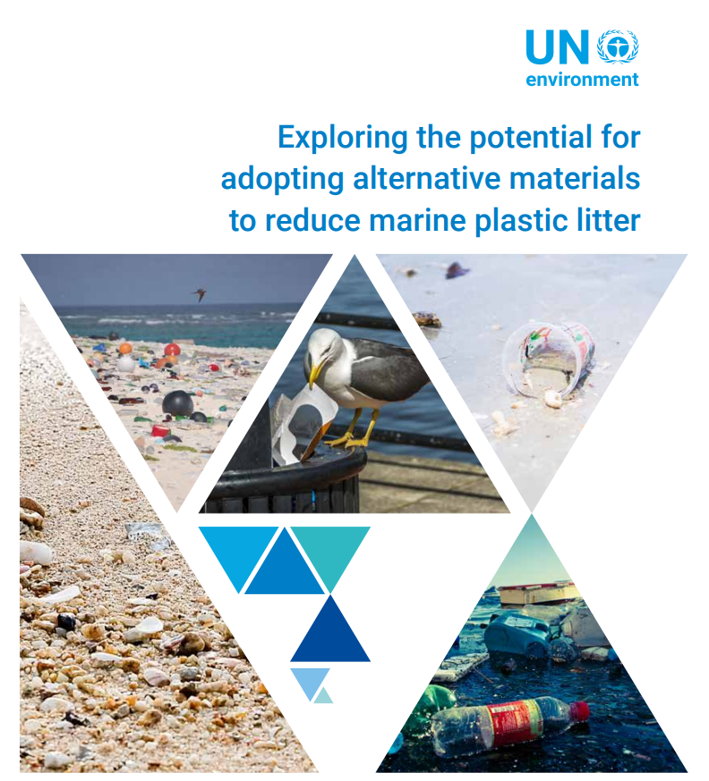


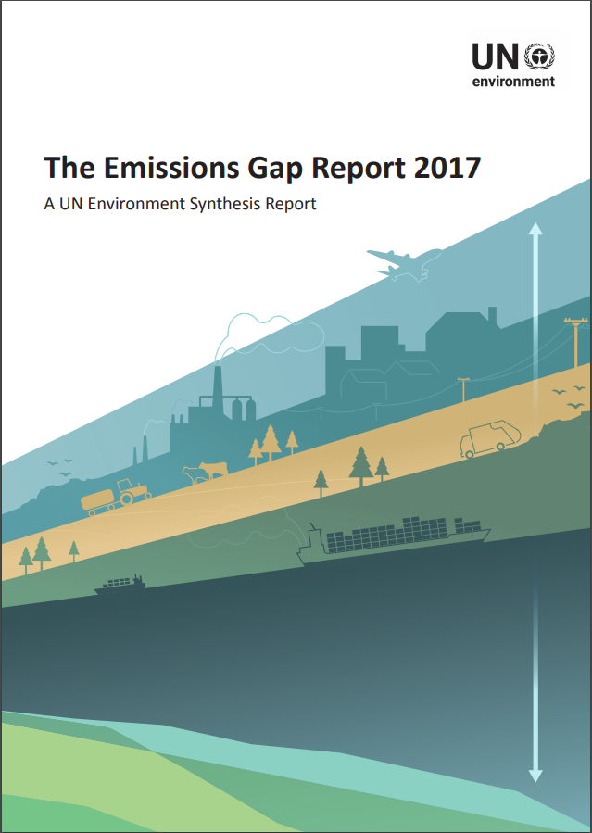
Progress January – June 2018:
On the utilization and access of our reports and environmental trends data
v
Number of relevant global, regional and national forums and institutions using data on environmental trends
iv
Accessibility and ease of use of UNEP environmental information

Slide 13
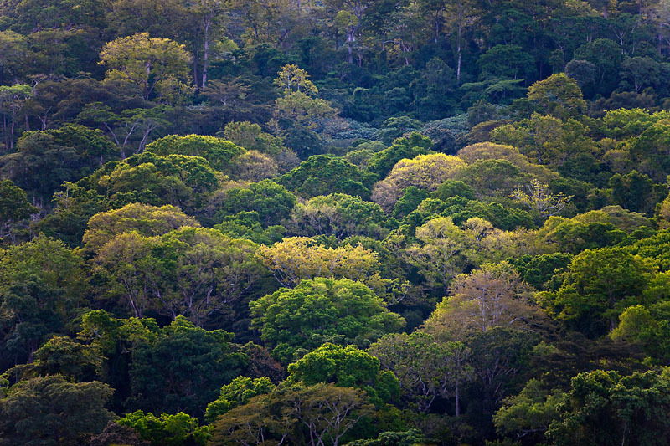






GEF/GCF Climate Information & Capacity Development Portfolio
  Building national capacities for environmental information management and use
  Strengthening national environmental monitoring, assessments, reporting and actionable information products for decision-making and policy action
  Supporting evidence-based integrated national planning for environment and sustainable development
  Piloting innovative approaches to evidence-based environmental management
  Enhancing climate information and knowledge services for resilience
  Regional and sub-regional networking on environmental and climate information for policy making
12 Projects in 61 Countries
1 Global project (Capacity building for national and regional environmental information): > 40 Countries
1 Regional project (GEF): 14 Countries
10 Individual GEF Country projects
Portfolio Overview
GEF Cross cutting capacity dev portfolio
$ 36M Total funding;
$ 15M GEF Grants
Capacity building for national and regional environmental information
Targeting > 40 Countries
$ 9M Extrabudgetary funding (2018)
GCF portfolio
Division recently designated GCF portfolio manager
18 Readiness projects underway
Climate Information pipeline

Slide 14

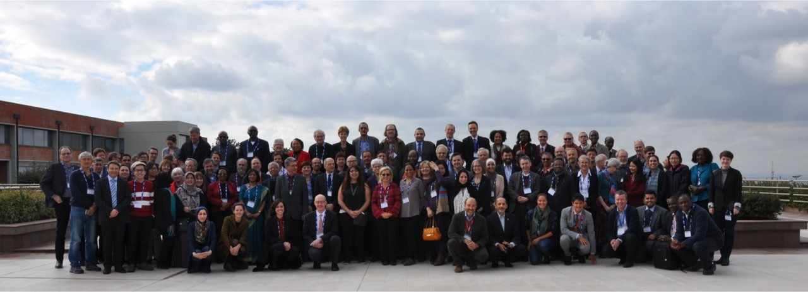
UN Environment Assembly Resolutions
3/L.2. Extension of the delivery date of the Sixth Global Environment Outlook report
Importance of delivering a high-quality sixth Global Environment Outlook report and its accompanying summary for policymakers as a key tool to strengthen the science-policy interface.
Assist member States in implementing the environmental dimension of the Sustainable Development Goals and other internationally agreed environmental goals, to inform decision-making
Progress to date
On track for delivery at UNEA-4
Technical peer review
Inter-governmental review
Authors meetings to review the second and third order drafts
Challenges
Insufficient human resources
Unpredictable financial resources

Slide 15
UN Environment Assembly Resolutions
Progress to date
Statistical methodologies up to international standard and reclassification of SDG indicators from Tier III to Tier II
Guidance documents for data collection on SDG indicator methodologies
Analytical input into the Secretary General’s the Secretary General’s SDG Progress Report
Promotion of geospatial statistics and big data sources for monitoring of the Sustainable Development Goals workshops conducted in 5 UN regions
3/L.7. Contribution of UNEA to High-Level Political Forum on Sustainable Development
United Nations Environment Programme as the leading global environmental authority that sets the global environmental agenda, promotes the coherent implementation of the environmental dimension of sustainable development within the United Nations system and that serves as an authoritative advocate for the global environment.
Challenges
Financial challenges jeopardize ensuring continuity of activities and continuity of project staff

Slide 16
Challenges
Funding gaps and delays affecting programme implementation and performance.
Access to environmental knowledge and data required linking Science to Policy opportunities.
Consolidation of UN Environment as the online hub for open access to environmental data and knowledge.
Improved project design arrangements, emphasizing rigor and quality of the project design.

Slide 17
Opportunities
Strong mandates from UNEA-3 to work towards deliver of GEO-6 and contribution to the High-Level Political Forum on Sustainable Development.
Structured process to track the impacts of providing data, information and change in the environment.
Delivering as one through increased collaboration with key partners, including divisions, regional offices, implementing partners and governments.

Slide 18
2018 - 2019 Planned Budget
Summary of source funds (January to June 2018)
2018-2019 Environment under Review
Fund Type | 2018 Budget | Available Resources as at 30 June 2018 | Expenditure as at 30 June 2018
Environment Fund | 9.5 | 7.2 | 2.5
Trust Funds & Earmarked contributions | 7.1 | 6.6 | 1.8
GEF | 1.2 | 5.6 | 1.1
Regular Budget | 3.8 | 3.8 | 1.7
 | 21.6 | 23.2 | 7.1
*Includes allocations of US$0.5m

Slide 19

Questions & Discussion
Programme Ag. Lead Director
Mr. Jian Liu
Science Division
UN Environment Programme Nairobi
jian.liu@un.org
Programme Coordinator
Ms. Rula Qalyoubi
Science Division
UN Environment Programme Nairobi
rula.qalyoubi@un.org

