Slide 1
GMP background under the Stockholm Convention
Katarina Magulova
Secretariat of the Basel, Rotterdam and Stockholm Conventions

Slide 2
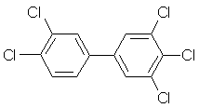
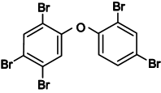

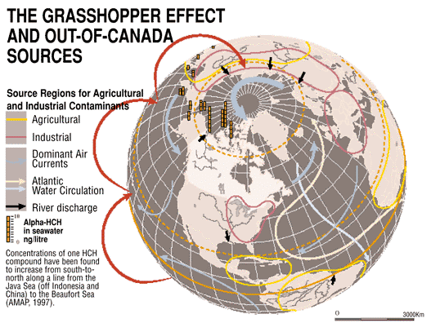
POPs/PTS properties
remain intact in the environment for a long time;
accumulate in living organisms;
become widely distributed throughout the environment; and
are toxic to humans and wildlife.

Slide 3
Bioaugmentation
Humans
???
Big Fish
5 x
Small Fish
8 x
Zooplankton
5 x
Phytoplankton
12 500 x
Environment
Bioaccumulation:
Increase in concentration of a pollutant from the environment to the first organism in the food chain
Biomagnification:
Increase in concentration from
one link in a food chain to another.
4.83 mg/kg
1.04 mg/kg
0.123 mg/kg
0.025 mg/kg
Enrichment factor
Courtesy of Dr. Heiko Patzelt. Data represent PCB concentration values in the Great Lakes (Great Lakes Environmental Atlas and Resource Book, Third Edition, USEPA 1995
2 ng/kg (2ppb), really only a trace

Slide 4
Stockholm Convention
Legally binding instrument to protect human health and the environment from persistent organic pollutants
Adopted in 2001, entered into force in 2004: 182 Parties
Covers POPs -15 pesticides and 13 industrial chemicals and by-products:
  Prohibition and/or elimination of the production and use, and the import and export of intentionally produced POPs listed in Annex A
  Restriction of the production and use, and the import and export of intentionally produced POPs listed in Annex B
  Reduction or elimination of unintentional releases of the POPs listed in Annex C

Slide 5
Mandate
ARTICLE 16 on Effectiveness Evaluation:
In order to facilitate such evaluation, the Conference of the Parties shall, at its first meeting, initiate the establishment of arrangements to provide itself with comparable monitoring data on the presence of the chemicals listed in Annexes A, B and C as well as their regional and global environmental transport.
These arrangements:
(a) Should be implemented by the Parties on a regional basis when appropriate, in accordance with their technical and financial capabilities, using existing monitoring programmes and mechanisms to the extent possible and promoting harmonization of approaches;
(b) May be supplemented where necessary, taking into account the differences between regions and their capabilities to implement monitoring activities; and
(c) Shall include reports to the Conference of the Parties on the results of the monitoring activities on a regional and global basis at intervals to be specified by the Conference of the Parties.

