Slide 1
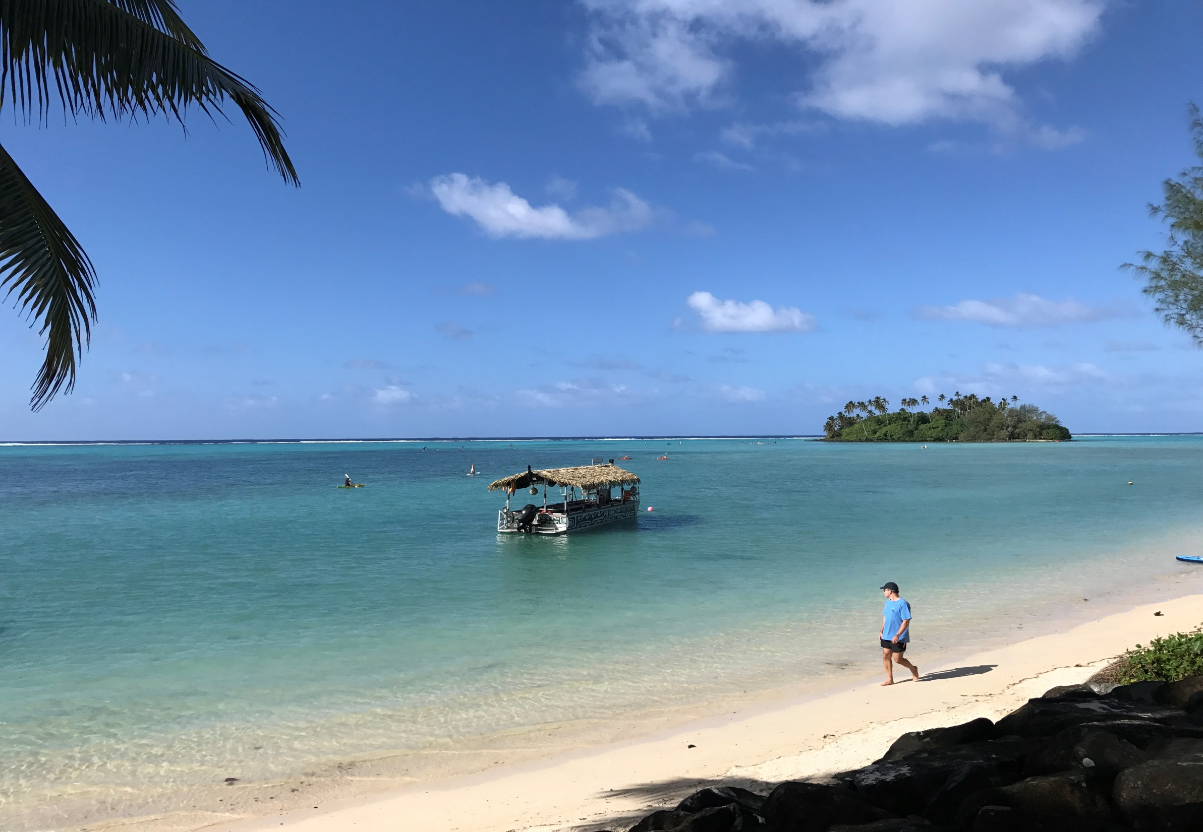
Sampling of matrices of national interest in the Pacific
Ike van der Veen, Rianne van Dijk, Jacob de Boer

Slide 2
Assignment of national samples, and analyses by the VU
Compounds | Countries | No. samples/country | Total No. samples
OCPs/PCBs | 9 | 6 | 54
PBDE/PBB/ HBCD screening | 9 | 5 | 45
Toxaphene | 9 | 0 | 0
HBCD isomers | 9 | 0 | 0

Slide 3
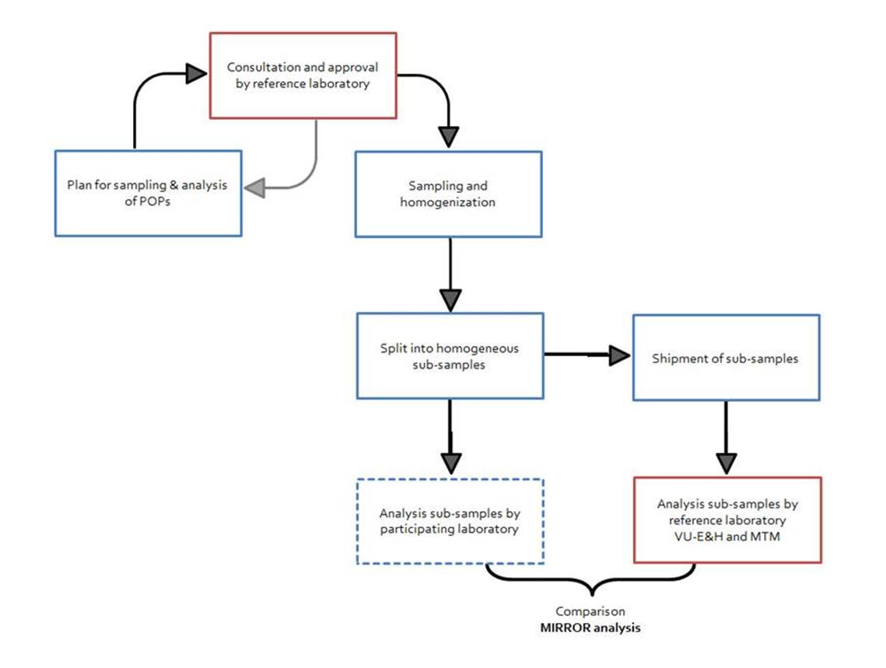
Scheme for Sampling and Analysis

Slide 4
Status
No samples received until now (!)
No sampling plans received

Slide 5
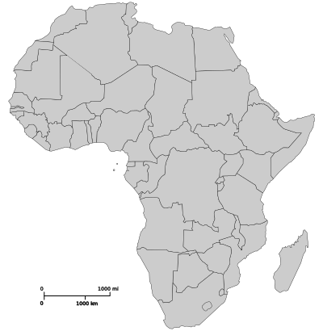
In Africa:….Samples received of……
Ghana: All samples received
Fish
Sediment
Soil
Tunisia
Tunesia: All samples received
Butter
Olive oil
Fish
Eggs
Senegal
Ghana
Ethiopia
Uganda
Uganda: All samples received
Honey
Sediment
Soil
Fish
Beef
Eggs
Chicken meat
Cow milk
Tomatoes
Banana
Some/ all samples received

Slide 6
Challenges with sending samples
Difficult to sent all kinds of samples to the Netherlands:
- We just received import permits biota and sediments
We had to pay import taxes for some samples:
- State that the samples are of No commercial value or less then 1 Euro

