Slide 1
GMP Pacific Midterm Workshop
The Institute of Applied Sciences
17-18 September 2018
Brisbane

Slide 2
The Institute of Applied Sciences
Analytical laboratory Services is one of the 6 Units
ISO17025 and IANZ accredited laboratory
Developed as one of the 6 regional reference laboratories for GMP POPs and the only one in the PIR
Service to local, regional and international clients/partners
Analyses related to environment, trade and health

Slide 3
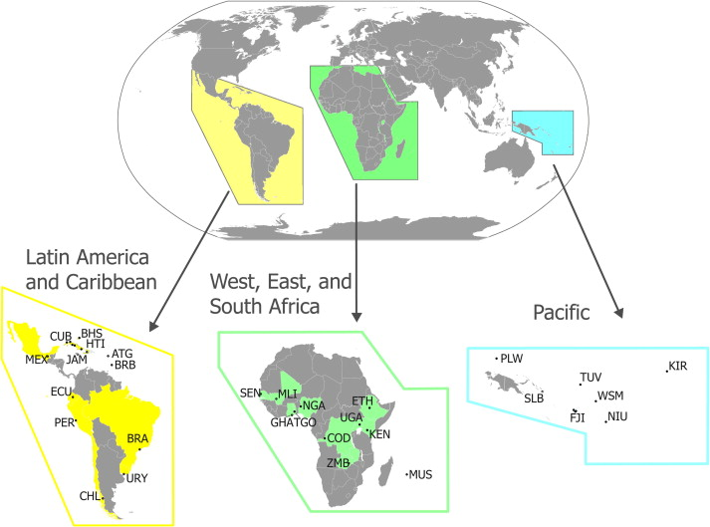

Slide 4
Overview of activities (GMP 2)
Air sampling (PUFs)
Surface water sampling
Human milk
National samples
Administration and logistical support

Slide 5
Facilities at IAS-USP
Dedicated technicians (sampling)
Transportation (4X4 vehicles)
Sampling gear (storage and retrieval)
Human resource (Admin and Scientific)
Equipment (1 X GC-µ ECD and POPs standards)
Regional laboratory for 12 member counties
USP has 14 campuses in the region (logistics)

Slide 6
Progress to-date
Air sampling (3rd sampling round – To be sent by September 2018)
Surface water sampling (2nd sampling round – To be sent by September 2018)
Human milk (awaiting ethical approval)
National samples (eggs, fish, water, sediment – by October 2018?)
Reporting (financial, workshops, photos)

Slide 7
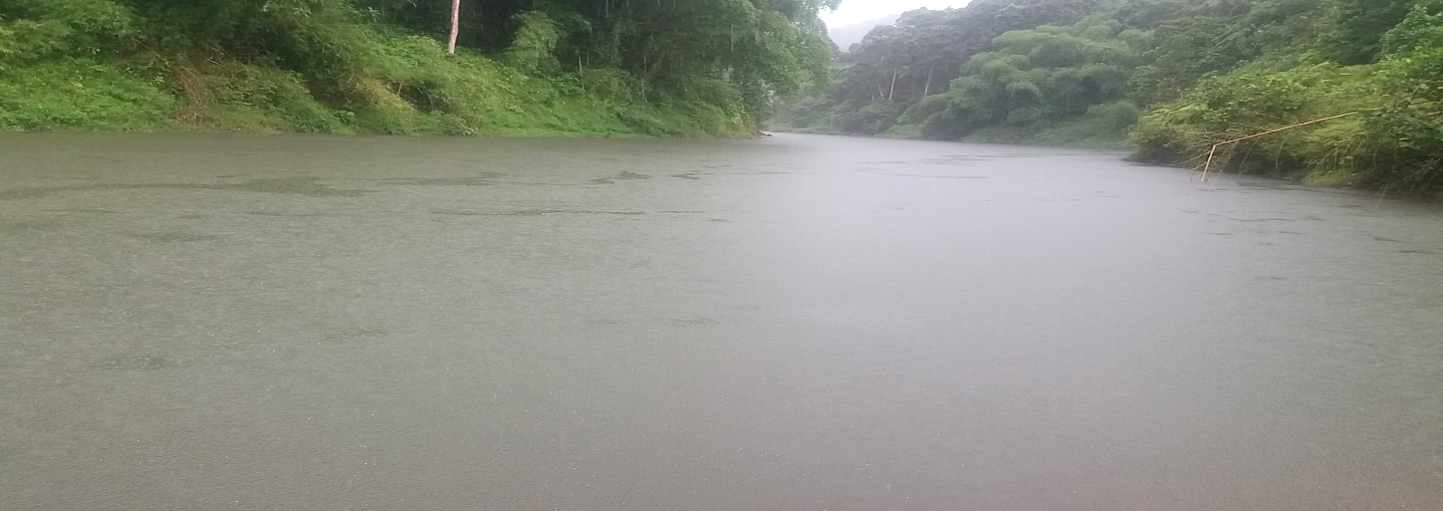
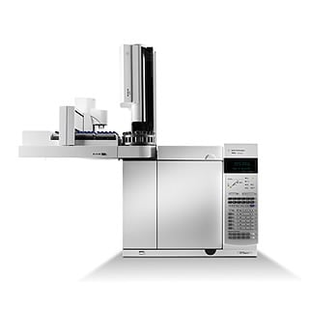
Surface water sampling site

Slide 8
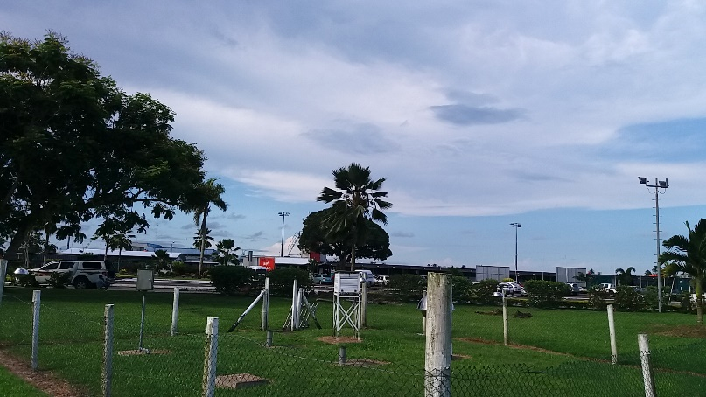
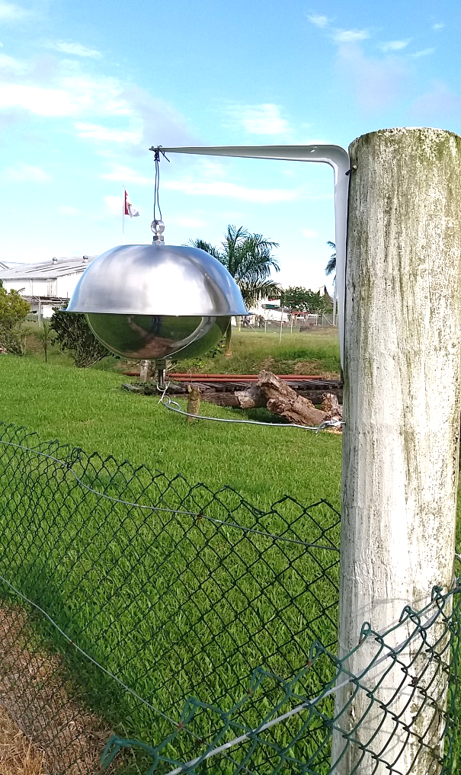
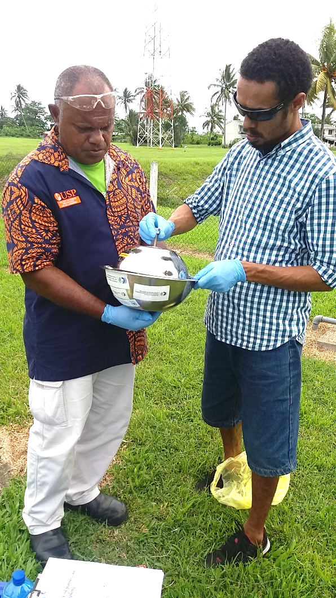
Air sampling site – Nausori met office

Slide 9
Challenges and solutions
Logistics (access to sites, transportation)
Approval process (ethical clearance)
Dedicated staff (sampling activities)
POPs analysis (training and standards)

Slide 10
Lessons learnt
GMP 1 vs GMP 2 (regional and individual)
Logistics (sampling, storage, transport)
Regional coordination (point of contact)

Slide 11
Benefits from GMP
Working towards baseline data
Increased awareness
National Policies
Enhanced Human capacity - Training and capacity building through projects implementation

Slide 12
Opportunities from GMP
Development of a training programme
Short technical courses for the region
USP – premier tertiary and vocational education provider in the Pacific

Slide 13
Considerations for sustainability
Training materials could be embedded in USP existing programmes or new programmes
Capacity building (train the trainer)
Support for a regional reference laboratory for testing legacy POPs (i.e. DDT, DDE, etc)

Slide 14
Vinaka

