Slide 1
POPs GMP in Kiribati
Teema Biko
Touakai Kambati

Slide 2
Overview of activities
POPs GMP is coordinated by Steering committee “POPs GMP steering committee” that function under National Chemical Coordinating Committee (NCCC)
The NCCC made of rep from government Ministries, government entities, private sectors and NGOs
POPs GMP Steering Com comprised of rep from Ministry of Fisheries, Health (Laboratory & Nutrition), MET office, Kiribati fish Limited and MELAD (ECD)
Project started in July 2017 after the funds and equipment received
Notes:
Basel - (Adopted: 22 March 1989; Entered into force: 5 May 1992)

Slide 3
Facilities available, including human resources, political support, logistics and laboratories
Infrastructure for chemical management, laboratory infrastructures in Kiribati are limited for health and education purposes
Environment testing laboratories are non-existent and health and educational laboratories do not have the capacity to carryout complex chemical analysis for environmental assessments
Existing cooperation programmes between Kiribati and regional countries have enable assistance in sharing laboratory facilities for chemical analysis i.e. POPs GMP for pops samples, MFAT water quality testing – NIWA for chemical test etc..
Technical expertise required to implement government policies and programmes related to chemical management is limited in Kiribati

Slide 4
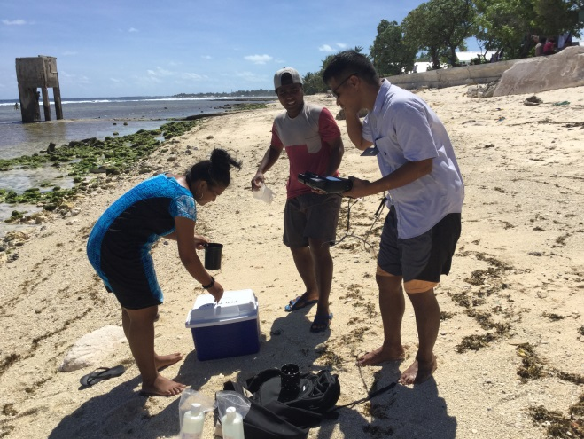
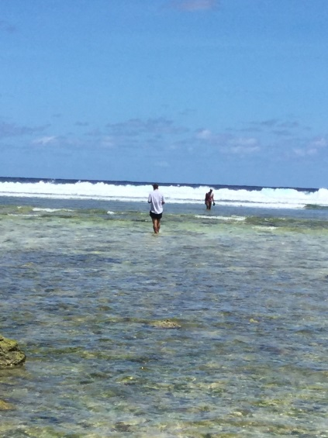
Progress until present
Water sampling
The June, Dec 2017 and Mar 2018 samples have been sent to expert lab
March, June 2018 continue – sample are stored in country
Notes:
Map – showing coverage of waigani and basel

Slide 5
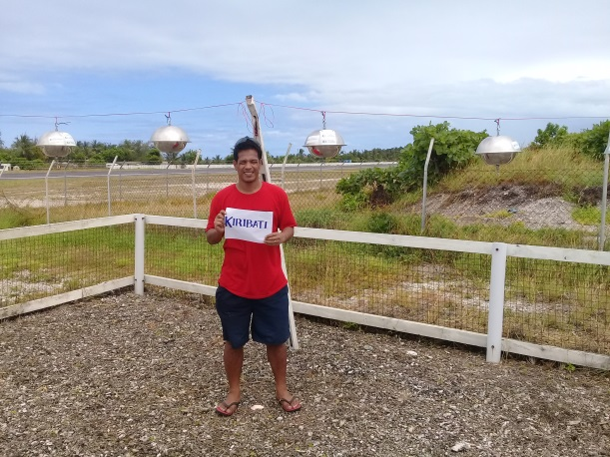
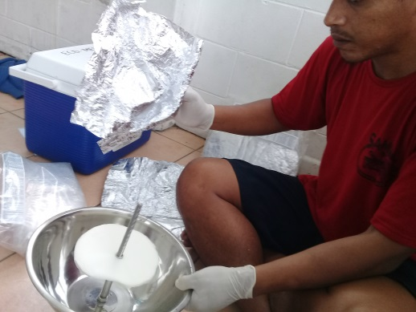
Cont..
Air sampling
The June, Sep, Dec sample for 2017 have been sent
The March and June 2018 have been retrieved
KIR-1 2017-III
KIR-3 2017-III
KIR-5 2017-III
KIR-9 2017-III
KIR-11 2017-III
KIR-1 2017-IV
KIR-3 2017-IV
KIR-5 2017-IV
KIR-9 2017-IV
KIR-11 2017-IV
KIR-1 2018-I
KIR-3 2018-I
KIR-5 2018-I
KIR-9 2018-I
KIR-11 2018-I
Notes:
Add more photos – waste covered

Slide 6
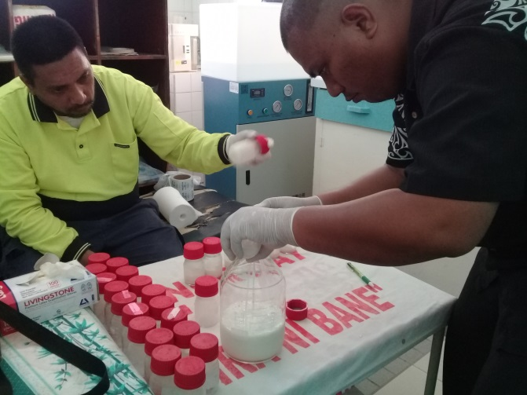
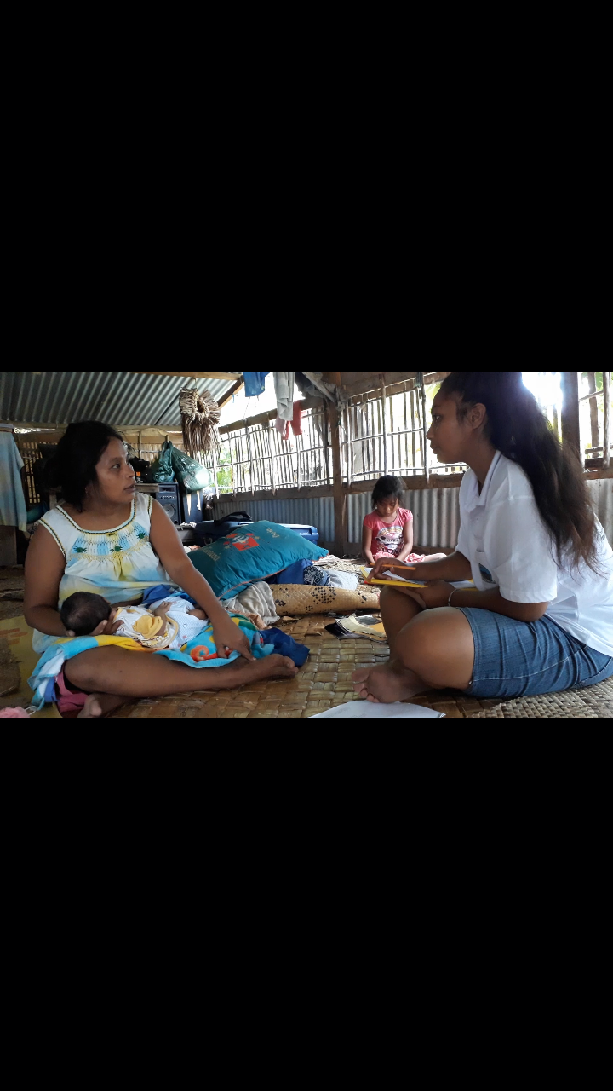
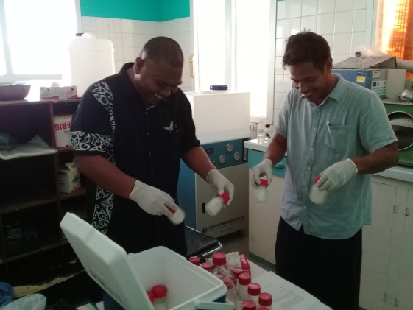
Cont..
Human milk sampling
MOU signed between MHMS and MELAD (ECD)
Engaged USP Science Students in the sampling
Student were trained and assist with translation of consent form
27 break milk sample collected (Oct 2017)
Samples send in June 2017 to expert lab

Slide 7
Cont…
National interest samples
The target food sample was approved by NCCC
The target food include:
Big eye fish
Canned Fish
Barracuda
Flying fish
The sampling will be conducted this year, 2018

Slide 8
Challenges of implementation and possible solutions
National level
Limited staff – progress related to availability of staff – assign a project officer.
Limited technical knowledge – i.e. preparing of food samples
Conveying information to cabinet – data available is regional but cabinet require individual result – training in analyzing data
Delay in funds and equipment– progress related to availability of fund
Regional level
Absence of a regional laboratory to analysis POPs samples for the pacific region.
Some of the pacific countries are not involved in the first GMP monitoring, and some are still haven’t conduct any monitoring hence the data for the region is not adequate to evaluate the trend for the pacific region

Slide 9
How do the GMP project's outcomes benefit your country?
Date generation
Strengthening national technical capacity in term of sampling protocol etc
Raise awareness on POPs chemicals (NCCC and donor mothers etc)
Link Kiribati (technical staff) with expert and international laboratory

Slide 10
Any opportunities, collaborations and networks that the GMP project contributed or will contribute to;
National level
Participating of the Kiribati Fish Limited to help prepare food samples to a good standard
Ministry of Health laboratory – the representative has been very helpful in preparing human milk pool sample and the proper packaging of samples.
Ministry of Fisheries – by providing general name and common name of fish that will be sampled
Ministry of Health- Environmental health department by providing water quality test meter.
Human milk sampling cannot be carried without involving Public health and Nutrition department. They have assisted in identifying donor mothers and the same time explain to the mothers the importance of breast feedings so that project does not contradict their message in promoting breast feeding.

Slide 11
Conti..
Regional level
Connecting Kiribati with expert lab and experts
Opportunities: The participation and the capacity of University of the South Pacific Institute of Applied Science need to be able to test and analysis POPs samples for the pacific region after the project.

Slide 12
Sustainability in monitoring and future expectations.
POPs monitoring would continue when the decision makers and public can relate their daily activities with the data that comes out from the project

Slide 13
Kam rabwa

