Slide 1


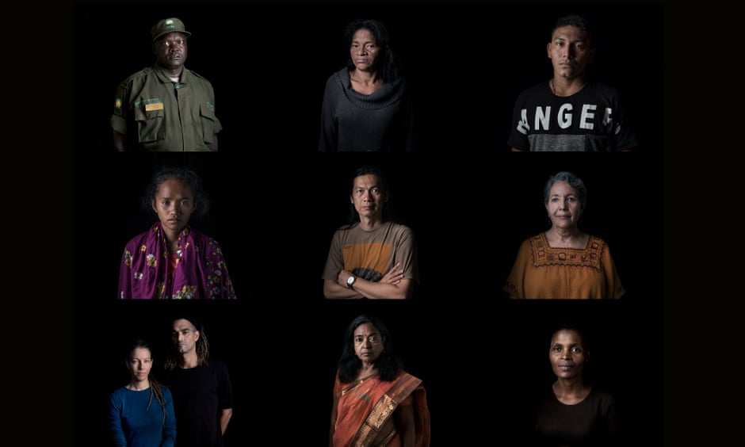
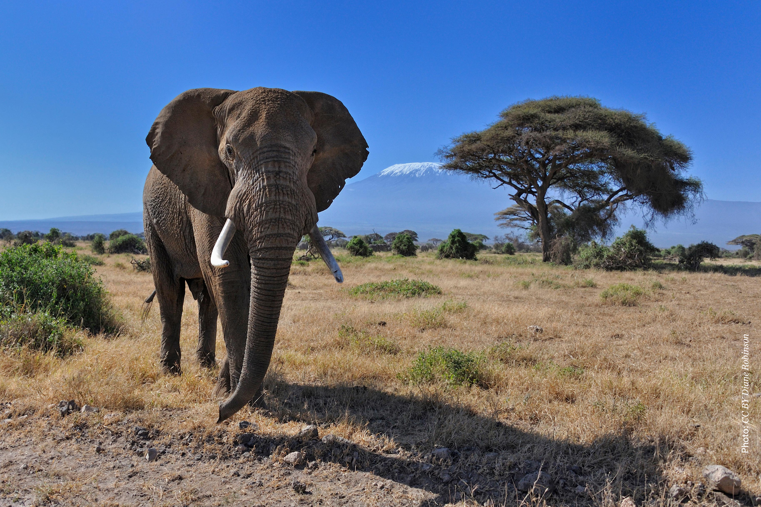
Environmental Governance
Programme Performance Report
Programme of Work 2020-21
5th Annual Subcommittee Meeting, 24 Oct 2018

Slide 2
Medium Term Strategy
Medium Term Strategy 2018-2021
Programme of work
2018-2019
Programme of work
2020-2021

Slide 3
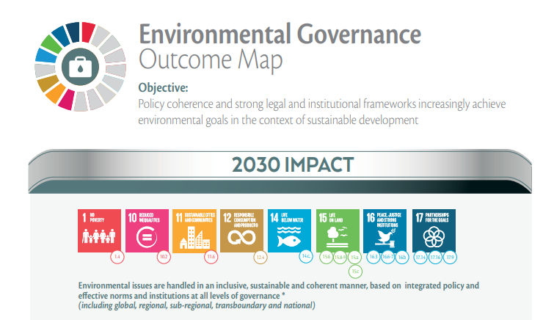
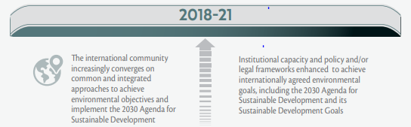

Slide 4
2018-21 project portfolio
 | Expected Accomplishment A. Common and integrated approaches at the international level to implement the 2030 Agenda |  |  | Expected Accomplishment B. Stronger institutional and legal capacities to implement the 2030 agenda
 | 2018-Indicator (i) | (ii) | (iiI) | (i) | (ii) | (iii)
 | Environment Management Group
 | Greening the Blue Initiatives Sustainable United Nations & REACT
 | Promoting Good Governance of the environment
 | Environmental treaties programme Biodiversity synergies - Capacity building in African, Caribbean and Pacific countries - African Elephant Fund -Biosafety and access and benefit sharing
 | Collective intelligence for environmental governance (InforMEA)
 | Addressing environmental priorities through the law Environmental law development - Environmental rights -Environmental crime/enforcement
 |  |  |  | Poverty-Environment Action for SDGs
Coherent delivery of the environmental dimension of SDGs
 |  |  |  | Strengthening institutions in Caribbean Biological Corridor
 |  |  |  | Faith and environment initiative

Slide 5
Programme Performance
2018-2019
Medium Term Strategy 2018-2021
Programme of work
2018-2019
Programme of work
2020-2021

Slide 6
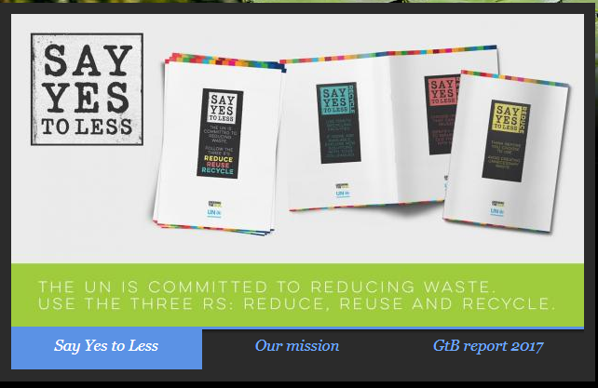
Highlights January - June 2018
Environment management group
E-waste coalition
Biodiversity
Environment and Humanitarian Action
Greening UN operations
“Say yes to less” campaign & waste management guidance
No single use plastics (10+ UN sites)
Environmental management systems toolkit
A. Common and integrated approaches at the international level to implement the 2030 Agenda
(i) Uptake of environmental policy issues by UN entities, international organizations and Fora
Various levels of contributions to the High-level Political Forum (political messages, knowledge, good practices on integrated implementation of SDGs)
Regional Ministerial Environmental Fora
UNEA Resolutions:
2/2 Role and functions of the regional forums of ministers of the environment and environment authorities
2/5 Delivering on the 2030 Agenda for Sustainable Development
2/17 Cooperation, collaboration and synergies among biodiversity- related conventions
3/3 Contributions of UNEA to the HLPF

Slide 7
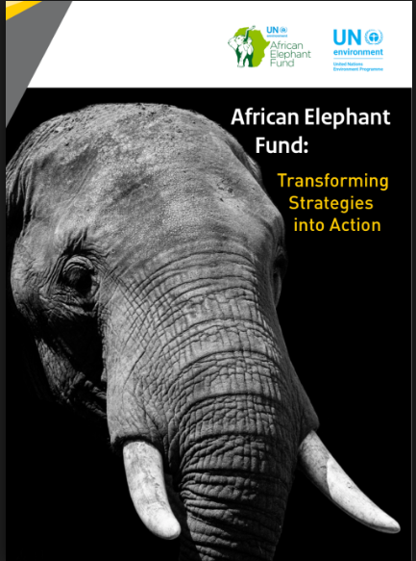
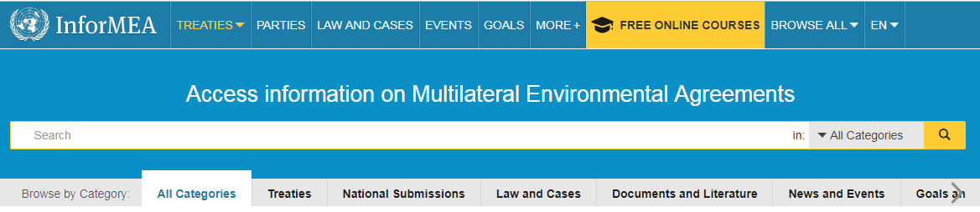
Highlights January - June 2018
Common and integrated approaches at the international level to implement the 2030 Agenda
(ii) Coherent implementation of multilateral environmental agreements
Biodiversity synergies - continued collaboration with Biodiversity secretariats for
Stronger evidence base for 2020
Common communication approaches
Baseline for long term capacity building
National level testing of synergies
Capacity building to implement chemicals and wastes and capacity
building MEAs – moving to a new project phase
Enabling action to halt poaching in range states through the African
Elephant Fund
Knowledge to inform implementation
UNEA Resolutions:
1/3 and 2/14 on Illegal trade in wildlife
2/16 Mainstreaming of biodiversity for well-being and 2/17 Cooperation, collaboration and synergies among biodiversity- related conventions
3/2 Pollution mitigation by mainstreaming biodiversity into key sectors

Slide 8
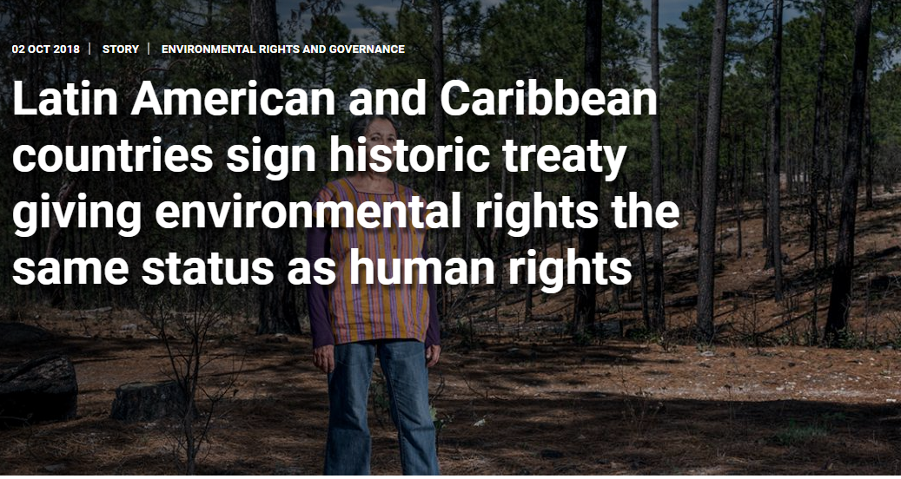
Progress January-June 2018
A. Common and integrated approaches at the international level to implement the 2030 Agenda
(iii) International instruments/
cooperation
Country driven process on environmental law
Montevideo Programme IV assessed
Development of a new global programme for submission to UNEA4
Escazù agreement
UNEA Resolutions:
2/19 Development and Periodic Review of Environmental Law
1/13 Implementation of Principle 10 of the Rio Declaration on Environment and Development
2/25 Application of Principle 10 of the Rio Declaration on Environment and Development in the Latin America and Caribbean Region

Slide 9
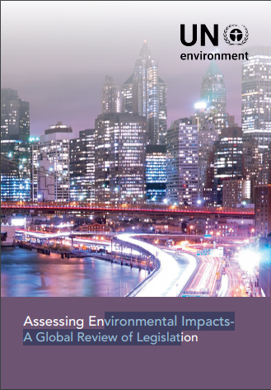
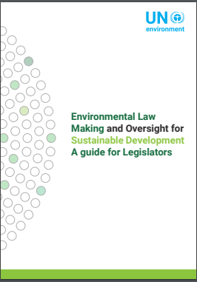
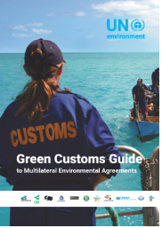
Highlights January-June 2018
B. Stronger institutional & legal capacities to implement the 2030 Agenda
(i) Stronger institutional capacity & legal frameworks
Executive
Parliamentarians
Judiciary
Enforcement
Civil society
Strengthening national legislation and capacities
Climate and wildlife legislation (six countries)
Guidance and knowledge products on EIA legislation, Environmental Law-making for SDGs
Judiciary initiatives: Asia and the Pacific, Africa, Bhutan, China
Environmental rights initiative launched
New green customs guide and fund mobilization for Green Customs Initiative
Fund mobilization efforts for Asia Regional Enforcement Network and related efforts
UNEA Resolutions:
1/3 and 2/14 on Illegal trade in wildlife
2/19 Development and Periodic Review of Environmental Law
Publications:
https://www.unepwcmc.org/system/dataset_file_fields/files/000/000/494/original/Assessing_Environmental_Impacts_A_Global_Overview_of_Legislation_report_fa_20_April_.pdf?1524215262
https://wedocs.unep.org/bitstream/handle/20.500.11822/25494/EnvLaw_SD.pdf?sequence=1&isAllowed=y

Slide 10
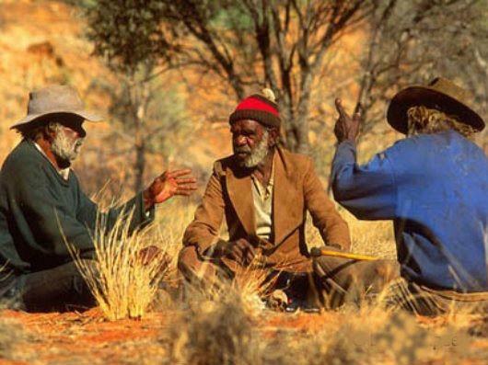
Highlights January-June 2018
B. Stronger institutional and legal capacities to implement the 2030 Agenda
(ii) Embedding environment in sustainable development planning
New programme Poverty Environment Action for Sustainable Development Goals (2018-2022) launched (full programmes in eight countries, technical assistance to broader set of countries).
Support to four countries (Bangladesh, Burkina Faso, Colombia, Guyana) to promote the Coherent Implementation of the Environmental Dimension of the Sustainable Development Goals and monitoring and reporting capacities.
Continued engagement with UN country teams in joint UN planning in all regions: Five new frameworks completed, more underway.
UNEA Resolutions:
2/5 Delivering on the 2030 Agenda for Sustainable Development

Slide 11
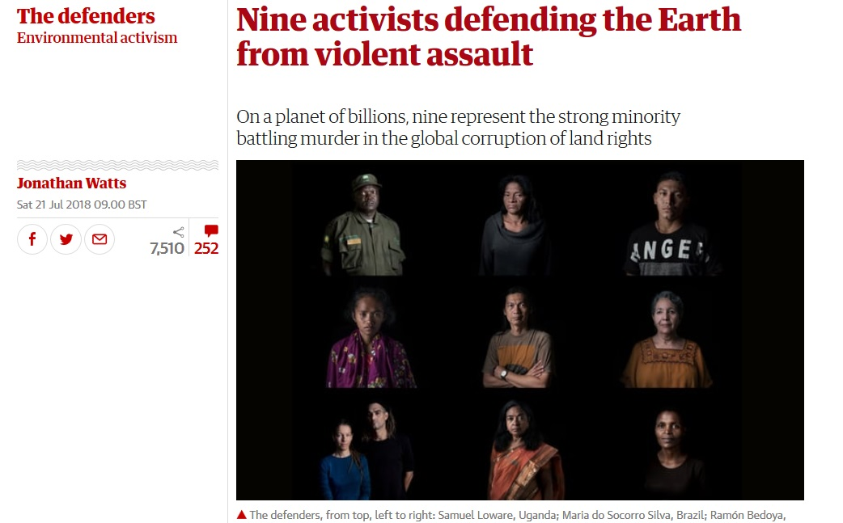
Highlights January-June 2018
B. Stronger institutional and legal capacities to implement the 2030 Agenda
(iii) partnerships
Media engagement and public outreach on Environmental Rights
Faith for Earth initiative
Partnerships to deliver our work

Slide 12
Partnerships
Parliamentarians association
Media
Judiciary networks
NGOs
UN agencies
Private sector
Special Rapporteurs
Regional organizations
Think tanks
MEAs
Universities
Global Organizations
Prosecutors networks
Faith based organizations

Slide 13
Budget performance
Jan-June 2018

Slide 14
Challenges /Risks Declining core resources income Limited financial resources for country level support, including to implement UNEA Resolutions Lessons/Mitigating measures Strengthen resource mobilization Efficient delivery model Reduced ambition for country level work? Opportunities UN reform: better position environment in UN’s work/environmental management of common premises Result-oriented, need-responsive, monitored and country driven global environmental law programme (follow up to UNEA Resolution 2/19) Enable UNEA outcomes

Slide 15

Questions & Discussion
Programme Lead Director
Ms. Elizabeth Mrema
Director, Law Division
elizabeth.mrema@un.org
Programme Coordinator
Ms. Cristina Zucca
Law Division
Cristina.zucca@un.org

Slide 16
Programme of Work
2020-2021
Medium Term Strategy 2018-2021
Programme of work
2018-2019
Programme of work
2020-2021

Slide 17
Theory of change
Environmental issues are handled in an inclusive, sustainable and coherent manner, at all levels of governance (global, regional, subregional, transboundary and national)
Environmental goals are being achieved through concerted efforts by the international community
Environmental objectives are being achieved based on adequate policy, legal and institutional frameworks and the contribution of all sectors of societies
The international community increasingly converges on common approaches to achieve environmental objectives and implement the 2030 Agenda
Institutional capacities and policy and/or legal frameworks enhanced to achieve environmental goals, including the 2030 Agenda and the SDGs
Advisory services to intergovernmental processes on the environmental dimension of SDGs
Capacity development + technical support for development & implementation of environmental laws
Promotion and servicing of interagency collaboration and technical support to UN agencies on environmental management
Technical assistance on integrated implementation of SDGs
Technical support to Governments and engagement with secretariats and member states to promote synergies in the implementation of MEAs
Technical assistance on integrating environment in sustainable development national planning, budgeting and one UN country programming
Support to international negotiations and transboundary cooperation initiatives
Trainings and dissemination of tools, information, communication and knowledge products

Slide 18
Our approach to change
Our deliverables
Progress on expected accomplishments
Long term impact
Environmental law programme
Guidance on legislation/model law
Technical assistance for drafting lead in paint legislation
Country adopts lead in paint legislation
Lead in paint is banned and the ban is enforced
Lead contamination is reduced
Global review /gap analysis of status of regulation
Implementation capacities are built
Enforcement capacities are strengthened
UNEA Resolution calls for action on lead in paint
Science demonstrates that Lead is harmful
Science –policy interface

Slide 19
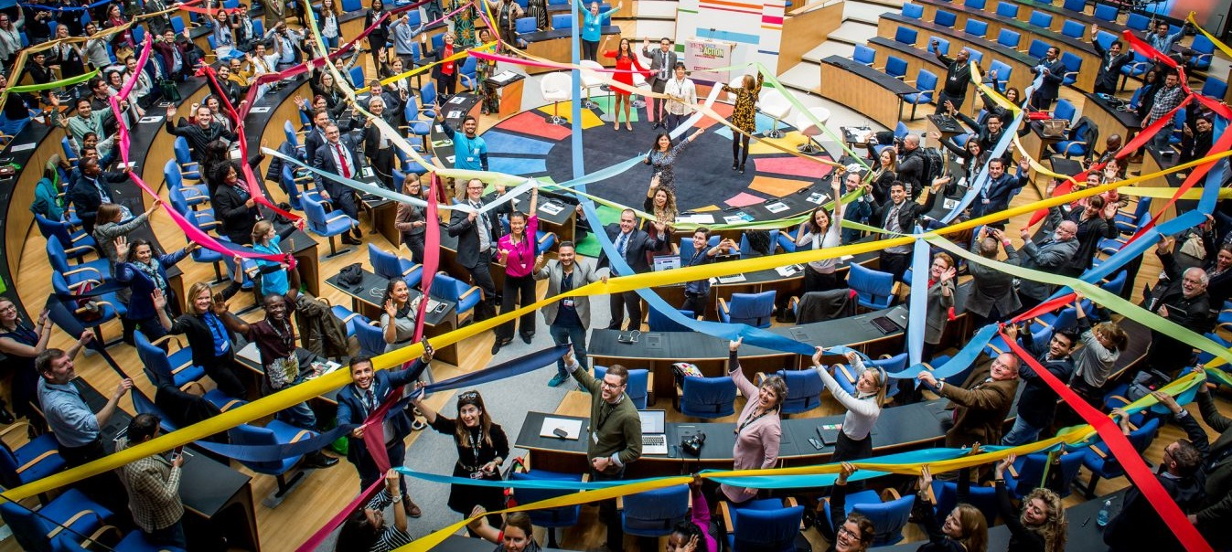
What is different in the
2020-21 programme of work
Stronger contribution to SDG targets and indicators
  Strengthens the environmental dimension of all the goals
  Contributes to policy/governance/law dimension of environmental goals
  Contributes to the environmental dimension of other goals (poverty eradication, stronger institutions, policy coherence)
More deliberate alignment to UNEA resolutions
  Facilitates delivery/coordinates progress reporting on 13 listed resolutions
  Contributes to other resolutions, e.g. on wildlife, climate, pollution, chemicals and wastes
  Will take on board future Resolutions, within its available resources unless additional resources are provided
Minor changes to indicators
  better reflect reality
  take on board lessons learned
Stronger focus on social aspects
  Environmental rights
  Gender

Slide 20
Stronger alignment to SDG targets and indicators
Impact level SDG indicators
1.b.1 Proportion of government recurrent and capital spending to sectors that disproportionately benefit women, the poor and vulnerable groups
16.10.1 Number of verified cases of killing, kidnapping, enforced disappearance, arbitrary detention and torture of journalists, associated media personnel, trade unionists and human rights advocates in the previous 12 months
16.b.1 Proportion of population reporting having personally felt discriminated against or harassed in the previous 12 months on the basis of a ground of discrimination prohibited under international human rights law
17.14.1 Number of countries with mechanisms in place to enhance policy coherence of sustainable development
Expected accomplishment level SDG indicators
16.10.2 Number of countries that adopt and implement constitutional, statutory and/or policy guarantees for public access to information 17.14.1 Number of countries with mechanisms in place to enhance policy coherence of sustainable development 17.15.1 Extent of use of country-owned results frameworks and planning tools by providers of development cooperation 17.16.1 Number of countries reporting progress in multi-stakeholder development effectiveness monitoring frameworks that support the achievement of the sustainable development goals 5.a.2 Proportion of countries where the legal framework (including customary law) guarantees women’s equal rights to land ownership and/or control | 12.4.1 Number of parties to international multilateral environmental agreements on hazardous waste, and other chemicals that meet their commitments and obligations in transmitting information as required by each relevant agreement 13.2.1 Number of countries that have communicated the establishment or operationalization of an integrated policy/strategy/plan which increases their ability to adapt to the adverse impacts of climate change, and foster climate resilience and low greenhouse gas emissions development in a manner that does not threaten food production (including a national adaptation plan, nationally determined contribution, national communication, biennial update report or other) 15.6.1 Number of countries that have adopted legislative, administrative and policy frameworks to ensure fair and equitable sharing of benefits 15.8.1 Proportion of countries adopting relevant national legislation and adequately resourcing the prevention or control of invasive alien species 15.9.1 Progress towards national targets established in accordance with Aichi Biodiversity Target 2 of the Strategic Plan for Biodiversity 2011-202 ( ‘Number of countries that have integrated biodiversity in National Development Plans, poverty reduction strategies or other key development plans’)
vs
17.14.1. Number of countries with mechanisms in place to enhance policy coherence of sustainable development (custodian agency UN Environment Programme, Tier III)
17.16.1 Number of countries reporting progress in multi-stakeholder development effectiveness monitoring frameworks that support the achievement of the sustainable development goals (custodian agencies: OECD, UNDP; partner agency: UN Environment Programme; Tier II)
16.10.2 Number of countries that adopt and implement constitutional, statutory and/or policy guarantees for public access to information (Custodian Agency: UNESCO-UIS; partner agencies: World Bank, UN Environment Programme; Tier II)
5.a.2 Proportion of countries where the legal framework (including customary law) guarantees women’s equal rights to land ownership and/or control (Custodian agency: FAO; partner agencies World Bank, UN Women; Tier II)

Slide 21
Main indicator changes
Expected accomplishment A
Common and integrated approaches at the international level to implement the 2030 Agenda
Expected accomplishment B
Stronger institutional and legal capacities to implement the 2030 Agenda
(i) Uptake of environmental policy issues by UN entities, international organizations and Fora
(ii) Coherent implementation of multilateral environmental agreements
(iii) International instruments/cooperation
(i) Stronger institutional capacity & legal frameworks
(ii) Embedding environment in sustainable development planning
(iii) Partnerships for the global environmental goals
Changes to indicators
2020-21 2018-19
Broadened scope beyond national level
Made reference to legal instruments more explicit
Stronger focus on implementation of partnerships

Slide 22
ENVIRONMENTAL GOVERNANCE

Slide 23
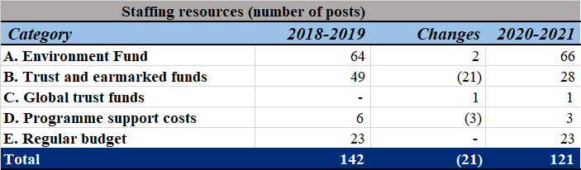

ENVIRONMENTAL GOVERNANCE: STAFFING

Slide 24
Challenges and
Opportunities ahead
Possible mandate from UNGA resolution 72/277: Towards a Global Pact on the Environment
Closer engagement with member states on environmental law
Stronger environment in SDGs remains core challenge:
  alignment of efforts at all governance levels
  Political role for member states through UNEA, regional ministerial fora, HLPF and sustainable development fora
    institutional capacity building
    Harnessing UN reform opportunities
  Heightened resources needed for this and to implement existing and future UNEA resolutions, including on pollution

Slide 25
Questions & Discussion
Programme Lead Director
Ms. Elizabeth Mrema
Director, Law Division
elizabeth.mrema@un.org
Programme Coordinator
Ms. Cristina Zucca
Law Division
Cristina.zucca@un.org

