Slide 1
Participating Country: VANUATU
Global Monitoring Plan for POPs
PRESENTED BY:
Roselyn Bue
GMP2 NATIONAL COORDINATOR
Department of Environmental Protection and Conservation

Slide 2
OVERVIEW:
Vanuatu has not participated in GMP1 Project. So there is no national baseline data on POPs for Vanuatu.
Vanuatu joined and participated in this GMP2 project late in 2017 to contribute to provide data on POPs in water, air and milk as part of the global monitoring plan on POPs.
From 2017-2018- the activities were: sites identification, short term contracts, land use agreements plus other authorities consents, installation of structures, collection of samples, storage and shipment.

Slide 3
FACILITIES, RESOURCES, SUPPORT & LOGISTICS
To implement the project;
Facilities: Fridge in the Office used to store samples. Need water sampling bottles
Resources: A permanent officer of the department (myself), is the Co-ordinator. Roles include; identify sites for water and air sampling, ensure construction of air sampler structure, write to appropriate stakeholders for establishing of processes for air and human milk sampling, identify and contract individuals for collection of samples. Work closely with the contracted individuals to ensure logistics for the sampling is conducted as best as possible following the SOPs
Political Support: Approval of the three other chemical related conventions: Basel, Rotterdam and Minamata Conventions

Slide 4
DHL is used to courier freight all the samples
No national laboratory for analysis of duplicate samples

Slide 5
PROGRESS OF THE ACTIVITIES
Water samples sent to MTM Research Centre,Orebro Univ, Sweden:
VUT A: 2017-4
VUT A: 2018-1
VUT A: 2018-2
Air samples sent to IVM, Netherlands and MTM research centres
VUT 1 - 2018 I (IVM) VUT 1 – 2018 II
VUT 3 - 2018 I (IVM) VUT 3 – 2018 II
VUT 5 – 2018 I (MTM) VUT 5 – 2018 II
VUT 9 – 2018 I (IVM) VUT 9 – 2018 II
VUT 11 – 2018 I (MTM) VUT 11 – 2018 II
The water and air samples for the 3rd quarter shall be collected on the 1st of October 2018

Slide 6
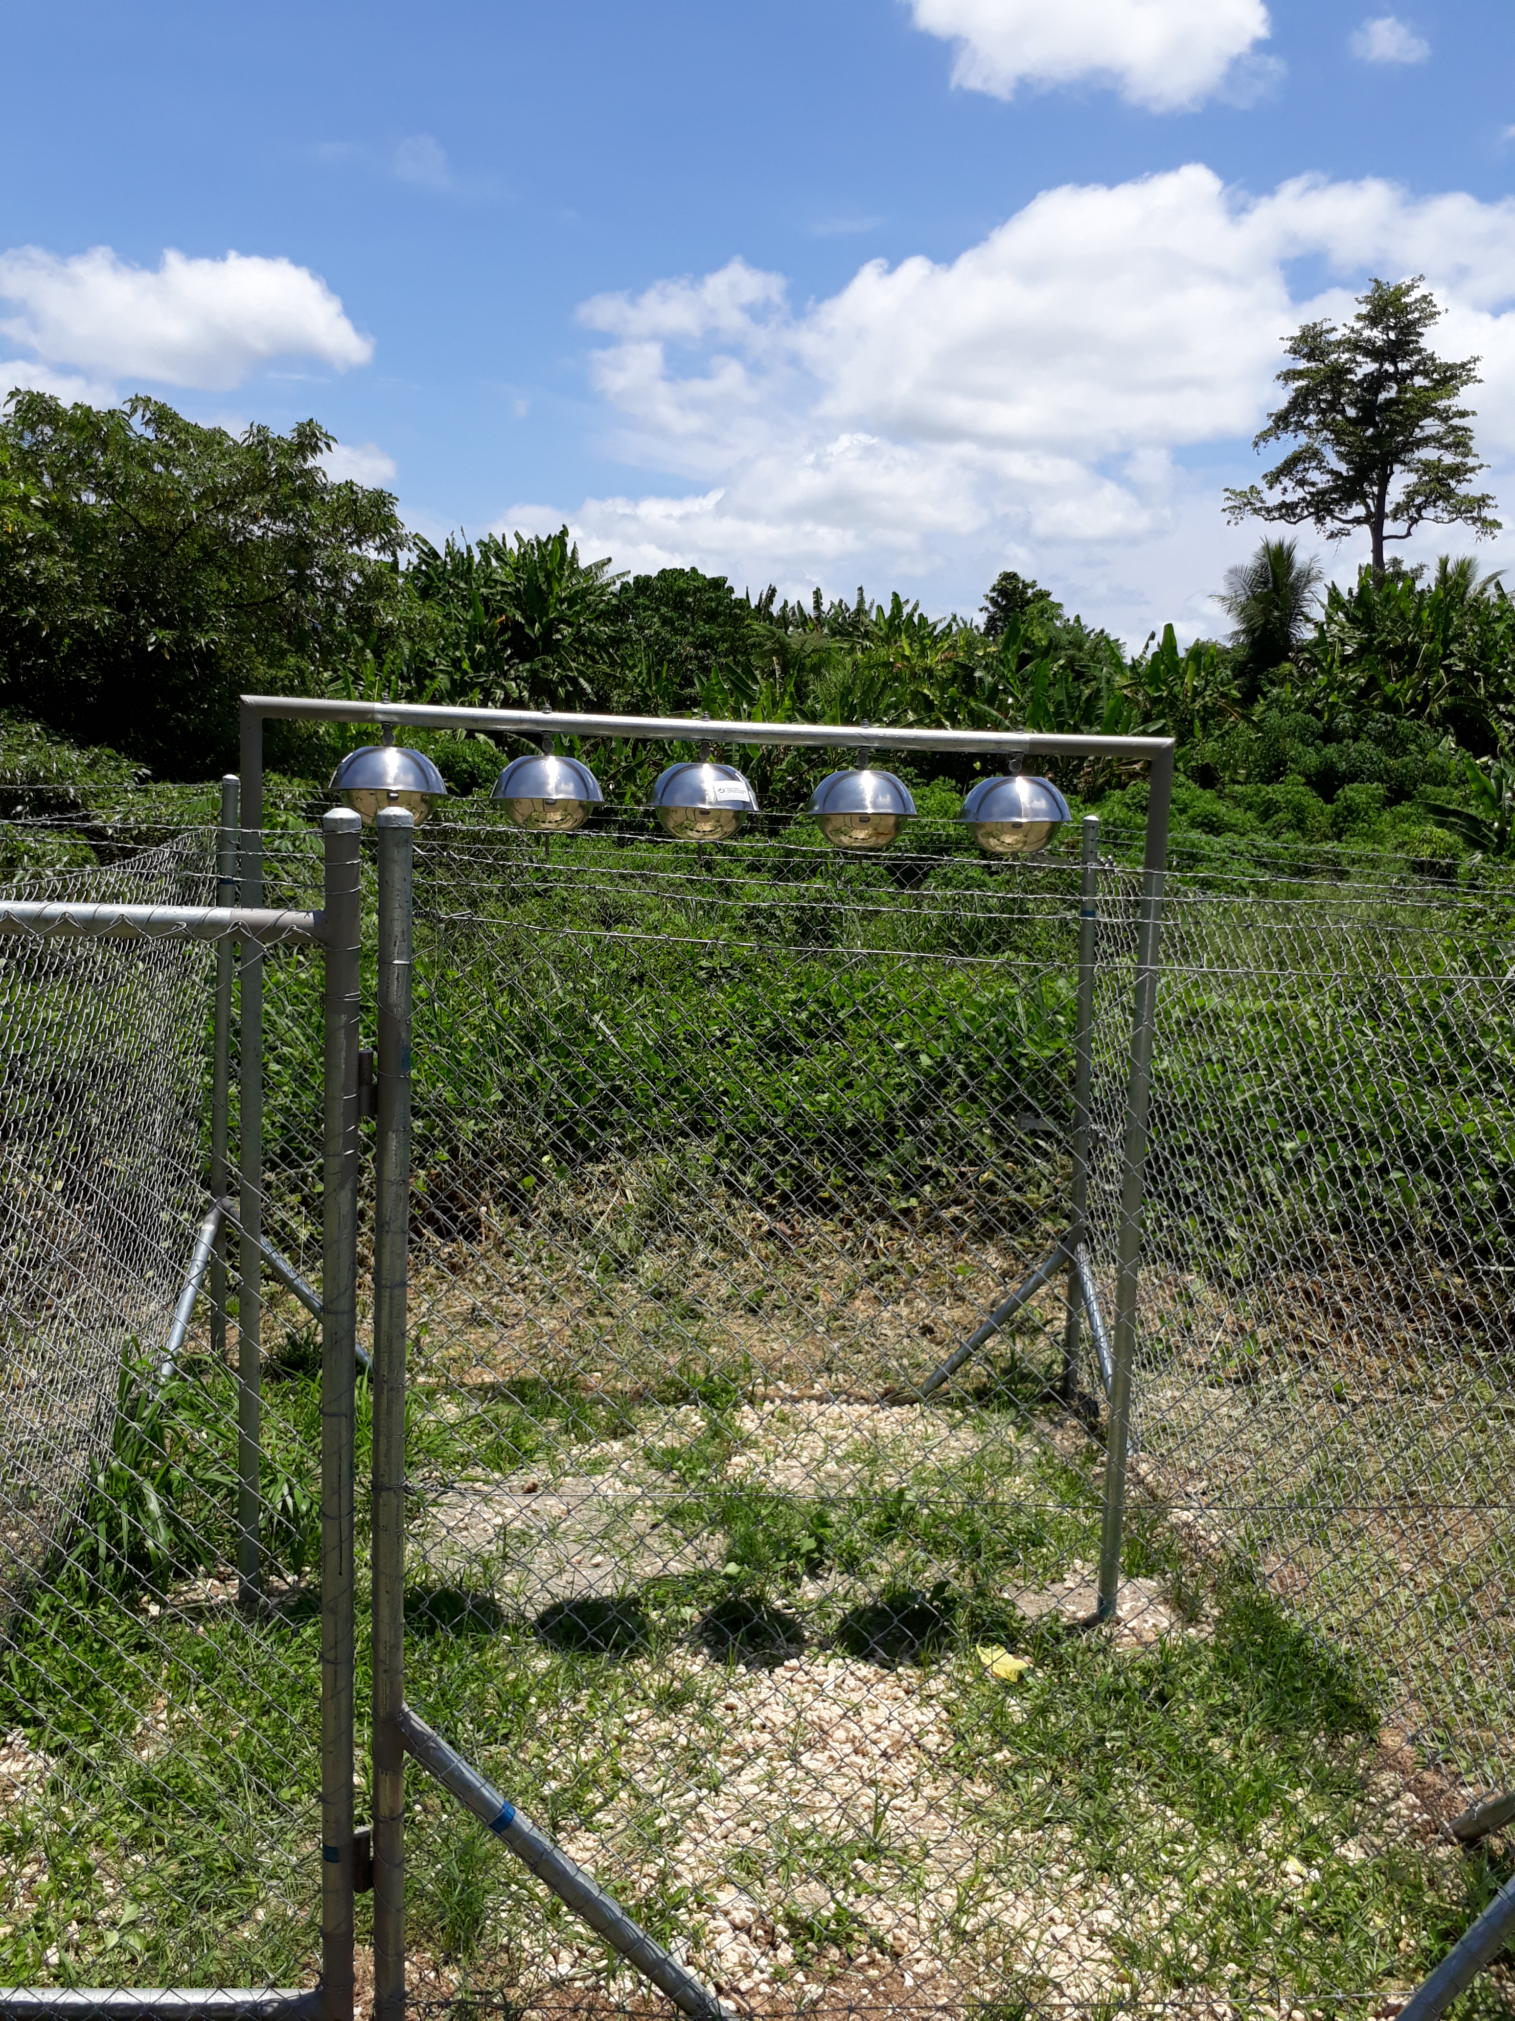
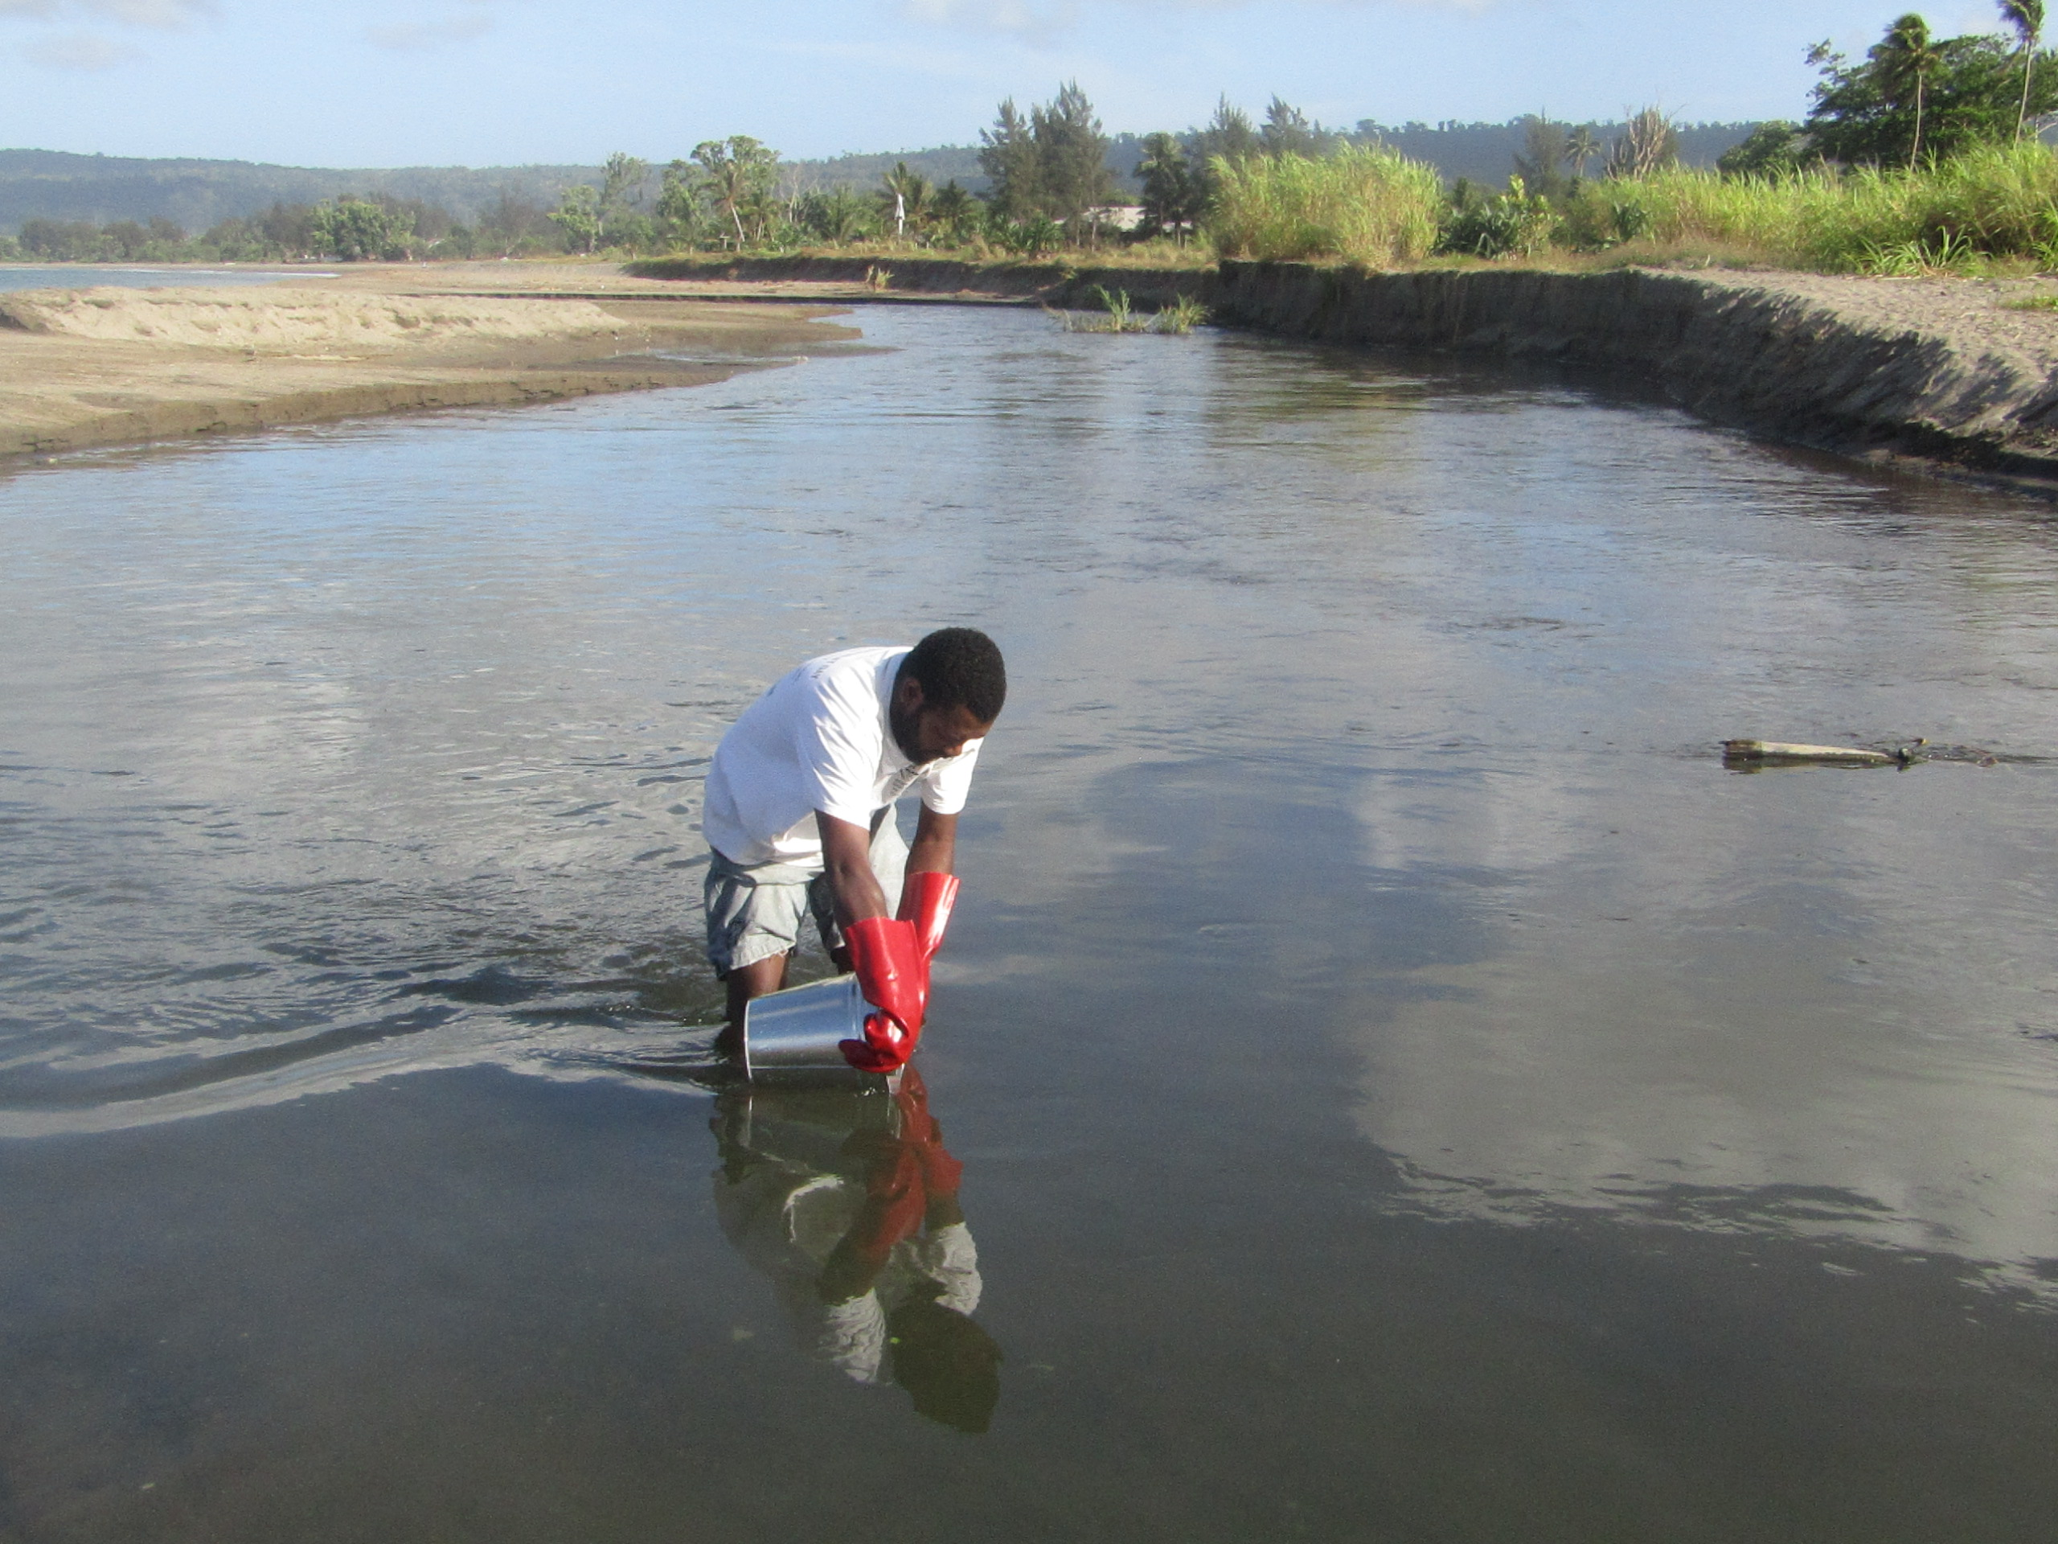
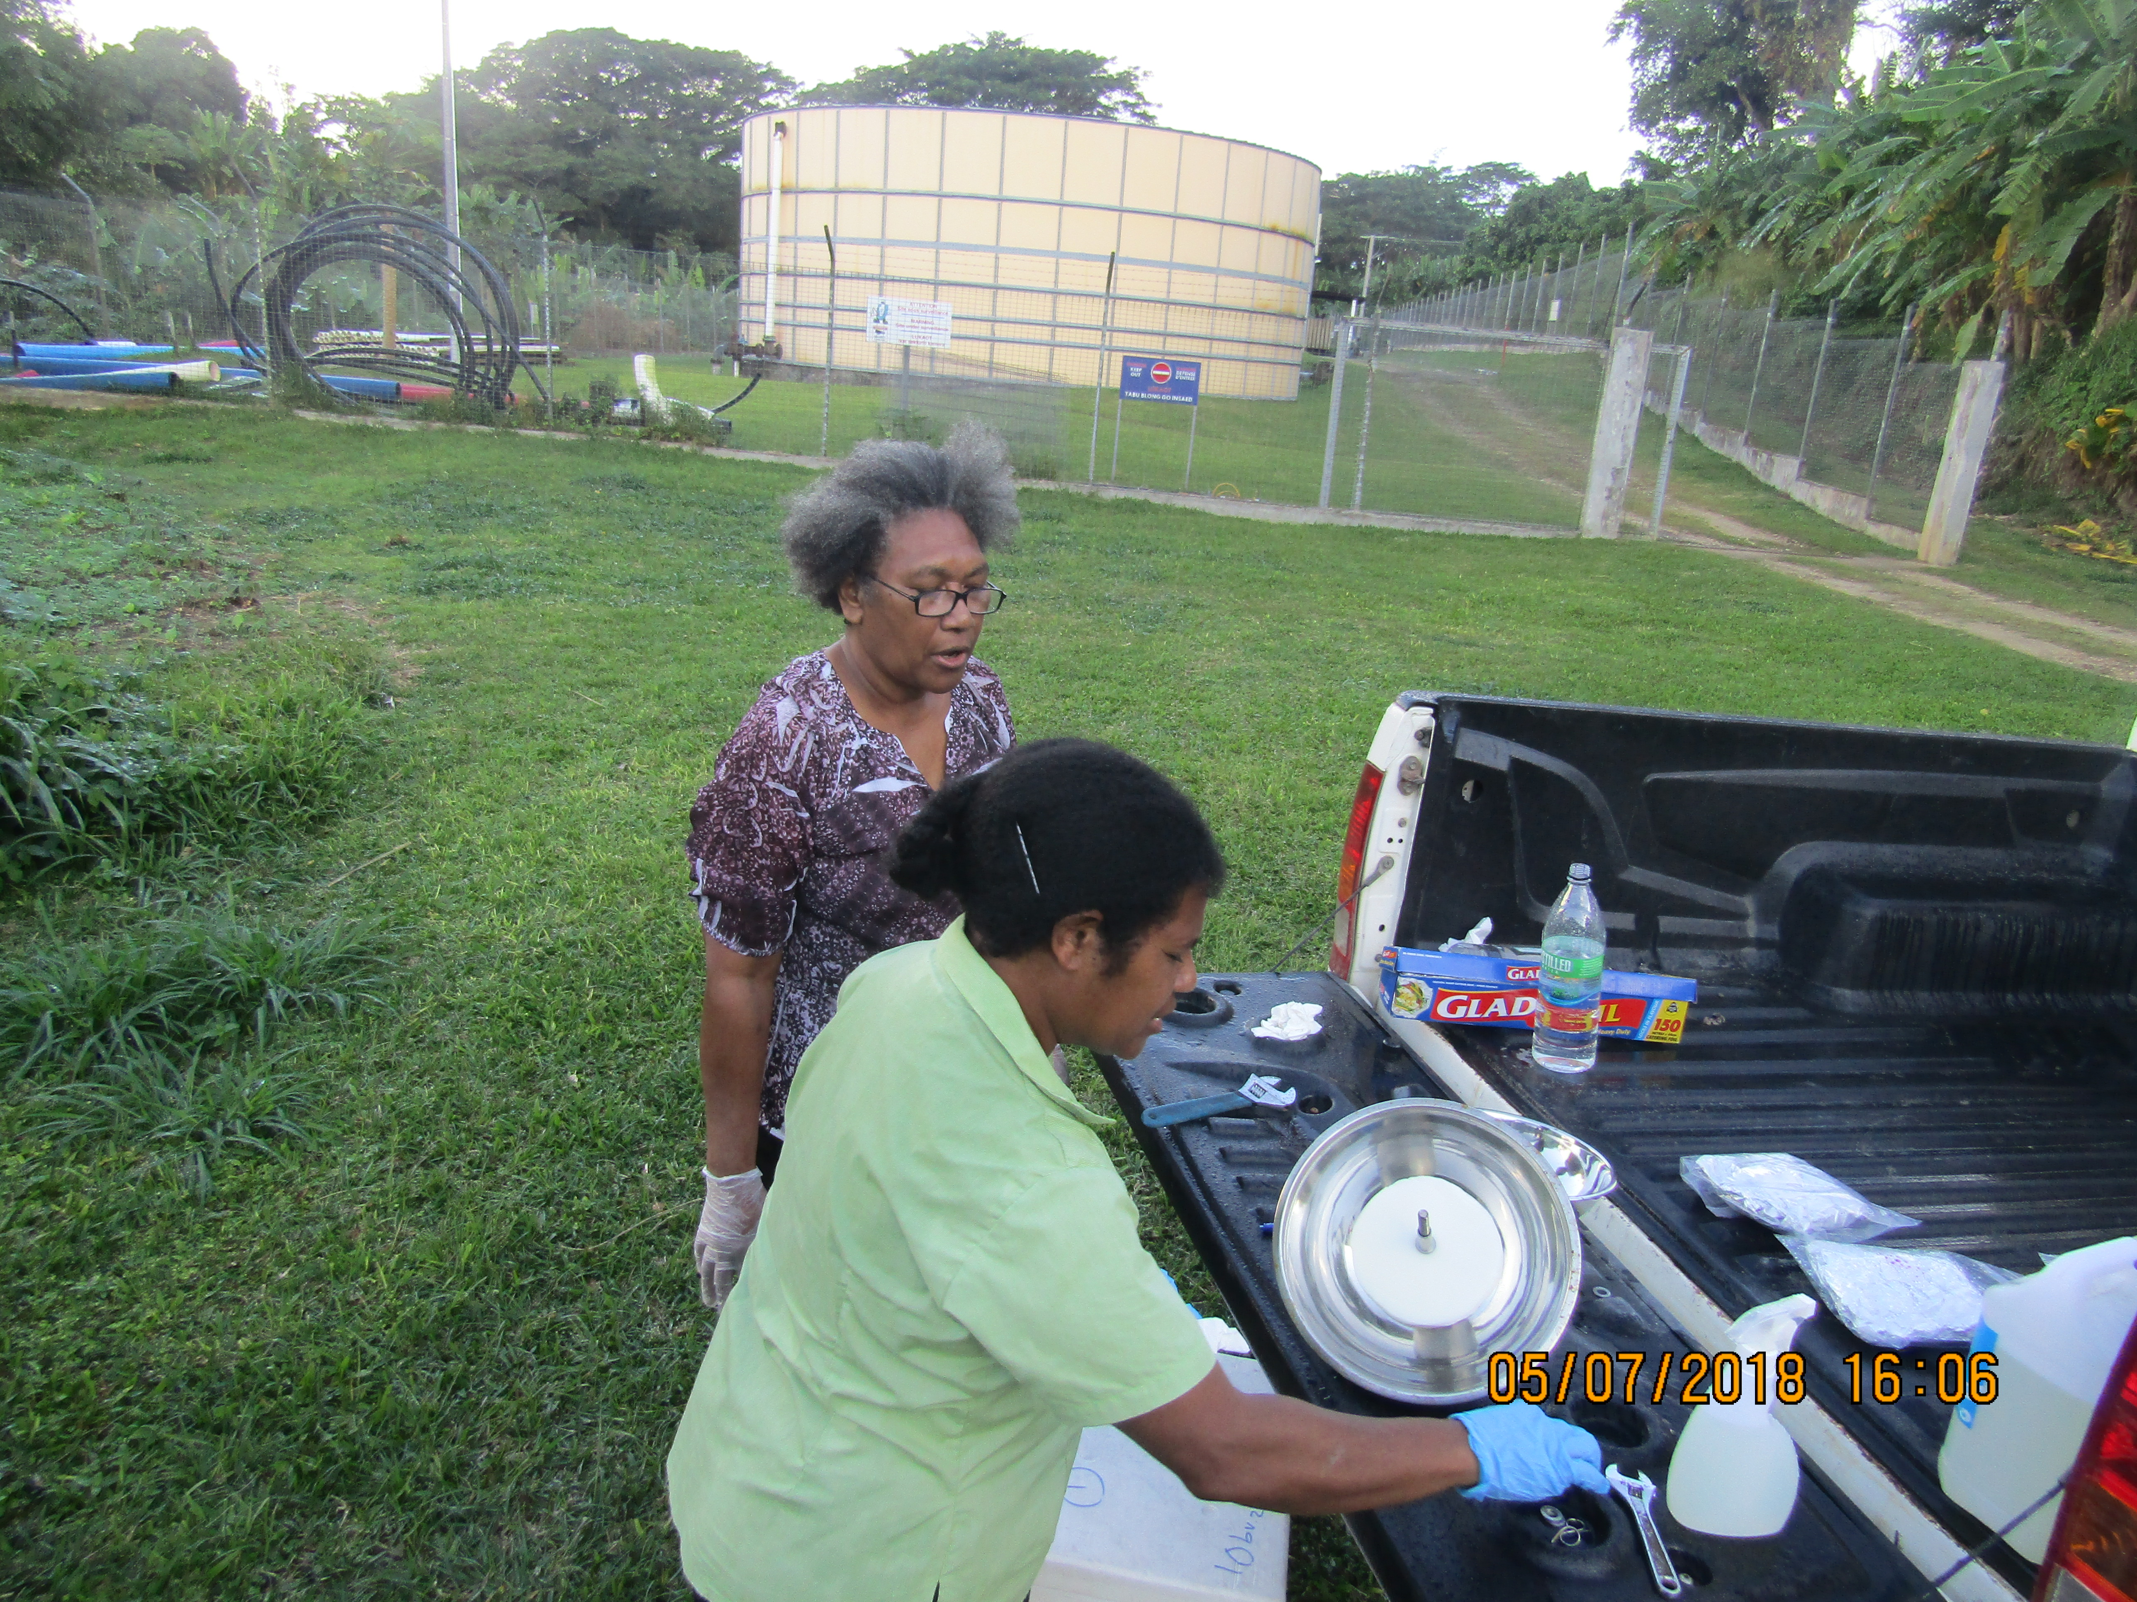
AIR SAMPLER STRUCTURE
SHORT TERM CONTRACTED OFFICER COLLECTING WATER SAMPLES
AIR SAMPLES PREPARED ASSISTED BY ASSISTANT OFFICER

Slide 7
PROGRESS OF THE ACTIVITIES
HUMAN MILK SAMPLES
50 samples of milk collected and mixed into a 1.25L bottle (pooled sample) and sent on the 3/3/18 to CVUA ,Germany.
NATIONAL SAMPLES/INTERESTS
No progress yet on National Samples
Samples will be sent before end of year

Slide 8
CHALLENGES
Main challenge is the capacity to ensure samples details for collection are well understood before collection begins
National organizations and their processes for approvals etc.. contributed to delay
Officers have competing priorities – have short term contracts
LESSONS LEARNT
Attend training, didn’t attend training as training logistics were communicated in very short time and lengthy government processes to allow for approval to travel made it impossible to attend.

Slide 9
BENEFIT of GMP PROJECT for VANUATU
The results of the project will provide for Vanuatu information on levels of the different POPs that Vanuatu is exposed to.
This can enable the Vanuatu government to make policies and/or take
necessary measures as required.
Capacity is built when we participate so that we have knowledge and skills for future similar projects.

Slide 10
OPPORTUNITIES, COLLABORATIONS & NETWORKS
Collaborate with regional institutions – e.g. SPREP to establish national coordinating body to oversee the implementation of chemicals programs at National Level
Experts are available to assist and provide knowledge and information about POPs
These information can be translated into awareness materials
Provide POPs awareness to the Politicians as well as communities
Knowing who is doing what and where and contacting the right people for information or assistance

Slide 11
SUSTAINABILITY OF MONITORING AND FUTURE EXPECTATIONS
A permanent officer within the Department of Environment to continue the coordinating work on POPs.
Vanuatu will continue to commit its efforts to complete the project.
Through the experience gained so far, improvements on the logistics for collection, storage, freighting etc.. is being improved so future handling of these is expected to be better.
Vanuatu looks forward to have information on the outcomes of the project and to be part of future projects relating to the GMP on POPs.

Slide 12
THANK YOU!
Roselyn Bue
Senior Officer (Chemical Ozone)
Department of Environmental Protection and Conservation
VANUATU

