Slide 1



Global Monitoring Plan Phase II Project –Mid-term Review Workshop
17th -18th September 2018, Brisbane
A PRESENTATION BY:
Ministry of Environment Climate Change Disaster Management & Meteorology
Solomon Islands

Slide 2

Outline of Presentation
Overview of the Project activities in Solomon Islands
Resources/Facilities Available
Progress until present
Challenges and possible solutions
Lessons learnt
GMP project's outcomes /benefit
Opportunities, collaborations and networks
Sustainability in monitoring and future expectations

Slide 3
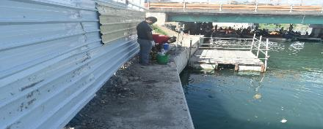
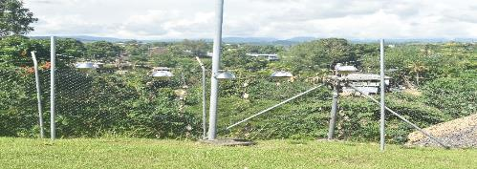
Overview of Project Activities in Solomon Is
Air sampling
Water sampling
Human milk sampling
Sampling of matrices of national interest
Policy & Legislative framework –Draft NIP, NWMPC Strategy 2017-2026, Environment Act under review

Slide 4
Resources/Facilities Available
Human Resources-
  Environment Officers conduct samplings for ambient air & water + shipment of samples
  Health Officers to conduct human milk sampling
Logistics support-Office vehicle utilized when available
Political Support – Endorsement of National Waste Management & Pollution Control Strategy in 2017, Draft NIP to be submitted for cabinet endorsement

Slide 5
Resources Utilized
Facilities
National Public Health Laboratory
- Tests for WQ covers e.coli, DO, salinity & arsenic but not for
POPs
Private Laboratory ( SPE Analytical)
- Soil sampling tests covers phosphorus, nitrogen, soil texture,
organic compounds, colouring & carbon but not on POPs.
- Water quality tests covers pH, conductivity, Dissolved oxygen,
salinity, e.coli but not heavy metals or POPs
Other Labs also exist but none of them does tests for POPs

Slide 6
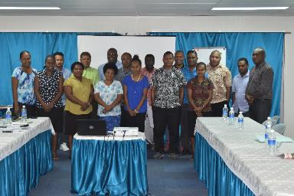
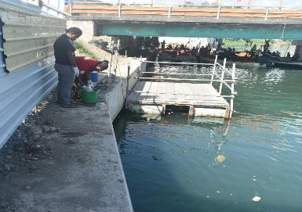
Progress until Present ( 2018)
GMP II National Inception held in 2016
Sampling sites identified in 2016
PUFs/Passive air sampling first installed in mid 2017
water samplings & passive air samplings conducted
Shipments of water samples & passive air samples done
SIHRERB committee approval to conduct breast milk sampling end of August 2018
National samplings- to be confirmed
Notes:
SIHRERB- Solomon Islands Health Research Ethical Review Board

Slide 7
Challenges & Solutions
Challenges | Solutions
Funding very restricted | Allow flexibility to support or enhance capacity and resources of national institutions
Coordination of multiple projects plus implementation of national priorities results in delays | Recruit dedicated person for coordination of project. Recruited person can then be absorbed by the Govt.
Logistics vehicle sometimes busy with other office tasks | Hire a taxi/vehicle to conduct the sampling

Slide 8
Challenges | Solutions
Health (SIHRERB) Ethical Review Procedures | Ensure all paper work and requirements are presented to the committee
Lack of ability of National Labs to do laboratory work on POPs | Seek funding support to upgrade national laboratory
Support Officers are not familiar with sampling protocols | In-house training on sampling protocols
Shipment preparation & logistics can be time consuming | Prepare supporting paperwork for shipment a day ahead before shipment

Slide 9
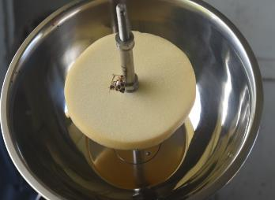

Slide 10
Lessons Learnt
Team work when conducting samplings to enhance each others capacity to do proper sampling
Coordination between stakeholders to maintain good networking & collaboration
Cross-check shipment paperwork by a second person ( ensure to include ‘no commercial value’ or 1 Euro dollar)
Preparation of shipment paperwork before date for shipment

Slide 11
Project Outcomes /Benefits
Builds/strengthen the capacity of officers to monitor POPs concentration or to conduct proper sampling
Government officers better equipped with scientific or technical knowledge & tools to a high standard
Data collection on air, water , human exposure to POPs relevant for decision making /Policy /Legislation
Increased awareness of POPs exposure amongst stakeholders
Helps Government to provide inputs to the Stockholm Convention & to facilitate reporting

Slide 12
Opportunities, Collaborations & Networks
Creates new networking through a multi-stakeholder approach
Builds on existing networking or coordination with stakeholders
Information dissemination and awareness

Slide 13
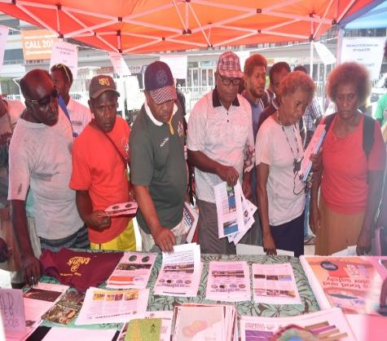
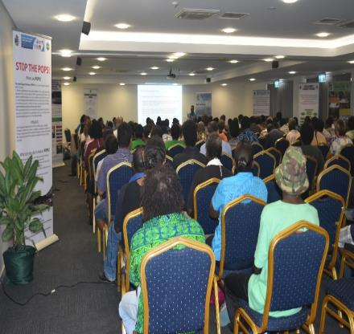
Opportunities, Collaborations & Networks

Slide 14
Sustainability & Future Expectations
Future Projects should have dedicated project officer
Flexibility of funding to support the capacity and resources of governments through:
  National Capacity building in MEAs
  Institutional strengthening
  Coordinate national initiatives/activities related to POPs
Harmonization of existing legislations to manage sound chemical management

Slide 15
Sustainability & Future Expectations
Ownership & Sustainability - Results to be translated to ensure policy makers understand why the need for on-going monitoring. This can then be incorporated into National Planning & Budget
Harmonization of existing legislations to manage sound chemical management
Maintain POPs sampling sites
Separate Chemical Unit and Human resources to be responsible for Chemical Management within the MECDM

Slide 16
Thank you for listening !
Tank iu tumas !

