Slide 1

Mid-term review:
“CONTINUING REGIONAL SUPPORT FOR THE PERSISTENT ORGANIC POLLUTANTS (POPs) GLOBAL MONITORING PLAN (GMP2)” under the Stockholm Convention in the Pacific Region: 17-18 Sept 2018, Brisbane, Australia
- SAMOA

Slide 2
Overview & Key activities
Undertake Air Sampling
Undertake Water Sampling
Undertake Human Milk Sampling
Undertake Sampling of Matrices of major national Interest

Slide 3
Water sampling
SITE | SAMPLES COLLECTED | DATE
Vaisigano River – Lelata Point | Sample 1 (2 water samples collected) | 6/12/2017
 | Sample 2 (2 water samples collected) Sample 3 (2 water samples) | 6/4/2018 6/7/2018
 | Sample 4 | 6/10/2018 (next)
Continue water sampling | As scheduled (3 months interval)
Shipment of water samples
- 30th Sept 2018 or await completion of next sampling on 6th Oct 2018

Slide 4
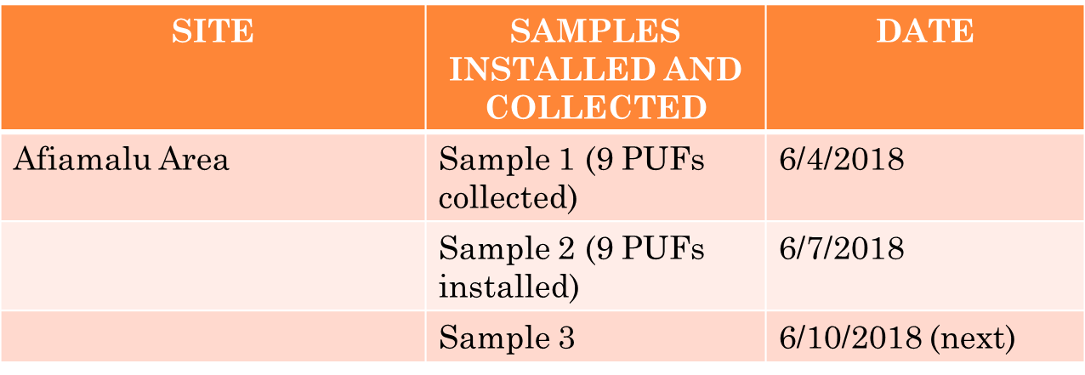
Air samples
Shipment of air samples
30th Sept 2018 or await completion of next sampling
on 6th Oct 2018

Slide 5
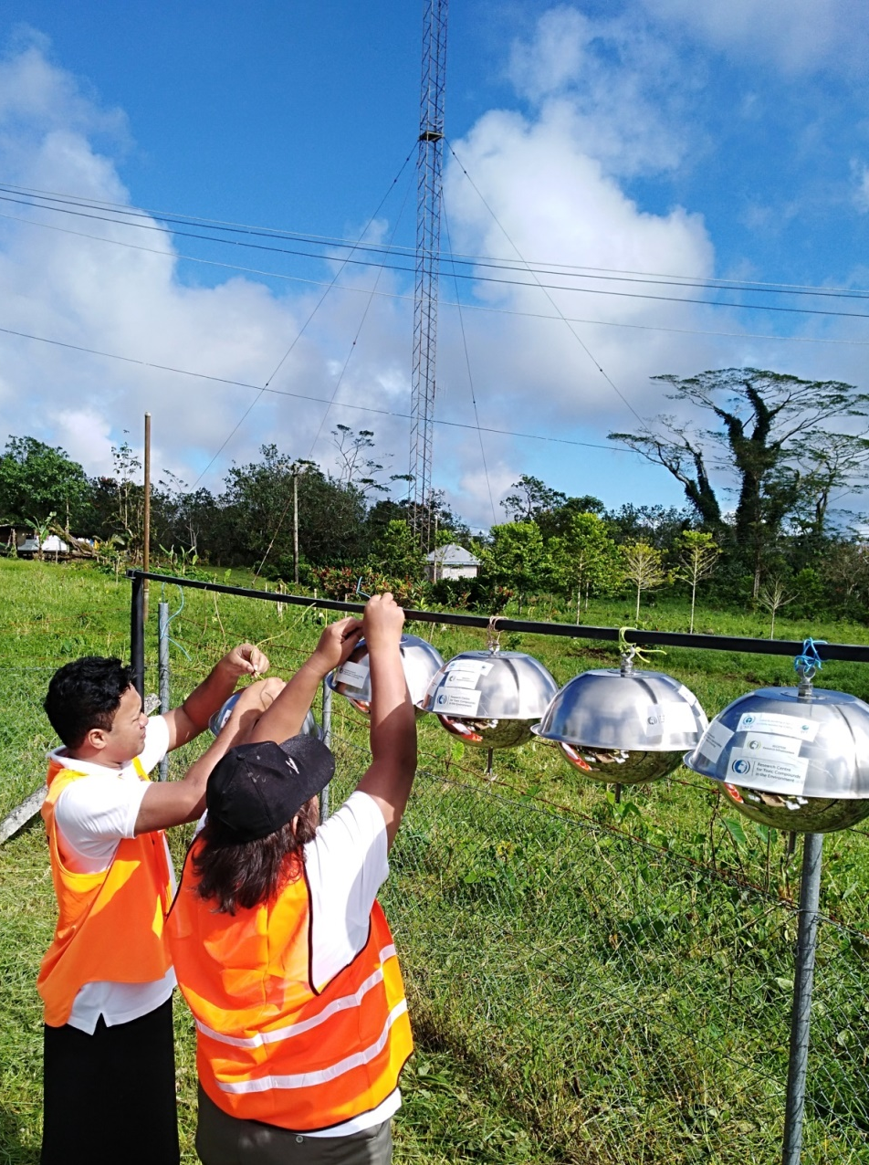
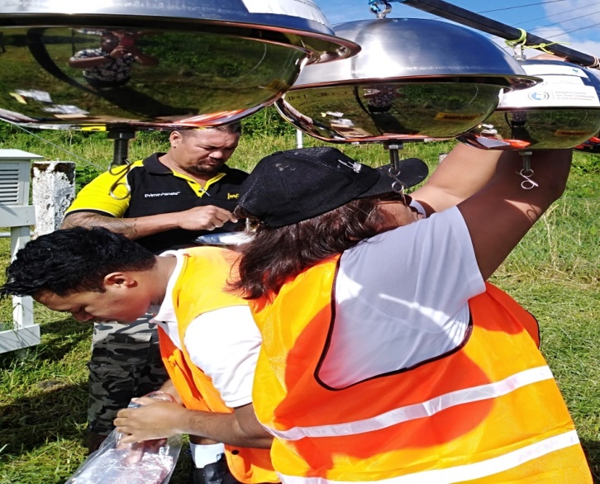
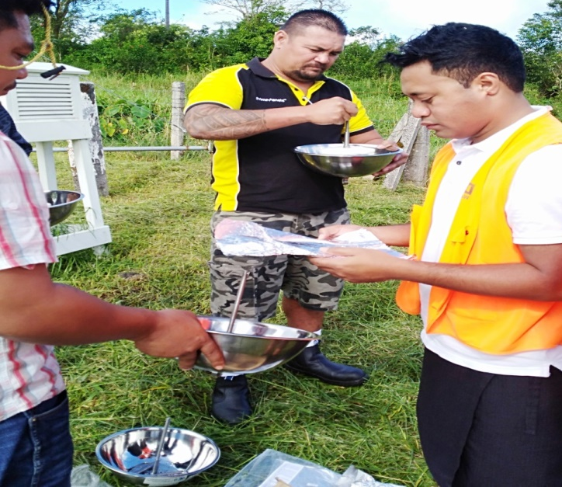
Photo reference

Slide 6
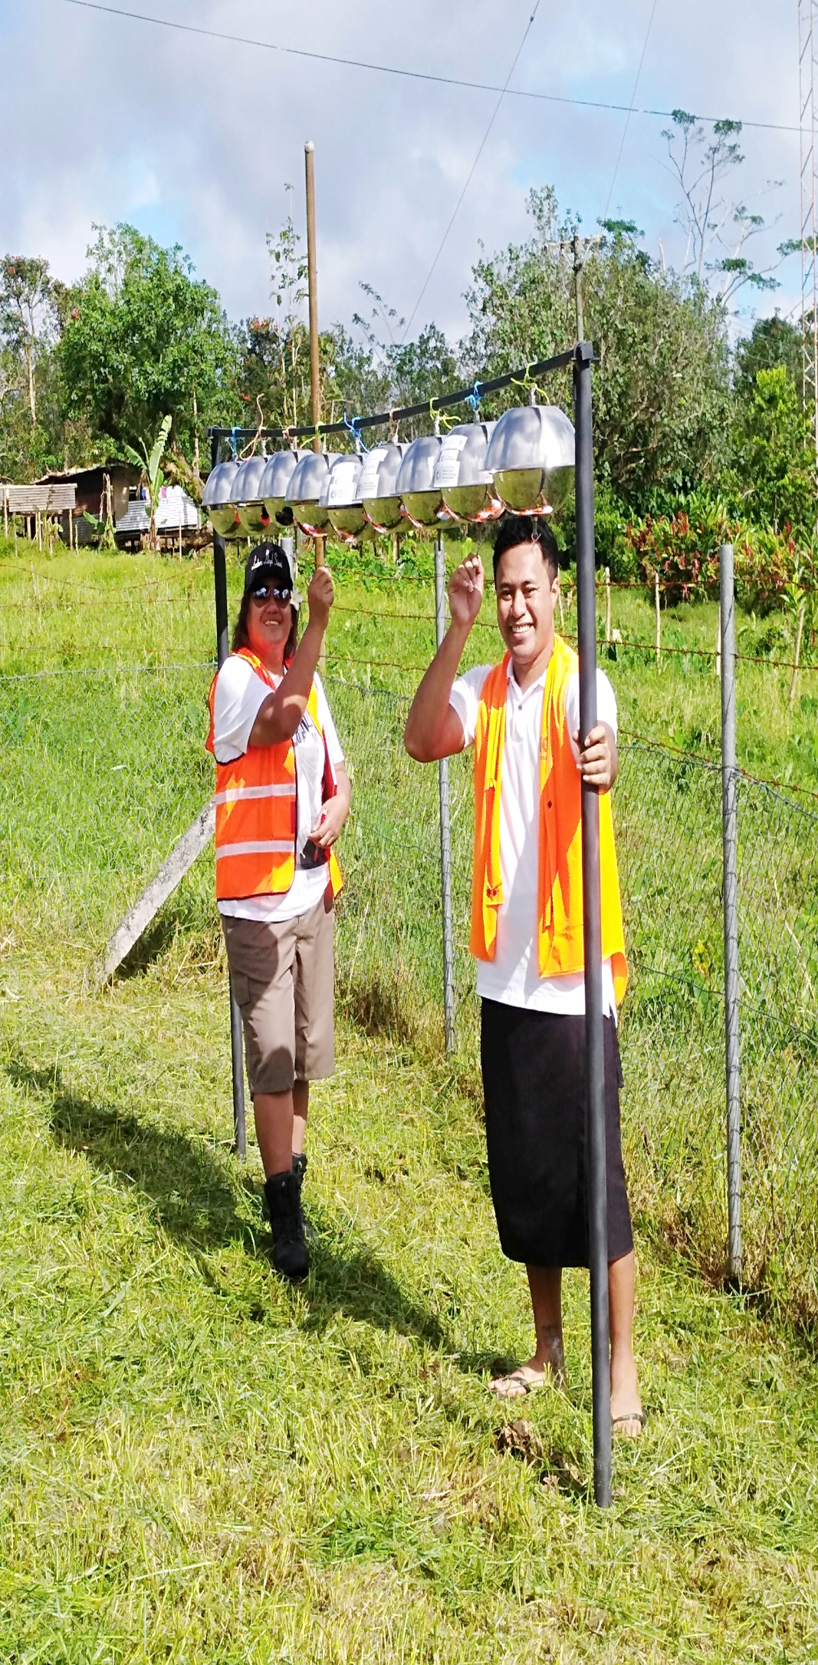
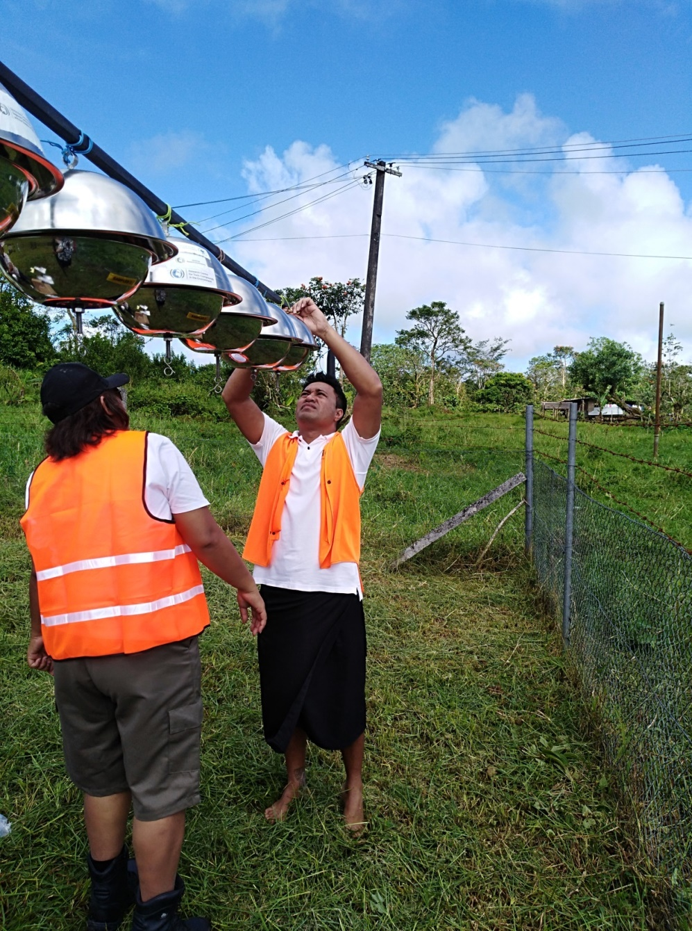

Slide 7
Human milk
Letter of request sent to MOH
Presentation request from MOH
Health research committee of MoH (approval & execution)
High Priority to implement as soon as possible

Slide 8
Facilities available to support implementation
Fridge available (storage samples)
Collaboration with MET (installation of air samplers & security)
Care taker & security fence erected

Slide 9
challenges
Government development: EPC (Need to change water sampling site)
Lack of coordination (MNRE vs MOH)
Non-compliance to work schedule (avoid delays)
Commitment from responsible staff (avoid further delays)

Slide 10
Lessons learnt & benefits
Capacity building for staff involved
Information gap for Samoa on POPs
Awareness of general public on POPs
Participation of community and understanding of POPs (human milk consultation)

Slide 11
Way forward
Finalize sampling site for Water (as soon as possible) – High priority
Implement Human Milk sampling using the most appropriate approach (High priority)
Revise work schedule for collection of samples and shipment timelines with strict compliance (High priority)
Improve communication with the Secretariat to provide progress and update
Shipment of samples as HIGH PRIORITY

Slide 12
Faafetai Lava! (Thank you)

