Slide 1
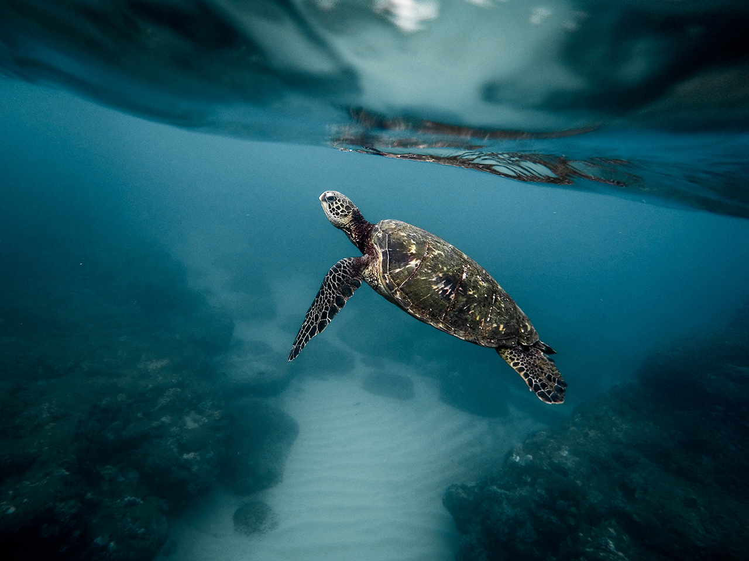
Country Presentation-RMI
Joann Komanta

Slide 2

Resources: Overview:
Kwajlein Local Government Air sampling- Ongoing
Rearlaplap Community Water sampling- Ongoing
MalGov Human Milk- Not yet started,
Ministry of Health (Kwajlein) (Before Dec 2018)
MIMRA (Marshall Islands Marine Resource Authority) National Interest: Fish & Eggs
(Before Dec 2018)
2

Slide 3
Facilities:
The Republic of the Marshall Islands doesn’t have any facilities and/or technology to help in terms of running test and to continue to do this kind of project on a long term.
RMI EPA Laboratory- Air & water samples stored
Hospital Lab- Not for POPS samples

Slide 4
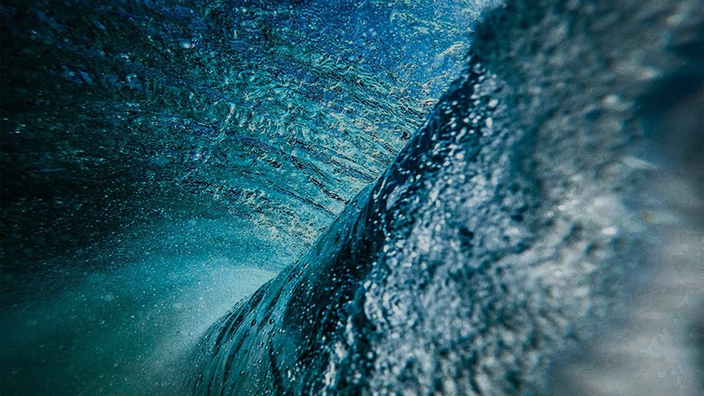
Progress
4

Slide 5
Progress
We’ve been able to hold numerous trips out to Rearlaplap. Five (5) trips in total. (Air sampling)
Recently were able to sit with the towns people of Rearlaplap and explain the purpose of the project.
Two trips were made to Ebeye to discuss human milk sampling. Unfortunately, because of some miscommunication and disagreement on the human milk sampling this project has just began. As of September 2018.
Meeting with hospital was done on September 2017.
Follow up meeting to help implement the project was done in June 2018, and the Kwajalein Atoll local Government is assisting with moving this particular part of the project.
As of August September 2018, hospital has finally given the green

Slide 6
Progress
light to go ahead and proceed with the project. Our Ebeye office had to tie what may have been lose strings from our end to get the project back on track.
Air Samples: Water Samples Human Milk & National Interest
May 20, 2017 June 5, 2017 Before Dec 2018
Sept 20, 2017 Sept 5, 2017
May 30, 2018 May 5, 2018
Aug 30, 2018 Sept 5, 2018

Slide 7
Challenges:
Logistics- Transportation
Challenges in terms of our air samples is there is no guarantee/safe transportation going out to Rearlaplap, Arno. Currently the only way to get to the air sampling spot is by boat.
Traveling to Ebeye is difficult as well. There are only two primary airlines and United is usually fully going to Kwajalein with military base staff and their family. Air Marshall, which is the airline for the RMI is full as well. For both airlines if you buy a ticket its not always guarantee you’ll have a seat, getting there, and in some cases getting back home.
Processing of financial papers ( Procurement) -More staff
Communication/Coordination
Hospital on Ebeye for awhile, wasn’t keen on joining this round because of miscommunication from their end. It took awhile and meeting from our Ebeye RMIEPA staff to get hospital to agree to come back on board to assist with this project.

Slide 8
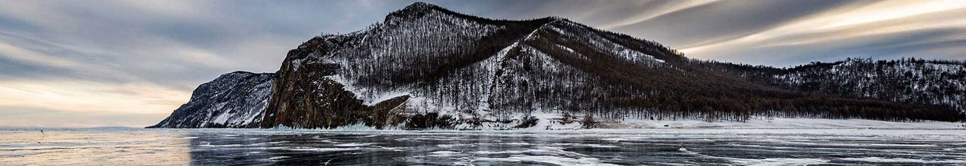
Lessons Learned:
Communication
Updates:
Team Work
Open communication from our end is a must. And keep that line available at all times. Not just when the team will be going out to collect samples and what not.
An update/outcomes should be given to the local governments, communities and hospital to better understand the importance of the project and it’s significant
Public awareness on POPS-
Working together and collaborating better with relevant stakeholders for better project results. Whether it be financial, data collecting etc. One person can not do it all. Ask for help where and when it’s needed with project manager and lab experts.

Slide 9
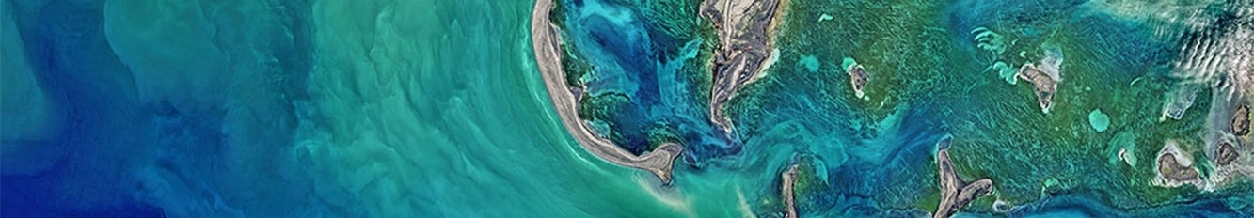
Benefits from the Project
Benefits:
This could be used to help with a new regulation the RMI is trying to create Air Pollution.
Opens more doors to educating the communities possible results could be used for further studies if needed.
Depending on the results, this information that can support other activities within the sectors on our islands.
If another study like this shall happen to take place we can use the final analysis to compare and contrast.
Able to understand sampling protocols.

Slide 10
Contribution
Fish Samples
Mangroves
We’ve partnered with MIMRA in hopes to collect fish samples
More awareness on POPS
Through this project, on our last trip to Anro, we were able to include an extra persons from the coastal department to assist with plotting the exact area of our project, as well as going out to assist the Mangroves.
Because there wasn’t much time, the coastal representative will have to go back, but we were able to help in getting one foot through the door.

Slide 11
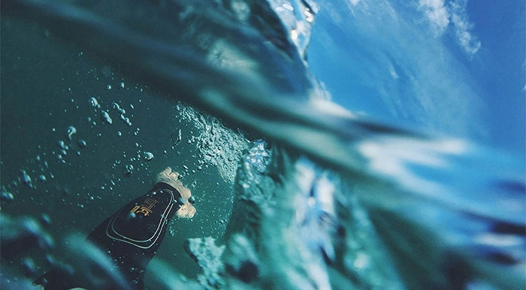
Quote and Image Slide
FUTURE EXPECTATION
“
We will continue to thrive and do better as we monitor towards the end of the GMP-2. Making an effort to be on time and send out materials within a time frame.
11

Slide 12
KOMOL TATA
Insert Image

