Slide 1

National Presentation:
Republic of Palau
Global Monitoring Plan 2
Midterm Workshop
Brisbane, Australia
17-18 September 2018

Slide 2
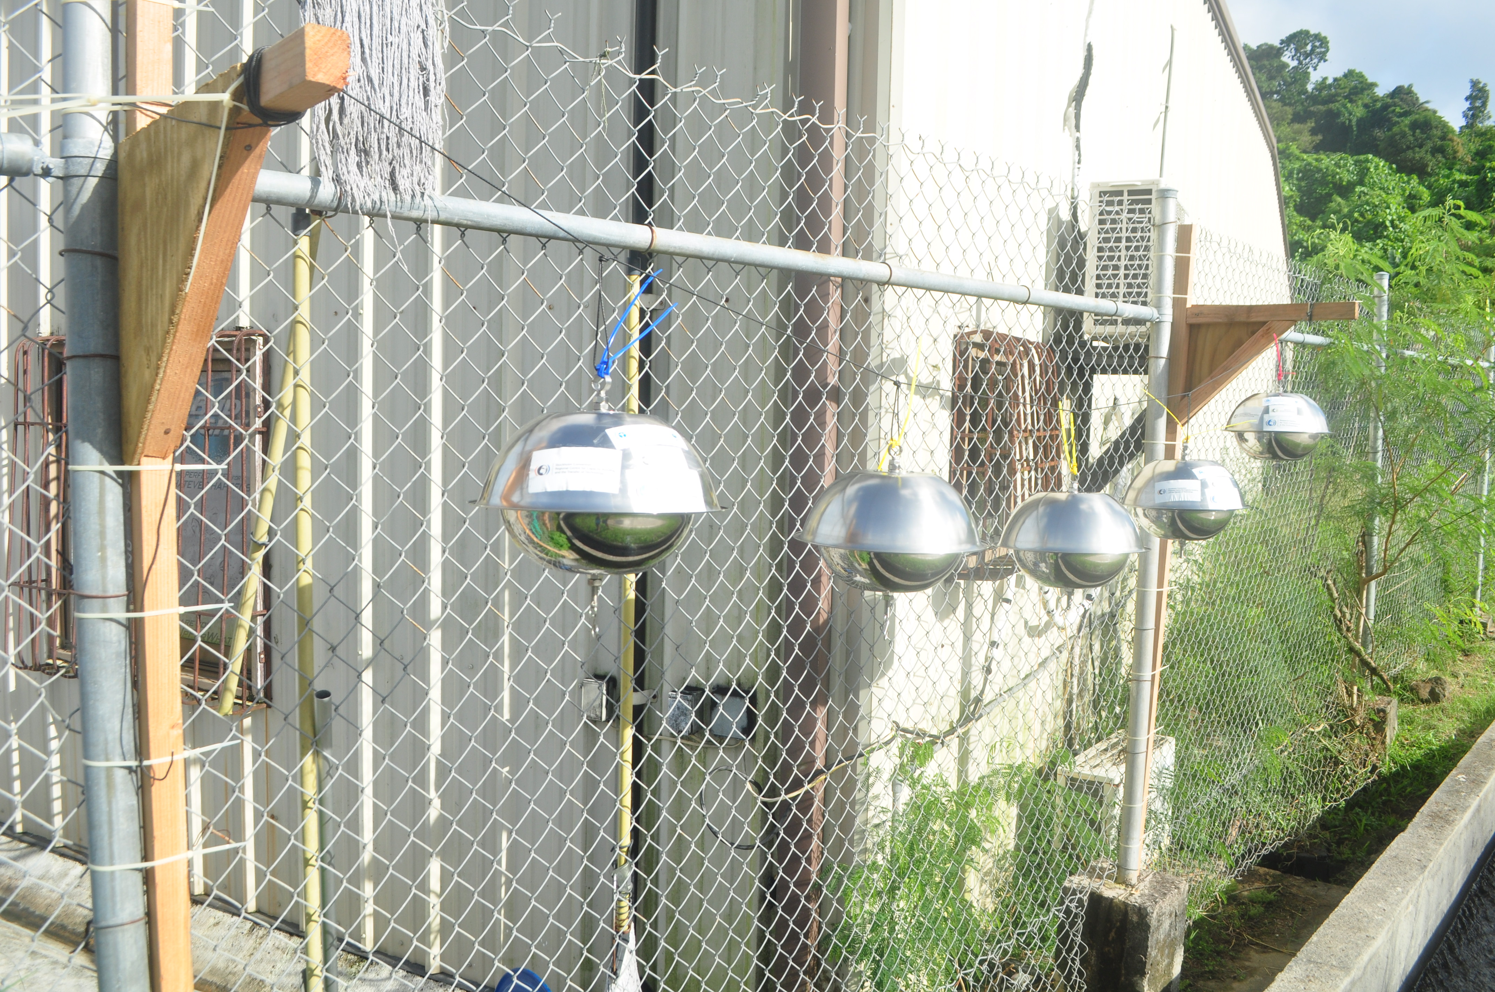
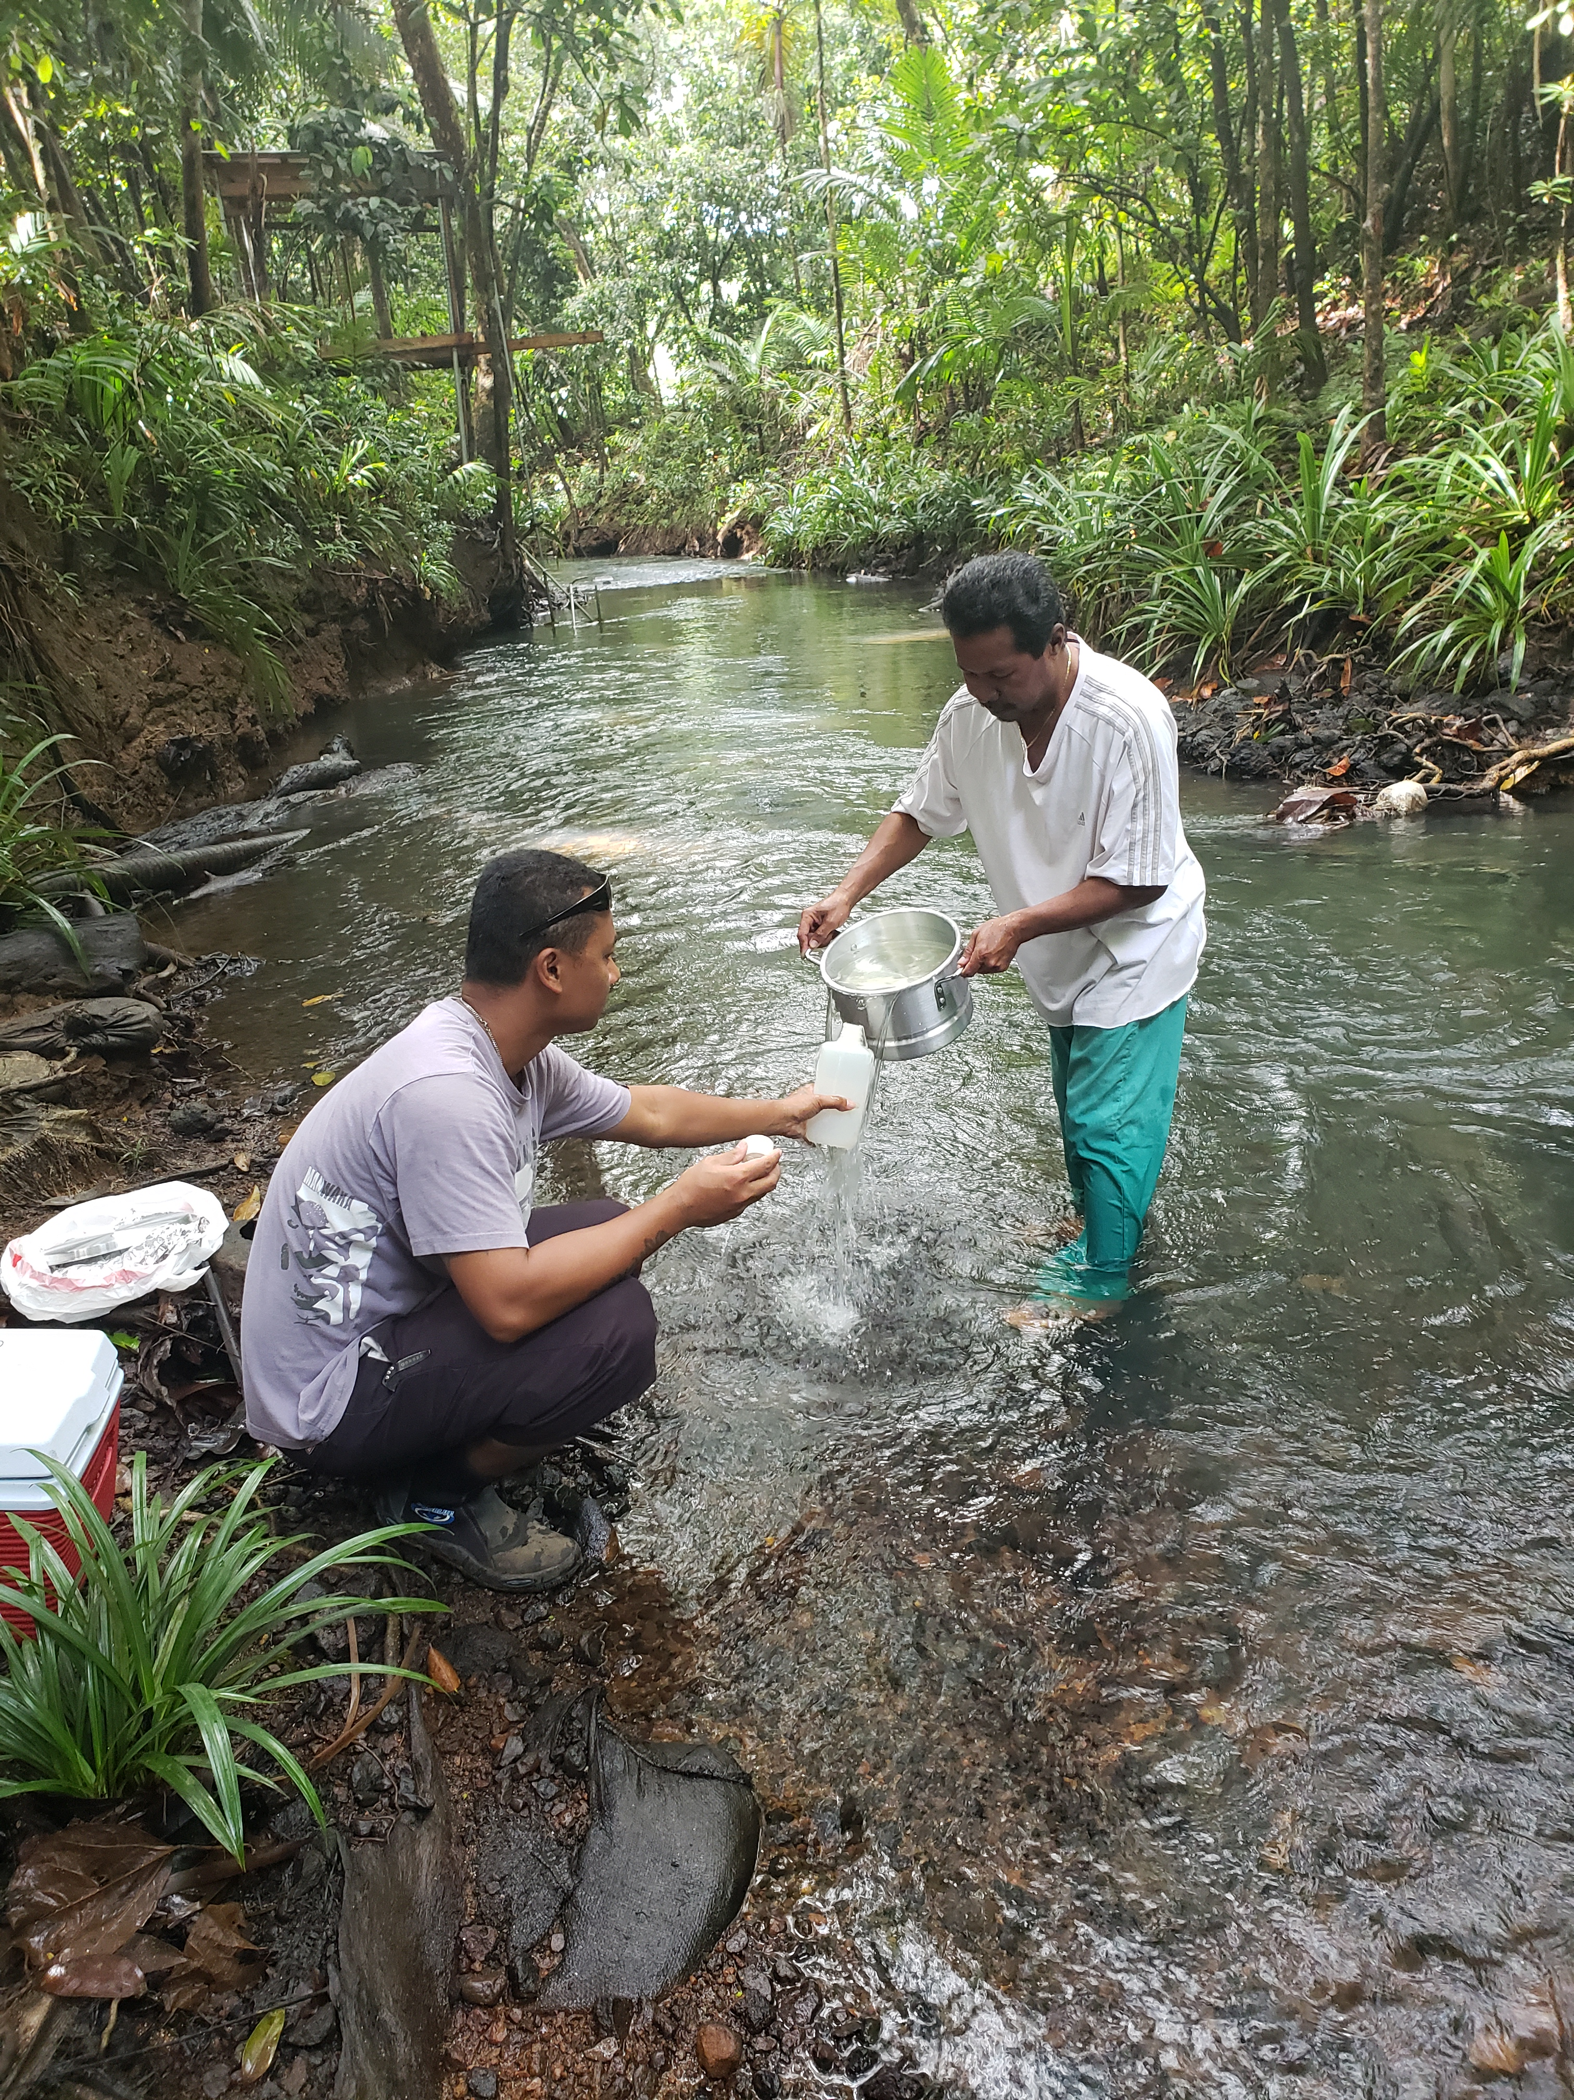
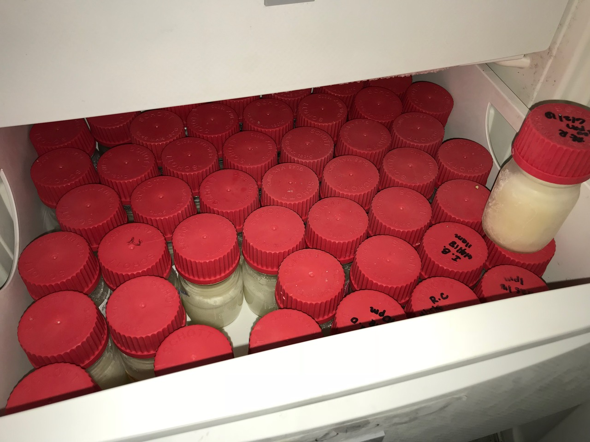
Overview of the activities under the project in Palau
Activity 1: Air Sampling
On schedule
Activity 2: Water Sampling
On schedule
Activity 3: Human Milk Sampling
Behind schedule: Not Sent
Collection complete
Activity 4: National Samples
Behind schedule
Some samples collected

Slide 3
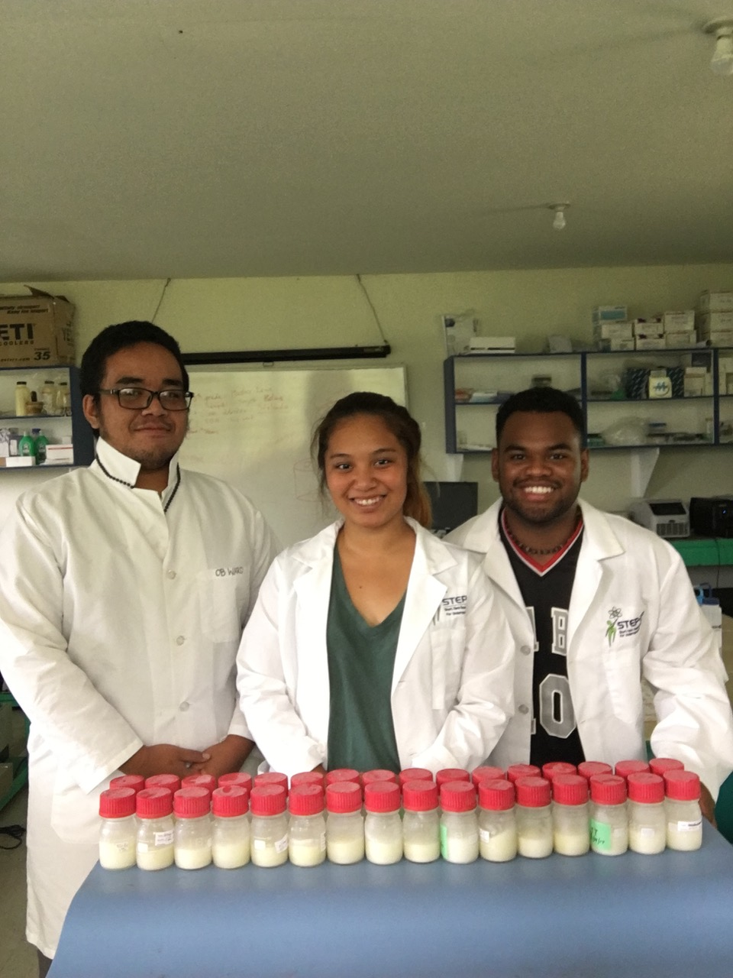
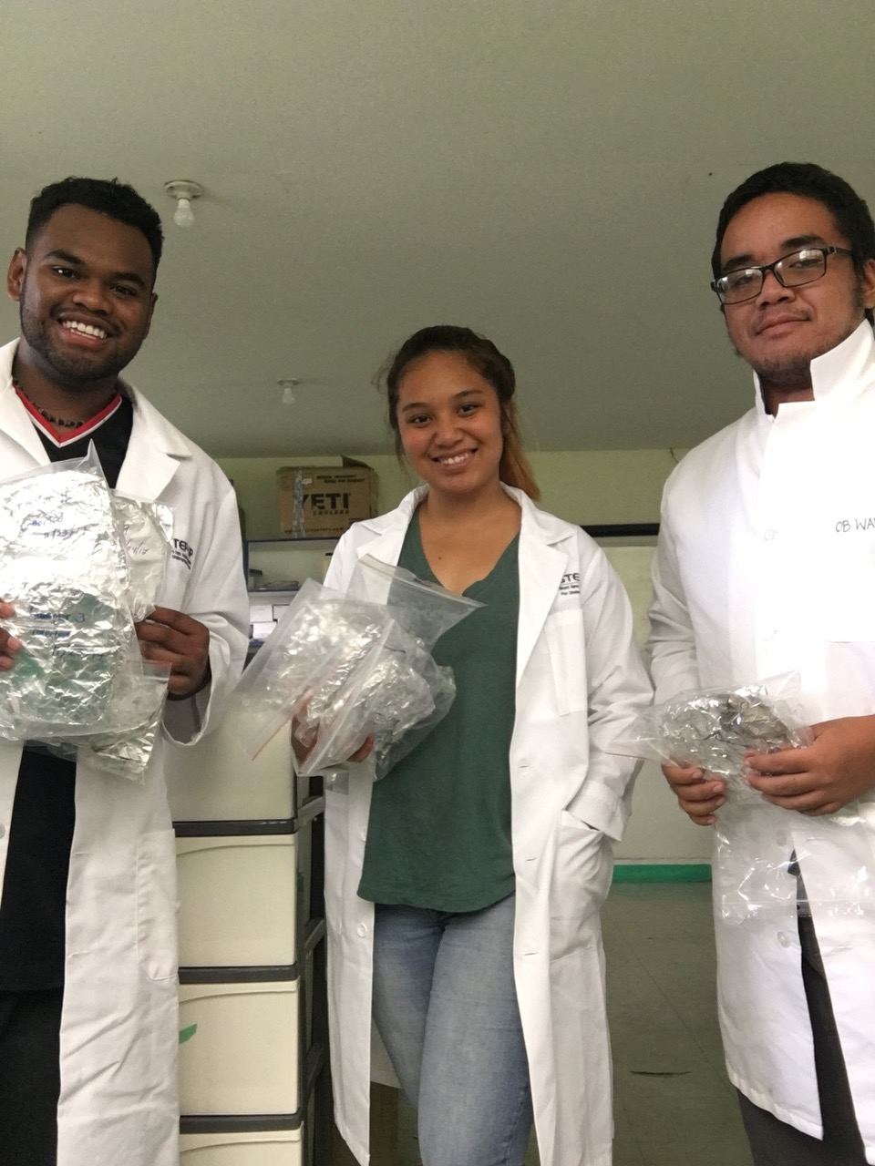
Facilities available to effectively implement the activities
Palau Community College Laboratory
EQPB Water Quality Laboratory
Pacific Institute for Academic Research
Memorandum of Understanding with Ministry of Health
National Chemicals Task Force (Developed through SAICM; Technical)
National Environment Protection Council (Political)

Slide 4
Progress
Activity 1:
Air Sampling
Set 1 – Complete
Set 2 – Complete
Set 3 – Complete (to be sent)
Set 4 – Complete (to be sent)
Set 5 – Complete (to be sent)
Set 6 – Complete (to be sent)
Set 7 – To be collected on 29 Sept
Set 8 – To be collected on 29 Dec
w/ blank
Sent to:
1,3,9 to IVM
5,11 to MTM
Activity 2:
Water Sampling
Set 1 – Complete
Set 2 – Complete
Set 3 – Complete
Set 4 – Complete
Set 5 – Complete
Set 6 – Complete (to be sent)
Set 7 – To be collected on
29 Sept
Set 8 – To be collected on
29 Dec w/ blank
Sent to: MTM
Activity 3:
Human Milk Sampling
Samples have been collected from 50 volunteers
Will be sent out by the end of the month with air samples.
Sent to: CVUA
Activity 4:
National Samples
2 Samples each collected:
Fish (Pelagic & Reef)

Slide 5
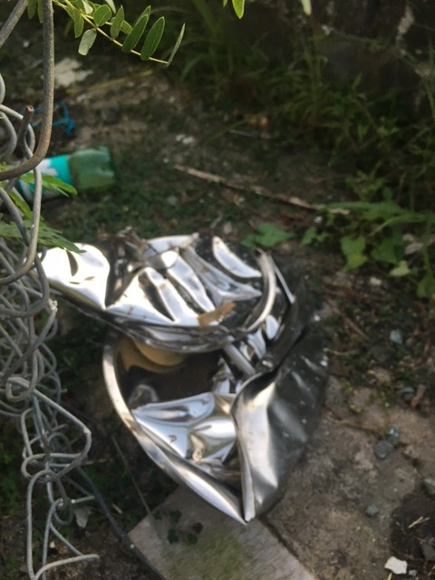

Highlights & Lessons learnt
Remember:
Communication
Follow-up
No matter how much you plan, sometimes things don’t go as planned!

Slide 6
How do the GMP project's outcomes benefit your country?
Building capacity on how to sample POPs
Provides data
    Addresses changes over time
Spreading awareness on POPs
    Presented during the 2nd National Environment Symposium
    Low concentrations (good news), but should not complacent

Slide 7
Any opportunities, collaborations and networks that the GMP project contributed or will contribute to:
Increased human resource capacity
  Palau Community College
  Pacific Academic Institute for Research (PAIR)
Increasing awareness on POPs (at the community level)
  Chemical Management
  Waste Management – reducing waste and improving landfill management
  Marine Pollution
  Hazardous Materials
  Open Burning – composting rather than burning

Slide 8
Sustainability in monitoring and future expectations
Strengthen institutional capacity
  Establishing chemicals management regulations that mandates monitoring
  I mprove a local laboratory

