Slide 1




Global Mercury Monitoring Project
17 November 2018, Geneva
Human Exposure to and Environment Concentration of Mercury
Project outcomes
UN Environment, Chemicals and Health Branch

Slide 2
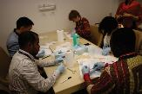
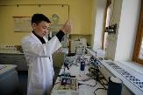
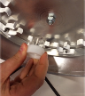
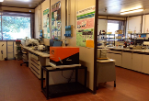




OVERVIEW
Objectives | To harmonize approaches for monitoring mercury in humans and the environment.
 | To strengthen the capacity for mercury analysis in humans and the environment to accurately determine their concentrations globally.
World Health Organization European Centre for Environment and Health
Italian National Research Council
Institute of Atmospheric Pollution Research
UN Environment
Chemicals and Health Branch
Global Environment Facility

Slide 3
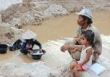



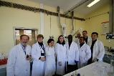

COMPONENTS
COMPONENT 1 - Review of existing information on human exposure to and environmental concentrations of mercury
COMPONENT 2 - Development of a monitoring plan on presence of mercury in ambient air
COMPONENT 3 - Development of a monitoring plan on human exposure to mercury

Slide 4
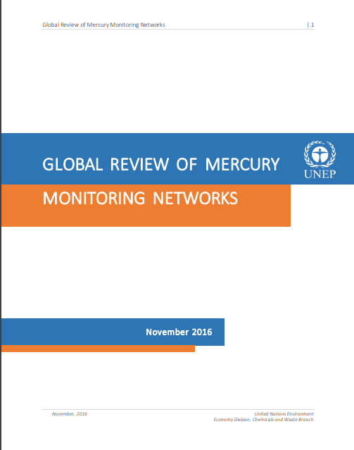
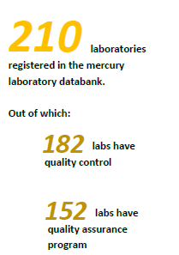
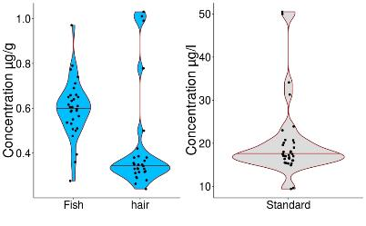
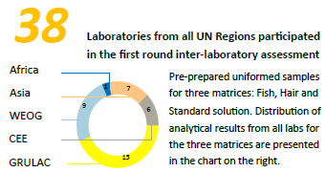
OUTPUTS
Notes:
COMPONENT 1 - Review of existing information on human exposure to and environmental concentrations of mercury

Slide 5
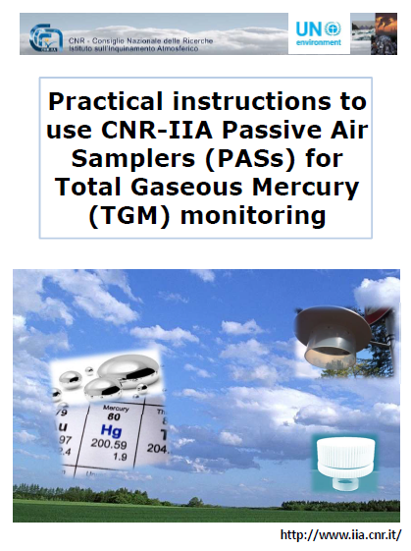
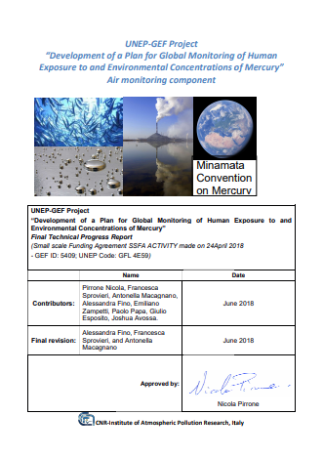
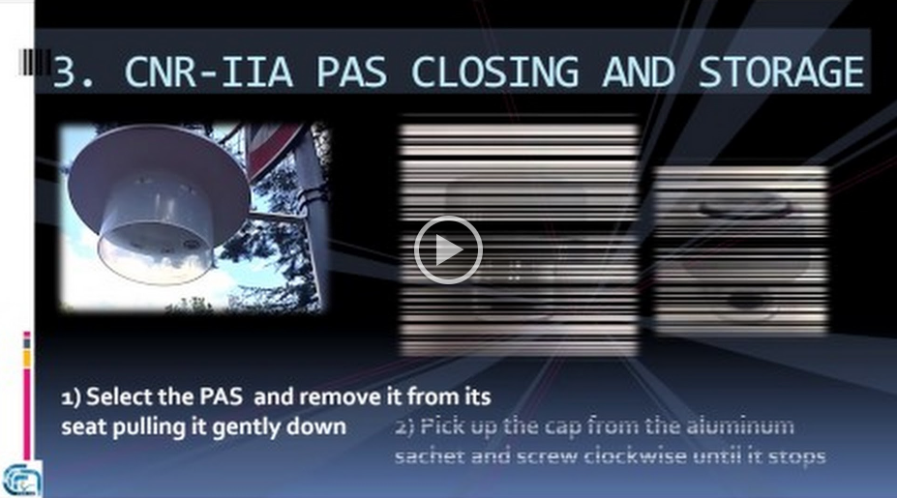
OUTPUTS
Network of stations for mercury atmospheric samples
One-year pilot testing of atmospheric mercury monitoring network
Elements to consider when developing air monitoring for mercury
Notes:
Assessment of prenatal exposure to mercury
Survey Protocol guide for assessment of prenatal exposure to mercury using biomarkers in cord blood, maternal urine and hair

Slide 6
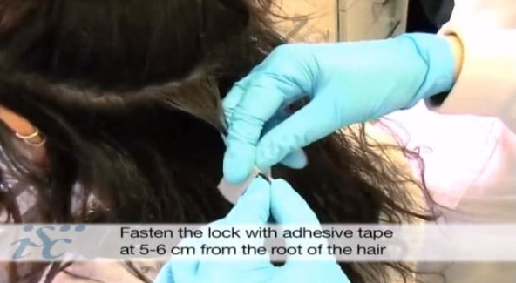
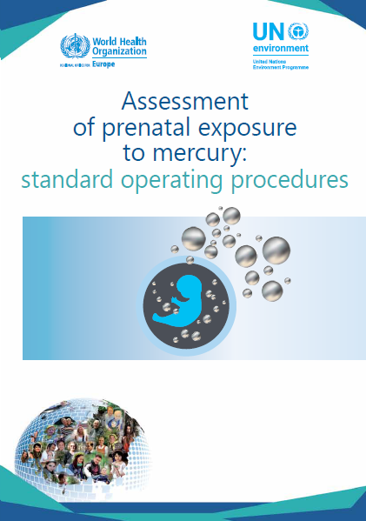
OUTPUTS
Standard Operating Procedures for human biomonitoring of mercury
Network for mercury biomonitoring and harmonized protocols for national assessment are available
Elements to consider when developing human biomonitoring for mercury
HBM survey assessment:
Site specific protocols in:
China
Ghana
India
Mongolia
Russia F.
Kyrgyzstan
English & Spanish v

Slide 7
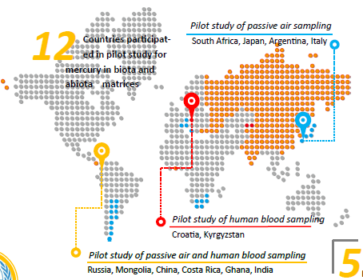

Slide 8
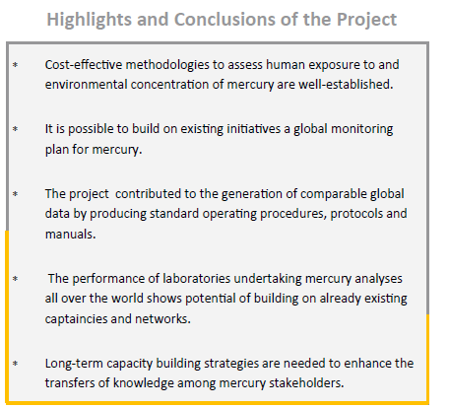
17 November 2018, Geneva

Slide 9
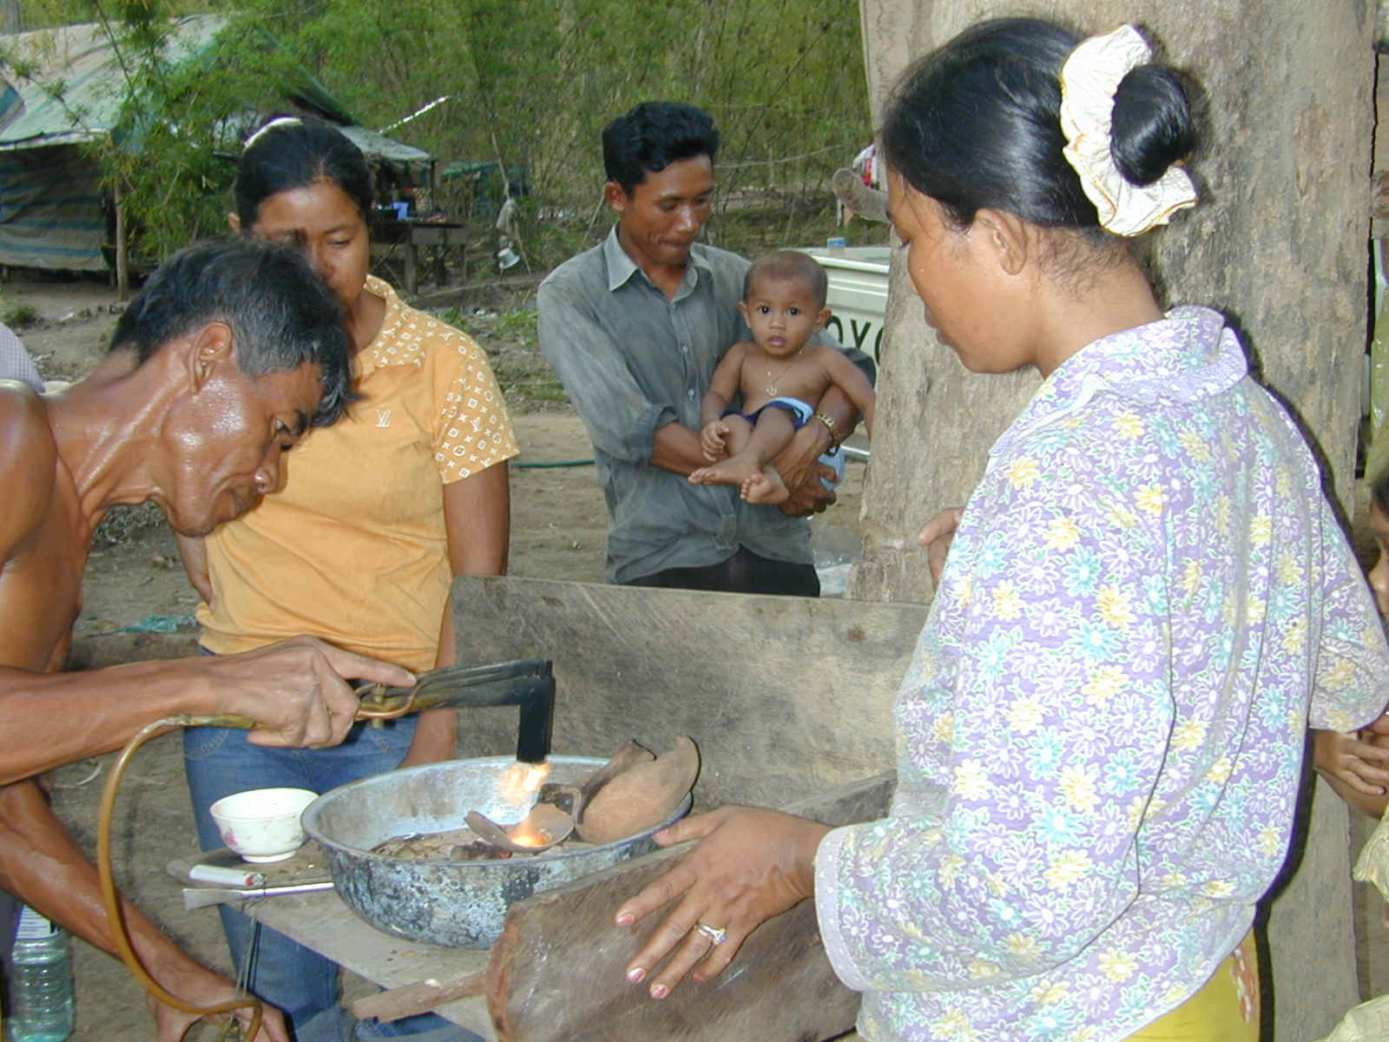
Thank you
17 November 2018, Geneva

