Slide 1
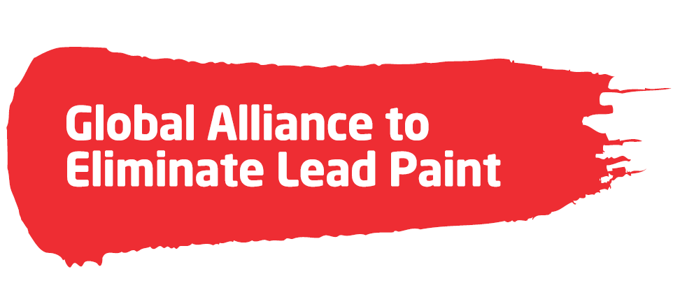
Overview of Global Efforts to Eliminate Lead Paint
Side Event at the African Ministers of Environment Conference

Slide 2
Outline
Lead Paint Background
Health and Economic Impacts of Lead
Overview of Lead Paint Alliance
Status of Lead Paint Laws
Recent Momentum
Region-Specific Activity
Resources

Slide 3

Lead is Poisonous
Lead’s lifelong consequences are borne by the affected children, their families, and society at large.
There is NO safe level of exposure to lead!
Globally, lead in paint is a major source of childhood lead exposure.
Notes:
There is no known safe level of lead exposure. Even low levels of lead exposure may cause lifelong health problems.

Slide 4
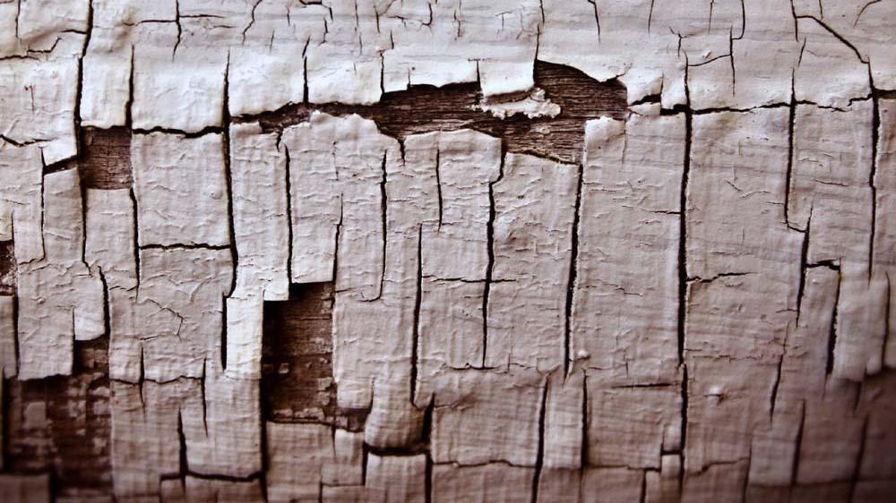
Why is Lead Paint a Problem?
Lead compounds are added to paints to improve drying time and color brightness.
Paint breaks down over time, fragmenting into flakes and dust that contaminate the domestic environment, air, and soil.
  Lead is a persistent neurotoxicant, and when released does not break down.
  Once released into the environment, potential for human exposure for persists many years into the future, which is especially harmful to children.
Lead exposure also happens during the manufacture, application, and removal of lead paint.
The term paint is used throughout this presentation broadly to include varnishes, lacquers, glazes, stains, enamels, primers, and coatings.

Slide 5
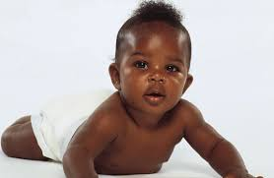
Children are at High Risk!
Unborn babies and young children are especially at risk.
  Pregnant women can pass lead to their unborn baby.
  Babies and young children put their hands and other objects into their mouths. If lead dust or paint chips are present in their environment, they can ingest lead.
Growing bodies absorb more lead, since lead is absorbed into the bloodstream before settling in the bones.
Notes:
· Lead is especially dangerous to children's developing brains, and causes reduced intelligence quotient (IQ) and attention span, impaired learning ability, and increased risk of behavioral problems.

Slide 6
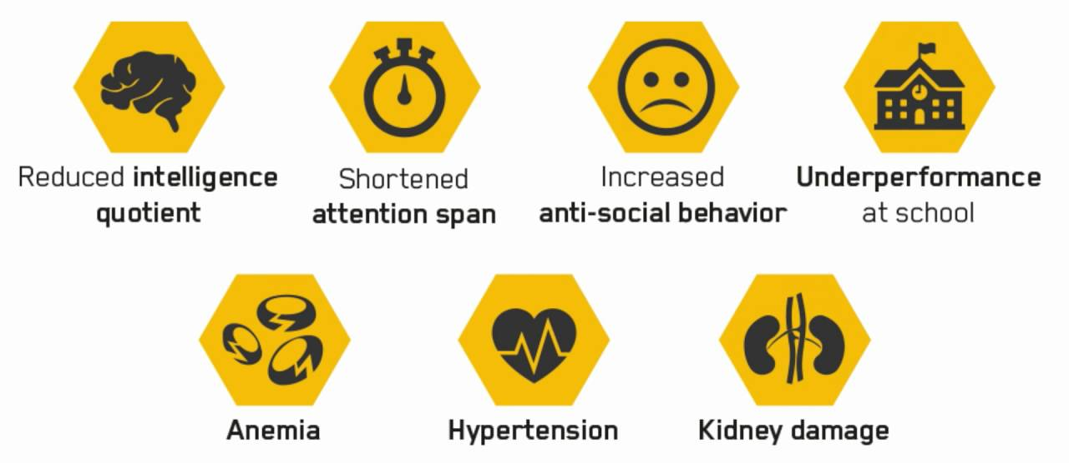
Health Effects
Exposure to lead in children has permanent negative impacts on children’s developing brains.
It can have life-long, negative consequences, such as:
Notes:
· Lead is toxic to multiple body systems, including the central nervous system and brain, the reproductive system, the kidneys, the cardiovascular system, and the blood and the immune system.

Slide 7

Individual Children & Global Costs
Childhood lead exposure (from all sources) has staggering economic costs.
  Reduction in intelligence quotient (IQ) can be correlated with decreases in lifetime earning potential.
Lead exposure costs $977 billion annually to low and middle-income countries from children’s lost IQ.
  In Africa, it costs $135 billion.
  Latin America: $142 billion
  Asia: $700 billion
Source: NYU School of Medicine http://www.med.nyu.edu/pediatrics/research/environmentalpediatrics/leadexposure
Notes:
An NYU study has estimated the annual cost of children's lost IQ in low and middle income countries at $977 billion – almost a trillion dollars per year.
For some countries the economic cost is 3, 5 or even 7 percent of their GDP.

Slide 8
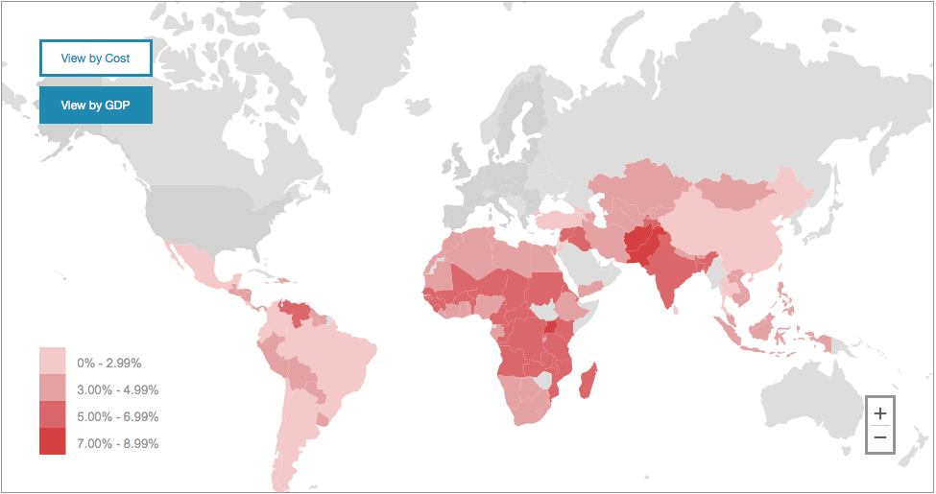

Economic Costs of Childhood Lead Exposure in Low-and Middle-Income Countries
An interactive map based on the findings of a New York University (NYU) analysis displays cost and corresponding percent loss to GDP in 110 low- and middle-income countries.
Source: NYU School of Medicine http://www.med.nyu.edu/pediatrics/research/environmentalpediatrics/leadexposure
Notes:
Web-Based Awareness Tool - Interactive map based on the findings of NYU analysis displays cost and corresponding percent GDP loss for 110 low and middle income countries.
A new map from NYU can help countries understand the economic cost of childhood lead exposure in their countries.
This map enables you to click on your country and see the economic cost of childhood IQ loss.
The map displays both the economic cost in dollars and the percent GDP loss for each country.
This view shows the impact in percentage of GDP lost. As you can see, there is a tremendous impact , with some countries losing more than 5% of their GDP because of the impact of lead exposure to their children.

Slide 9
Select African Country Results
A full report by NYU researchers is available online and by request.
Country | Annual Cost (billion $) | % GDP
Algeria | 11.83 | 3.77
Cameroon | 2.52 | 5.28
Côte d’Ivoire | 1.76 | 4.85
DR Congo | 1.52 | 5.99
Egypt | 17.79 | 3.41
Kenya | 3.76 | 5.26
Madagascar | 1.19 | 5.73
Nigeria | 16.22 | 3.94
South Africa | 17.71 | 3.17
Zambia | 1.44 | 6.59

Slide 10
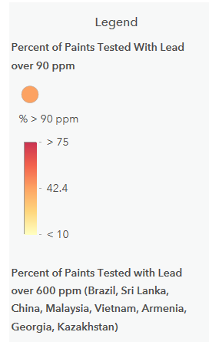
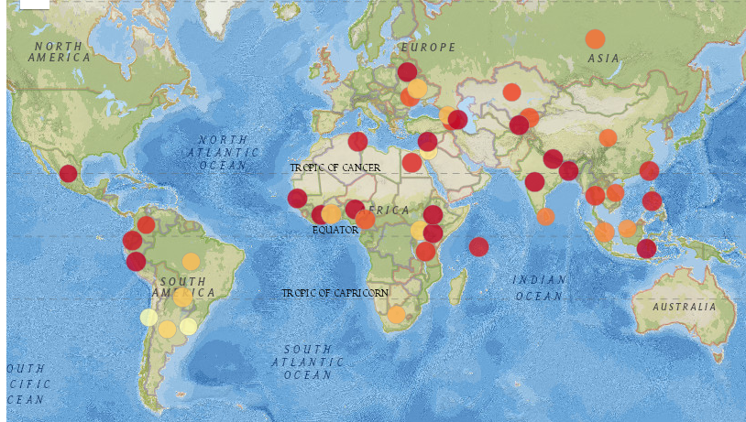
Lead Paint Testing Around the World
High levels of lead found in paint.
Source: IPEN 2016; http://ipen.org/projects/eliminating-lead-paint/lead-levels-paint-around-world
Notes:
This map shows that paints around the globe have levels of lead that are dangerous. It shows the percent of lead paint levels over 90 ppm (or 600 ppm depending on the country).
The darker the color the more paints tested are over 90 ppm, which is the current best, technically achievable level of lead in paint (and the standard in the US and other countries).
You can see from the dark dots, that in most of the countries where paints were tested, most paints (over 75%) are over 90 ppm.
In fact, in many countries levels well about 10,000 even 100,000 were found.
Most of these countries do not have laws. Chile (90 ppm), Uruguay (90 ppm), Brazil (600 ppm), Mexico (600 ppm), China (90 pm soluble) and Russia (5,000 ppm) are some of the countries with laws.

Slide 11
Lead Paint Levels in Africa
Country | # of Paints | Year of Study | % < 90 ppm | % < 600 ppm | % < 10,000 ppm
Benin | 28 | 2017 | 79% | 71% | 36%
Cameroon | 35 | 2017 | 43% | 40% | 15%
Cote D’Ivoire | 44 | 2017 | 63% | 59% | 27%
Egypt | 58 | 2017 | 62% | 26% | 3%
Ethiopia | 36 | 2017 | 75% | 72% | 42%
Ghana | 18 | 2013 | 33% | 28% | 17%
Guinea | 18 | 2017 | 28% | 6% | 0%
Kenya | 31 | 2017 | 69% | 55% | 33%
Morocco | 33 | 2017 | 39% | 39% | 18%
Mozambique | 32 | 2017 | 25% | 25% | 12%
Nigeria | 23 | 2017 | 74% | 72% | 54%
Senegal | 21 | 2009 | 86% | 76% | 19%
Seychelles | 28 | 2009 | 68% | 61% | 43%
South Africa | 29 | 2009 | 38% | 34% | 31%
Sudan | 25 | 2017 | 64% | 56% | 28%
Tanzania | 46 | 2017 | 46% | 37% | 22%
Togo | 27 | 2017 | 30% | 15% | 7%
Tunisia | 30 | 2013 | 70% | 63% | 27%
Uganda | 50 | 2017 | 67% | 57% | 37%
Zambia | 39 | 2017 | 36% | 33% | 18%

Slide 12
Global Alliance to Eliminate Lead Paint
The Global Alliance to Eliminate Lead Paint (Lead Paint Alliance) is a voluntary, global public-private initiative formed by:
  Secretariat: UN Environmental Programme and World Health Organization
  Chair of Advisory Group: U.S. Environmental Protection Agency
  Partners, including governments, NGOs, industry, and academia
The Alliance is modeled on successful on another successful public-private initiative, the Partnership for Clean Fuels and Vehicles.
Alliance Goal: Establish lead paint laws in every country
Notes:
The Lead Paint Alliance was created to address these challenges. Our goal is to phase out lead in paint worldwide by establishing laws in every country by 2020.
The Lead Paint Alliance is a voluntary partnership that is jointly led by the World Health Organization and UNEP.
Partners to the alliance include government agencies, NGOs, Industry and academics.
Models PCFV, which was successful in phasing out lead in gasoline.
The Lead Paint Alliance is currently working with countries to support them in establishing laws to eliminate lead in paint.

Slide 13








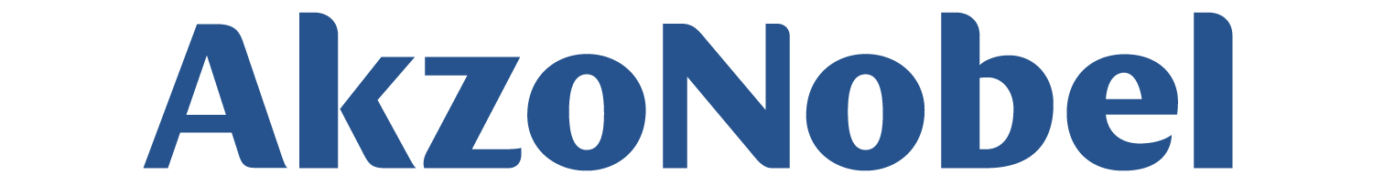
Lead Paint Alliance Advisory Council
Governments
Colombia
Kenya
Republic of Moldova
Thailand
United States of America (Chair)
NGOs
Industry
Flags Designed by Freepik; https://www.freepik.com/free-vector/flags-of-the-world-collection_837815.htm.
Notes:
A subset of governments from each major region in the world, industry, NGOs and international organizations are members of an Advisory Group. EPA serves as the Chair of the Alliance Advisory Group.

Slide 14
Action Needed on Lead Paint
Countries in the developed world banned lead in paint in 1970s and 1980s.
However, in most of the developing world, lead paint is still legal.
Alternative paints without added lead are affordable and widely available
Voluntary labeling of paints is not effective.
Industry and governments agree that the solution is enacting lead paint laws in countries worldwide.

Slide 15
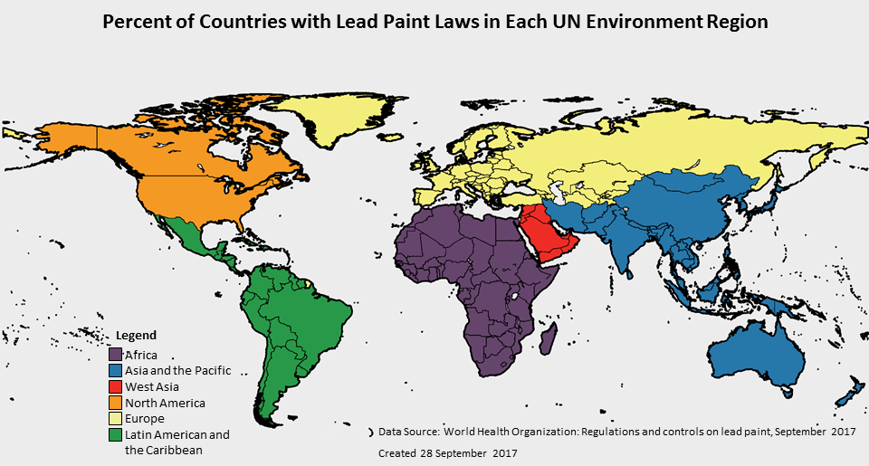
Percent of Countries with Lead Paint Laws in Each UN Environment Region
74%
100%
20.5%
7.4%
18.2%
33%
15
Notes:
Note: for UN Environment, Israel is part of the Europe region
This map is from the most recent Global Status update and it shows the work that needs to be done – it shows the percentage of countries where lead paint laws have been confirmed by WHO.
Only 34.7% of all countries in the world have lead paint laws
You can see we have a lot of work to do in most regions of the world.
And with significant national health and economic impacts from lead in paint, it is an issue that must be addressed and can be solved

Slide 16
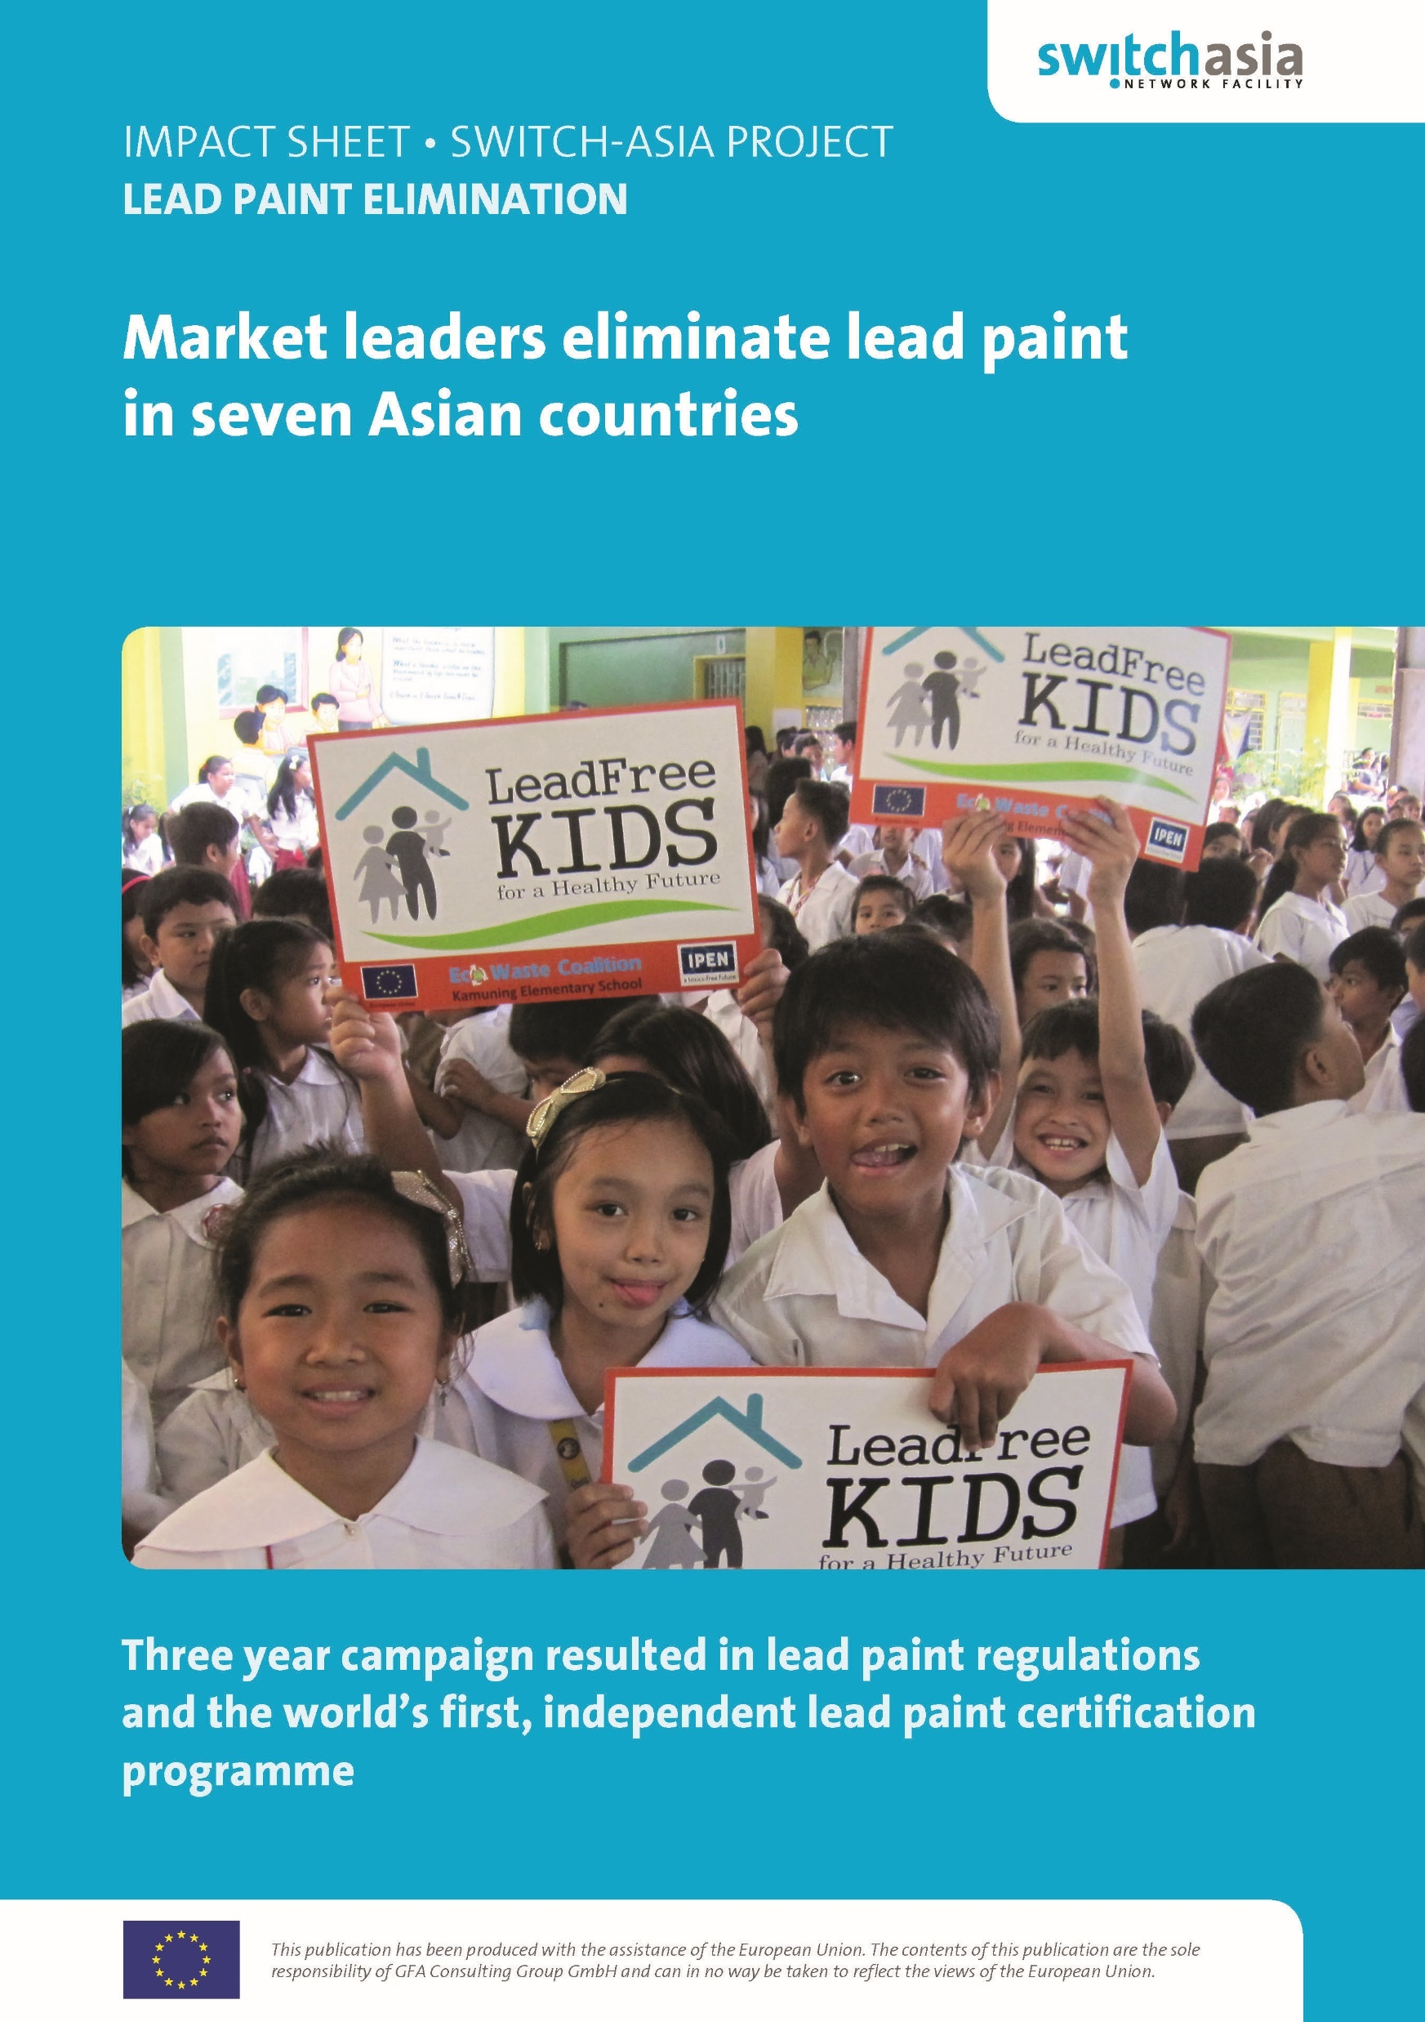

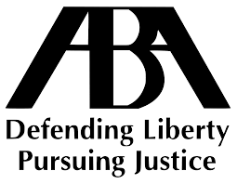
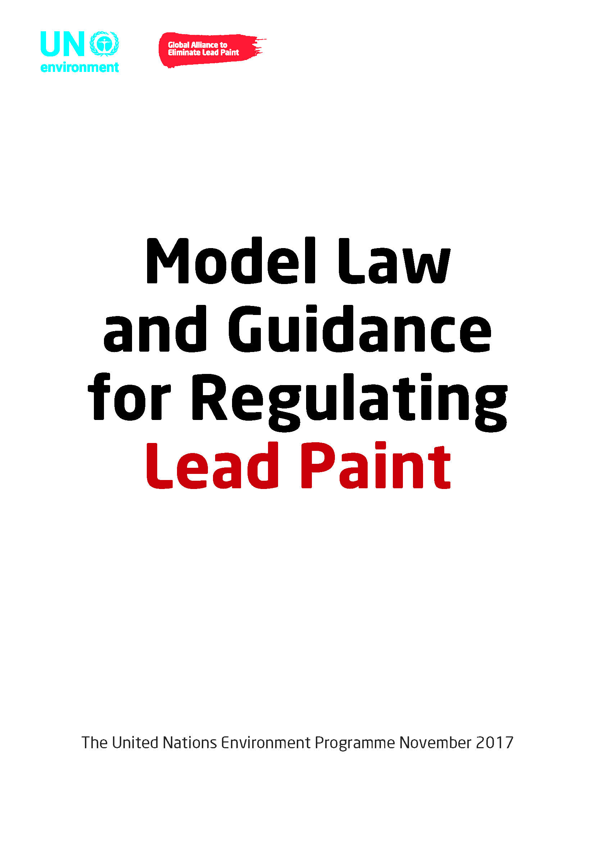
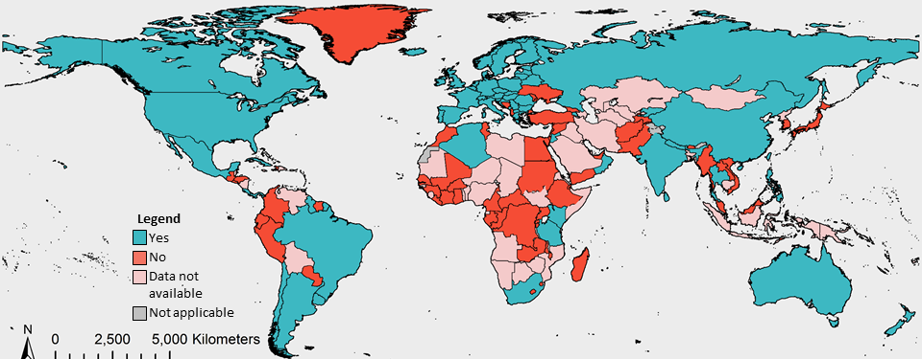
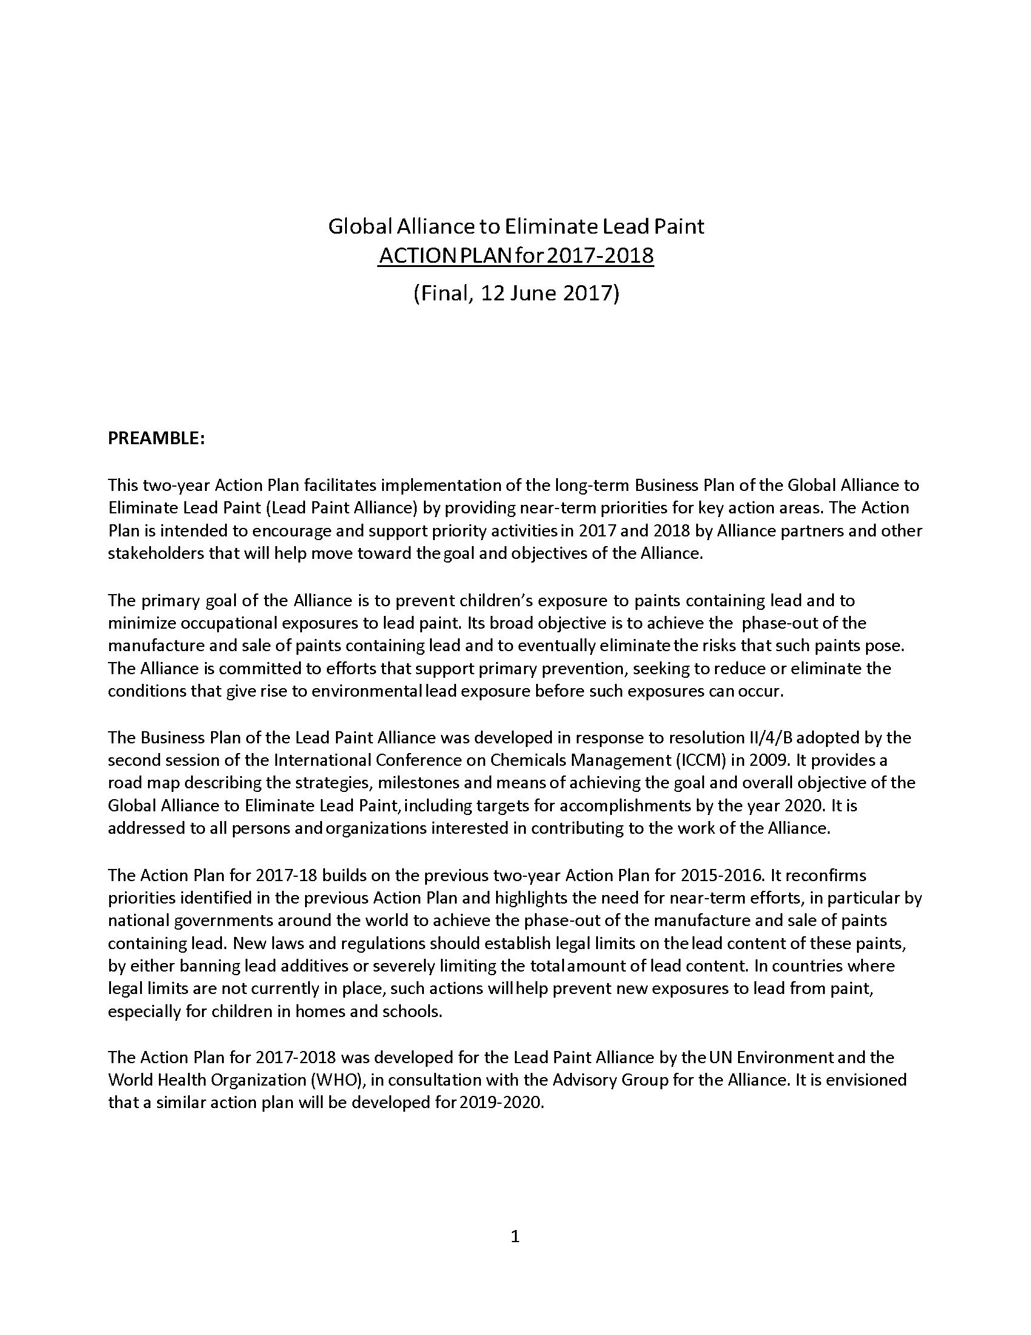
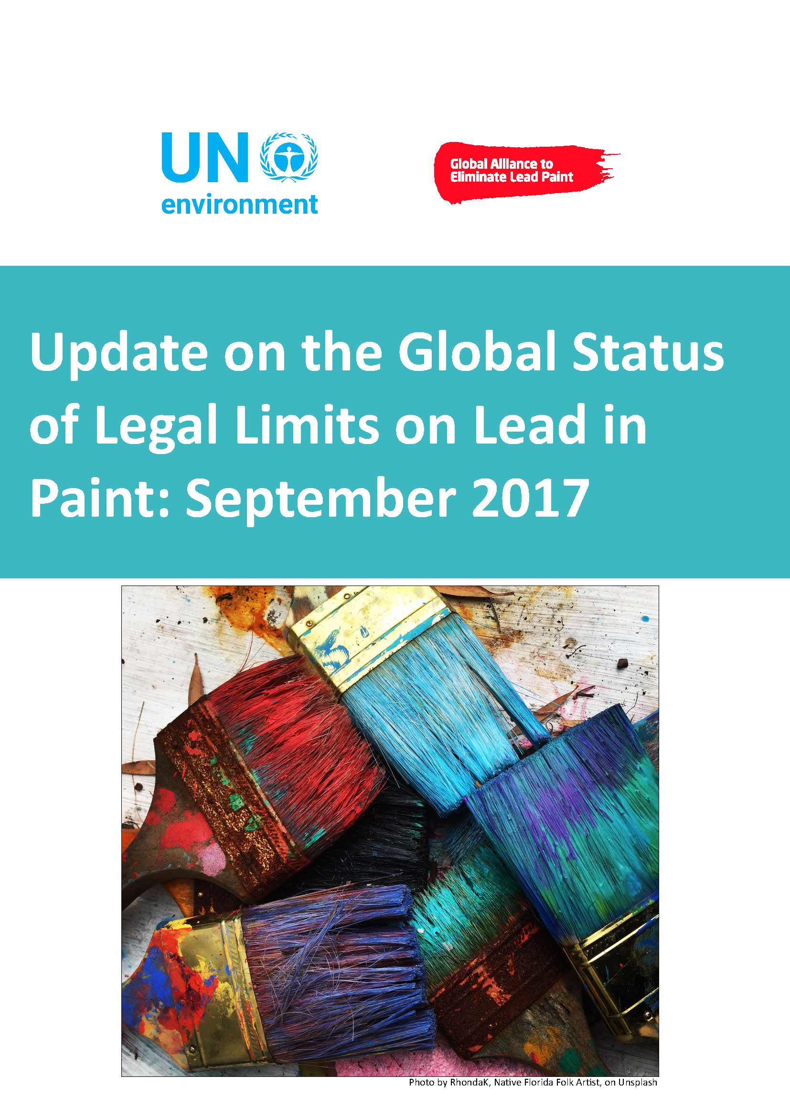


Growing Momentum
2009-2016
American Bar Association Resolution to Support Lead Paint Laws Worldwide
GEF Global Lead Paint Project
SWITCH-Asia Lead Paint Elimination Project
Roadmap for Health in Chemicals Management
Model Law
& Guidance
August 2017
November 2017
2018-2021
2012-2015
May 2017
SAICM establishes the Lead Paint Alliance
GEF Lead Paint Elimination Project in Africa
2017-2018 Lead Paint Alliance Action Plan
UNEA-3 Resolution on Lead Paint
Global Status Update
2009
2014-2017
June 2017
September 2017
December 2017
2009-2016
2017
2018
Notes:
There is growing momentum on lead paint globally. You can see here the many accomplishments on lead paint with accelerating action in recent years.
UNEP Lead Paint Model Law & Guidance (Nov 2017)
UNEA3 Resolution on Lead Paint (Dec 2017)
UNEP Update on Global Status of Laws (Sept 2017)
American Bar Association (ABA) Resolution to Support Lead Paint Laws World-wide (Aug 2017)
World Health Assembly Roadmap for Health in Chemicals Management (May 2017)
Global Environment Facility’s Funding to UNEP for Global Lead Paint Project (2019)
World Bank Report on Lead (to be final by March 2018)
US Dept of Commerce, Commercial Law Development Program: Project on lead paint for Central Asia (ongoing)

Slide 17
ABA Resolution
Adopted August 2017: Urges national governments worldwide to enact laws to phase out the manufacture, import, and sale of lead paint.
Supports efforts of the international community, governments, industry, and non-governmental organizations to promote the phase-out of lead paint by no later than 2020.
Urges lawyers, law firms, bar associations, and other professional and nonprofit organizations to support adoption and implementation of laws to phase out and eliminate lead paint through pro bono support, educational initiatives, and other appropriate means.

Slide 18
UNEA-3 Resolution
The Third United Nations Environment Assembly passed a resolution in December 2017 to address lead paint that encourages governments to:
  Develop, adopt and implement legislation/regulations
  Support the development of private sector strategies to eliminate lead paint
  Undertake actions to remove the risks from lead paint especially to vulnerable groups
  Join the Lead Paint Alliance
The resolution also requests the Executive Director of UN Environment to assist countries to eliminate lead paint, providing tools and capacity building for developing national legislation and regulations.
Notes:
The third United Nations Environment Assembly (December 2017) passed a resolution to address lead in paint. The resolution emphasizes the importance of reducing exposure to lead, recognizes the progress made by the Global Alliance to Eliminate Lead Paint (including the release of the Model Law and Guidance for Regulating Lead Paint), and expresses strong determination to continue to reduce exposure to lead, including by eliminating lead paint.
Specifically, the resolution encourages governments to:
develop, adopt and implement legislation/regulations,
support the development of private sector strategies to eliminate lead paint, and
undertake actions to remove the risks from lead paint, especially to vulnerable groups.
The resolution also invites governments and other relevant stakeholders to join the Alliance. It also requests the Executive Director of the United Nations Environment Programme to assist countries to eliminate the use of lead in paint, in particular providing tools and capacity-building for developing national legislation and regulations.

Slide 19
Progress and Momentum in Africa
Lead paint testing and workshops helped bring about new lead paint laws in Cameroon, Ethiopia, Kenya, and Tanzania.
  Paint testing was conducted in 13 countries in the African Region.
  Depending on the country study and the target level, levels of lead exceeding target levels of 90 ppm to 600 ppm have ranged from 26% to 100% of samples.
Workshops to promote lead paint laws in East Africa:
  December 2015: East African regional workshop held in Addis Ababa, Ethiopia.
  September 2016: Follow-up workshop was held in Dar Es Salaam, Tanzania to assist the East African Community (EAC) in working towards harmonized regional standards for lead in paint set at 90 ppm.
  December 2016: Kenya finalized its lead paint law.
Workshops to promote lead paint laws in Central and West Africa:
  December 2016: A Central and West African workshop was held in Yaoundé, Cameroon, including participants from other countries in Economic Community of West African States (ECOWAS).
Notes:
This workshop is the first time the model law was presented.
The Caribbean Lead Paint Workshop was held in Kingston, Jamaica in December and was the first UN workshop to publicly present the Model Law and Guidance for the Regulation of Lead in Paint
To present the new Model Law, the Lead Paint Alliance worked closely with the legal community, partnering with the American Bar Association Rule of Law Initiative and the University of the West Indies Norman Manley Law School.
The experiences shared by countries with laws and those without laws highlighted the importance of adjusting the model law to meet the legislative structure of each unique country
The workshop was a successful pilot for how future workshops around the globe will focus on the development of lead paint laws

Slide 20
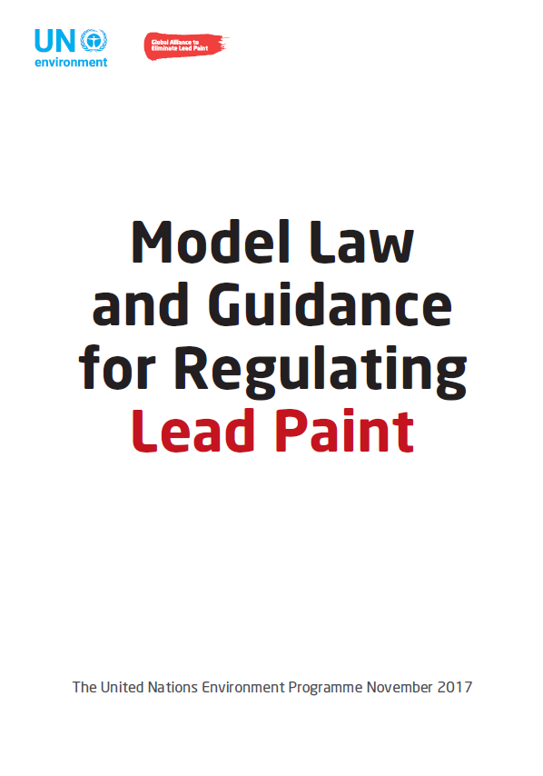
Model Law
Requested by governments
Development supported by industry and NGOs
Provides best available and practical regulatory approach by:
  Encouraging a consistent lead limit of 90 ppm and regulatory approach.
  Reducing global demand for lead paint through lead limits on both imported and locally-produced paints
  Reducing trade barriers through consistent standards
It is adaptable to each country’s regulatory framework.
Provisions include:
    Definitions
    Clear limit on total lead
    Setting effective dates
Compliance and enforcement provisions
Consequences for non-compliance

Slide 21
Global Environmental Facility (GEF)
Project
Global best practices on emerging chemical policy issues of concern under SAICM
SAICM project with a lead component
Managed by UN Environment
Partners include:
  World Health Organization
  IPEN
  American Bar Association Rule of Law Initiative
  U.S. Environmental Protection Agency
  National Cleaner Production Centers and industry
Notes:
The Global Environment Facility (GEF) has funded UN Environment to conduct a project on lead paint that is starting soon and will run through 2021
It has legal goals of getting 40 countries to pass lead paint laws / or improve existing laws
Legal activities will be implemented by IPEN and the American Bar Association Rule of Law Initiative
The project also has paint industry goals to conduct demonstration projects with Small and Medium Enterprises in 5-6 countries
Paint industry activities: implemented by Cleaner Production Centers in cooperation with the NGO IPEN
US EPA (Chair of the Lead Paint Alliance) will serve on Project Steering Committee

Slide 22
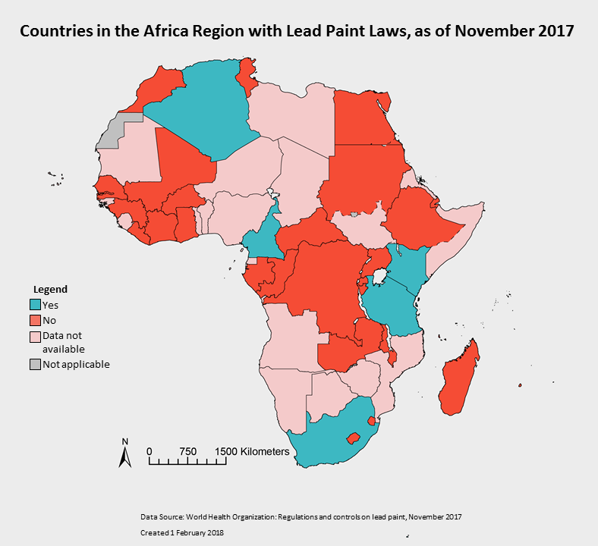
Status of Laws and Current Activities in Africa
Countries with lead paint laws as of November 2017:
  Algeria
  Cameroon
  Ethiopia
  Kenya
  Tanzania
  South Africa
Goals of new GEF funded Project on Lead Paint, 2018-2020:
  40 countries to establish or improve lead paint laws, including African countries; and
  Paint Industry to conduct demonstration projects with Small and Medium Enterprises in 5-6 countries
Notes:
This workshop is the first time the model law was presented.
The Caribbean Lead Paint Workshop was held in Kingston, Jamaica in December and was the first UN workshop to publicly present the Model Law and Guidance for the Regulation of Lead in Paint
To present the new Model Law, the Lead Paint Alliance worked closely with the legal community, partnering with the American Bar Association Rule of Law Initiative and the University of the West Indies Norman Manley Law School.
The experiences shared by countries with laws and those without laws highlighted the importance of adjusting the model law to meet the legislative structure of each unique country
The workshop was a successful pilot for how future workshops around the globe will focus on the development of lead paint laws

Slide 23
Actions For Success
Lead paint elimination is gaining momentum.
This problem can be solved in the foreseeable future.
Actions that will help:
  Join the Lead Paint Alliance
  Establish new or strengthen existing laws
  Serve as “champions” to encourage others to take action

Slide 24
Resources
Lead Paint Alliance (Model Law available here): https://www.unenvironment.org/explore-topics/chemicals-waste/what-we-do/emerging-issues/global-alliance-eliminate-lead-paint
UNEA3 Resolution: https://www.informea.org/en/decision/eliminating-exposure-lead-paint-and-promoting-environmentally-sound-management-waste-lead
WHO Map of Lead Paint Laws: http://www.who.int/gho/phe/chemical_safety/lead_paint_regulations/en/
WHO Database of Lead Paint Law Status: http://apps.who.int/gho/data/node.main.LEADCONTROLLEG?lang=en
World Health Assembly Chemicals Roadmap: http://www.who.int/ipcs/saicm/roadmap/en/
Economic Impact of Childhood Lead Poisoning: http://www.med.nyu.edu/pediatrics/research/environmentalpediatrics/leadexposure
Map of Levels of Lead in Paint:
  http://ipen.org/projects/eliminating-lead-paint/lead-levels-paint-around-world
American Bar Association Resolution on Lead Paint: https://www.americanbar.org/content/dam/aba/images/abanews/2017%20Annual%20Resolutions/109B.pdf

