Slide 1
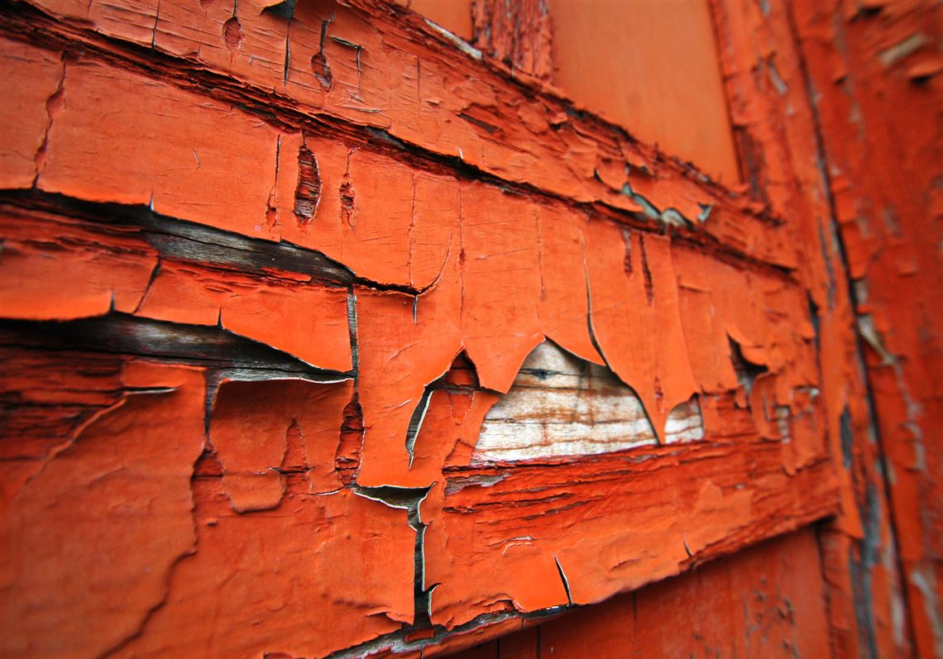

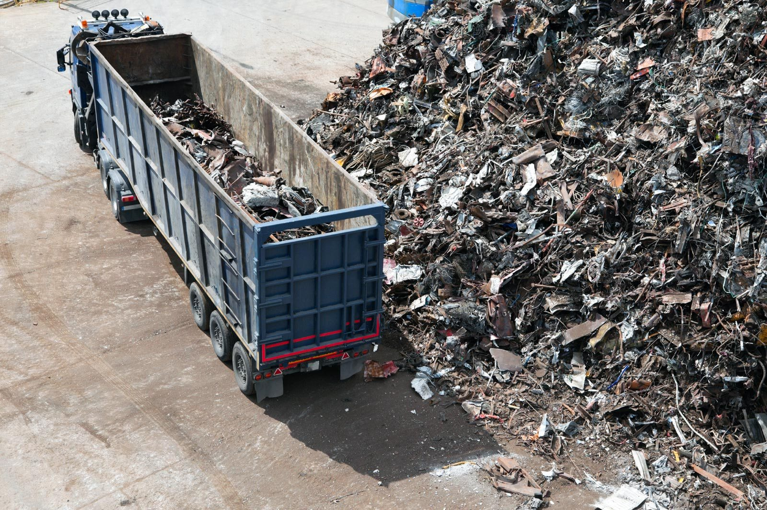
Update on Resolution 3/9: Eliminating Exposure to Lead Paint and Promoting the Environmentally Sound Management of Lead Acid Batteries
144th Meeting of the Committee of Permanent Representatives
8 January 2019 / Chemicals and Health Branch
© Photo: Antony Conroy

Slide 2

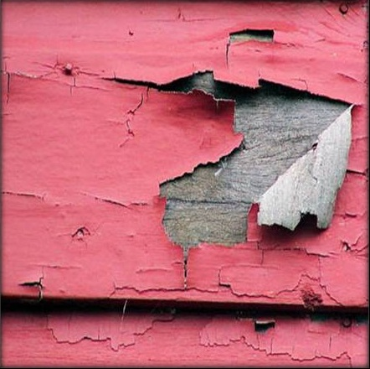


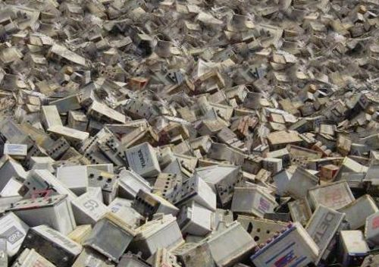
Mandate
The Assembly mandated UN Environment’s Executive Director to:
Assist countries in eliminating the use of lead paint, under the leadership of the Global Alliance to Eliminate Lead Paint and the World Health Organization by providing tools and capacity building for
developing national legislation and regulations
Continue to assist countries, in their efforts to strengthen and enhance the sound management of waste, including by providing further capacity-building with respect to waste lead-acid batteries to implement regulatory frameworks and programmes for recycling, and better track and trace shipments in close cooperation with the
secretariat of the Basel Convention
2
Notes:
Assist countries in eliminating the use of lead paint, under the leadership of the Global Alliance to Eliminate Lead Paint and the World Health Organization, in particular by providing tools and capacity-building for developing national legislation and regulations, and to work regionally, where appropriate.
Continue to assist countries, in particular developing countries and countries with economies in transition, in their efforts to strengthen and enhance the national, subregional and regional implementation of environmentally sound management of waste, including by providing further capacity-building with respect to waste lead-acid batteries to implement regulatory frameworks and programmes for recycling, and better track and trace shipments, in close cooperation with the Secretariat of the Basel Convention.

Slide 3



UN Environment’s work on lead
Important contribution ‘Towards a Pollution-Free Planet’ and the 2030 Agenda on Sustainable Development (esp. SDG3)
work on lead
Addressing risks of exposure
from lead
and cadmium
(2016-2017)
Accelerating the implementation of the chemicals and waste Multilateral Environmental Agreements and achieving the targets of related Sustainable Development Goals for improved human health and a clean environment (2018-2019)
3
Notes:
UN Environment’s work on lead contributes to the over-all implementation of its efforts “towards a pollution- free planet” and to the 2030 Agenda on Sustainable Development and the SDGs, especially Goal 3 on good health and well-being. It contributed to the achievement of UN Environment’s project on “Addressing risks of exposure from lead and cadmium” (2016-2017) and is now a core output of the programme of work 2018-2019 project “Accelerating the implementation of the chemicals and waste Multilateral Environmental Agreements and achieving the targets of related Sustainable Development Goals for improved human health and a clean environment” (2018-2019).

Slide 4


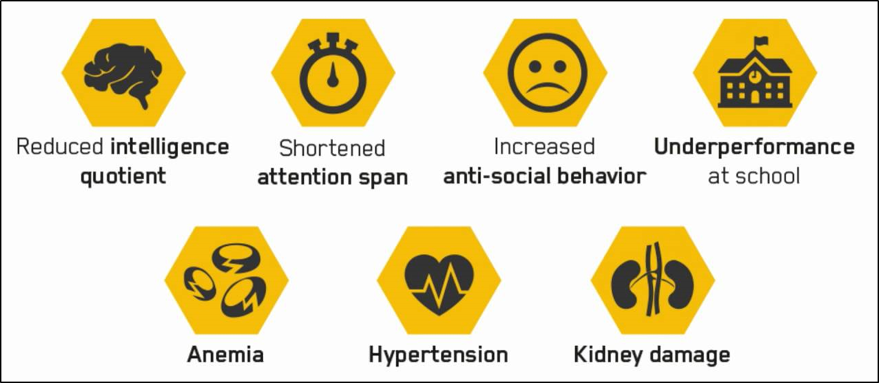
Impacts and exposure to lead
Lead is a poisonous and persistent neurotoxicant, and when released it does not break down.
NO safe lead exposure levels exist.
Lead’s lifelong consequences are borne by those affected, especially children, their families and society at large.
Lead compounds are added to paints to improve drying time, anti-corrosiveness and color brightness.
Globally, lead in paint is an important source of childhood lead exposure, as it is used in homes, schools and playgrounds.
The manufacturing and recycling of lead-acid batteries is practised globally in both regulated industries and unregulated informal establishments.
Lead recycling is an important source of environmental contamination and human exposure mostly coming from emissions.
4
Notes:
Lead is a multisystem toxicant for which no safe level of exposure has been identified. Exposure can cause chronic and debilitating health impacts in all age groups, but lead is particularly harmful to young children. This is because the developing nervous system can be damaged by lead, resulting in reduced cognitive abilities, poor educational attainment, attention deficit disorder and antisocial behaviour. In adults, lead exposure can cause hypertension, renal impairment and damage to the reproductive organs.
Lead paint: Lead paint is paint to which one or more lead compounds have been added, e.g. as pigments, driers or as anti-corrosives. Lead paint used in homes, schools and playgrounds is an important source of exposure to lead for children. Intact lead paint is safe, however as it ages, the paint starts to decay, fragmenting into flakes and dust that contaminate the environment. Paint flakes and dust are readily swallowed by young children who typically play on the ground and frequently put their hands to their mouths.
Lead-acid batteries: The main pathways of exposure to lead from recycling used lead-acid batteries arise from environmental emissions. These occur at various stages in the recycling process. Lead particles and fumes emitted into the air can be inhaled and can be deposited onto soil, water bodies and other surfaces. Used acid with high concentrations of lead is often dumped on land or released in waterways. Lead can enter the food chain through crops growing on contaminated areas and consuming lead particles, and from fish and shellfish living in lead-contaminated water.

Slide 5

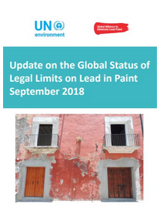
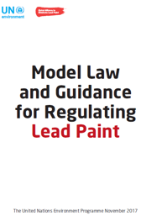

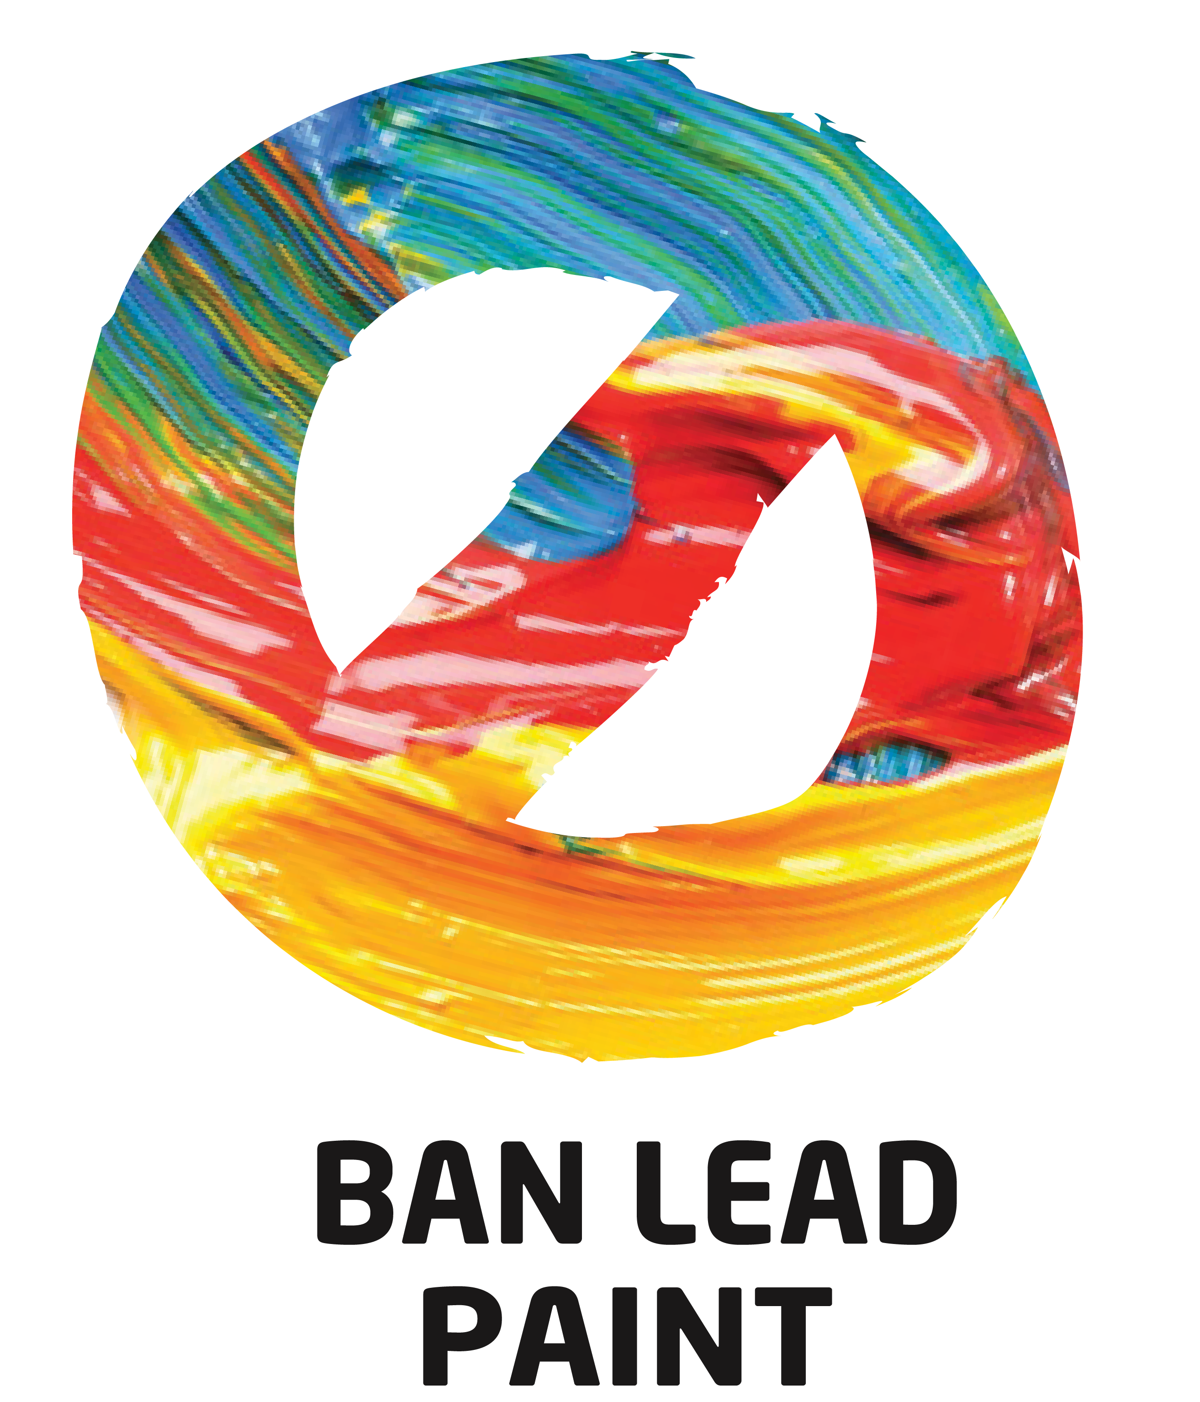

Progress of Implementation of UNEA 3 Resolution 9: Lead in Paint
Partnership
Knowledge
Implementation
Voluntary
Led by UNEP and WHO
90 partners
Guided by an Advisory Council
71 out of 194 countries (36.5%) have legally binding controls to limit the production, import and sale of lead paint
Model Law and Guidance to Regulate Lead Paint (all UN languages)
Published in September 2018
GEF-funded SAICM project
lead in paint component
Infrastructure
Awareness
Leadership
USEPA, Chair of the Lead Paint Alliance continues to engage stakeholders to achieve goals of the Alliance
Provided financial resources to support the work of the Alliance
Paint industry is engaged in innovative solutions for lead-free paint manufacturing and paint reformulation
National Cleaner Production Centres
Communication strategy in place
Resource package for the Annual International Lead Poisoning Prevention Week
5
Notes:
Partnership: The Lead Paint Alliance currently has 90 partners. It is guided by an Advisory Group currently chaired by the United States of America through the Environmental Protection Agency (US EPA) and consisting of Government representatives from Colombia, Kenya, the Republic of Moldova, Thailand, the International POPs Elimination Network (IPEN), the Health and Environmental Alliance (HEAL), the International Paint and Print Ink Council (IPPIC), AkzoNobel, Boysen Paints and the United Nations Industrial Development Organization (UNIDO).
Knowledge: As of 30 September 2018, four additional countries (Cameroon, Ethiopia, Iraq, Kazakhstan) had enacted lead paint laws, since UNEA 3.
Implementation: Enacting Lead Paint Laws has been found to be the most effective way to eliminate lead paint. The Lead Paint Alliance has set a standard of 90 ppm total lead in paint and has actively provided tools to assist countries legislate and implement legislation on lead paint. To support countries to develop, adopt and implement laws to regulate or eliminate lead paint, the Alliance has elaborated and made available to Governments a guidance entitled “Model Law and Guidance to Regulate Lead Paint” in all six UN languages. The GEF-funded SAICM project lead paint component about to start in January 2019 will provide support to 40 additional countries in the development of lead paint laws, in line with the Strategic Approach 2020 goal of lead paint elimination. [This is a specific goal under SAICM]
Infrastructure: The Strategic Approach-GEF project will engage the National Cleaner Production Centres and the paint industry (at least 30 small and medium enterprises) in paint reformulation using alternatives to lead additives in paint. [The SAICM GEF Project will aim at targeting 40 countries and 30 SMEs]
Awareness: The Alliance has developed a resource package for heightened awareness on the elimination of lead paint.
Leadership: The US Environmental Protection Agency (US EPA), Chair of the Lead Paint Alliance, continues to be the leader in engaging governments, industry, civil society and academia to achieve the goal of eliminating lead paint. The US EPA has provided some financial resources to support the work of the Alliance.

Slide 6
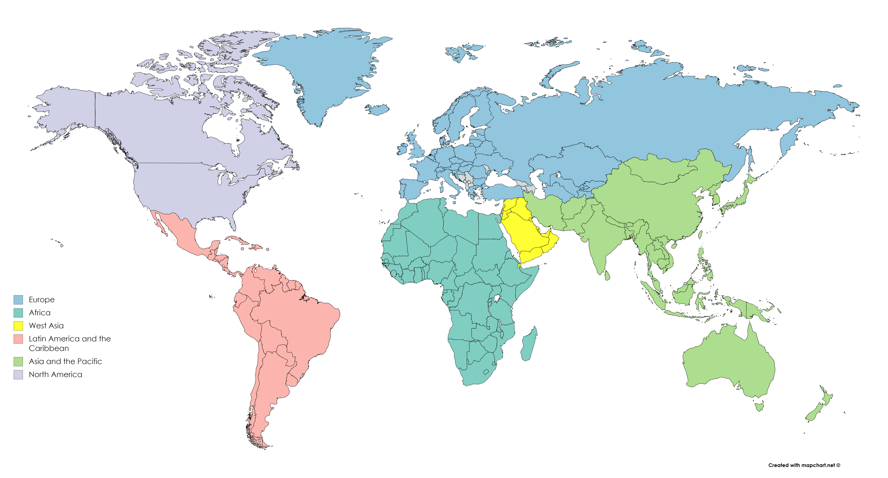
Progress of Implementation of UNEA 3 Resolution 9: Lead in Paint
Percent of Countries with Lead Paint Laws in Each UN Environment Region, as of 30 September 2018
74.1%
100.0%
20.5%
11.1%
27.3%
33.0%
6
Notes:
Many countries were actively supported by the Lead Paint Alliance in drafting lead paint laws. By region, the number of countries with lead paint laws with percentages in relation to the number of countries in each region is as follows: African region, 6 countries (11.1%); Asia-Pacific, 8 countries (20.2%); West-Asia, 3 countries (27.3 %); Latin America and the Caribbean, 11 countries (33 %); Europe, 41 countries (74.1%); and North America, 2 countries (100 %). [WHEN YOU PRESENT THIS, I SUGGEST THAT YOU JUST REFER TO THE PERCENTAGES FOR SAKE OF CLARITY AND CONSISTENCY WITH THE GRAPH, AND FOR SAKE OF TIME]

Slide 7
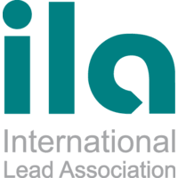




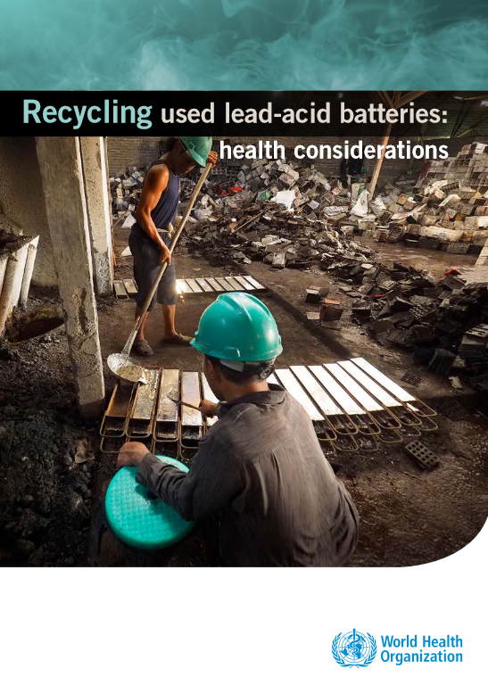
Progress of Implementation of UNEA 3 Resolution 9: Waste Lead-Acid Batteries
Partnership
Knowledge
Implementation
Trade and market analysis available
Needs assessment survey conducted
11th Basel Convention OEWG made reference to UNEA 3 resolution
UN Environment partnering with International Lead Association and Pure Earth / Blacksmith Institute
Technical assistance and capacity- building provided
Joint BRS-UN Environment project proposal developed
Proposal on best practices for lead-acid batteries
Infrastructure
Awareness
Leadership
UN Environment joined the Global Battery Alliance
Promote circular economy and alternatives for lead-acid batteries
Government of Japan is providing leadership and financial assistance
Supported related activities by the International Environmental Technology Centre
Work with WHO
Recycling of used lead-acid batteries: health considerations
7
Notes:
Partnership: UN Environment is working with industry and civil society partners - the International Lead Association and Pure Earth/Blacksmith Institute - to provide technical assistance and capacity- building on the environmentally sound management of waste lead acid batteries in low and middle-income countries.
Knowledge: the Basel Convention Open-Ended Working Group made reference to the UNEA 3 resolution on waste lead acid batteries and it is likely that, at the fourteenth Meeting of the Conference of the Parties to the Basel Convention (Geneva, April-May 2019), Parties to the Convention will discuss the possibility of an update of the Technical Guidelines for the environmentally Sound Management of Waste Lead Acid Batteries
Implementation: Government of Japan is already providing funding. A joint BRS-UN Environment project concept aimed at capacity-building activities in four countries on the environmentally sound management of waste lead acid batteries is available. The project entitled “Strengthening capacities of Parties to the Basel Convention and UN Environment Member States for the environmentally sound management of hazardous and other wastes, including prevention and minimization with a focus on WLAB” will address the collection of waste lead acid batteries and the issue of remediation of contaminated sites.
Infrastructure: UN Environment has joined the Global Battery Alliance in an effort to exchange knowledge and best practices on alternatives to lead acid batteries, while promoting the environmentally sound recycling of waste lead acid batteries. The Global Battery Alliance is promoting the concept of a circular economy for lead-acid batteries and its alternatives such as lithium ion, nickel-metal hydride, nickel-cadmium and nickel-zinc.
Awareness: The WHO document “Recycling of used lead acid batteries: health considerations “aims to help the health sector recognize recycling used lead-acid batteries as an important source of lead exposure so that they can advocate for this practice to be better controlled and regulated. It also aims to inform policymakers of the health and economic burdens of lead exposure as a stimulus to introducing and enforcing control measures.
Leadership: The Government of Japan is providing leadership in the environmentally sound management of waste lead acid batteries and has supported related activities at UN Environment Chemicals and Health Branch, including the International Environmental Technology Centre in Osaka, Japan.

Slide 8
Thank you
Chemicals and Health Branch / Economy Division
International Environment House I
11-13 chemin des Anemones
CH 1219 Chatelaine | Geneva, Switzerland
email: lead-cadmiumchemicals@un.org
www.unenvironment.org
Notes:
Overall, the work on lead in paint and waste acid batteries is gaining momentum and we look forward to keeping you informed of further progress. Thank you for your attention.

