Slide 1


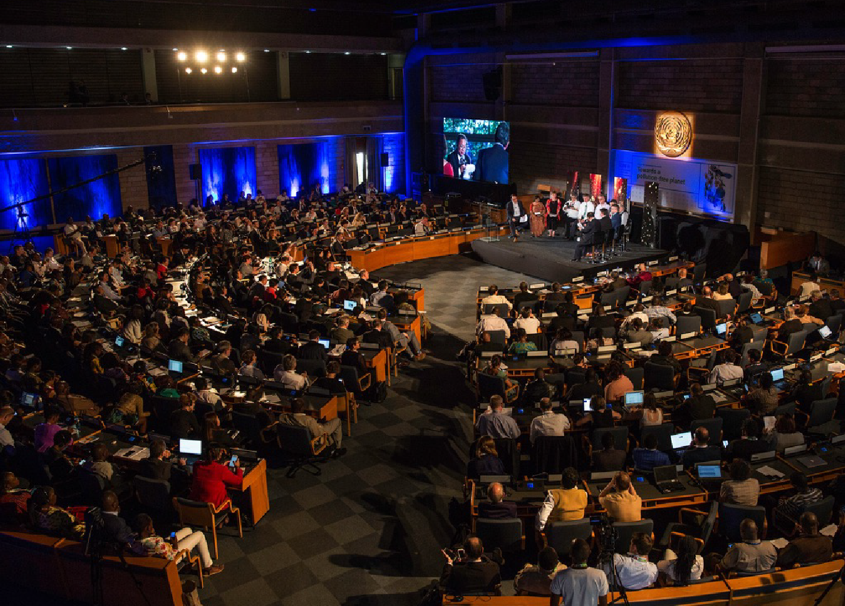

UN SCIENCE POLICY BUSINESS FORUM ON THE ENVIRONMENT
A UN-facilitated, self-financed, solutions-based, multi-sectoral platform to incubate and accelerate innovative solutions for the environment

Slide 2
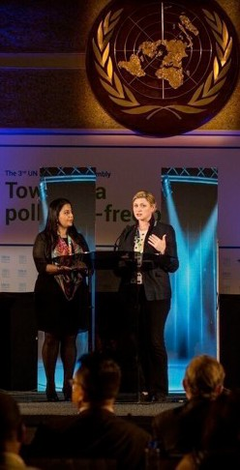
UN-SPBF Who We Are
The Forum provides a unique, self-sustained platform for multi-sectoral collaboration.
We contribute ideas and innovative solutions to the world’s environmental challenges
WE CONVENE
Technology giants
Startups at the forefront of innovation
Science sector
Citizen science leaders
Policy makers
OUR GOAL

Slide 3












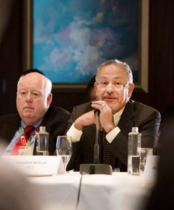















UN-SPBF Who We Are
" A powerful membership of over 2000 ins=tu=ons worldwide ”

Slide 4














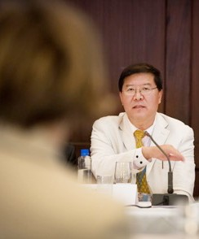
















UN-SPBF Who We Are
" A coali=on of the Willing and a coali=on of the Working ”
County Government of Kakamega
Government of Costa Rica

Slide 5








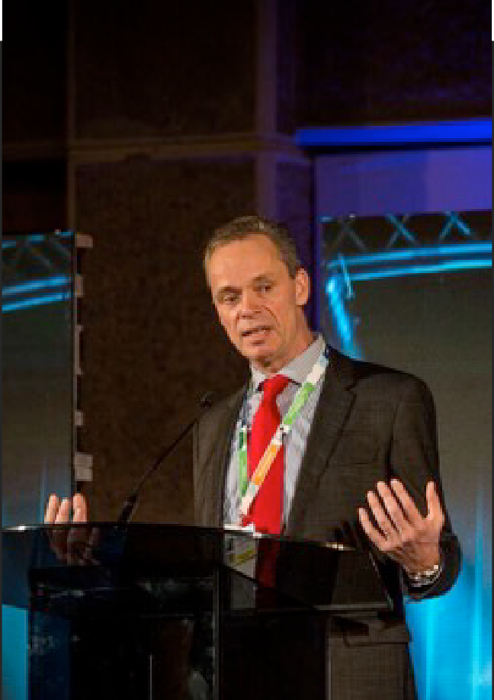











UN-SPBF Who We Are
" Every Member has something to bring to the table. ”

Slide 6

UN-SPBF What We Do
ACTIVITIES AND INITIATIVES ARE DESIGNED TO:
Strengthen science, policy, business interface for POW and SDG delivery
Encourage innovation and entrepreneurship for the environment
Ensure that the Fourth Industrial Revolution is a GREEN revolution
GOAL
Empower a circular economy transition and growth of green technology markets through sound policies and innovative finance
Harness citizen science
and knowledge
Informs decision makers on policies required to grow green technology markets, encourage a circular economy and foster innovation

Slide 7

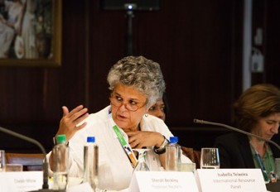
UN-SPBF Milestones
" The Forum is fast evolving
into an incubator of innova=on and joint ini=a=ves for the environment and an accelerator of the circular economy and eﬀorts to sustainably grow green technology markets. ”
May 2019
2nd Forum at UNEA-4
Planetary Data Meeting
Oct 2018
Held in Paris:
- Foundation Session
Sept 2018
Earth Innovation Summit
Held in Tallin:
-
In Support of the UNEA Bureau
1st Steering Committee
May 2018
Held in New York:
-
-
Set the agenda
-
Contributions to PoW
Dec 2017
Forum launch at UNEA-3
Held in Nairobi:
- Foundation Session

Slide 8
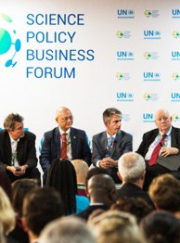
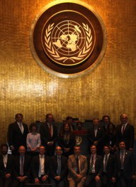
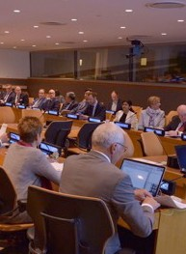
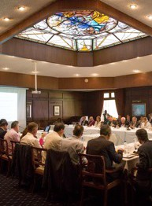
UN-SPBF Milestones
NAIROBI
Dec 2017
NEW YORK
May 2018
TALLIN
Sept 2018
PARIS
Oct 2018
1st Forum Session
1st Steering Committee
Earth Innovation Summit
12 specialised sessions provided unique opportunities for dialogue, presentation of latest technologies, exchange of ideas and consultations that aimed to inform the UNEA bureau and key partners ahead of the Bureau meeting.
Speakers included :
Business sectors leaders, Startup innovators, Scientists and visionaries, Citizen science pioneers, Investors
Planetary Data Meeting
The Forum supported the lanuch of the world’s first Alliance for Citizen Science.
Twelve months on, we are working with the Alliance to build the first global on- line platform for Citizen Science, hosted by Environment Live and the World Environment Situation Room
The Forum’s Governing Consortium identified work streams to support in 2018-2019, in consultation with relevant UN programmes and sister agencies
An Extraordinary Session was hosted by the Government of France.
Key tracks: Opportunities offered by Artificial Intelligence and Machine Learning; Big Data, Earth observations and remote sensing, Governance, Equity and Ethics; Financing and opportunities in PPP.
Next Steps: Launch a HL working group to strengthen and expedite delivery of the platform in coordination with Environment Live and the UN Environment Situation Room

Slide 9


UN-SPBF Upcoming Session
Most influential gathering of Green-Tech Start- ups and investors at the Green Tech Start up Hub
Launch of Green-Tech Start-up Alliance
Strong participation of international Citizen Science organizations and launch of the first Online Platform for Citizen Science, supported by the Forum and Environment Live
Launch of an international multi-sectoral Working Group on Big Data on the Environment – in cooperation with World Environment Situation Room
30 Specialized sessions covering innovation and SCP and featuring industry leaders, top scientists and policy makers
White papers on Growing Green Tech Markets; Artificial Intelligence and Big Data on the Environment and Green Innovation in Agricultutre and the Copper Sectors will be presented.
30 Sessions aligned with the UNEA theme
Launch of several initiatives and white papers on environmental issues
8-10 May
2019
Over 800 high level participants
Contributors from multiple sectors keen to support UNEP’s work

Slide 10

UN-SPBF Key Streams
Redesigning Metropolis: Smarter, Greener Solutions for Cities
Climate Challenge and Non-State Actors: From Transparency to Leadership
Leverage innovative technologies to tackle urban challenges and encourage the efficient use of natural resources
Review the latest in environmentally sound design and infrastructure
Encourage positive resourcing and procurement decisions
Behavior change
Policy action
Empower/support private sector transparency and leadership to tackle climate change
Review mechanisms to monitor, measure, verifying and report on emissions reductions by industry and non-state actors
Examine how policy and incentives can regulate and strengthen such reporting
Examine how the future installations of the Emissions Gap Report will measure and analyse action by non-state actors
1
2
Launch Green-Tech Startup Hub
In support of UNEA theme
3
Identify, communicate and shed light on innovative solutions and technologies by this fast-growing sector
Identify and encourage enabling policies
Bridge the technology and policy divide
Encourage investment in green tech
Sustainable Food for a Healthy Planet
4
Science for Decision-Making: Shaping Policies and Market Responses
-
Agricultural transformation – sustainable and climate-smart agricultural models minimizing impacts on pollution - examples from rice sector and others including livestock sector.
Nutrition and healthy diets - embracing difficult questions and debates about meat vs. vegetarian diets, considering biofortification, plant health, which benefits in turn human health
Food waste – measuring and achieving food waste reduction at a global level
5
-
Review of the latest recommendations from flagship environmental assessments and White Papers by Partners Discussions around the required policy responses and actions by policy makers, the private sector and key stakeholders.
-
-
-

Slide 11


WE WELCOME YOUR ACTIVE PARTICIPATION AND YOUR CONTRIBUTION TO
THE EVENTS
E-mail: forum@un-spbf.org
Website: un-spbf.org

