Slide 1
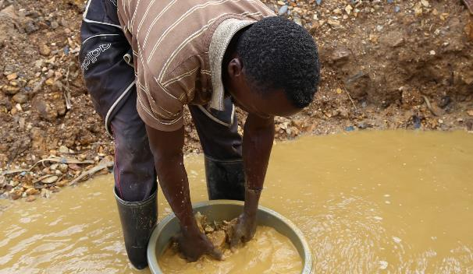
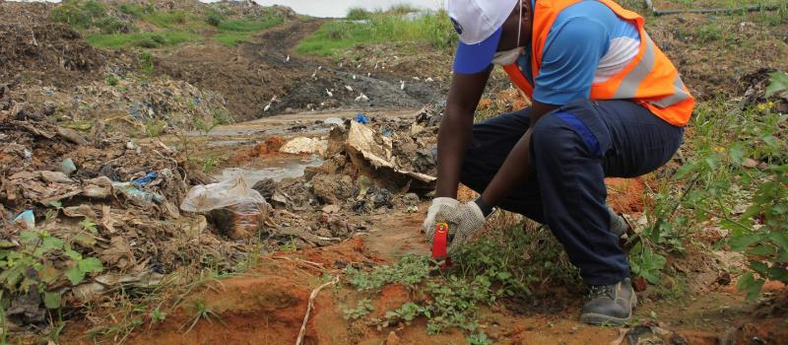
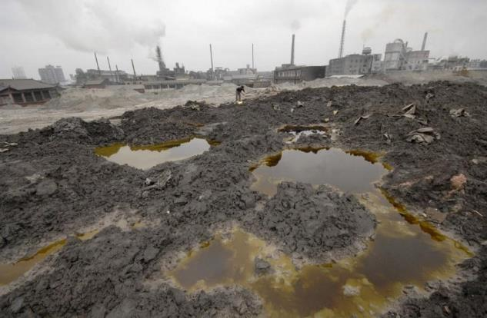

Tackling the growing challenge of soil pollution
“Towards a Pollution-Free Planet”
CPR Meeting
08th January 2019
UNEP, Nairobi, Kenya
Abdelkader Bensada
Ecosystems Division
UN Environment

Slide 2

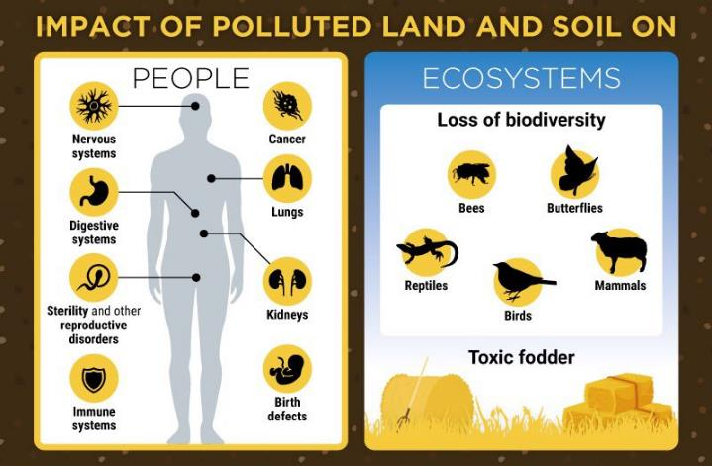
Land/soil (chemicals) pollution
Why does it matter?
Pollution remains a massive challenge – threatens to intensify as a result of rising consumption, living standards and population growth.
Pollutants, including human-made chemicals and emissions and domestic and industrial waste streams, are impairing air, water (fresh and marine) and soil quality.
WHO estimates (2012): 23% of deaths worldwide - 12.6 million people are due to environmental causes
middle-income countries bear the brunt of pollution-related illnesses, with a disproportionate impact on children.

Slide 4
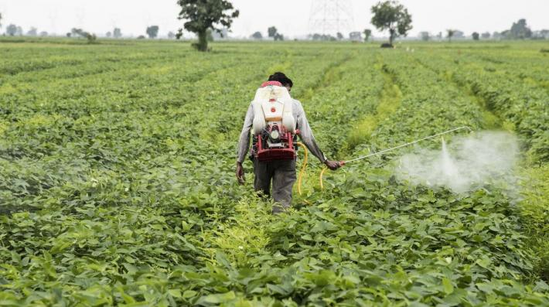
Pollution challenges
The land/soil pollution perspective
Key concerns:
Complex pollution leachate mixtures from mismanaged and uncontrolled dumpsites; includes mercury, arsenic, organic compounds, heavy metals and other hazardous substances
Pesticides and antimicrobial drugs in crop and livestock productions are among pollutants of key concern
Pollution from abandoned industrial sites, armed conflict zones, nuclear power stations, pesticide stockpiles, waste landfills - part of a longer-term legacy

Slide 5
Framing Action against the
UNEA 3/6 Resolution Implementation Plan:
Managing soil pollution to achieve sustainable development

Slide 6
UNEA 3/6 resolution:
Managing soil pollution to achieve sustainable development
OP7: Requests the Executive Director, …., by UNEA5, to invite, within their respective mandates, relevant United Nations organizations,….:
  (a) To prepare a report based on available scientific information and data on:
    (i) … extent and future trends of soil pollution, ….;
    (ii) … risks and impacts of soil pollution on health, the environment and food security, ……
  (b) To elaborate technical guidelines for the prevention and minimization of soil contamination ……;
OP8: Requests the United Nations Environment Programme, in consultation with member States, to invite, …the UNCCD, the WHO, FAO…..other relevant UN entities, in collaboration with partners, ……..:
  (a) To promote research and development that contributes to controlling and managing soil pollution;
  (b) To strengthen the science-policy interface to inform policymaking on soil pollution, …..;
  (c) To raise awareness and improve the dissemination of knowledge on soil pollution;
  (d) To promote a coordinated approach for combating soil pollution, ….;
OP9: Requests the Executive Director to UNEA4 on progress ……

Slide 7
Soil Pollution-relevant resolutions from UNEA1, 2 and 3
Soil pollution resolution
Environment and Health
Water pollution
Lead (paint and batteries)
Armed conflicts
Innovation
Air pollution
Marine litter and microplastics
Combating desertification, drought and encouraging sustainaible rangelands and pastoralism
Sustainable consumption and production
Air quality
Global Environment Monitoring System/Water Programme
Prevention, reduction and reuse of food waste
Marine plastic litter and microplastics
UNEA3 resolution
UNEA2 resolution
UNEA1 resolution
UNEA2 and UNEA1 resolution
Chemicals and waste
Importance of:
Regional Dialogues
Partnerships
Concerted Actions

Slide 8
Analysing the UNEA 3/6 resolution to form the building blocks of the implementation plan.
Main categories of activities of Soil Pollution Resolution
Science, data, access to information, reporting, SDGs
Standards, regulations and integrated policy development
Industry, private sector engagement, (incl. circular economy/lifecycle) and NGO engagement
Methodologies and tools development, Capacity-building, strengthening of technical and institutional capacity
Education, training
Communication
Regional cooperation, partnership building with all, incl. UN Agencies

Slide 9

International Symposium on Soil Pollution
It was co-organized between UNEP, FAO, the WHO that was held in Rome at FAO Headquarters in May 2018.
A side event on the UNEA 3 soil pollution resolution was
convened by UNEP within symposium to present an agenda which suggested way forward.
The FAO's Intergovernmental Technical Panel on Soils (ITPS) launched the report titled "Soil Pollution: a hidden reality". This report is comprehensive and will be a significant input to the UNEA3 resolution.
The ITPS has agreed to remain engaged in the process and maintain a core role in making technical and scientific contributions, with UNEP facilitating the bridge to the policy reform and mainstreaming with governments and collaborating agencies.

Slide 10
Stakeholders Consultation Workshop
A consultation workshop to advance implementation of the UNEA pollution resolutions was convened in Paris in June 2018 which was attended by various stakeholder groups, and some Member States through the CPR subcommittee.
The meeting provided an opportunity for stakeholder input and engagement to shape the UNEA3 Implementation Plan. The meeting assisted to identify and prioritize solutions relevant to the Soil Pollution Resolution.

Slide 11
Coordination & Joint planning
The Environment and Health UNEP/EA.3/RES.4 resolution being led by the Economy Division has overlap with the Soil Pollution Resolution. The anticipated report under the Environment and Health resolution addresses the impacts of pesticides and fertilizers, and joint planning to harmonize the outputs from the two resolutions is ongoing.

Slide 12
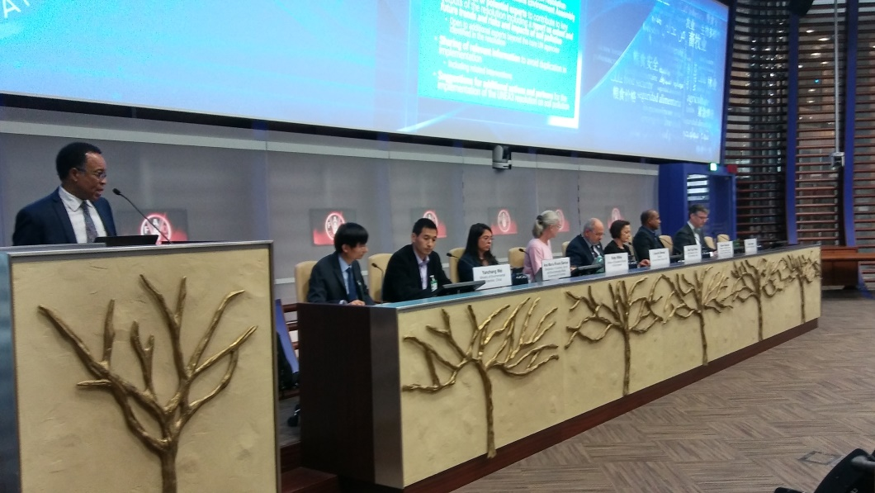
FAO’s Joint Meeting on Pesticides Management (JMPM)
Within the scope of the Environment
and Health resolution, a First Consultative
Meeting was held in October 2018
back-to-back with FAO’s Joint Meeting on
Pesticides Management (JMPM).
The meeting brought together subject-area experts on both pesticides and fertilizers to provide clarity on joining the work between the two resolutions.

Slide 13
Implementation Plan and Budget
A proposal on the broad outline of the UNEA5 Soils Pollution Report has been developed. Against this, a draft implementation plan and budget has been prepared to facilitate resource mobilization. This is being incorporated into a joint mobilization strategy proposal with the FAO for the implementation of the resolution.
In September 2018, the Government of France kindly confirmed a grant to UN Environment of Eur 30,000 toward the implementation of the resolution.

Slide 14
Pollution challenges
The land/soil pollution perspective
Critical gaps
Implementation gaps: lack of resources; inadequate capacities or political will
Knowledge gaps: inadequate awareness of key information, insufficient disclosure of information, limited understanding of pollution’s social and gender dimensions
Infrastructure gaps: monitoring and management of wastes; recycling
Limited leadership - financial institutions and industry: challenges in information disclosure; compliance/due diligence; access to ‘green financing’
Mispricing, invisibility of ecosystems services: treatment of ecosystems as waste dumps and sinks; choices made without awareness of full consequences
Lack of recognition of consequence of consumer choices: limited understanding of behaviors and incentives; limited empowerment to influence choices, limited information on alternative (affordable options)

Slide 15
Thank you

