Slide 1
UNEA 4 and OECPR App and Papersmart portal
Victor Oburu
victor.oburu@un.org

Slide 2
The App will enable you to:
Access real-time schedule of events
Access all the documents pertinent to OECPR and UNEA 4
Get real-time updates through notification of all events
Create your own calendar for the meetings you would like to attend and integrate it with your own calendar. This requires you to create an account through an easy two step process

Slide 3


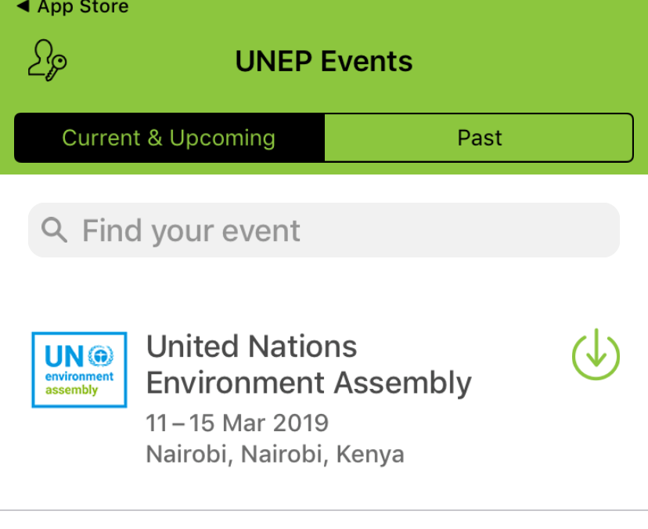
Downloading the App on iOS devices
iOS devices supported includes (iPhones, iPads) on the App Store
Go to the App store icon ,
Search for UN Environment Events
Once you download the Events App, click on the download arrow to get the UNEA 4 App

Slide 4

Downloading the App on Android devices
Go to your devices Play Store icon
Search for UN Environment Events and click on install
Once the events app is installed, click on the download arrow to get the UNEA 4 App

Slide 5
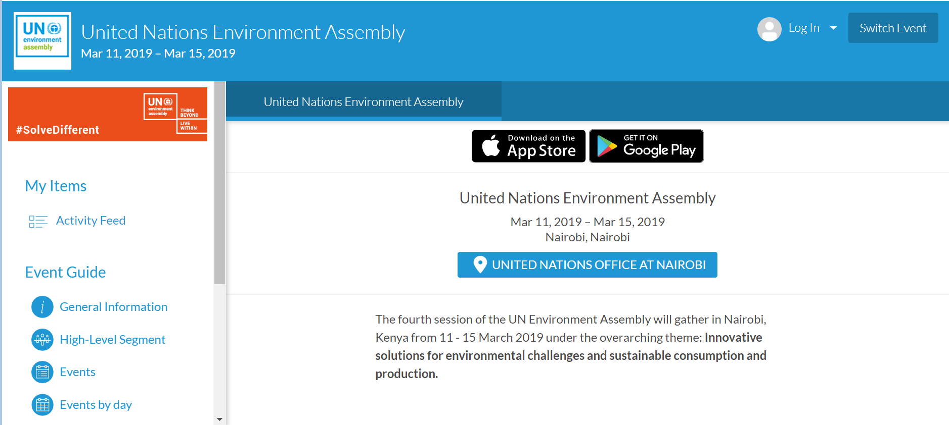
Accessing the App via web browser
To access the app via web browser, use the link below:
https://event.crowdcompass.com/unea-4

Slide 6
Papersmart portal
The papersmart portal is a secure portal that will enable you:
Access all the in-session documents as well as access the resolution tracker;
The resolutions tracker enables you to access all the versions of resolutions as they evolve.
Through the papersmart portal, you will also be able to submit your comments directly to specific resolutions.
The portal will also enable you contact directly the resolution proponets, sponsors as well as the resolution focal points from the secretariat
The link to the portal is: https://papersmart.unon.org/resolution/unea4

