Slide 1


CPR Briefing
Conference of Plenipotentiaries on the Minamata Convention on Mercury and its Preparatory Meeting
7 to 11 October 2013
Kumamoto & Minamata, Japan
4 July 2013
Tim Kasten, Head, Chemicals Branch

Slide 2

Mercury – a global pollutant
2003 – Governments agree on the need for global action on mercury, based on its adverse health and environment effects and its long range transport in the environment
2007 – Governments agree to consider the need for a legally binding instrument to further address the mercury issue
2009 – Governments agree to negotiate a legally binding instrument on mercury and establish the INC.

Slide 3
Minamata Convention on Mercury – negotiating the legally binding instrument
Diplomatic Conference, Japan
OEWG
Bangkok
INC1 Stockholm
INC3
Nairobi
INC2 Chiba
INC4 Punta del Este
INC5
Geneva
UNEP GC decision
2009
2010
2011
2012
2013
2018 onwards
2001-2008
2009-2013
2014-2017?
Entry into force?

Slide 4
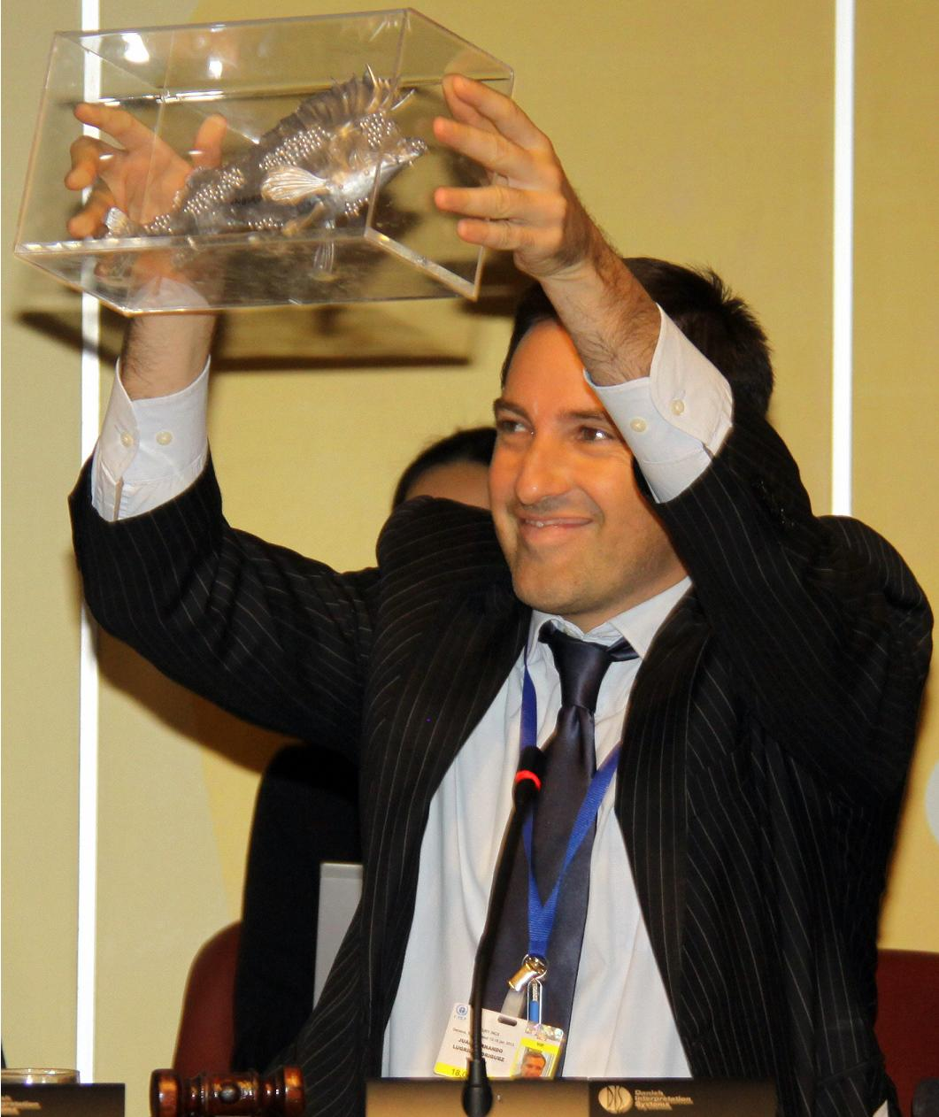
Outcome of INC5
19 January 2013
Governments agreed to the text of the “Minamata Convention on Mercury” and successfully fulfilled the GC 25/5 mandate
Secretariat requested to prepare draft elements of the Final Act to be adopted at the DipCon
Notes:
4

Slide 5
Outcome of GC 27
GC DECISION 27/12 PURSUANT TO MERCURY:
11. Welcomes the completion of the negotiation of a global legally binding instrument on mercury, which was accomplished prior to the twenty-seventh session of the Governing Council/Global Ministerial Environment Forum as requested in paragraph 26 of decision 25/5;
12. Requests the Executive Director to convene a conference of plenipotentiaries for the purpose of adopting and opening for signature the Minamata Convention on Mercury, in Kumamoto and Minamata, Japan, from 9 to -11 October 2013, subject to the availability of extra-budgetary resources, and welcomes the offer by the Government of Japan to host the conference of plenipotentiaries;
13. Calls on Governments and regional economic integration organizations to adopt and thereafter sign the Minamata Convention on Mercury at the conference of plenipotentiaries;
14. Encourages States and regional economic integration organizations to take, as soon as possible, the necessary domestic measures to enable them to meet their obligations upon ratification, and thereafter to ratify, accept, approve or accede to the Minamata Convention on Mercury, once adopted, with a view to its entry into force as soon as possible;
Notes:
5

Slide 6
Outcome of GC 27
16. Requests the Executive Director to inform the diplomatic conference of the Minamata Convention on Mercury about possible options available for the interim secretariat;
17. Recognizes that the decision on interim secretariat arrangements will be taken by the conference of plenipotentiaries and that it is for the Conference of the Parties to the Minamata Convention on Mercury to decide on secretariat arrangements;
18. Urges the Executive Director through an interim secretariat of the instrument to assist in the implementation of relevant resolutions of the conference of plenipotentiaries with a view to facilitating capacity-building, early entry into force and financing regarding the instrument;
19. Request the Executive Director to take actions to facilitate voluntary implementation of the instrument prior to its entry into force and to provide interim support for developing countries and countries with economies in transition, if so decided by the conference of plenipotentiaries;
Notes:
6

Slide 7
Outcome of GC 27
20. Appeals to Governments as well as intergovernmental and non-governmental organizations and the private sector to support early action designed to facilitate ratification and implementation of the Minamata Convention and further to provide financial resources for the implementation of interim arrangements for the Minamata Convention, in conformity with relevant resolutions of the conference of plenipotentiaries, for the period until the end of the financial period in which the first meeting of the Conference of the Parties to the Minamata Convention takes place, and welcomes with appreciation the contributions already made, including from China, Denmark, Japan, Norway and Switzerland, for those purposes;
23. Invites the Council of the Global Environment Facility to take into account any relevant resolutions of the conference of plenipotentiaries and consider ways of supporting their implementation;
24. Invites Parties to the Basel, Rotterdam and Stockholm conventions to use the opportunity of their extraordinary meetings from 28 April to 10 May 2013 to consider steps that would facilitate possible future cooperation and coordination with the Minamata Convention on Mercury and to forward any outcome of that consideration to the conference of plenipotentiaries;
Notes:
7

Slide 8
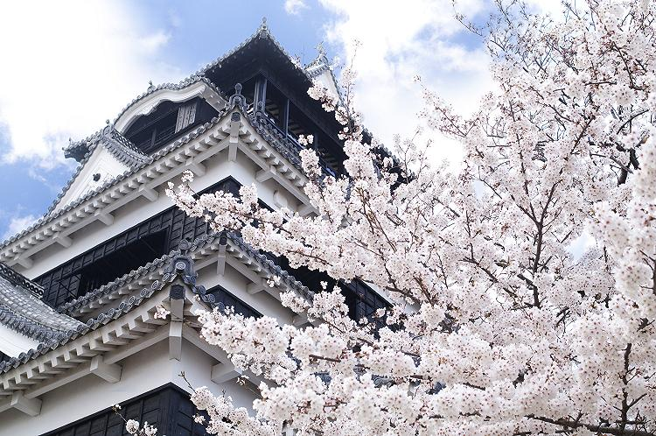
Objectives for the Preparatory meeting & the DipCon
OBJECTIVE FOR THE PREPARATORY MEETING
Finalize the resolutions to be considered and adopted by the DIPCON
OBJECTIVES FOR THE DIPCON
      Adopt and sign the Final Act of the Conference which will include its report, the resolutions & the text of the Minamata Convention.
      Adopt and open for signature the Convention.
→ No further negotiation will take place on the Convention, neither on its English nor on its language versions.

Slide 9
Schedule for the week – 7 to 11 October 2013
MONDAY 7 – TUESDAY 8 OCTOBER
    Regional meetings
        Preparatory meeting for the Conference of plenipotentiaries – Kumamoto
WEDNESDAY 9 OCTOBER
        Ceremonial day at Minamata Bay – Minamata
THURSDAY 10 - FRIDAY 11 OCTOBER
        Conference of plenipotentiaries– Kumamoto

Slide 10
Organization of work at the preparatory meeting
PROVISIONS FOR 3 PLENARY SESSIONS:
7 October: 3 - 6 p.m.
8 October: 10 a.m. - 1 p.m. and 3 - 6 p.m.
POSSIBLE ORGANIZATION OF WORK:
Opening statements
Organizational matters, including adoption of the rules of procedure, election of officers and adoption of the agenda
Discussion on the preparation of the resolutions → possible use of smaller groups
.
Executive Director of UNEP or his representative presides the meeting, until the election of the Chair and the Bureau
IN THE CASE OF PREVIOUSLY ADOPTED CHEMICALS AND WASTE MEAS,
THE PREPARATORY MEETING:
  Applied the same rules of procedure as the INC
  Recommended to the DipCon it also applied the same rules
  Usually elected as officers the members of the INC Bureau
Notes:
10

Slide 11
Organization of work at the Conference of Plenipotentiaries
POSSIBLE ORGANIZATION OF WORK:
Opening statements
Organizational matters, including adoption of the rules of procedure, election of officers, adoption of the agenda and appointment of the Credentials Committee
Report of the Credentials Committee
Adoption of the Convention, the resolutions and the Final Act
Signature of the Final Act and the Convention
Final statements
PROVISIONS FOR 4 PLENARY SESSIONS:
10 a.m. - 1 p.m. and 3 - 6 p.m. on 10 and 11 October
.
Executive Director of UNEP or his representative presides the Conference, until the election of the Chair and the Bureau
IN THE CASE OF PREVIOUSLY ADOPTED CHEMICALS AND WASTE MEAS, THE DIPCON:
  Applied the same rules of procedure as the INC
  Traditionally elected one high-level representative from each of the five UN regions and entrusted the role of Chair to the host Government
Notes:
11

Slide 12
Meeting documents
INDICATIVE LIST OF DOCUMENTS FOR THE DIPCON
  UNEP(DTIE)/Hg/CONF/1 - Provisional agenda
  UNEP(DTIE)/Hg/CONF/1/Add.1 - Annotated provisional agenda
  UNEP(DTIE)/Hg/CONF/2 – Scenario note prepared by the secretariat for the Conference of Plenipotentiaries on the Minamata Convention on Mercury
  UNEP(DTIE)/Hg/CONF/3 - Text of the Minamata Convention on Mercury for adoption by the Conference of Plenipotentiaries
  Resolutions for possible adoption by the Conference of Plenipotentiaries (available after the preparatory meeting)
INFORMATION DOCUMENTS:
  Statements delivered on 10 and 11 October following the signing of the Minamata Convention on Mercury (available after the DipCon)
  Outcome of the meeting of governments and REIO to further develop terms of reference for a special programme to support institutional strengthening at the national level for implementation of the Minamata Convention.

Slide 13
Meeting documents
INDICATIVE LIST OF DOCUMENTS FOR THE PREPARATORY MEETING
  UNEP(DTIE)/Hg/CONF/PM/1 - Provisional agenda
  UNEP(DTIE)/Hg/CONF/PM/1/Add.1 - Annotated provisional agenda
  UNEP(DTIE)/Hg/CONF/PM/2 – Scenario note
  UNEP(DTIE)/Hg/CONF/PM/3 - Draft resolutions for consideration and possible adoption by the Conference of Plenipotentiaries
INFORMATION DOCUMENTS:
  Rules of procedure for the INC
  Possible options available for the hosting of the interim secretariat prepared by the secretariat
  Outcome of the country-led meeting of governments and REIO to further develop terms of reference for a special programme to support institutional strengthening at the national level for implementation of the Minamata Convention.

Slide 14
Regional preparations
Regional meetings tentatively scheduled
on 7 October, from 9 a.m. to 1 p.m. and throughout the week as necessary
POSSIBLE ISSUES FOR DISCUSSION :
  Rules of procedure for the Preparatory meeting & DipCon
  Election of the Bureau for the Preparatory meeting & DipCon
  Resolutions for the DipCon
  Possible composition of expert group on BAT/BEP
  Any recommendation regions may wish to submit to the DipCon

Slide 15
Rules for participation
    Participation in the Preparatory meeting open to Government representatives designated in an official letter sent through the official contact point.
    IGOs and accredited NGOs welcome as observers in both the Preparatory meeting & the DipCon.
NOTE:
  To participate in the DipCon and sign the Final Act, Government representatives must be accredited in a credential issued by the Head of State or Government or the Minister for Foreign Affairs.
  To sign the Convention at the DipCon, the Government representative must have full powers for signature.

Slide 16
Full powers for signing the Convention text
The Head of State, Head of Government or Minister for Foreign Affairs may sign the Convention on behalf of the State without an instrument of full powers. Any other representative must have full powers for signature.
While there is no specific form for it, the instrument of full powers must :
Be signed by the Head of State, Head of Government or Minister for Foreign Affairs and must unambiguously empower a specified person to sign the Minamata Convention on Mercury. Full powers may also be issued by a person exceptionally exercising the power of one of the above-mentioned three authorities of State ad interim. This should be stated clearly on the instrument.
Indicate the title of the treaty, i.e. the Minamata Convention on Mercury, and express authorization to sign the Convention.
State the full name and title of the representative authorized to sign the Convention. They are individual and cannot be transferred to another person. Due to the individual character of the full powers, it is prudent to name at least two representatives, in case one is hindered by some unforeseen circumstance from performing the designated act.
Indicate date and place of signature of the instrument of full powers.
Official seal: This is optional and it cannot replace the signature of one of the three authorities of State, i.e. the Head of State, Head of Government or Minister for Foreign Affairs.
EXAMPLE OF AN INSTRUMENT OF FULL POWERS IS ATTACHED TO THE DIPCON INVITATION LETTER

Slide 17

THANK YOU!
For more information please visit us at:
www.unep.org/hazardoussubstances

