Slide 2
Assessing SDGs interlinkages and trade-offs
Adriana Castro
National Planning Department
July, 2019

Slide 3
1.
The SDGs in the NDP 2018-2022 “Pact for Colombia. Pact for Equality”

Slide 4
Targets of the 2018-2022 NDP
Experiencias nacionales para la reducción de las inequidades: buenas prácticas, logros y desafíos. El caso de Colombia
Monetary poverty: 26.9% to 21.0% -2.9 mill. People
Extreme poverty: 7.49% to 4.4% -1.5 mill. People
Multi-dimensional poverty: -2.5 mill. People
Gini coefficient: 0.508 to 0.478

Slide 5








SDGs with higher number of synergies
NDP indicators - SDG targets
663 indicators in the NDP, which include 24 sectors, 43 entities and 94 budget programs.
98,2 % of the NDP indicators are associated to one or more SDG targets.
1570 synergies

Slide 6




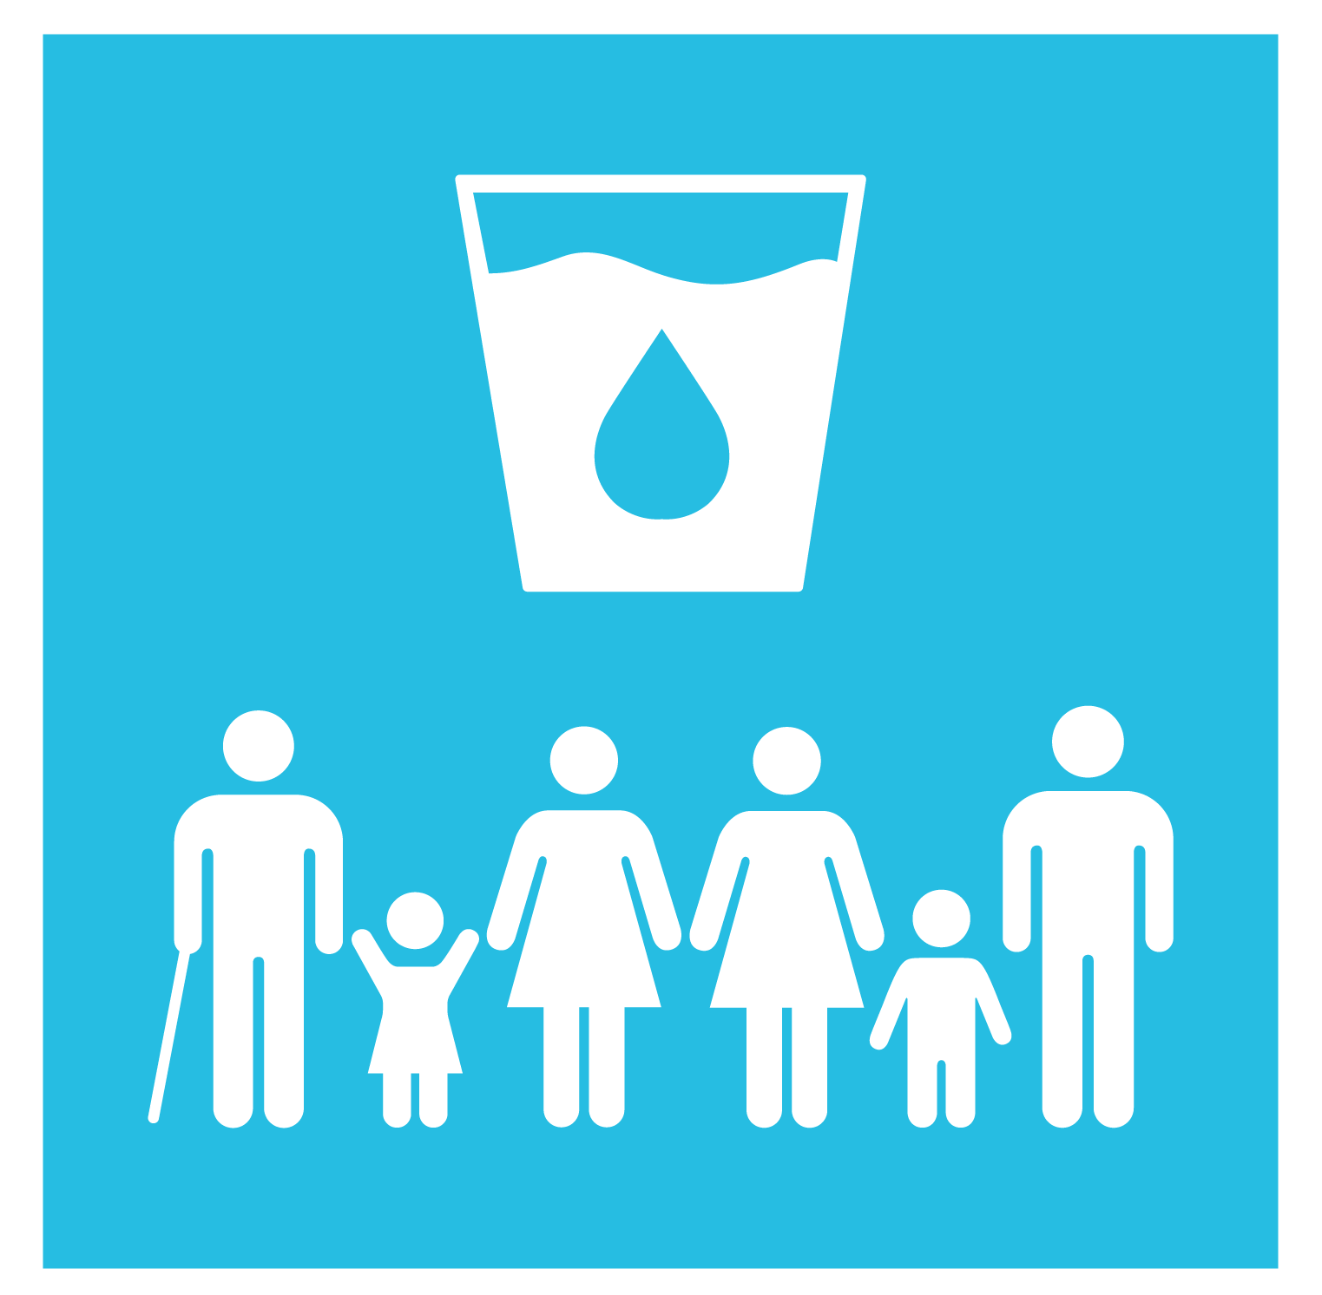
Synergies
NDP Indicators – SDG Targets
SDG Targets with higher number of synergies
Target 10.2
157 (10,0%)
102
(6,5%)
Target 1.4
69
(4,4%)
Target 8.3
44
(2,8%)
Target 16.3
36
(2,3%)
Target 6.1

Slide 7


Ejercicio de asociación
Indicadores PND – Metas ODS
Asociación con los ODS en revisión durante el HLPF 2019
Meta ODS | % asoc
4.2 | 2,1 %
4.1 | 2,0 %
4.3 | 1,2 %
Meta ODS | % asoc
8.3 | 4,4 %
8.2 | 2,1 %
8.1 | 1,9 %
Meta ODS | % asoc
10.2 | 10,0 %
10.1 | 0,9 %
10.4 | 0,3 %
Meta ODS | % asoc
13.1 | 0,5 %
13.2 | 0,4 %
13.3 | 0,1 %
Meta ODS | % asoc
16.3 | 2,8 %
16.6 | 2,6 %
16.7 | 1,2 %
Meta ODS | % asoc
17.18 | 1,0 %
17.11 | 0,5 %
17.8 | 0,2 %

