Slide 1

SDGs, inter-linkages,
Statistical Systems and
UN Global Platform a collaborative environment for the global statistical community
Ronald Jansen,
Assistant Director, DESA/Statistics

Slide 2


Slide 3
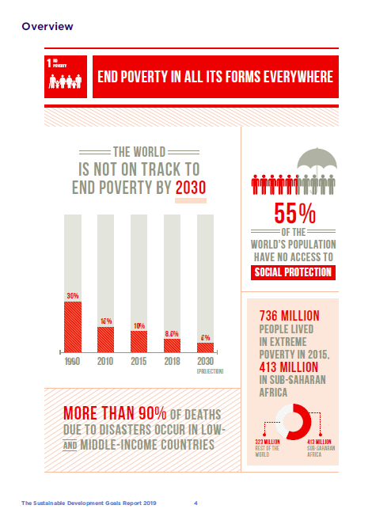

Slide 4
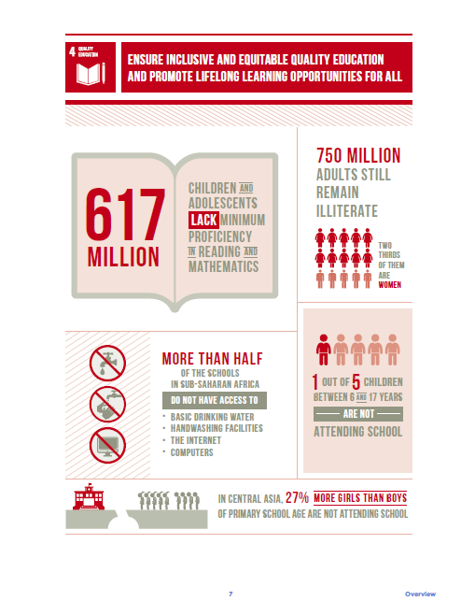

Slide 5
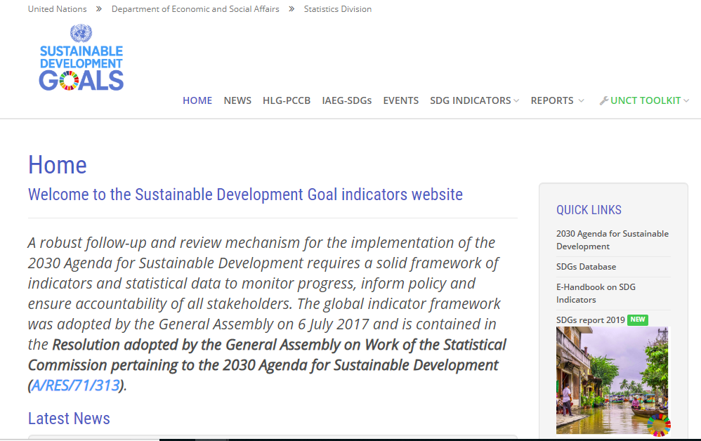

Slide 6
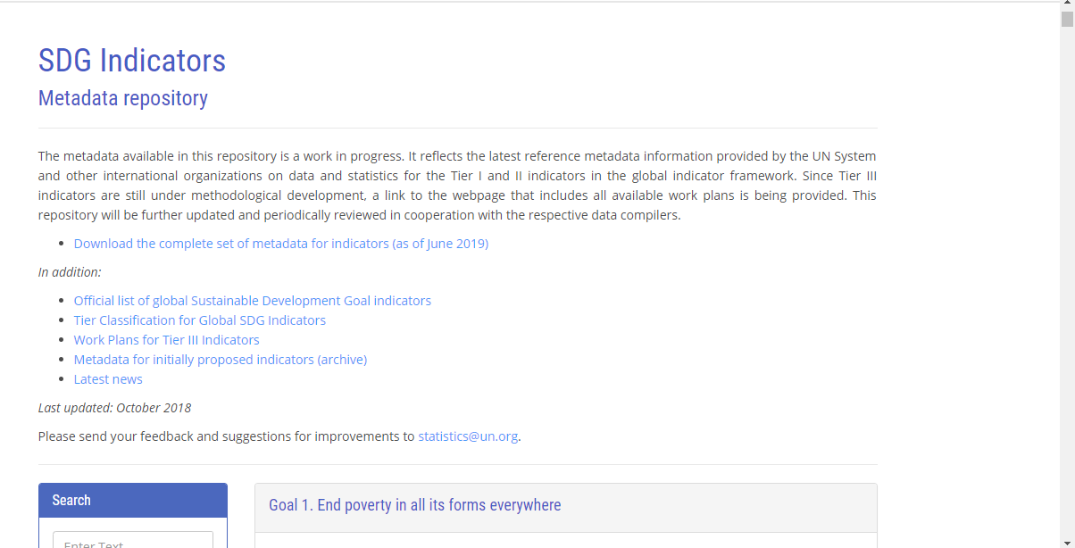

Slide 7
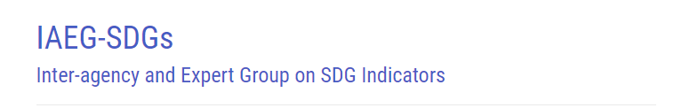
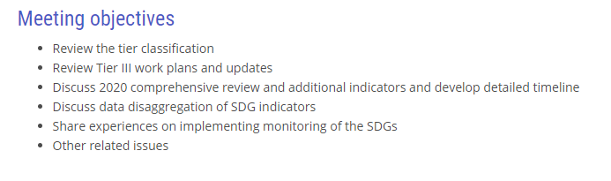
Most recent meeting: 25-28 March 2019 in Beirut

Slide 8
Interlinkages of the 2030 Agenda for Sustainable Development
Prepared by IAEG-SDGs, March 2019
This report synthesizes some existing approaches:
Institute for Global Environmental Strategies (IGES),
Aichi Framework,
indicator framework Drivers, Pressures, State, Impact and Results (DPSIR),
modelling proposed by the Italian National Institute of Statistics (ISTAT)

Slide 9
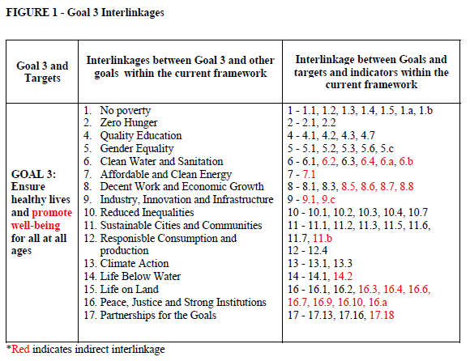

Slide 10
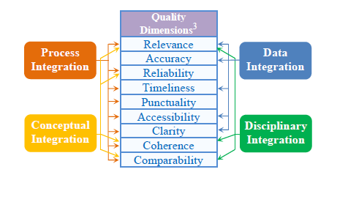
How can we measure interlinkages?

Slide 11
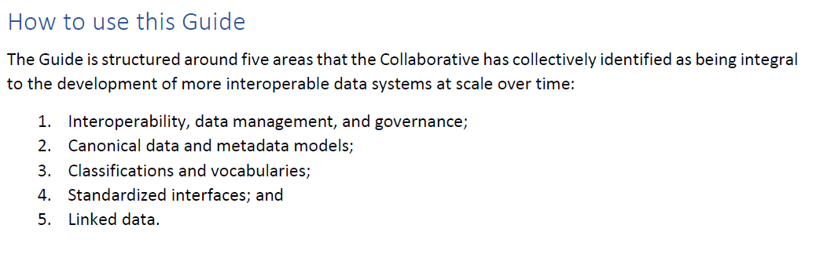
DATA INTEROPERABILITY: A PRACTITIONER’S GUIDE TO JOINING UP DATA IN THE DEVELOPMENT SECTOR

Slide 12
Statistical Data Infrastructure
Country
1. Statistical data
District
2. Register Data
Community
3. Other Administrative Data
Person
4. Big Data
Business
Geo-Spatial integration
13/07/2019
United Nations Statistics Division
Slide 12

Slide 13
Integrated statistics approach
Statistical operations
Outputs / Dissemination
Macroeconomic
accounts
Household and demographic statistics
Economic & environmental
statistics
Inputs
Data integration
Data processing
Data collection
Registers and frames
Surveys
Statistical infrastructure
Standards and methods
Institutional setting
Information, Communication Technology (ICT)
Management and internal policy
Institutional arrangements

Slide 14
System’s approach
System of National Accounts
System of Environmental-Economic Accounting
Satellite Accounts
  Education and Training
  Tourism
  Health
  Transportation
Multi-Country Global Value Chain Accounts

Slide 15
Tools to enable
Global collaboration on Data innovation
UN Global Platform

Slide 16
UN Global Platform
Datasets

Slide 17
Automatic Identification System (AIS)
40 Million Records / Day
Ship Position / Movement
3 Months Trial
Analysis via
  Methods Service
  Location (Stealth) Service
  Jupyter Notebooks
  APIs

Slide 18
Satellite Imagery
Open Data
  Landsat
  Sentinel
Commercial
  Planet (Trial)
  AirBus (Trial)

Slide 19
UN Global Platform - Update
Trusted Methods Library/Service
  https://methods.officialstatistics.org
Earth Observation Service
  https://eo.officialstatistics.org
Location Analytics Service
  https://location.officialstatistics.org
Developers Service
  https://developers.officialstatistics.org

Slide 20
Projects:
Satellite data for agricultural crop identification ➔ link to coastal eutrophication
Satellite data for SDG 6.6.1
AIS data for transport and CO2 emissions
AIS data for Fishery Watch
Open Street Map to calculate SDG 9.1.1

Slide 21
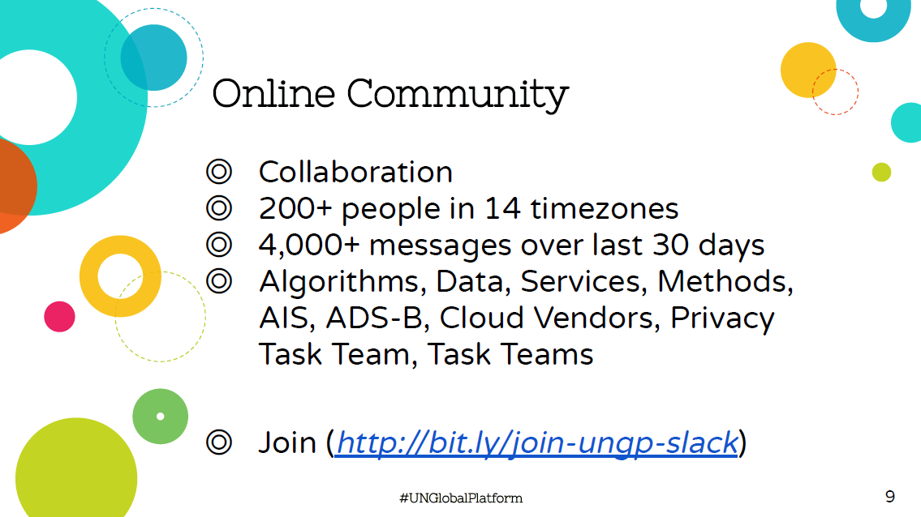

Slide 22
Tools to enable
Global collaboration on Data innovation
UN Global Platform
Access to Data
Access to Technology services
Access to Expertise
Making use of Big Data possible for small offices

Slide 23
UN Global Platform
(under GWG and UN Statistical Commission)
National Statistical Offices
International agencies
Private sector, academia, civil society, donor community
Positium, Flowminder, UN Global Pulse, OneSoil, Sinergise, Azavea, Planet, Telenor, GSMA, Algorithmia, …

