Slide 1
SDGs Implementation in Nepal: Status and Way Forward
Khomraj Koirala
Joint Secretary
National Planning Commission
Government of Nepal

Slide 2
Presentation Outline
Background
Implantation of SDGs in Nepal
SDGs: Status and Roadmap,
SDGs: Needs Assessment, Costing and Financing Strategy,
Mainstreaming SDGs in National Planning and Budgeting System,
Initiatives and Challenges,
Way Ahead.

Slide 3
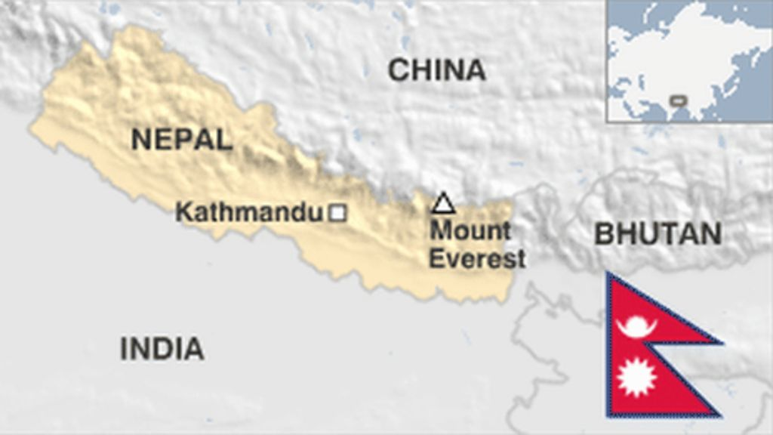
Nepal : Country at a Glance
Area: 1,47,181 sq km
Population: 30 million
  GDP (at basic prices, 2019): NRs. 3,464 billion
  GDP Growth rate : 7.05%
  Inflation: 4.4%
  Export Import Ratio: 1:15
  Literacy rate (15-24): 87% (2019)
  Life expectancy (at birth): 70.1 years (2019)
  Human Development Index : 0.574 (2018)

Slide 4
Background
Nepal has committed on implementation and achievement of SDGS before 2030,
Mainstreaming of SDGs its into planning and budgeting systems,
Strong collaboration between federal and SNGs for SDGs implementation,
Partnership between stakeholders including development partners,
Explore new avenues for resources to fulfill the financing gap,

Slide 5
Implementation of SDGs in Nepal
14th and 15th Plan’s objectives and strategies consistent with SDGs,
SDGs: Status and Roadmap for 15 years,
Preparation of SDGs Needs Assessment and Financial Strategy,
SDGs mainstreaming in in MTEF and Annual Development Program/Budget
Institutionalization and capacity building in all tier of Government
Disaggregation of SDG indicators at provincial and local levels,
Harmonization with UNDAF

Slide 6

Implementation Stages of SDGs
Implementation Stages
Identification
Instruments/ Interventions
Institutions
Investment

Slide 7
SDGs : Status and Roadmap 2016-2030
Goals |  | Global Targets | Indicators
 |  |  | Global | Local | All
1 | No poverty | 7 | 14 | 14 | 28
2 | Zero Hunger | 8 | 13 | 17 | 30
3 | Healthy life | 13 | 27 | 32 | 59
4 | Quality education | 10 | 11 | 35 | 46
5 | Gender equality | 9 | 14 | 22 | 36
6 | Water & sanitation | 8 | 11 | 14 | 25
7 | Clean energy | 5 | 6 | 9 | 15
8 | Decent work & Economic Growth | 12 | 17 | 14 | 31
9 | Industry & Infrastructure | 8 | 12 | 8 | 20
10 | Reduced inequality | 10 | 11 | 16 | 27
11 | Sustainable Cities | 10 | 15 | 15 | 30
12 | Responsible Consumption/Production | 11 | 13 | 10 | 23
13 | Climate Action | 5 | 8 | 11 | 19
14 | Lives Below Water | 10 | 10 | 0 | 10
15 | Lives on Land | 12 | 14 | 17 | 31
16 | Peaceful, justice & strong institutions | 12 | 23 | 8 | 31
17 | Partnership for sustainable development | 19 | 25 | 3 | 28
Total (*Global Indicators, ** National Indicators Excluding Goal 14) |  | 169 | 232* | 245 | 479**

Slide 8
Major Interventions
S.N. | SDGs | Major Interventions
1 | No Poverty | Increase of income, grants for SMEs, social security, mitigation of disasters, food program for work, food grants for the poor, targeted local infrastructure program.
2 | Zero Hunger | MSNP, Food and nutrition security, Agriculture education system, Irrigation, Expansion of rural road network, agro-enterprises, use of chemical fertilizers and technology, promotion of sustainable agriculture and agriculture system.
3 | Good Health and Well-being | Strengthening of health system, health care services, health insurance plan, health related strategic plans and institutional capacity building across all levels of government.
4 | Quality Education | Comprehensive primary/basic education, vocational trainings, literacy and lifelong education, natural disaster risk mitigation, development of youth and sports.
5 | Gender Equality | Awareness on sexual and reproductive health, ending all forms of violence against women, encourage political participation of women, women empowerment programs.
6 | Clean water and Sanitation | Long term access to clean drinking water, management of water sources, drinking water and sanitation and conduction of sanitation and health programs.

Slide 9
Major Interventions
S.N. | SDGs | Major Interventions
7 | Access to clean energy | Production and expansion of electricity, expansion of transmission lines, micro hydro, transmission and distribution system, fair use of energy, promotion of renewable energy
8 | Decent work and sustainable economic growth | Promotion of labor intensive sectors agriculture, construction, production, tourism, etc., social security for laborers/employees, safe workplace and development of labor-friendly law employment information system, eradication of child labor, construction of tourism infrastructure and development and expansion of market
9 | Industry, innovation and infrastructure | New infrastructures i.e. roads, railway, bridges and airport construction, construction of strategic road network, development of production sectors, development of ICT
10 | Reducing inequality | Social Security Program, targeted program, Corporate Social Responsibility, Opportunity without discrimination, progressive tax system, expansion of revenue base
11 | Sustainable cities and communities | Construction of safe roads, drinking water and waste management, conservation of cultural heritage, construction of housing for the poor and upgraded housing for squatters, earthquakes and post disaster reconstruction

Slide 10
Major Interventions
S.N. | SDGs | Major Interventions
12 | Sustainable Consumption and Production | Fair and sustainable use and management of natural resources, environment-friendly investment, fair use of food.
13 | Climate Action | Promoting adaptation capacities, control of harmful gas emissions, production and strengthening of climate statistics, climate friendly technology, strengthening M&E.
14 | Life Below Water | Not Relevant
15 | Life Above Water | Forests, lakes, water reservoir, biodiversity, conservation of land and glaciers, promotion of community forests, promoting production and use of herbs.
16 | Peace, Justice and Strong Institutions | Access to justice, capacity building for corruption alleviation, awareness regarding election, development of statistical system for monitoring of SDGs
17 | Partnership for Achieving the Goals | Coordination with public, private, cooperative and development partners, fair policy formulation, emphasis on local participation and resource mobilization.

Slide 11

Investment Requirement
Annual Average Resource estimated during the period is about NRS 2025 billion
There are about thirteen sectors that resource need is identified
Sectoral need for four milestone period i.e. 2016-19, 2019-22, 2022-25 and 2026-30
Yearly estimated average economic growth 8.67% and proportion of revenue in GDP: 27%
The Financing need and gap is estimated for Four different sectors in different proportion
Financing and implementation strategies are developed accordingly

Slide 12
Investment Requirement

Slide 13
Sector-wise yearly average investment (Rs. Billion)

Slide 14
Overall SDGs Financing Gap (Rs. In billion; 2015)

Slide 15
Overall Financing Gap as % of GDP
Overall Financing Gap as Percentage of GDP

Slide 16
Mainstreaming SDGs in 15th Periodic Plan
S.N. | Dimensions of SDGs | National Strategies | SDGs
1 | Economic | Increase production and productivity | Goal no. 2,7,8,9
 |  | Fast, sustainable and employment generating economic growth
 |  | Internal and inter-state interdependence and sustainable cities/ settlement development
2 | Social | Ensure affordable and quality health and education services | Goal no. 1,3,4,5,10
 |  | Provide complete, sustainable, and productive social security and protection
 |  | Judicial social mobility
3 | Environmental | Conservation, mobilization and development of natural resources | Goal 13,15
4 | Governance | Strengthen public service and federal governance system | Goal no. 16,17
The milestone targets of 60 indicators of 15th plan and 34 indicators of Long Term Vision are aligned with SDGs

Slide 17
Budget estimates and Expenditure Projection for next three years by SDGs
(Rs. In Lakhs)
S.N. | SDGs | Revised estimation of FY 2075/76 |  | Estimation of FY 2076/77 |  | Forecast of FY 2077/78 |  | Forecast of FY 2078/79
 |  | Amount | % | Amount | % | Amount | % | Amount | %
1 | No Poverty | 741,637 | 8.7 | 986,530 | 8.9 | 1,025,870s | 9.2 | 1,067,096 | 8.9
2 | Zero Hunger | 482,916 | 5.7 | 609,575 | 5.5 | 677,702 | 6.1 | 739,989 | 6.2
3 | Good Health and Well-being | 325,680 | 3.8 | 437,249 | 4.0 | 482,398 | 4.3 | 529,409 | 4.4
4 | Quality Education | 493,927 | 5.8 | 678,062 | 6.1 | 711,324 | 6.4 | 744,301 | 6.2
5 | Gender Equality | 31,373 | 0.4 | 48,623 | 0.4 | 53,360 | 0.5 | 58,578 | 0.5
6 | Clean Water and Sanitation | 245,101 | 2.9 | 373,693 | 3.4 | 367,052 | 3.3 | 377,420 | 3.2
7 | Access to modern and clean energy | 735,644 | 8.6 | 714,733 | 6.5 | 808,557 | 7.3 | 928,890 | 7.8
8 | Decent work and inclusive economic growth | 153,443 | 1.8 | 240.037 | 2.2 | 307,403 | 2.8 | 316,900 | 2.7
9 | Industry, Innovation and Infrastructure | 1,445,691 | 16.9 | 2,197,476 | 19.9 | 2,628,961 | 23.6 | 2,929,889 | 24.5
10 | Reducing inequality | 411, 865 | 4.8 | 645,684 | 5.8 | 645,709 | 5.8 | 677,985 | 5.7

Slide 18
Budget estimates ...
(Rs. In lakhs)
S.N. | SDGs | Revised estimation of FY 2075/76 |  | Estimation of FY 2076/77 |  | Forecast of FY 2077/78 |  | Forecast of FY 2078/79
 |  | Amount | % | Amount | % | Amount | % | Amount | %
11 | Sustainable cities and settlement | 1,861,383 | 21.8 | 2,178,147 | 19.7 | 1,342,193 | 12.1 | 1,423,923 | 11.9
12 | Sustainable consumption and production | 51,535 | 0.6 | 70,170 | 0.6 | 77,889 | 0.7 | 86,456 | 0.7
13 | Climate Action | 29,404 | 0.3 | 52,126 | 0.5 | 55,396 | 0.5 | 58,880 | 0.5
14 | Life below Water | - | - | - | - | - | - | - | -
15 | Life on Land | 142,705 | 1.7 | 158,501 | 1.4 | 166,329 | 1.5 | 174,574 | 1.5
16 | Peace, justice and strong institutions | 1,320,887 | 15.5 | 1,594,798 | 14.4 | 1,709,369 | 15.4 | 1,743,348 | 14.6
17 | Partnership for Sustainable Development | 59,656 | 0.7 | 72,189 | 0.7 | 75,087 | 0.7 | 77,579 | 0.6
 | Total | 8,532,847 | 100 | 11,057,593 | 100 | 11,134,598 | 100 | 11,935,218 | 100
 | Uncategorized | 3,550,829 | - | 4,272,078 | - | 6,456,098 | - | 8,593,662 | -
 | Grand Total | 12,083,676 | - | 15,329,671 | - | 17,590,696 | - | 20,528,880 | -

Slide 19
Initiatives
Developing National Data Profile System under Central Bureau of Statistics,
Produce SDG indicators at Provinces and Local level to assist policy decisions,
Availability of disaggregated on Census and Geospatial Data for SNGs,
An online portal on NPC website, open to public
Intra-government MIS data sharing practices.
Dissemination and transparency mechanism
Notes:
GESI analysis is a methodology for examining the causes and consequences of inequality in terms of gender, caste, and ethnicity.

Slide 20
Challenges
Policy reform, mainstreaming and Localization of SDGs- Plan, MTEF and Budget,
Weak database : Lack of disaggregated data in provincial and local levels,
Financial gap: To fill the gap of the SDGs Financing,
Coordination: Horizontal and Vertical coordination ,
Access to technology, capacity building and good governance
Landlocked, climate change and other natural disasters
LDC graduation: meaningfully, smoothly, sustainably and irreversibly.

Slide 21
Step Ahead
Mainstreaming Planning and Budgeting System: Periodic Plan, MTEF and ADP,
Double Digit growth with Human face- Prosperous Nepal and Happy Nepali
Localization of SDGs: in the provincial and local levels,
Institutional Strengthening and Capacity Development at provincial and local Level
Economic Reform Package: Implementation of financial strategy and fulling the gap funding
National Statistical System: NDP, NSDS, Legal and Institutional Reform
Capacity building, Monitoring and Evaluations: Progress Reports and Review.

Slide 22

Thank you

