Slide 1
Session IV
Expert Group meeting on optimising SDGs implementation in the framework of integration and policy coherence
Charmina Saili, Regional Planning Adviser
Pacific Islands Forum Secretariat
Saturday 13 July 2019
New York
In the pursuit of policy coherence….
Implementing & Measuring the SDGs in the context of complexity and limited capacities in the Pacific

Slide 2
Outline
Pacific context & approach to implementing & measuring sustainable development
Where we are in developing indicators
Good practices on SDGs monitoring, data collection and reporting
Key challenges & next steps
Sectors requiring most data-related support from the UN system

Slide 3
Complexity of Planning, Implementation & Reporting at country level
Long term vision plan
2030 Agenda
Global Development Declarations & Agreements
SAMOA Pathway
National Plan planning, implementation & reporting
Medium Term Plan
Paris Agreement on CC
Addis Ababa Action Agenda
Sendai Framework
Paris Declaration
GPEDC
Corporate Plans
Govt sector planning, implementation & reporting
Sector Plans
CRC
CEDAW
International Conventions, Treaties, Multilateral Agreements
CBD
Donor Project planning, implementation & Reporting
CITES
Development Projects
CRPD
Government Officials
Pacific Leaders Gender Equality Declaration
Govt budget reporting planning, implementation
Small Administrations
Limited capacities
Limited resources
Limited data/information
Lack of coordination
Framework for Persons with Disabilities
Regional Frameworks Reporting
Ministry Work Plans
Framework for Resilient Development
Notes:
So what is the impact on reporting at the country level in response to all the global, regional and national policy framworks?
The Burden of Reporting on FICs is the WORST kept secret in the Pacific.!
We have known this for decades especially over the last 10 to 15 years
We have heard this at too many regional meetings
Government officials complain that they spend more thah 50% of their time either writing reports or attending meetings to write the reports!
This is clearly ineffective and inefficient.

Slide 4
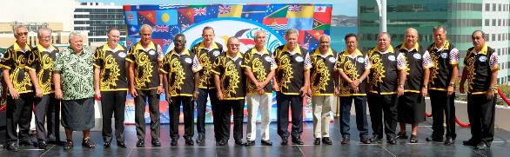
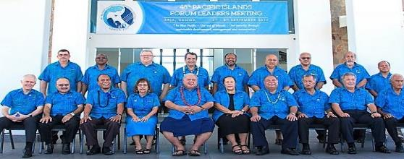
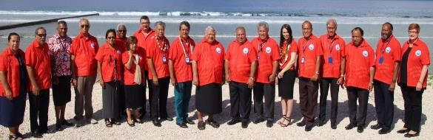
  Political commitment to integrated implementation & reporting
2015 – committed to SDGs, called for integrated implementation & reporting on global & regional sustainable development commitments
Contextualise
Integrate implementation & reporting
Reduce reporting
2017 – endorsed the Pacific Roadmap for sustainable Development
2018 – endorsed the 1st Quadrennial Pacific Sustainable Development Report
Notes:
So how are we dealing with this?
Through political leadership to integrate and reduce complexity.
I would like to start by highlighting how important the 2030 Agenda and SDGs is to our Pacific Leaders.
In 2015 they committed to the full implementation of the 2030 Agenda and SDGs BUT they made 3 key directives that are very important
Need to tailor the global SDGs and integrate with reporting on other global commitments to reduce the reporting burden and to make it more relevant to the Pacific.
Asked for 1 set of regional indicators to measure progress of the Pacific and 1 reporting process and 1 report
They directed that the process of implementation of the SDGs be as inclusive and country led as possible
They called on development partners to assist with financing, data and capacity building
2017 they endorsed the Pacific Roadmap for Sustainable Development that calls for 1 report
2018 they endorsed the first Pacific Sustainable Development Report as the ONLY report by the Pacific on the SDGs and the SAMOA Pathway

Slide 5

THE PACIFIC ROADMAP FOR SUSTAINABLE DEVELOPMENT
1
  LEADERSHIP & COORDINATION
Establishing/strengthening national & regional leadership &coordination mechanisms for sustainable development (National Plans/SDGs/SAMOA Pathway/FPR) implementation & monitoring
2
ADVOCACY & COMMUNICATIONS on the Pacific Roadmap for Sustainable Development and on SDGs/SAMOA Pathway and FPR at all levels across Pacific countries engaging all stakeholders
Planning & Implementation
REGIONAL PRIORITIES, MONITORING & INDICATORS
Regional Priorities established and monitored regionally through Initial Regional set of Sustainable Development Indicators
3
2026
2027
2028
2029
2030
2022
2023
2024
2025
2021
4
INTEGRATED REPORTING
Integrated regional Process of Follow up and Review for SDGs/SAMOA Pathway/FPR & PLGED through the 4 yearly Pacific Sustainable Development Report
  SUPPORTING IMPLEMENTATION
  Coordinated regional support to countries to assess/map the Means of Implementation, tailor SDGs targets/indicators in national development plans/budgets, strengthen national statistical systems & help deliver & report on SDGs/SAMOA Pathway/FPR
5
2019
2020
2015
2016
2017
2014
Samoa VNR
2018
Australia
& Kribati VNRs
1st Pacific SDR
UN SDG Summit
S.A.M.O.A Pathway
2019 High Level Political Forum
Addis Ababa Action Agenda HLM
2nd GA HLPF
3rd Pacific SDR
4th Pacific SDR
2030 Agenda
UN Climate Action Summit
SAMOA Pathway High Level Review
2nd Pacific SDR
3rd GA HLPF
4th GA HLPF
Addis Ababa Action Agenda
Sendai Framework
Paris Agreement
Fiji, Nauru, NZ, Palau, Tonga, Vanuatu VNRs
PNG
RMI, Samoa
Tuvalu, Solomon Islands VNRs
Voluntary National Reviews (VNR)aligned to National plan reviews & consider peer review
Accountability & Reporting
Pacific Sustainable Development Report every 4 years to inform the GAHLPF

Slide 6
193 UN Member countries (16 Forum member countries plus territories through NZ, USA, France)
UN Global
2030 Agenda for Sustainable Development & 17 SDGs
Paris Agreement, Sendai Framework, Addis Ababa Action Agenda (AAAA), Global Partnership for Effective Development Cooperation (GPEDC)
S.A.M.O.A Pathway
Framework for Pacific Regionalism(FPR),
Pacific Roadmap for Sustainable Development (PRSD)
Sector Regional Frameworks
Pacific Leaders Gender Equality Declaration (PLGED), Framework for Resilient Development in the Pacific (FRDP), Boe Declaration
National Development & Sector Plans
1
52 Smaller Island Developing States (SIDS) (20 Pacific Island countries & territories (incl East Timor)
UN
SIDS
2
Pacific Islands Forum
22 Forum members, associate member states & territories
3
4
Pacific Islands Countries & Territories
22 Forum Members & Territories
5
Pacific Islands Countries & Territories
22 Pacific Island Countries & Territories
Notes:
So how do we integrate the national, regional and global reporting?
this slide highlights the links between the national, regional and global frameworks.
While the titles of these frameworks and agendas are different – THEY ALL SPEAK THE SAME LANGUAGE – which is about improving our lives, improving access to health, and education services, about having jobs and ensuring we sustain our environment.
Its really about leaving no one behind. So while the titles may be different and they may be packaged differently, they are all about sustainable development.

Slide 7
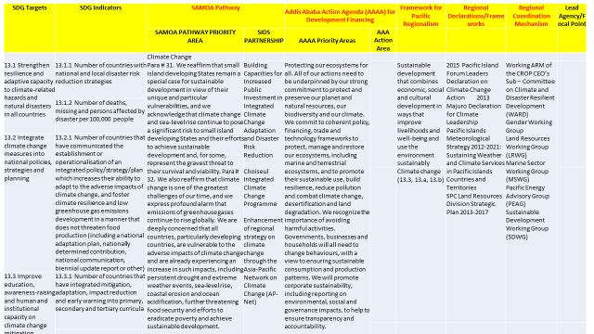
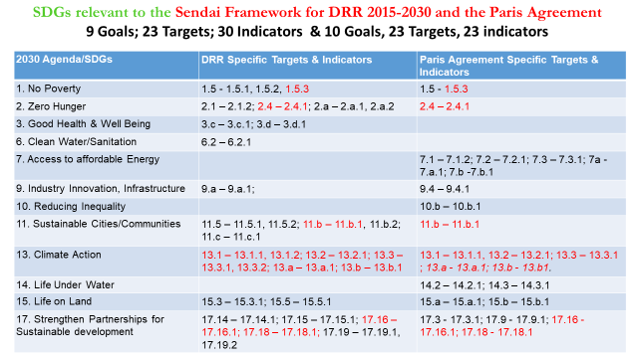
Mapping the SDGs against global, regional & national priorities

Slide 8
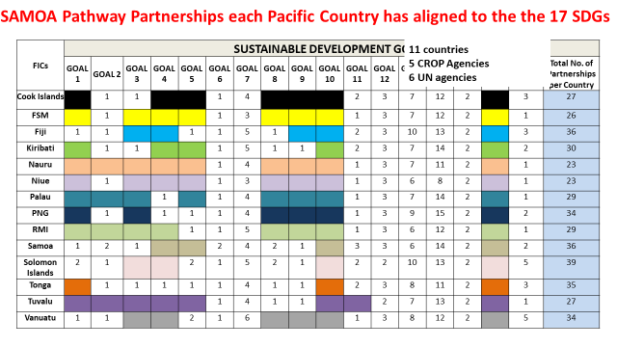
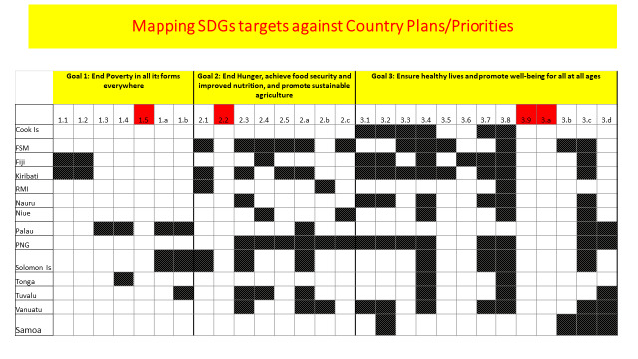
Mapping the SDGs against global, regional & national priorities

Slide 9
Regional priorities monitoring and indicators
SDG | Global # of SDGs indicators | # of selected Pacific SD indicators | %
SDG1 No Poverty | 12 | 5 | 42%
SDG2 Zero Hunger | 14 | 7 | 50%
SDG3 Good Health & Wellbeing | 26 | 16 | 62%
SDG4 Quality Education | 11 | 8 | 73%
SDG5 Gender Equality | 14 | 11 | 79%
SDG6 Clean Water & Sanitation | 11 | 3 | 27%
SDG7 Affordable & Clean Energy | 6 | 4 | 67%
SDG8 Decent work & Economic Growth | 17 | 9 | 53%
SDG9 Industry, Innovation& Infrastructure | 12 | 3 | 25%
SDG10 Reduced Inequalities | 11 | 7 | 64%
SDG11 Sustainable Cities and Communities | 15 | 5 | 33%
SDG12 Responsible Consumption & Production | 13 | 4 | 31%
SDG13 Climate Action | 7 | 5 | 71%
SDG14 Life Below Water | 10 | 9 | 90%
SDG15 Life on Land | 14 | 6 | 43%
SDG16 Peace, Justice & Strong Institutions | 23 | 7 | 30%
SDG17 Partnerships for the Goals | 25 | 18 | 72%
Pacific Proxies |  | 5
 | 241 | 132 | 55%
The region will focus on three key types of Pacific priorities:
  Regional transboundary issues of climate change (and disaster risk management) and oceans (including integrated oceans management).
  Unfinished business of MDGs & common priority issues at country level– NCDs and cervical cancer; improving connectivity; empowering women, girls and people with disabilities; reducing inequality and improving quality of education.
  Means of Implementation; SDG 16 and 17; Effective institutions and partnerships for the 2030 Agenda

Slide 10
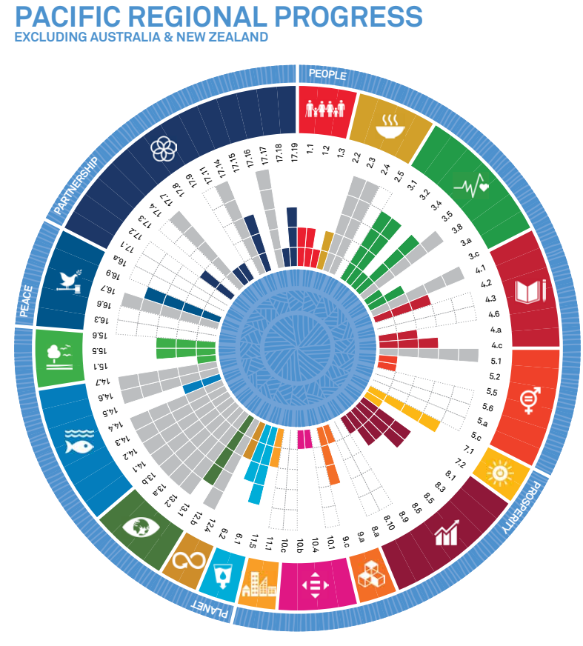
INTEGRATED REPORTING
Integrated regional Process of Follow up and Review for SDGs/SAMOA Pathway/FPR & PLGED through the 4 yearly Pacific Sustainable Development Report
https://pacificdata.org/content/17-goals-transform-pacific
Notes:
The Pacific Roadmap for SD has 5 interlinked elements as outlined in the diagram
The Quadrennial Sustainable Development Report is a key part of delivering on the Roadmap
Coordination of implementation and monitoring of the Roadmap will be through the Pacific Steering Committee for Sustainable Development consisting of PIF member country, CROP, UN development partner and NSA representatives

Slide 11
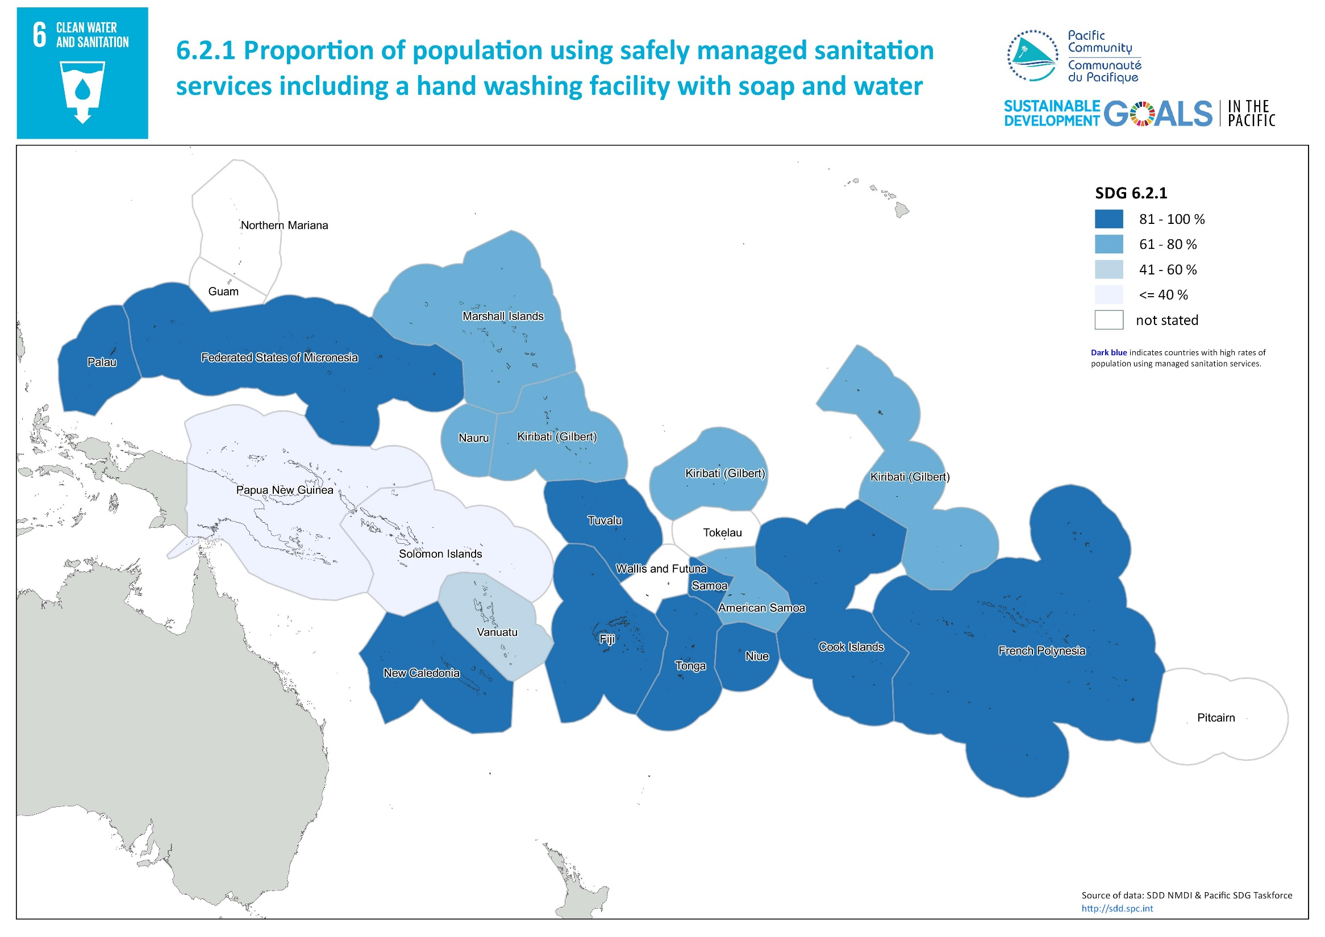

Slide 12
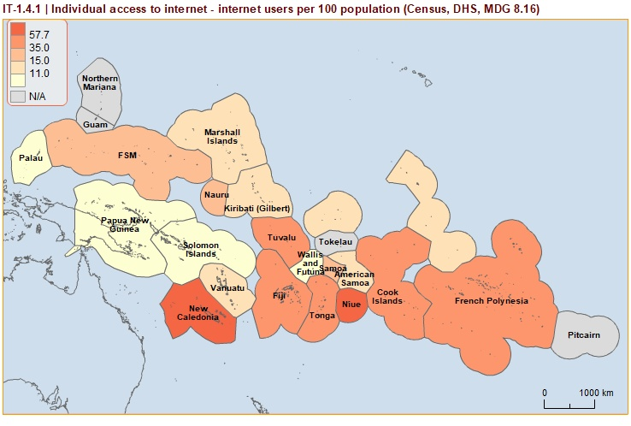

Slide 13
Regional progress

Slide 14
Where are we in developing indicators – National level
Most of the Pacific countries have either mapped or are in the process of mapping the SDGs against National development plans
Some have integrated SDGs into their National Monitoring processes – Cook Islands, Fiji, Samoa, Solomon Islands, Tonga, Vanuatu
Indicators range from 150 to more than 400 in some of the countries
Tonga National Poverty definition
those that experience both low income and are also materially and socially deprived;
those vulnerable because of deprivation socially perceived necessities (items and activities) that the Tongan majority consider that no-one should go without; and
those vulnerable because of income -measured at the household level and takes into account both monetary (e.g. wages) and non-monetary sources (e.g. self-production).
New Zealand Living Standards Framework and Indicators Aotearoa NZ

Slide 15
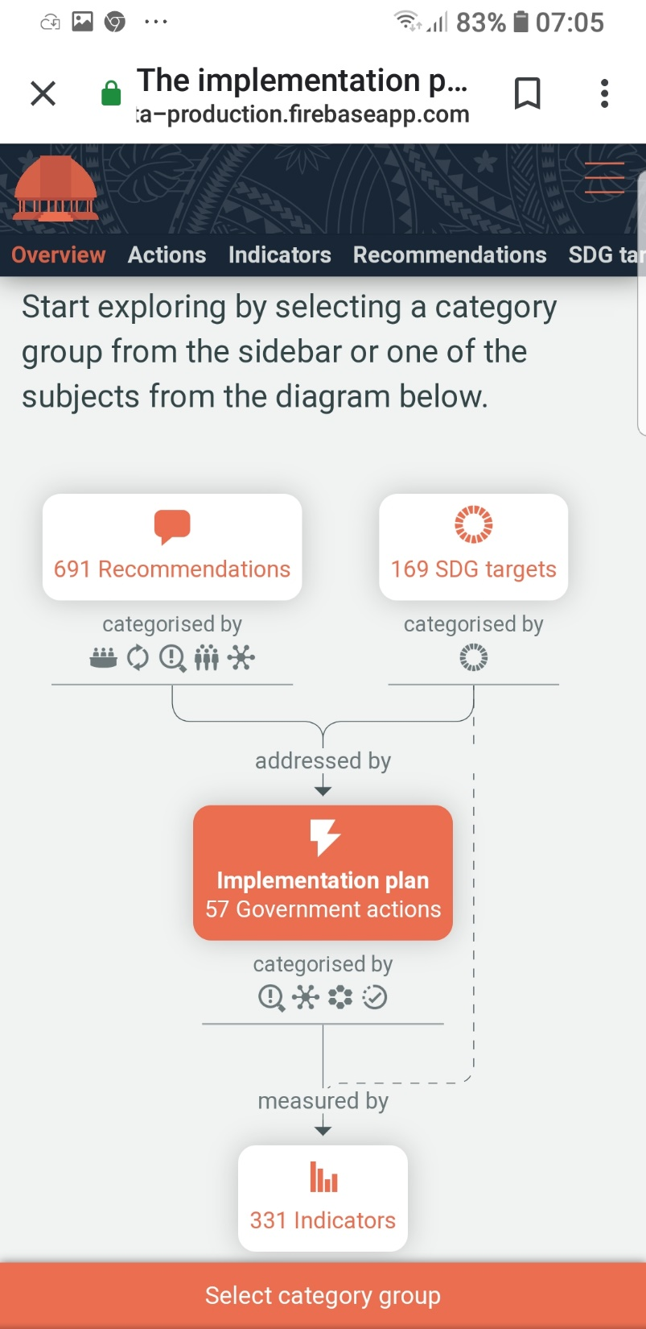
Good practices at the national level on SDGs monitoring, data collection and reporting
SADATA - Samoa through NZ and UN support established a tool –initially to manage and monitor their human rights recommendations and progress – added SDGs and considering adding Aichi and Multi-lateral Environment Agreement indicators
Vanuatu
  Annual Development Report
  M&E unit in the PMs office, M&E focal points in all line ministries
  Vanuatu NSDP baseline/SDGs indicators survey
Vanuatu, Tonga and Samoa have developed national databases for their data, information
https://sadata-production.firebaseapp.com/

Slide 16
Challenges
Regional Level
Only 48% of PSDI can be measured
Lack of disaggregation of data across countries
Silo approach to statistical capacity building
National / country level
Average less than 50% of national indicators can be measured
Lack of disaggregation
Limited capacities and poor funding for national statistics offices and statistical systems
Lack of integration of national statistical systems
Lack of demand for and capacities for analysis of data

Slide 17
REGIONAL SUPPORT:
HIES Experiment –extra modules added to base HIES
Labour Force
Disability
HIES
Partakers
Better tailored questionnaire and survey instruments –such as Disability Surveys and Vanuatu’s ‘National Baseline Indicator Survey’
Support to Pacific countries in the use of data in VNR reporting
Development of a regional .stat SDG dashboard –
Should be possible to generate poverty estimates disaggregated by disability as required in SDG indicators (if disability prevalence is high enough)
Use of the tested Labour Force module will promote harmonization and comparability of labour market data across the Pacific, while reducing the time and costs associated with the development of questionnaires, manuals and other survey tools.
Fisheries
Household Shocks
Food consumed outside household
Food Insecurity Experience Scale
Notes:
FIES -2.1.2
The Food Insecurity Experience Scale is a set of 8 questions developed by FAO Statistics Division to estimate the prevalence of moderate or severe food insecurity in a country as a result of lack of access to food

Slide 18
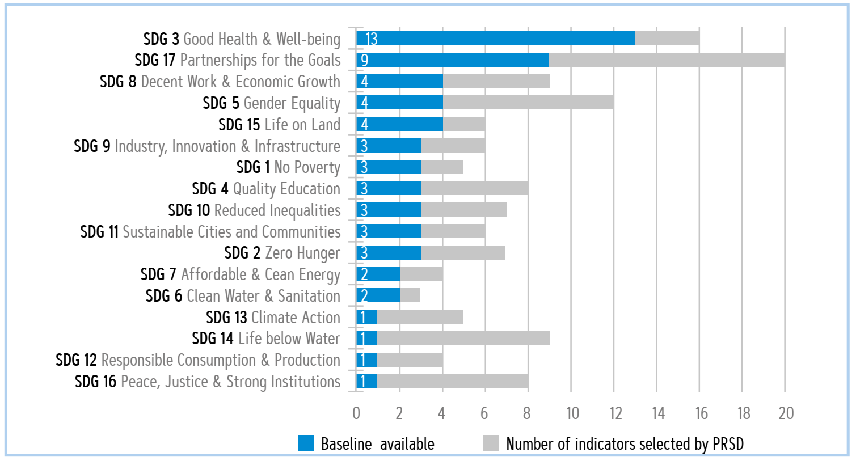
Which sectors require most data-related support from the UN system?
What can we measure now?
  Environment (SDG12, 13,14)
  Peace, Justice & Strong Institutions
  Gender Equality
  Education

