Slide 1
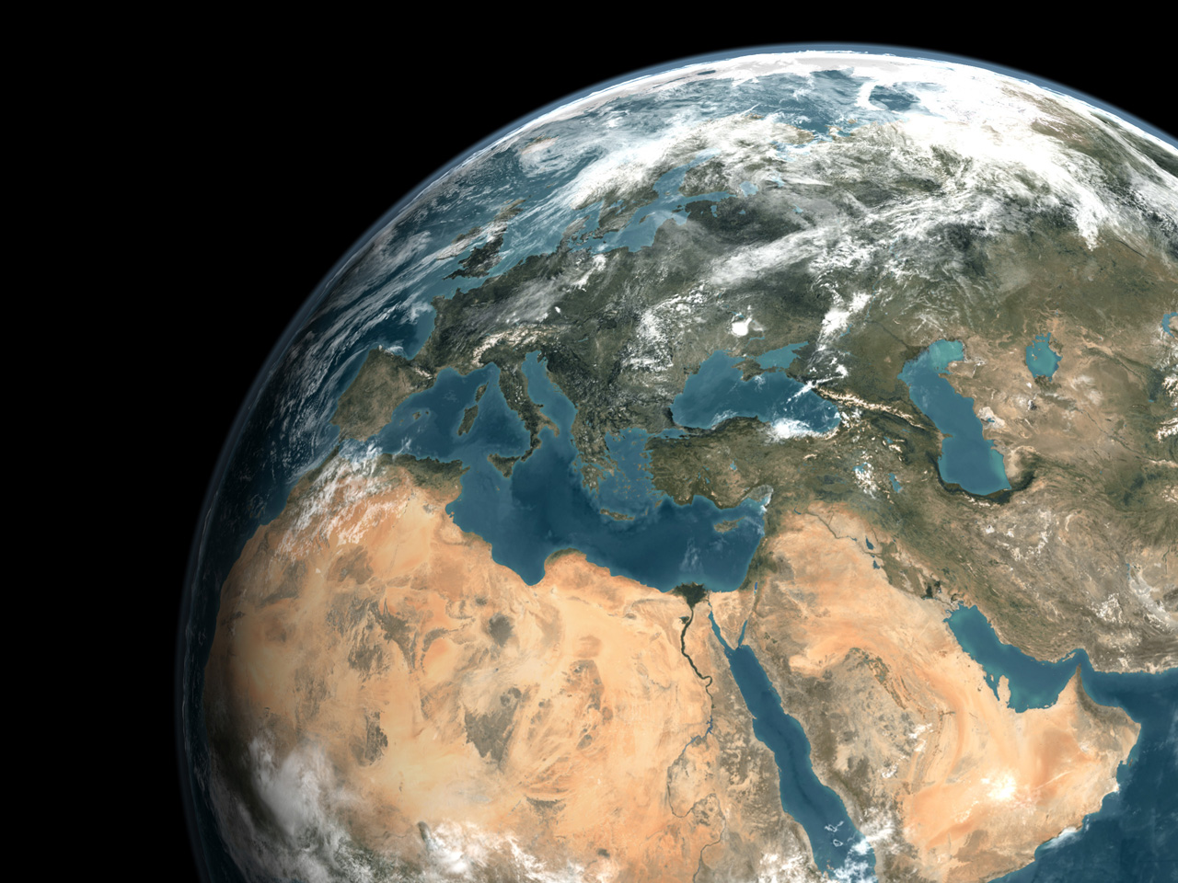

Monitoring the SDGs: how and why
Brennan VanDyke
Chief of the Capacity and Innovation Branch
Science Division
UN Environment
Photo credits: Ludovic Bernaudat

Slide 2
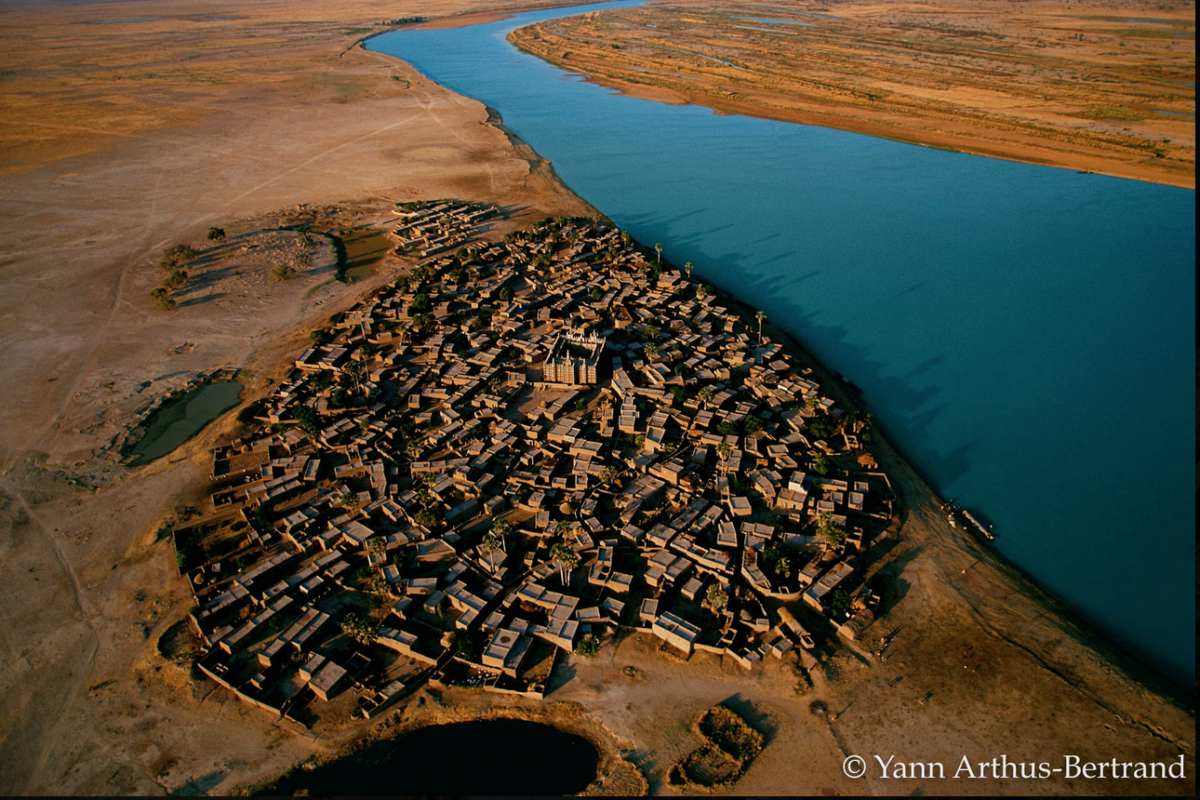

The challenge
How can we provide food, water, energy for 9,4 billion people, avoid dangerous climate change, and protect our planet’s biodiversity?
Notes:
We know we have a monumental challenge before us – of an existential nature – just in the environmental dimension of the SDGs. We need (1) to fill data gaps for the SDG indicators, using new forms of data; (2) methodologies to enhance our understanding of the interlinkages between efforts to meet the different SDGs; (3) mechanisms to bring together the science and policy making communities to monitor progress on each indicator and to make course corrections; (4) capacity across the world to do all of this.
A significant common endeavor has been to measure our progress using agreed indicators, commonly defined, and populated using agreed metadata. Even before the SDGs, there was work on measuring the environment: with the post-Brundtland development of the Framework for the Development of Environment Statistics and then with the post-Earth Summit development of the System of Environmental Economic Accounts (for capturing interlinkages between the environment and the economy). However, work on measuring the environment is still rather new; there are still methodological gaps in measuring aspects of the environment; there is very limited information which on the interlinkages, and there are capacity gaps in countries attempting to build their environmental information systems to measure the environmental dimension of development.

Slide 3
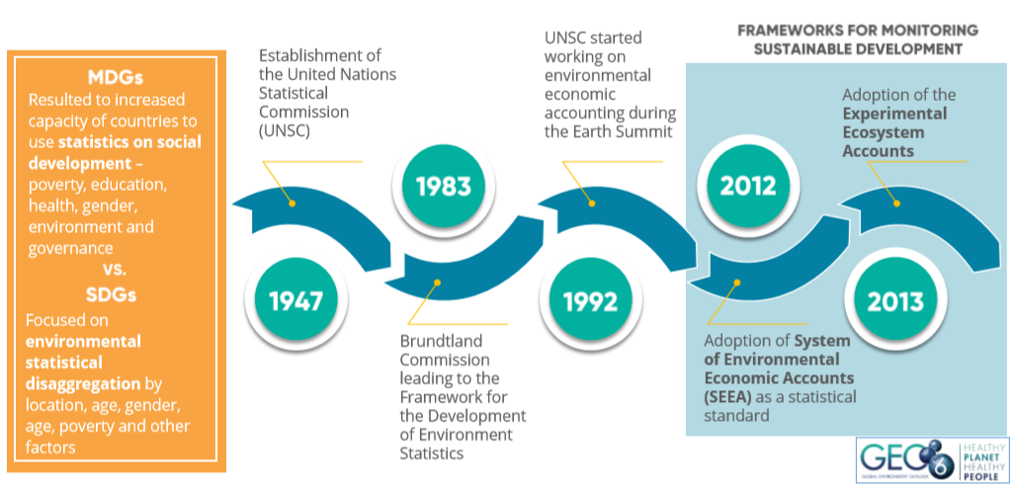
MDGs to SDGs
Notes:
The beautiful thing about the SDGs is that they seem to be pulling us all together in a way I have not seen in my 20 years working for the UN system. However, the system needs the tools to make solid, science-based decisions on how to move forward and on how to correct initiatives mid-course because we are running out of time.
A major shift in terms of the MDGs and the SDGs is the recognition that the environment must be part of the global framework for sustainable development. We spoke yesterday about the deeply interlinked nature of the SDGs.

Slide 4
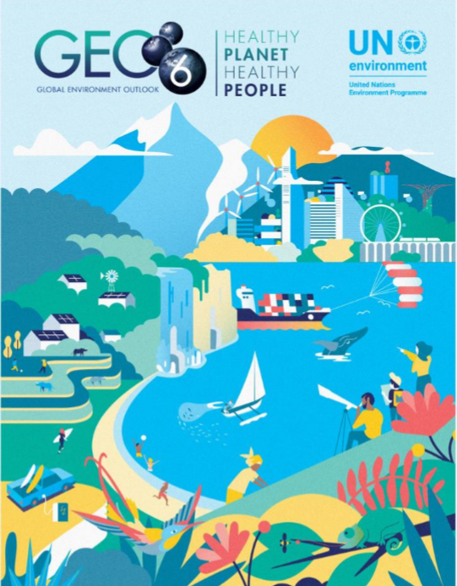
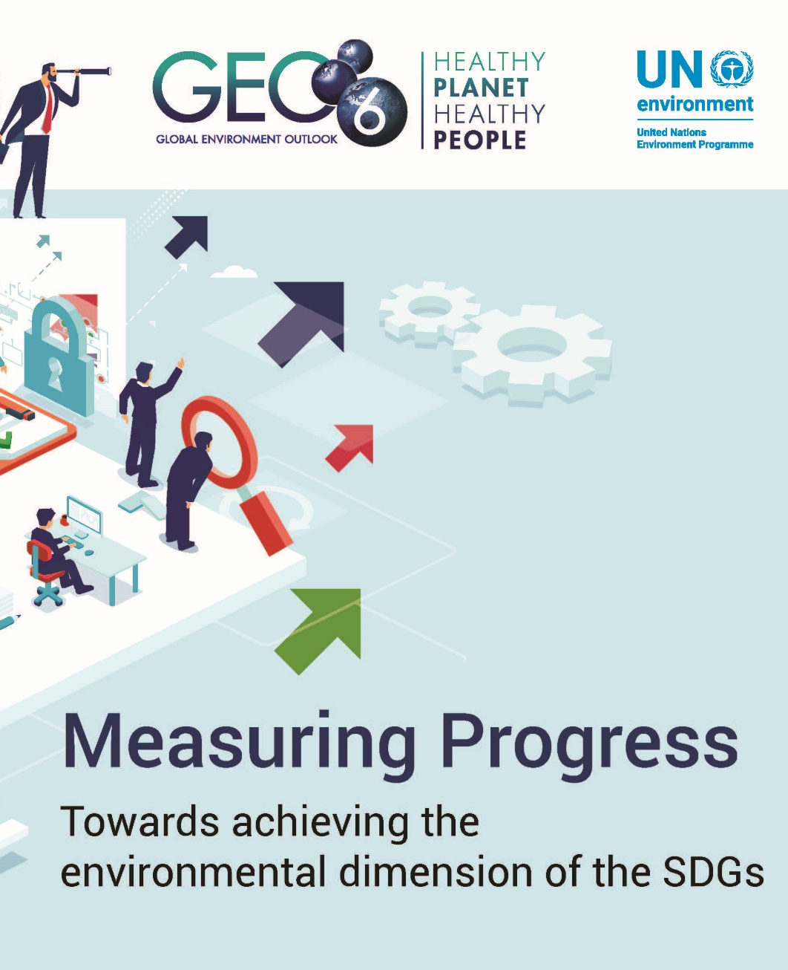
Knowledge Products: measuring the SDGs
Notes:
UN Environment is tracking how we are doing in terms of monitoring the environmental dimension of the SDGs, and in translating data into knowledge into action. Here are two of our premier publications. Chapters 3 and 25 of the Global Environment Outlook are focused on current state of data and future data needs, respectively. Measuring Progress takes the currently available data and identifies trends toward or away from the Goals, as well as data gaps.

Slide 5
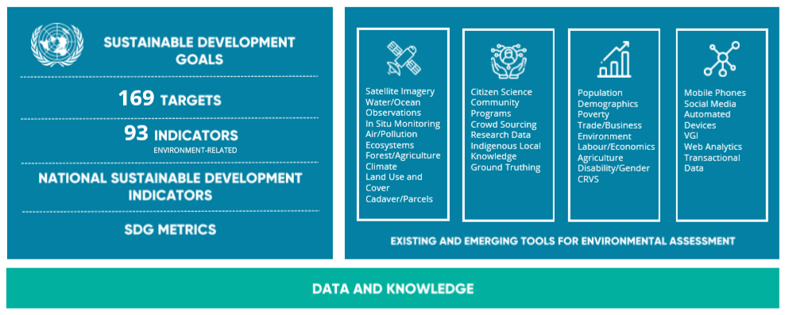
Environment-related indicators in the SDGs
Notes:
Out of the total of 169 targets and 244 indicators in the SDG framework, UN Environment has identified at least 93 environment-related indicators. The GEO noted that there is a wealth of techniques for measuring the environment: from remote sensing to in situ measurement, to citizen science, to surveys, to new forms of big data. These techniques must allow countries to create common statistics and indictors that capture their developmental situation, including time series statistics for geospatial data products.

Slide 6
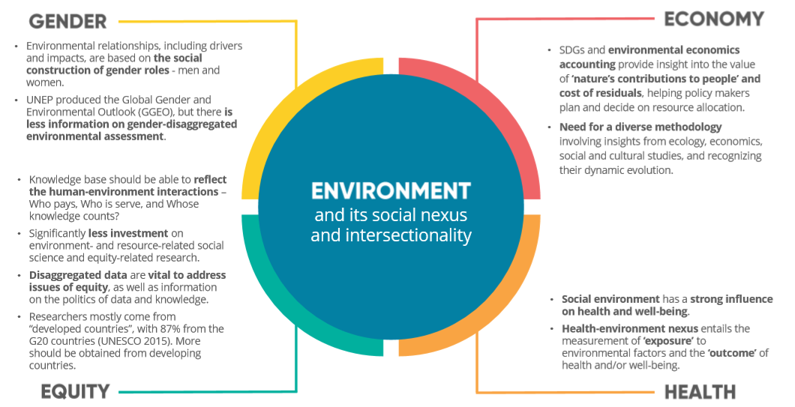
Environment-related indicators in the SDGs: what we need to know
Notes:
The environmental dimension of the SDGs also creates opportunity for linking gender, equity, health and the economy with the environment – recognizing the interconnectedness of the planet. By having data in a standard format, we put ourselves in a position to analyze overlays of different policy arenas and their interactions. However, this area of work needs to mature. We are currently not able to make integrated decisions readily.

Slide 7
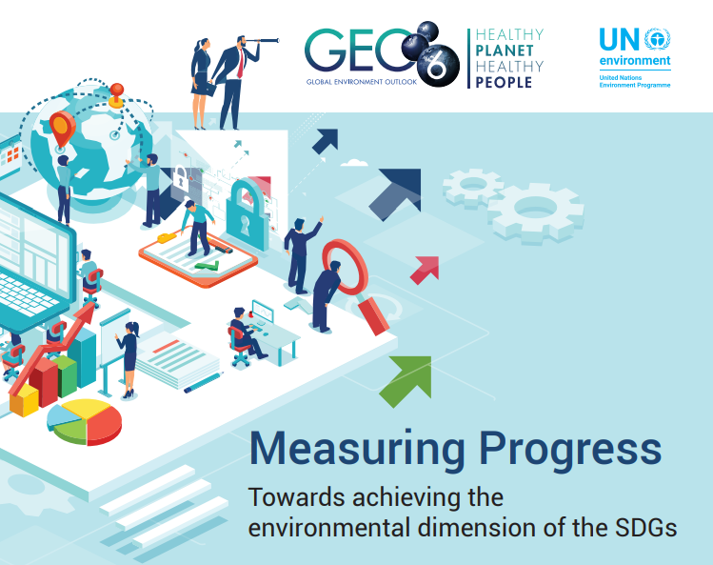
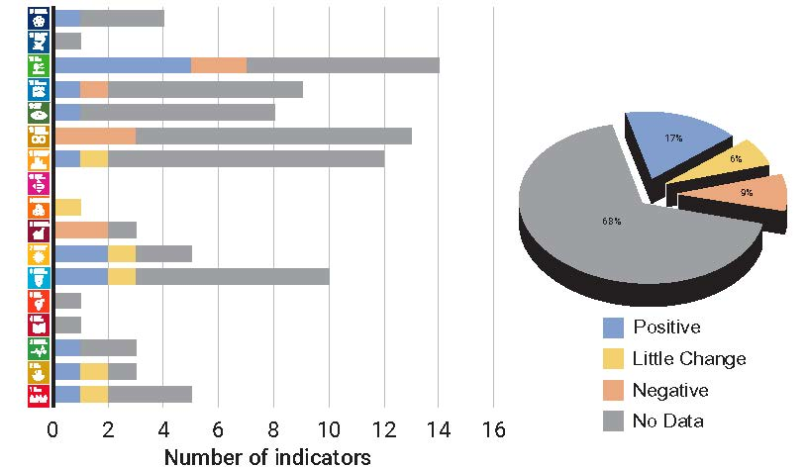
Data underpins good decisions
68% of environment-related SDG indicators do not have enough data to assess global progress.
There is even less data availability that is disaggregated by vulnerable population or geospatially.
Notes:
In March 2019, UN Environment launched a report called ‘Measuring Progress Towards monitoring the environmental dimension of the SDGs’, which analysed the state of the environmental dimension of sustainable development based on the 93 environment-related SDG indicators. The analysis included a review of the availability of statistical and spatial data. Simple extrapolation procedures were used to estimate if the SDG targets at the global and regional level would be met based on the current state of the SDG indicators (i.e., no effort to change the current data trend). A simple extrapolation method was chosen because this method is easy to employ and duplicate.
This report found that:
There is a significant gap between where we want to be and where we actually are. Where the data exists, it shows that the environmental dimension of the SDGs will not be met based on current trends. Our efforts are not keeping pace with the rate of change that is driving environmental degradation.
"Measuring Progress Towards Achieving the SDGs", shows that we are able to demonstrate either a positive or neutral trend for only 23% of the environment-related SDG indicators – and many of these indicators are measuring the existence of policy instruments as opposed to environmental outcomes.
We lack the data necessary to assess the trends for 68% of these indicators.

Slide 8
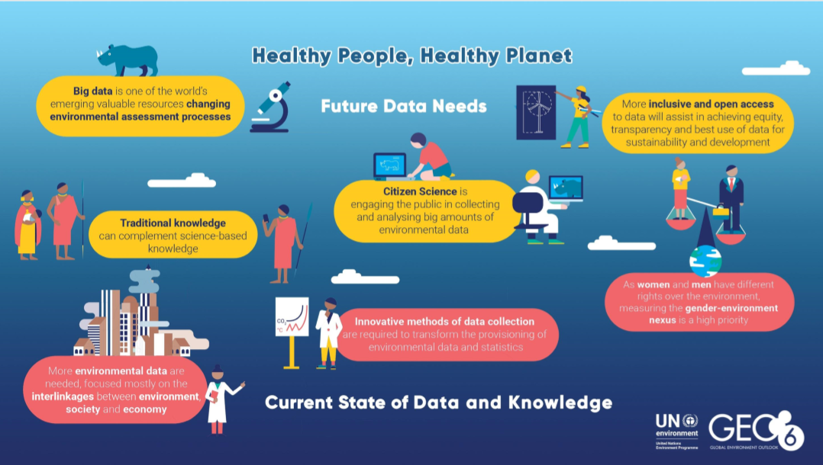
Where do we want to go?
Notes:
We need to seriously scale up – and soon – to achieve the SDGs and ensure the long-term sustainability of the planet. This will require:
Systems for finding and sharing data: openness and common standards, open metadata, more tagged data and more awareness that the data exists. A recent hackathon on marine sciences to bring together data did not make as much progress as hoped because of differences in definitions, etc. We need to work better with academics and citizen science groups to agree on standards and use them.
Data-driven knowledge to explore interlinkages across environmental areas and with social and economic information to produce insights.
Not only national level statistics, but geospatial data and data which can be disaggregated for vulnerable populations and other forms of new data.
Moreover, bringing together new and existing data: citizen science, satellite, in situ, survey, transactional and other forms of data.
Methodologies for combining top-down and bottom-up analyses of the data that will help us choose more effective interventions, in addition to monitoring the interventions we have chosen.
Knowledge communities to explore the interlinkages. We need regional, sub-regional, and country-level mechanisms to improve SDG follow-up, review and implementation.
Unfortunately, we are not there yet.

Slide 9
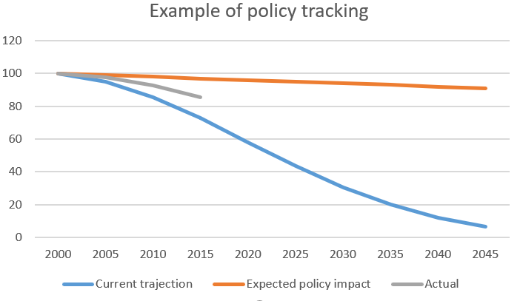
Course correction
Notes:
We need to be able to use the data not only to measure what we are doing, but to help us get on track – to get us where we want to go: a healthy planet, a sustainable, inclusive economy and healthy, better lives for people.
We have seen progress in designating protected areas, clean fuel, funding for biodiversity and ecosystems and disaster risk reduction.
However, these policy mechanisms have not changed the trajectory in terms of endangered species, land degradation or halting ecosystem decline. And we are not on track to meet any of the SDG targets in Goal 12 on sustainable consumption and production. This is a problem. Tracking progress alone is not sufficient, but it is a start.
Our ability to measuring progress and think through trends can inform us – to an extent – whether our current actions are working as anticipated. For example,
Imagine that in 2000, a policy was developed which was expected to completely change the trajectory of a particular issue, but after monitoring for 15 years, it became clear that the things were not on track.
We also need science-based methods for identifying optimal interventions to change the trajectory. Just monitoring the indicators is not sufficient.

Slide 10

Biodiversity Loss
Between 1970 and 2010, the planet has lost 52% of its biodiversity.
Currently, 1 million species face extension.
Notes:
For example, we know that between 1970 and 2010, the planet has lost 52 percent of its biodiversity. According the IPBES report last month more than 1 million species are at risk of extinction in the next few years. During that same time, protected areas went from almost nothing to currently around 15% of all terrestrial land is protected (SDG 15.1.2), and many countries have developed biodiversity action plans and become signatories to the CBD (SDG 15.9.1) and investment in biodiversity and conservation is on the rise (SDG 15.a.1). Yet, while countries may be on track to reach these SDG indicators related to the biodiversity, the planet is still at risk.

Slide 11

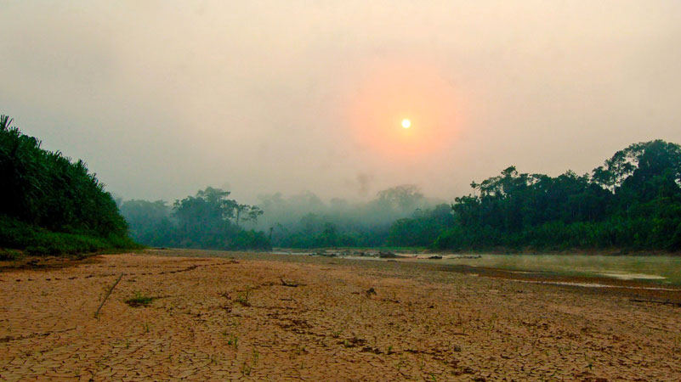
“The global environmental governance framework is simply not keeping pace with the rate of change that is driving environmental degradation, biodiversity loss and climate change”
– Dr. Jian Liu, UN Environment Chief Scientist
We need better data and science in order to better manage natural resources, target investments and technologies and develop policy.
Photo: Equator Prize Winner AIDER
Notes:
We should not give up hope, but we need to feed faster and better data and integrated analysis into multi-sectoral policy, and we need citizens, companies, governments and all stakeholders to work together.

Slide 12
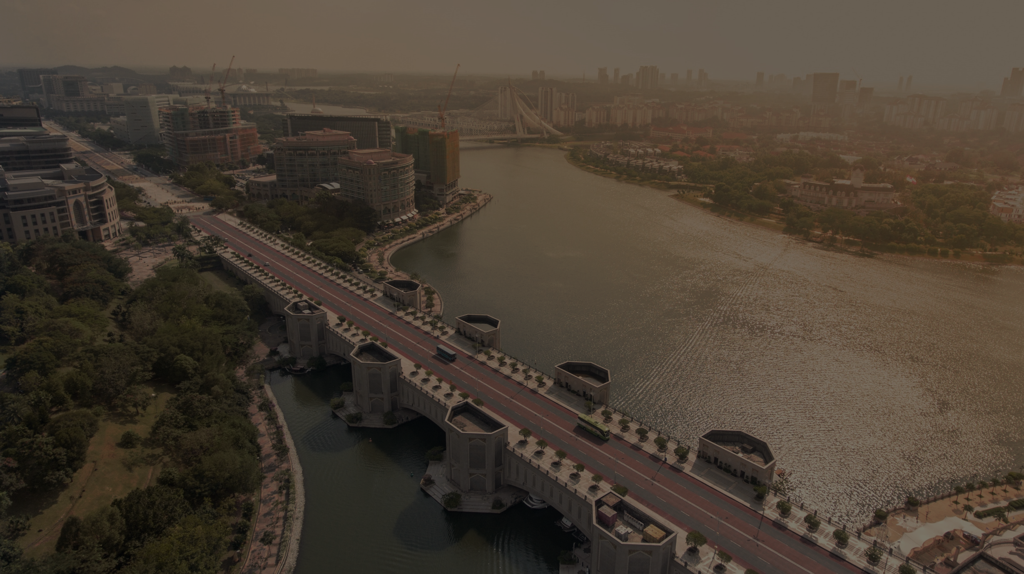
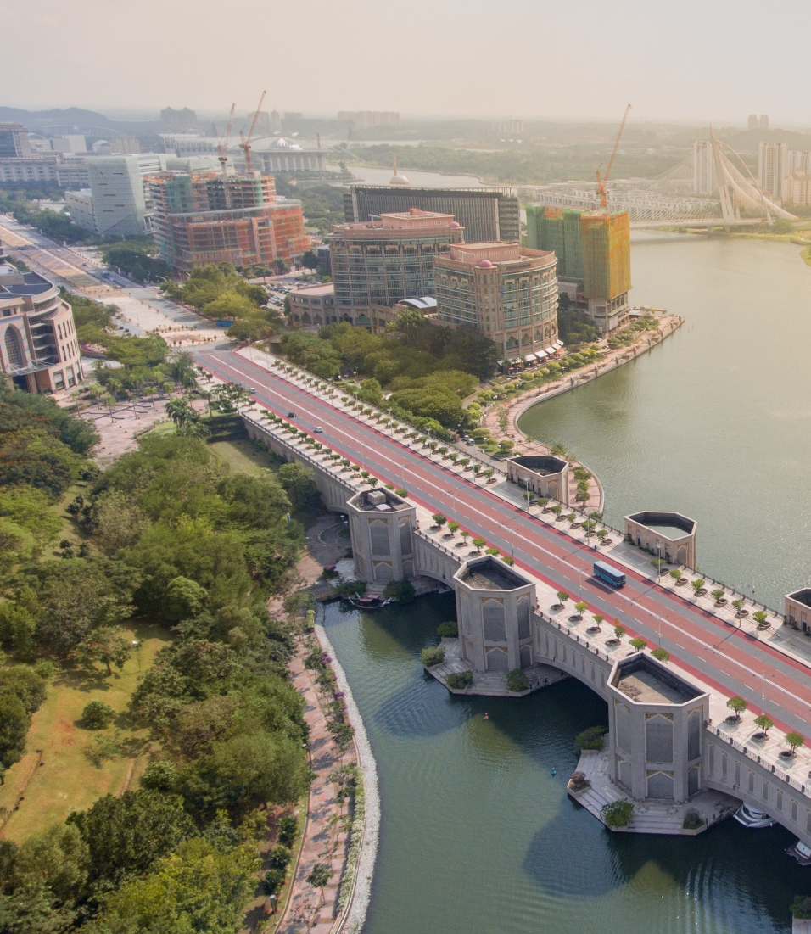
Moving forward
We need better, faster data so that we can identify problems as they happen.
We need data to be used
  Capacity development on data and data use
  Systems for sharing and finding data
We need to find ways to not only create information but action
  Integrated analysis
  Citizen engagement
@Ishan 2015

Slide 13
Monitoring the SDGs: how and why
Brennan VanDyke
Chief of the Capacity and Innovation Branch
Science Division
UN Environment
Photo credits: Ludovic Bernaudat

