Slide 1
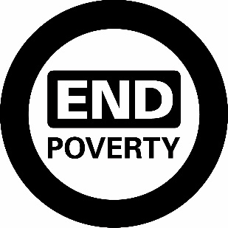
Financing the SDGs
Expert Group Meeting on
Optimizing the Implementation of the
Sustainable Development Goals
in the Framework of Integration and Policy Coherence
July 12 & 13
New York
Jaehyang So
Senior Adviser
World Bank Group
@wbg2030
worldbank.org/sdgs
Notes:
Expert Group Meeting on Optimizing the Implementation of the Sustainable Development Goals (SDGs) in the Framework of Integration and Policy Coherence
I am very pleased and honored to be here today on behalf of the World Bank Group to share with you our latest approaches on development finance.
SDGs are the most powerful global framework in existence today. Almost every country in the world has committed to the SDGs. And No country in the world has achieved the SDGs.

Slide 2
103 countries have presented VNRs in HLPF
48 countries are set to present VNRs in 2019
…8 countries for the second time
2016
22 countries
2017
43 countries
2018
47 countries
2019
48 countries
China
Colombia
Egypt
Estonia
Finland
France
Georgia
Germany
Madagascar
Mexico
Montenegro
Morocco
Norway
Philippines
Republic of Korea
Samoa
Sierra Leone
Switzerland
Togo
Turkey
Uganda
Venezuela
Afghanistan
Argentina
Azerbaijan
Bangladesh
Belarus
Belgium
Belize
Benin
Botswana
Brazil
Chile
Costa Rica
Cyprus
Czech Republic •
Denmark
El Salvador
Ethiopia
Guatemala
Honduras
India
Indonesia
Italy
Japan
Jordan
Kenya
Luxembourg
Malaysia
Maldives
Monaco
Nepal
Netherlands
Nigeria
Panama
Peru Portugal
Qatar
Slovenia
Sweden
Tajikistan
Thailand
Togo
Uruguay
Zimbabwe
Albania
Andorra
Armenia
Australia
Bahamas
Bahrain
Benin
Bhutan
Cabo Verde
Canada
Colombia
Dominican
Republic
Ecuador
Egypt
Greece
Guinea
Hungary
Ireland
Jamaica
Kiribati
Lao PDR
Latvia
Lebanon
Lithuania
Mali
Malta
Mexico
Namibia
Niger
Paraguay
Poland
Qatar
Republic of Congo
Romania
Saudi Arabia
Senegal
Singapore
Slovakia
Spain
Sri Lanka
State of Palestine
Sudan
Switzerland
Togo
UAE
Uruguay
Viet Nam
Algeria
Azerbaijan
Bosnia and Herzegovina
Burkina Faso
Cambodia
Cameroon
CAR
Chad
Chile
Congo
Cote d'Ivoire
Croatia
El Salvador
Eswatini
Fiji
Ghana
Guatemala
Guyana
Iceland
Indonesia
Iraq
Israel
Kazakhstan
Kuwait
Lesotho
Liechtenstein
Mauritania
Mauritius
Mongolia
Nauru
New Zealand
Oman
Pakistan
Palau
Philippines
Rwanda
St. Lucia
Serbia
Sierra Leone
South Africa
Tanzania
Timor-Leste
Tonga
Tunisia
Turkey
Turkmenistan
UK
Vanuatu
Note: Indicates countries that have presented VNRs more than once
Notes:
Over 100 countries have presented their Voluntary National Reviews at the UN to date, and another 40 or so countries will present this year. While many of the VNRs present excellent and comprehensive approaches to achieve the SDGs, only around 10% of the VNRs to date include a financing plan.

Slide 3
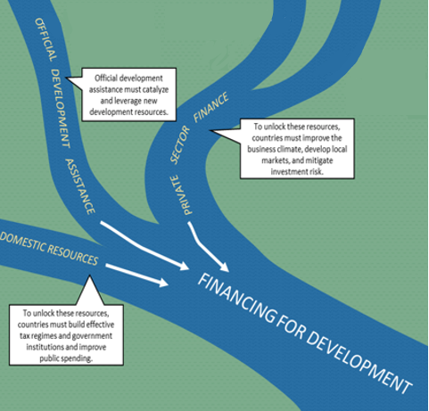
Financing the SDGs: Three Sources
Notes:
A comprehensive financing plan for SDGs should include 3 sources: 1) domestic public resources; 2) external public sources such as ODA; and 3) domestic and international private sources.
For most countries, domestic resource mobilization is the largest resource available to fund their national development plans. A country’s ability to mobilize domestic resources and spend them effectively—at the national, sub-national and municipal levels—lies at the crux of financing for development.
The World Bank has been working closely with the IMF; OECD; and the UN on the Platform for Collaboration on Tax. The Platform aims to address issues such as tax base erosion, both domestic and international, and help design solutions in line with country priorities.
Domestic: Improved tax administration and compliance
International: Increased transparency to tackle illicit financial flows
Official Development Assistance (ODA) remains an important source of external public financing. Yet ODA flows are only a small part of development flows, and ODA must be targeted increasingly to crowd-in other funding sources: (i) for Low-Income Countries (LICs), on the basis of poverty, vulnerability, and limited fiscal capacity; and (ii) for Middle-Income Countries (MICs), by playing an increasing role to leverage and catalyze public and private sources of financing.

Slide 4

World Bank Group Interventions in
Private Sector Development
IBRD
International
Bank for Reconstruction and Development
IDA
International Development Association
IFC
International Finance Corporation
MIGA
Multilateral Investment Guarantee Agency
ICSID
International Centre for Settlement of Investment Disputes
Loans to
middle-income
and credit-worthy
low-income country governments for projects executed by the private sector
Interest-free loans and grants to governments
of poorest
countries for projects executed by the private sector
Solutions in private sector development
Guarantees of foreign direct investment’s non-commercial risks for private investors
Conciliation and arbitration of investment disputes
3
Notes:
At the World Bank Group, we are trying our best to maximize these ODA results. The WBG’s latest capital increase was an excellent example of how the world can get together through 189 shareholders to agree on a package of measures that include a $13 billion paid-in capital increase and through the leveraging exercise and through financial innovation, that will have a capacity of over $100 billion a year from fiscal year 2019 through 2030 benefitting all of the World Bank Group members across all spectrums of income, and with a focus on gender and in partnerships with the private sector.
This capital increase will greatly strengthen the institution’s financial ability to support the 2030 Agenda and the SDGs and allow for greater responsiveness to risks to global stability and security, particularly in poorer countries and fragile states.

Slide 5
$75 Billion mobilized through
IDA18 Replenishment
Every three years, donors and borrower representatives agree on IDA’s strategic directions, financing, and allocation rules—known as the replenishment
Offers exceptional value for money, with $3 in spending for every $1 in partner contributions
Key Eligibility Criteria
Poorest: GNI per capita below IDA operational cutoff (US$1,185 in FY17)
Lack creditworthiness: No access to IBRD
77 Countries in FY17
x2
x3
$26B
$23B
Partner grant contributions (excl. MDRI)
Total Replenishment
Partner grant contributions (excl. MDRI)
IDA 18
Total Replenishment
Notes:
IDA: The IDA 18 replenishment, finalized in December 2016, was the largest ever. Through the generosity of the IDA contributors, including those on the panel today, and by using financial engineering to leverage the cash contributions of IDA donors, we were able to make $75 billion available for the world’s poorest countries. We are in the middle of the IDA 19 mobilization and look forward to working with all of you.

Slide 6
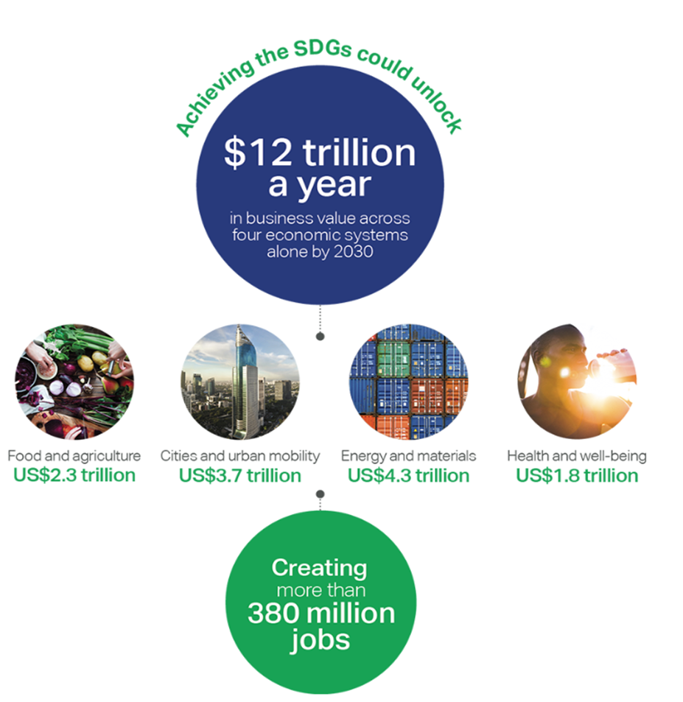
How much is out there?
$24.4 trillion
in low-yield government securities
$22 trillion
in annual global savings
More than $8 trillion invested in negative interest rate bonds
Notes:
And finally, private sector finance. Let me start by remembering our collective efforts three years ago as many of the institutions represented today outlined our ambitions for financing the post-2015 development agenda under the Addis Ababa Agenda for Action. The “Billions to Trillions” slogan developed in Addis Ababa signified that a paradigm shift could unlock a much greater magnitude of resources to achieve the SDGs.
The world needs intelligent development finance that goes well beyond filling financing gaps and that can be used strategically to unlock, leverage, and catalyze private flows and domestic resources.
Here is the context:
Over $24 trillion in low yield government securities; $22 trillion in annual global savings; and more than $8 trillion invested in negative interest rate bonds. This is our context. What can we do to draw this capital to development?
Also, there are real business opportunities out there. What started out as Corporate Social Responsibility during the MDG days has evolved into sustainable business. The World Business Council for Sustainable Development has generated, through a survey of their member companies, a potential for $12 trillion dollars a year, based on only 4 of the sectors. These business opportunities are anticipated to create an additional 380 million jobs.

Slide 7
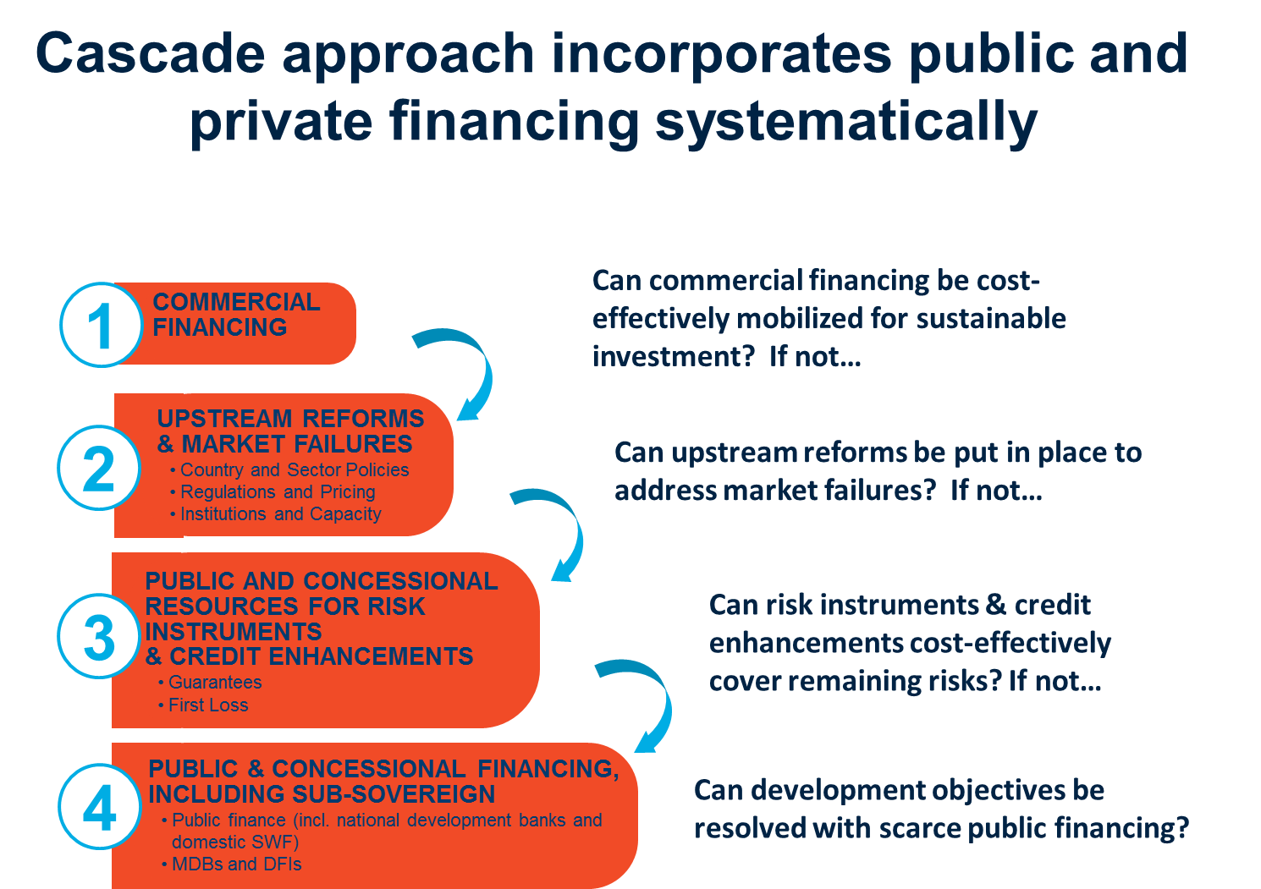
Notes:
The World Bank Group has introduced a Maximizing Finance for Development (MFD) approach to systematically assess and leverage all sources of finance, expertise, and solutions to support developing countries’ sustainable growth. It extends and shapes our involvement – Bank, IFC, and MIGA - by asking a number of cascading questions that ensure countries are able to use precious ODA for the most important projects, and that private sector is able to finance all the projects it can.
The four questions are:
Can commercial finance be used to finance this project?
Is there any public law or regulation that limits commercial financing?
If all the laws should enable, but no one is taking the risk, is there a guarantee needed to enable public financing? And finally,
Will development finance work for this project to achieve good societal impact?
A good example is the Nachtigal hydroelectric plant in Cameroon, where the WBG mobilized 1.5 billion EUR following the Cascade Approach

Slide 8
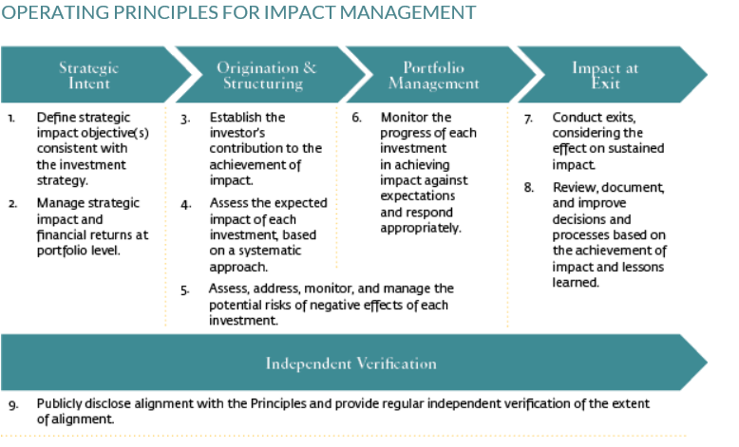
IFC Impact Investment Principles
Notes:
The latest example of WBG efforts in impact investing was launched by the IFC during the World Bank Group Spring Meetings in April this year. Over 60 companies around the world pledged to direct their investments following these 9 principles of Impact Investment.
These Operating Principles for Impact Management (the Principles) describe the essential features of managing investment funds with the intent to contribute to measurable positive social, economic, or environmental impact, alongside financial returns. This goes beyond asset selection that aligns investment portfolios with impact goals (for example, the SDGs), to requiring a robust investment thesis of how the investment contributes to the achievement of impact. The Principles have been designed from the perspective of an end-to-end process. The five elements of this process are: strategy, origination and structuring, portfolio management, exit, and independent verification. The nine Principles that fall under these five main elements are the key building blocks for a robust impact management system.

Slide 9

The World Bank Group Partnership Fund for the Sustainable Development Goals
WBG SDG Fund
Joint research project/ intervention
Provide consultative feedback on WBG interventions
Opportunity
to partner with WBG
on the best innovations for SDGs in
countries
FOR FURTHER INFORMATION PLEASE CONTACT
Juliana Knapp – jknapp@worldbank.org
Lisa Maria Castro – lcastro1@worldbank.org
8
Notes:
The Financing challenge looms large for all of us working on SDGs. The World Bank Group continues to strive to reduce the overall cost of achieving SDGs through innovation. We launched the WBG SDG Fund in October 2018, less than 1 year ago, to design and implement innovations that could help all countries to accelerate development to SDGs.
Examples of innovation supported by SDG Fund:
Job creation in refugee communities, starting with a $30 million investment matching platform in Jordan
GPS Mapping urban rooftops in 11 cities around the world to determine suitability for solar power in Vietnam, Ethiopia, Sri Lanka, Tanzania, Bangladesh, Philippines, Pakistan, Nigeria, Mexico, Kenya and Uzbekistan.
Generating and managing databases for SDG services for disabled population in piloted in Nigeria and Ghana to ensure No One is Left Behind
Currently financed by government of Sweden and Korea, the Fund is actively seeking both sovereign and private sector contributors, and I would be pleased to speak with any of you about potential partnerships.

Slide 10
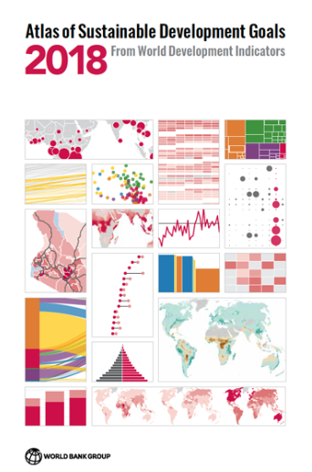
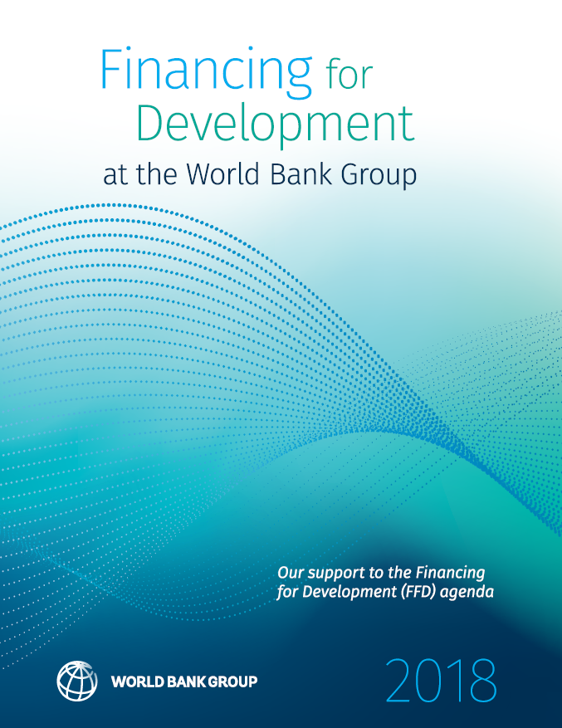
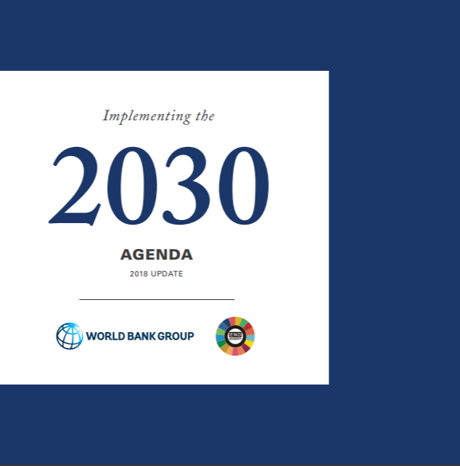



Thank You
worldbankgroup.org/sdgs
Follow us on twitter @WBG2030
Jaehyang So on
@wbg2030
worldbank.org/sdgs

