Slide 1
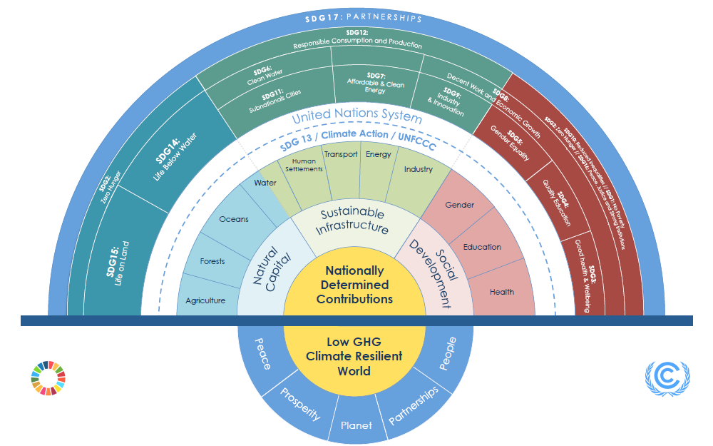
Climate Action – Achieving the SDGs
OVERCOMING CHALLENGES TO CLIMATE CHANGE

