Slide 1

Objectives of the meeting
Stakeholder Consultation on Securing Sustainable Conditions for the Monitoring of Persistent Organic Pollutants under the Stockholm Convention
Brisbane, Australia, 10-11 December 2019

Slide 2
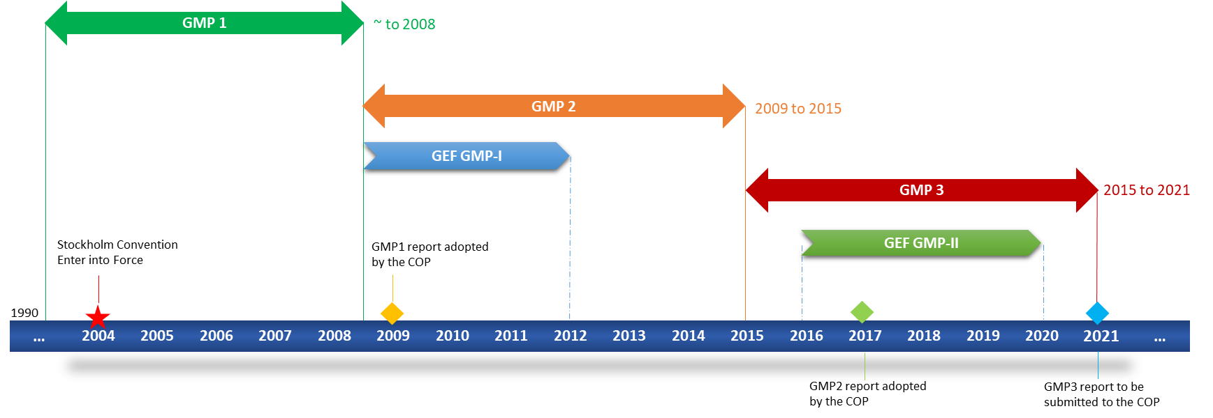
Capacity Assistance Time Line for POPs Global Monitoring
2

Slide 3

UNEP/GEF POPs
Monitoring Projects

Slide 4
GMP I: 2009 - 2012
GMP II: 2016 - 2020
Funding
Global Environment Facility (GEF)
SAICM Trust Fund
Government of Norway
European Union
BRS Secretariat
Funding
Global Environment Facility
31 Countries
Pacific
GRULAC
West Africa
East and South Africa
42 Countries
Pacific
GRULAC
Africa
Asia

Slide 5
UNEP/GEF POPs Global Monitoring Plan Projects in the Africa, Asia, Pacific and Latin America
and Caribbean Regions
2016-2020

Slide 6
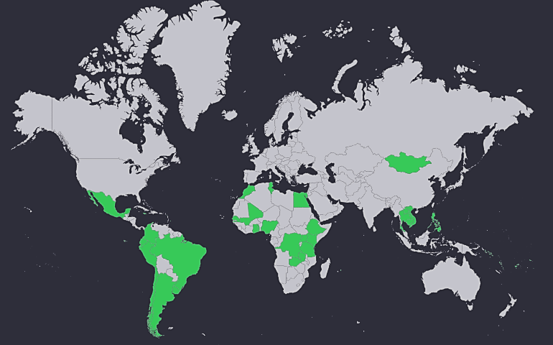

GEF/GMP2
Support the development
of pharmaceutical product
candidates from discovery to
the patient with high success
rates at a competitive cost.
Africa (15)
DR Congo
Egypt
Ethiopia
Ghana
Kenya
Mali
Morocco
Mauritius
Nigeria
Senegal
Tanzania
Togo
Tunisia
Uganda
Zambia
Pacific Islands (9)
Fiji
Kiribati
Marshall Islands
Niue
Palau
Samoa
Solomon Islands
Tuvalu
Vanuatu
GRULAC (11)
Antigua and Barbuda
Argentina
Barbados
Brazil
Chile
Colombia
Ecuador
Jamaica
Mexico
Peru
Uruguay
Asia (7)
Cambodia
Indonesia
Lao PDR
Mongolia
Philipines
Thailand
Vietnam
Follow-up of GEF/GMP projects (31 countries) from
2008-2012

Slide 7

Executing agencies
UNEP for Africa, Asia and Pacific Islands regions
Basel Convention Coordinating Centre, Stockholm Convention Regional Centre, for Capacity Building and Transfer of Technology hosted by Uruguay co-execution in coordination and collaboration with UNEP for Latin America and Caribbean Islands Region

Slide 8
Partners
Project countries
Secretariat of the Basel, Rotterdam and Stockholm Conventions
World Health Organization (WHO)
Man-Technology-Environment Research Center (MTM), Örebro University, Sweden
Chemisches und Veterinäruntersuchungsamt (CVUA), Freiburg, Germany
Department of Environment and Health, Vrije Universiteit, Netherlands
Research Centre for Toxic Compounds in the Environment (RECETOX), Czech Republic
Spanish National Research Council (CSIC)
Japan Environmental Sanitation Center
National Institute for Environmental Studies, Japan

Slide 9
UNEP/GEF GMP II Project Components
Securing conditions for successful project implementation
Capacity building and data generation on analysis of core abiotic matrices (air and water)
Capacity building and data generation on analysis of core biotic matrices (human milk)
Assessment of existing analytical capacities and reinforcement of national POPs monitoring
Securing conditions for sustainable POPs monitoring

Slide 10
UNEP/GEF GMP II Project Key Activities
Two years of water and passive air sampling and analysis
One round of human milk sampling and analysis
Two rounds of interlaboratory QA/QC assessments
Tools and training on sampling and analysis
Analysis of samples of national interest
Mirror analysis of samples of interest in national laboratories

Slide 11
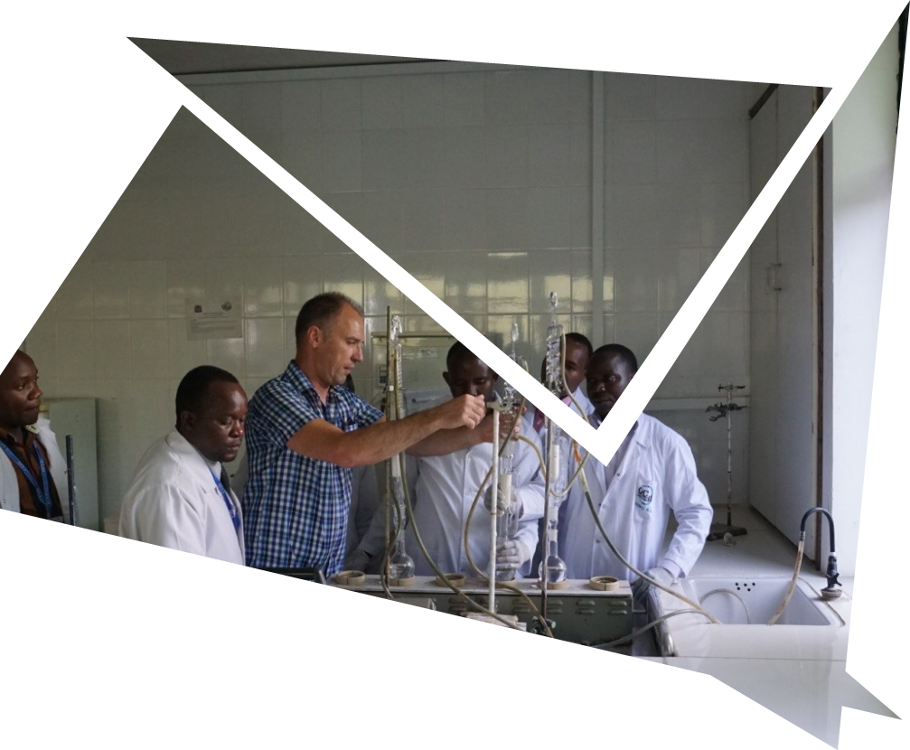


Implementation Status
Sampling concluded in June 2019
26out of 30 trainings colcluding
2 rounds of interlaboratory assessments
Most of the analysis is expected to be completed by the end of the year
Results are expected by March 2020

Slide 12
Project Comp. 5-Securing conditions for sustainable POPs monitoring
Several rounds of consultation
Project steering committee
Project implementing partners
GMP Global Coordination Group
Trainings & guidance material
Laboratory testing
Sampling

Slide 13
Sustainability consultations: Key Partner/Steering Committee outcomes
Priorities for continued support
Air and water monitoring are important elements
Centralized human milk monitoring
Inter-laboratory assessment
When enhancing laboratory capacities, initially to focus no one or two from each region

Slide 14
Some highlights of the GCG consultation
Consider long term strategies to generate information over time that is needed for the effectiveness evaluation
Enhance capacity on the critical gaps
Water monitoring at sites where past activities have already generated baseline data
Air monitoring in a limited number of sites that complement activities conducted by the monitoring programmes within the GMP,
Global human milk survey covering all developing regions
Capacity building and QA/QC data generation on critical core matrices

Slide 15
Meeting Objectives
Identify the scope and key elements for strengthening technical capacities in developing countries to sustainably contribute to POPs monitoring;
Identify Political and financing strategies to generate synergy between monitoring and related other activities;
Identify opportunities to facilitate effective engagement of key stakeholders

Slide 16
Expected meeting deliverables
Essential and most feasible requirements for a global, sustainable and technically sound monitoring system which also supports/includes national POPs management and monitoring needs
Purposes, other than GMP, for which chemical analytical monitoring are needed (linkage to the wider goals
Development of an efficient and cost-effective implementation strategy, focusing on the best possible scenarios
Sustainable financing opportunities and options.

Slide 17
Meeting documents
Meeting expectations
Provisional Agenda
Concept note
Paper 1: Background
Paper 3:Review of related chemicals initiatives
Case study 1: Environmental Persistent Organic Pollutants Monitoring Project in East Asian Countries

