Slide 1
global monitoring plan for POPs and the Effectiveness evaluation: Mandate, Current Status, and FUTURE Activities
Secretariat of the Basel, Rotterdam and Stockholm Conventions

Slide 2
Mandate
ARTICLE 16 on Effectiveness Evaluation:
In order to facilitate such evaluation, the Conference of the Parties shall, at its first meeting, initiate the establishment of arrangements to provide itself with comparable monitoring data on the presence of the chemicals listed in Annexes A, B and C as well as their regional and global environmental transport.
These arrangements:
(a) Should be implemented by the Parties on a regional basis when appropriate, in accordance with their technical and financial capabilities, using existing monitoring programmes and mechanisms to the extent possible and promoting harmonization of approaches;
(b) May be supplemented where necessary, taking into account the differences between regions and their capabilities to implement monitoring activities; and
(c) Shall include reports to the Conference of the Parties on the results of the monitoring activities on a regional and global basis at intervals to be specified by the Conference of the Parties.

Slide 3
SC:8/19 GMP
Welcomes the second global monitoring report and the conclusions and recommendations of the global coordination group;
Adopts the revised terms of reference and mandate of the regional organization groups and the global coordination group;
Requests the regional organization groups and the global coordination group to continue to implement the global monitoring plan according to the revised terms of reference and mandate.
Requests the Secretariat, subject to the availability of resources, to continue to support the work of the regional organization groups and the global coordination group in the implementation of the third phase of the global monitoring plan.

Slide 4
SC:8/18 EE
Welcomes the report on the effectiveness evaluation of the Stockholm Convention, including the conclusions and recommendations of the effectiveness evaluation committee;
Acknowledges that the Convention provides an effective and dynamic framework for addressing the production, use, release, import, export and disposal of POPs, but that inadequate implementation is the key issue identified in the evaluation;
Encourages Parties to step up their efforts to achieve full implementation of the Convention;
Takes note of the priority areas for action to address implementation challenges identified by the effectiveness evaluation committee.

Slide 5
GMP outcomes in 2015-2017
Global monitoring report (COP.8/21/Add.1 and COP.8/INF/38)
Five regional monitoring reports (COP7/INF/37 and 38 in 2015)
Updated GMP guidance document (UNEP/POPS/COP.7/INF/39)
GMP data warehouse (available online at http://www.pops-gmp.org/)
Main findings of the global report
National and international regulation of POPs has achieved significant decreases of some POPs in recent decades by controlling primary sources.
Secondary sources dominate the persistent low levels of legacy POPs (PCBs, DDTs, aHCH, PCDD/Fs).
Newly listed POPs (PBDE, PFOS, HBCD) do seem to be slowing or reversing increases in most samples.
The coverage and abundance of good quality monitoring data on POPs has increased very significantly since 2009, in particular in Africa, GRULAC, and Asia and the Pacific.
Long Range Transport Modeling has shown to be central in the interpretation and improvement of available data.

Slide 6
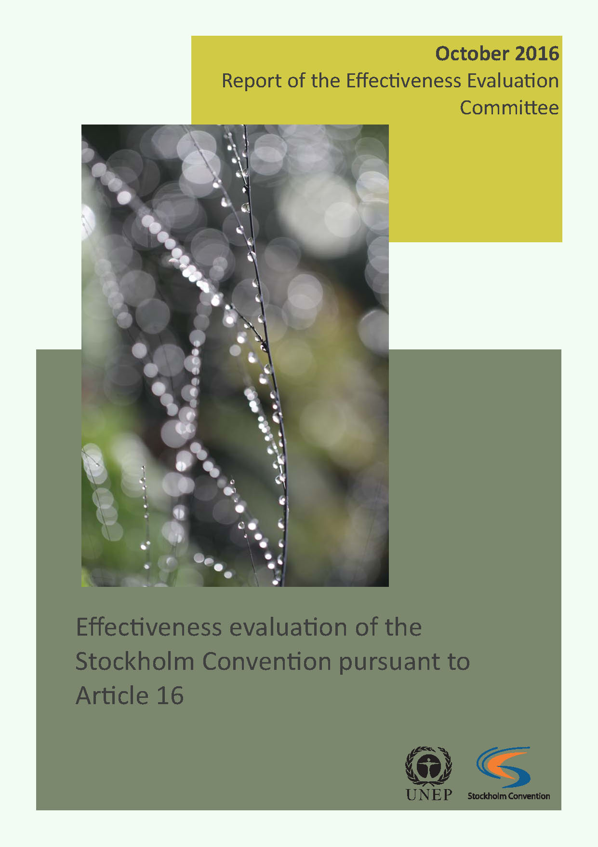
Effectiveness Evaluation: outcomes in 2017
Effectiveness Evaluation report (COP.8/22/Add.1 and COP.8/INF/40)
Report of the effectiveness evaluation framework (COP7/INF/41)
Substance specific factsheets (available online at http://chm.pops.int)
Overall outcomes
The Convention provides an effective and dynamic framework to regulate POPs throughout their lifecycle, addressing the production, use, import, export, releases, and disposal of these chemicals worldwide.
Inadequate implementation is the key issue that has been identified.
A key challenge was the limited data available from national reports and NIPs.
Mechanisms and processes required by the Convention to support Parties in meeting their obligations have all been put in place, with the exception of procedures and mechanisms on compliance.
Global monitoring of POPs, as well as data sharing and modelling should be sustained in the long term to confirm decreasing concentrations of legacy POPs and to identify trends in the concentrations of the newly listed POPs.

Slide 7
GMP in the context of EE
The analysis and interpretation of monitoring data has shown to be central in assessing the effectiveness of the Convention.
The GMP can
    identify and attribute observed changes in POPs concentrations
    help in approaching global inventories of POPs and
    help in documenting new substances of concern.
The input provided through the GMP is the outcome of a stable long term process of international cooperation between:
A number of long term POP monitoring programs including AMAP, IADN, Great Lakes, LRTAP/EMEP, OSPAR, HELCOM, East Asia Network, MONET, GAPS, WHO/UNEP and national monitoring programmes such as Australia, China, Japan and Spain.
5 Regional Organization Groups composed by 6 members of each region (Africa, Asia and the Pacific, CEE, GRULAC, WEOG) and a Global Coordination Group including 3 members of each ROG.

Slide 8
Challenges for the GMP in the Third phase 2017-2023
Sustain, consolidate and develop existing cooperation and monitoring.
Develop strategies to deal with growing lists of substances of concern, including alternatives.
Harness new sampling and analytical tools, and in data analysis and modeling to make best use of past and ongoing monitoring efforts to improve process understanding.
Strive to facilitate and enhance QA/QC and data access.

Slide 9
COP-9
As the work on GMP-3 progresses towards the development of the third regional monitoring reports, COP-9 acknowledged the need for the global monitoring plan to be sustained in the long term to enable it to continue to provide valuable data for effectiveness evaluation, and re-iterated its request for continued implementation of the GMP.

Slide 10
GMP ROGs meeting in October 2019
Consider the outcomes of the process for revision and updating of the GMP guidance document
Consider aspects of implementation of GMP-3 for air monitoring, human milk survey, water monitoring
    a. Presentations of regional activities and information likely to be available for the 3rd monitoring reports (regional coordinators to report) – incl. GEF projects activities;
    b. Regional strategies (ROGs to develop during the meeting);
Data handling for GMP-3
Other matters
Outputs
Regional strategies for GMP-3
ROG members enabled to work with the GMP data warehouse
Arrangements and tools are in place to ensure the preparation of the third monitoring reports

Slide 11
Conclusions of the meeting on future
GMP-GEF projects
Regarding future activities it was noted that the mandate and implementation arrangements of the GMP, with strong global and regional components, needs to inform any future project design. The aim of the projects to support implementation of the GMP needs to translate into enabling generation of meaningful information on changes in concentrations of POPs over time that is required for the effectiveness evaluation.
The implementation of the human milk survey as part of the GEF projects worked very well and generated extremely valuable human exposure data for GMP-3. Air monitoring could continue as a project component in the future to cover critical gaps in current geographical coverage. Water sampling activities are also an important project component as monitoring of PFOS in this core matrix is at its incipient stage, and its scope would be enlarged to accommodate the recent listing of PFOA, and eventually PFHxS in the near future. Focus would be on capacity building and QA/QC data generation on critical core matrices and in critical locations that complement other GMP activities.
The project design should also consider long term strategies to generate information over time that is needed for the effectiveness evaluation. An example of success story that enabled continuation of activities and effective use of the capacity that was built through the projects was the involvement of the research community and academia.
The formulation of a global project to enhance capacity on the critical gaps that are still identified within the GMP, in particular a global human milk survey covering all developing regions, air monitoring in a limited number of sites that complement activities conducted by the monitoring programmes within the GMP, and water monitoring at sites where past activities have already generated baseline data, could offer a cost effective way to continue GMP capacity enhancement in a sustainable way.

Slide 12
Milestones | 1st ½ 2017 | 2nd ½ 2017 | 1st ½ 2018 | 2nd ½ 2018 | 1st ½ 2019 | 2nd ½ 2019 | 1st ½ 2020 | 2nd ½ 2020 | May 2021 | 2nd ½ 2021 | 2022 | 2023
Meetings of the COP | COP8 |  |  |  | COP9 |  |  |  | COP10 |  |  | COP11
Air monitoring activities
Water monitoring activities
Human monitoring
Updating of Guidance after listing new POPs (expert group) |  | X |  |  | Up dated
Meetings of the global coordination group (GCG) |  |  | X |  |  | X |  | X |  | X
Meetings of the ROGs |  |  | X |  | x |  | X
ROGs to check availability of existing programmes for GMP Phase 3
ROGs to identify additional programmes to fill the geographic gaps
ROGs to identify programmes to contribute baseline for new POPs
GCG to evaluate further needs for capacity enhancement
Establish arrangements to receive data sets
ROGs to establishing drafting team
ROGs collecting all data and information to be used for drafting
ROGs to evaluate quality of data sets and process data
ROGs to finalize the first draft of the regional monitoring reports
Draft regional monitoring report submitted for regional comments
ROGs to revise the regional reports according to comments
Finalization of the regional monitoring reports and submission to SSC |  |  |  |  |  |  |  | X
Reports considered and welcomed at COP 10
GCG to develop the global monitoring report
Full effectiveness evaluation by the EEG
GMP global report and second EE report considered at COP-11
Cut-off date to receive the data in the GMP DWH is 31 March 2020

Slide 13
The worldwide implementation of the Global Monitoring Plan was made possible thanks to the generous contributions to the Stockholm Convention Voluntary Trust Fund from the Governments of Japan, Norway, Sweden, and through the European Commission’s Thematic Programme for Environment and Sustainable Management of Natural Resources, including Energy (ENRTP). Further, the contribution of the projects to support POPs monitoring activities in regions, funded through the Global Environmet Facility (GEF) and the Strategic Approach to International Chemicals Management (SAICM), is greatly acknowledged. Monitoring activities, and data collection and analysis are implemented in the five UN regions in cooperation with strategic partners and through involvement of Regional Organization Groups and Global Coordination Group.

Slide 14
Thank you for your attention

