Slide 1

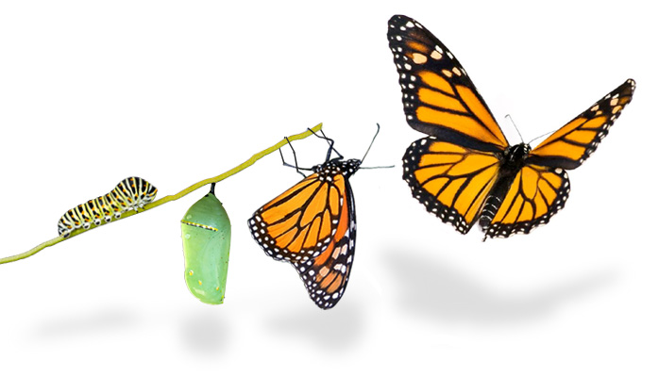
Medium-term Strategy
2022-2025 and
Programme of Work
2022-2023
Transforming the way we deliver

Slide 2

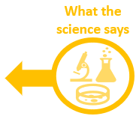
Towards the 2030 Sustainable Development Goals
“For people, prosperity and equity”
Strategic objectives
Living In Harmony
with Nature
Climate Stability
Pollution Free Planet
Enabling Programmes
Digital Transformations
Science
Finance & Economic
Transformations
Foundational Programmes
Nature Action
Environmental Governance
Climate Action
Chemical & Pollution Action
MEAs
Science - Policy
Thematic Programmes
Climate Change
Biodiversity Loss
Pollution
Climate change
Biodiversity loss
Pollution
A Planetary and Human Crisis caused by
Unsustainable Consumption and Production

Slide 3
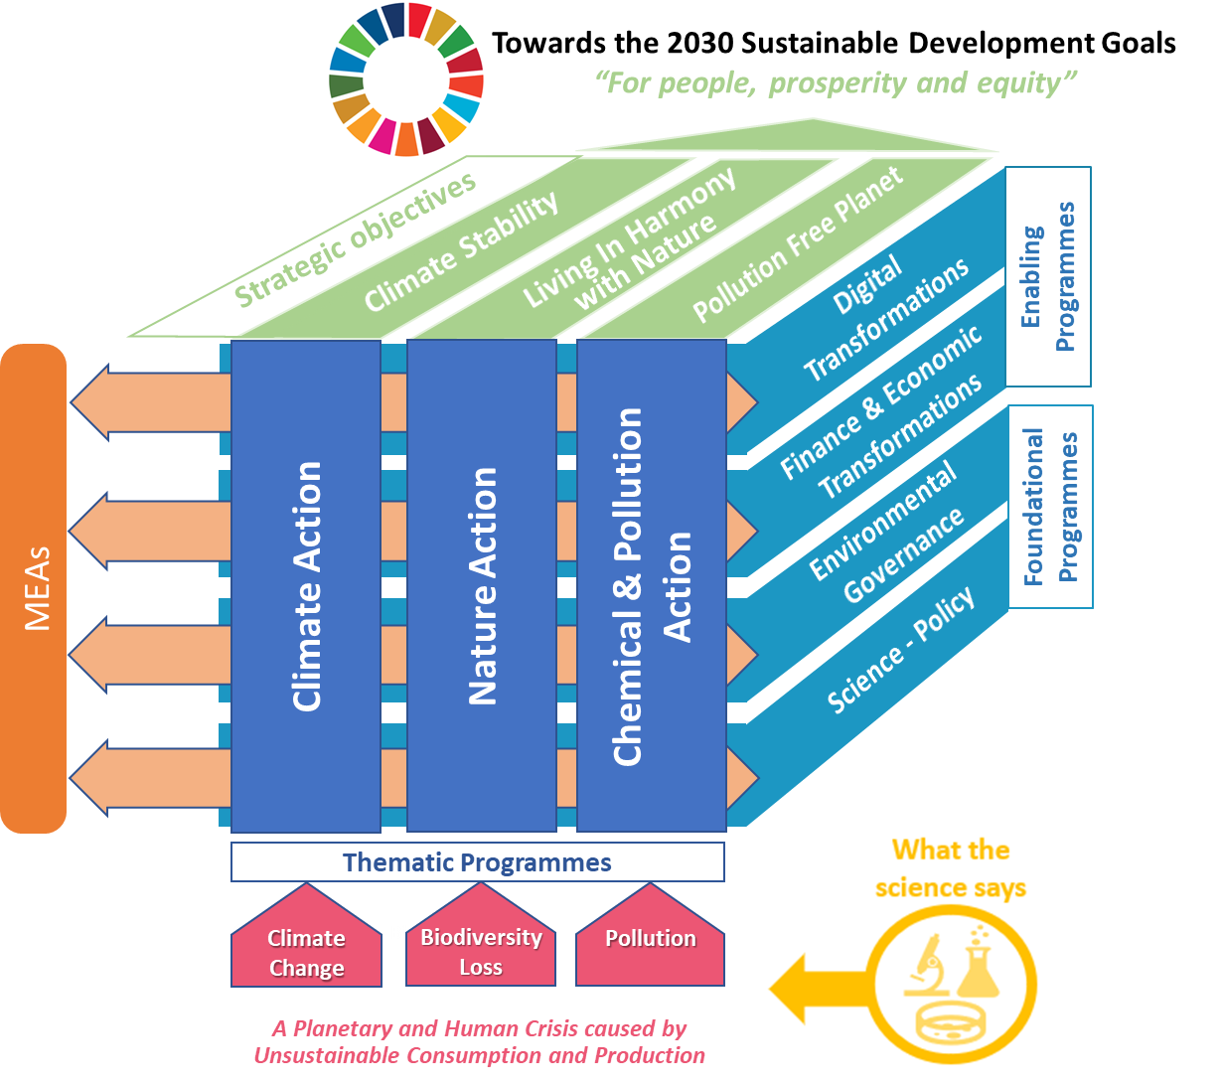

Slide 4
Strategic objectives
Climate Stability
Nature Action
Climate Action
Chemical & Pollution Action

Slide 5
Strategic objectives
Climate Stability
Foundational Programmes
Nature Action
Climate Action
Chemical & Pollution Action
Science - Policy

Slide 6
Strategic objectives
Climate Stability
Foundational Programmes
Nature Action
Environmental Governance
Climate Action
Chemical & Pollution Action

Slide 7
Strategic objectives
Climate Stability
Enabling Programmes
Finance & Economic
Transformations
Nature Action
Climate Action
Chemical & Pollution Action

Slide 8
Strategic objectives
Climate Stability
Enabling Programmes
Digital Transformations
Nature Action
Climate Action
Chemical & Pollution Action

Slide 9
Strategic objectives
Living In Harmony
with Nature
Nature Action
Nature Action
Climate Action
Chemical & Pollution Action

Slide 10
Strategic objectives
Living In Harmony
with Nature
Foundational Programmes
Nature Action
Nature Action
Climate Action
Chemical & Pollution Action
Science - Policy

Slide 11
Strategic objectives
Living In Harmony
with Nature
Foundational Programmes
Nature Action
Environmental Governance
Nature Action
Climate Action
Chemical & Pollution Action

Slide 12
Strategic objectives
Living In Harmony
with Nature
Enabling Programmes
Finance & Economic
Transformations
Nature Action
Nature Action
Climate Action
Chemical & Pollution Action

Slide 13
Strategic objectives
Living In Harmony
with Nature
Enabling Programmes
Digital Transformations
Nature Action
Climate Action
Chemical & Pollution Action

Slide 14
Strategic objectives
Pollution Free Planet
Nature Action
Climate Action
Chemical & Pollution Action

Slide 15
Strategic objectives
Pollution Free Planet
Foundational Programmes
Nature Action
Climate Action
Chemical & Pollution Action
Science - Policy

Slide 16
Strategic objectives
Pollution Free Planet
Foundational Programmes
Nature Action
Environmental Governance
Climate Action
Chemical & Pollution Action

Slide 17
Strategic objectives
Pollution Free Planet
Enabling Programmes
Finance & Economic
Transformations
Nature Action
Climate Action
Chemical & Pollution Action

Slide 18
Strategic objectives
Pollution Free Planet
Enabling Programmes
Digital Transformations
Nature Action
Climate Action
Chemical & Pollution Action

Slide 19
Towards the 2030 Sustainable Development Goals
“For people, prosperity and equity”
Strategic objectives
Living In Harmony
with Nature
Climate Stability
Pollution Free Planet
Enabling Programmes
Digital Transformations
Science
Finance & Economic
Transformations
Foundational Programmes
Nature Action
Environmental Governance
Climate Action
Chemical & Pollution Action
MEAs
Science - Policy
Thematic Programmes
Climate Change
Biodiversity Loss
Pollution
Climate change
Biodiversity loss
Pollution
A Planetary and Human Crisis caused by
Unsustainable Consumption and Production

Slide 20
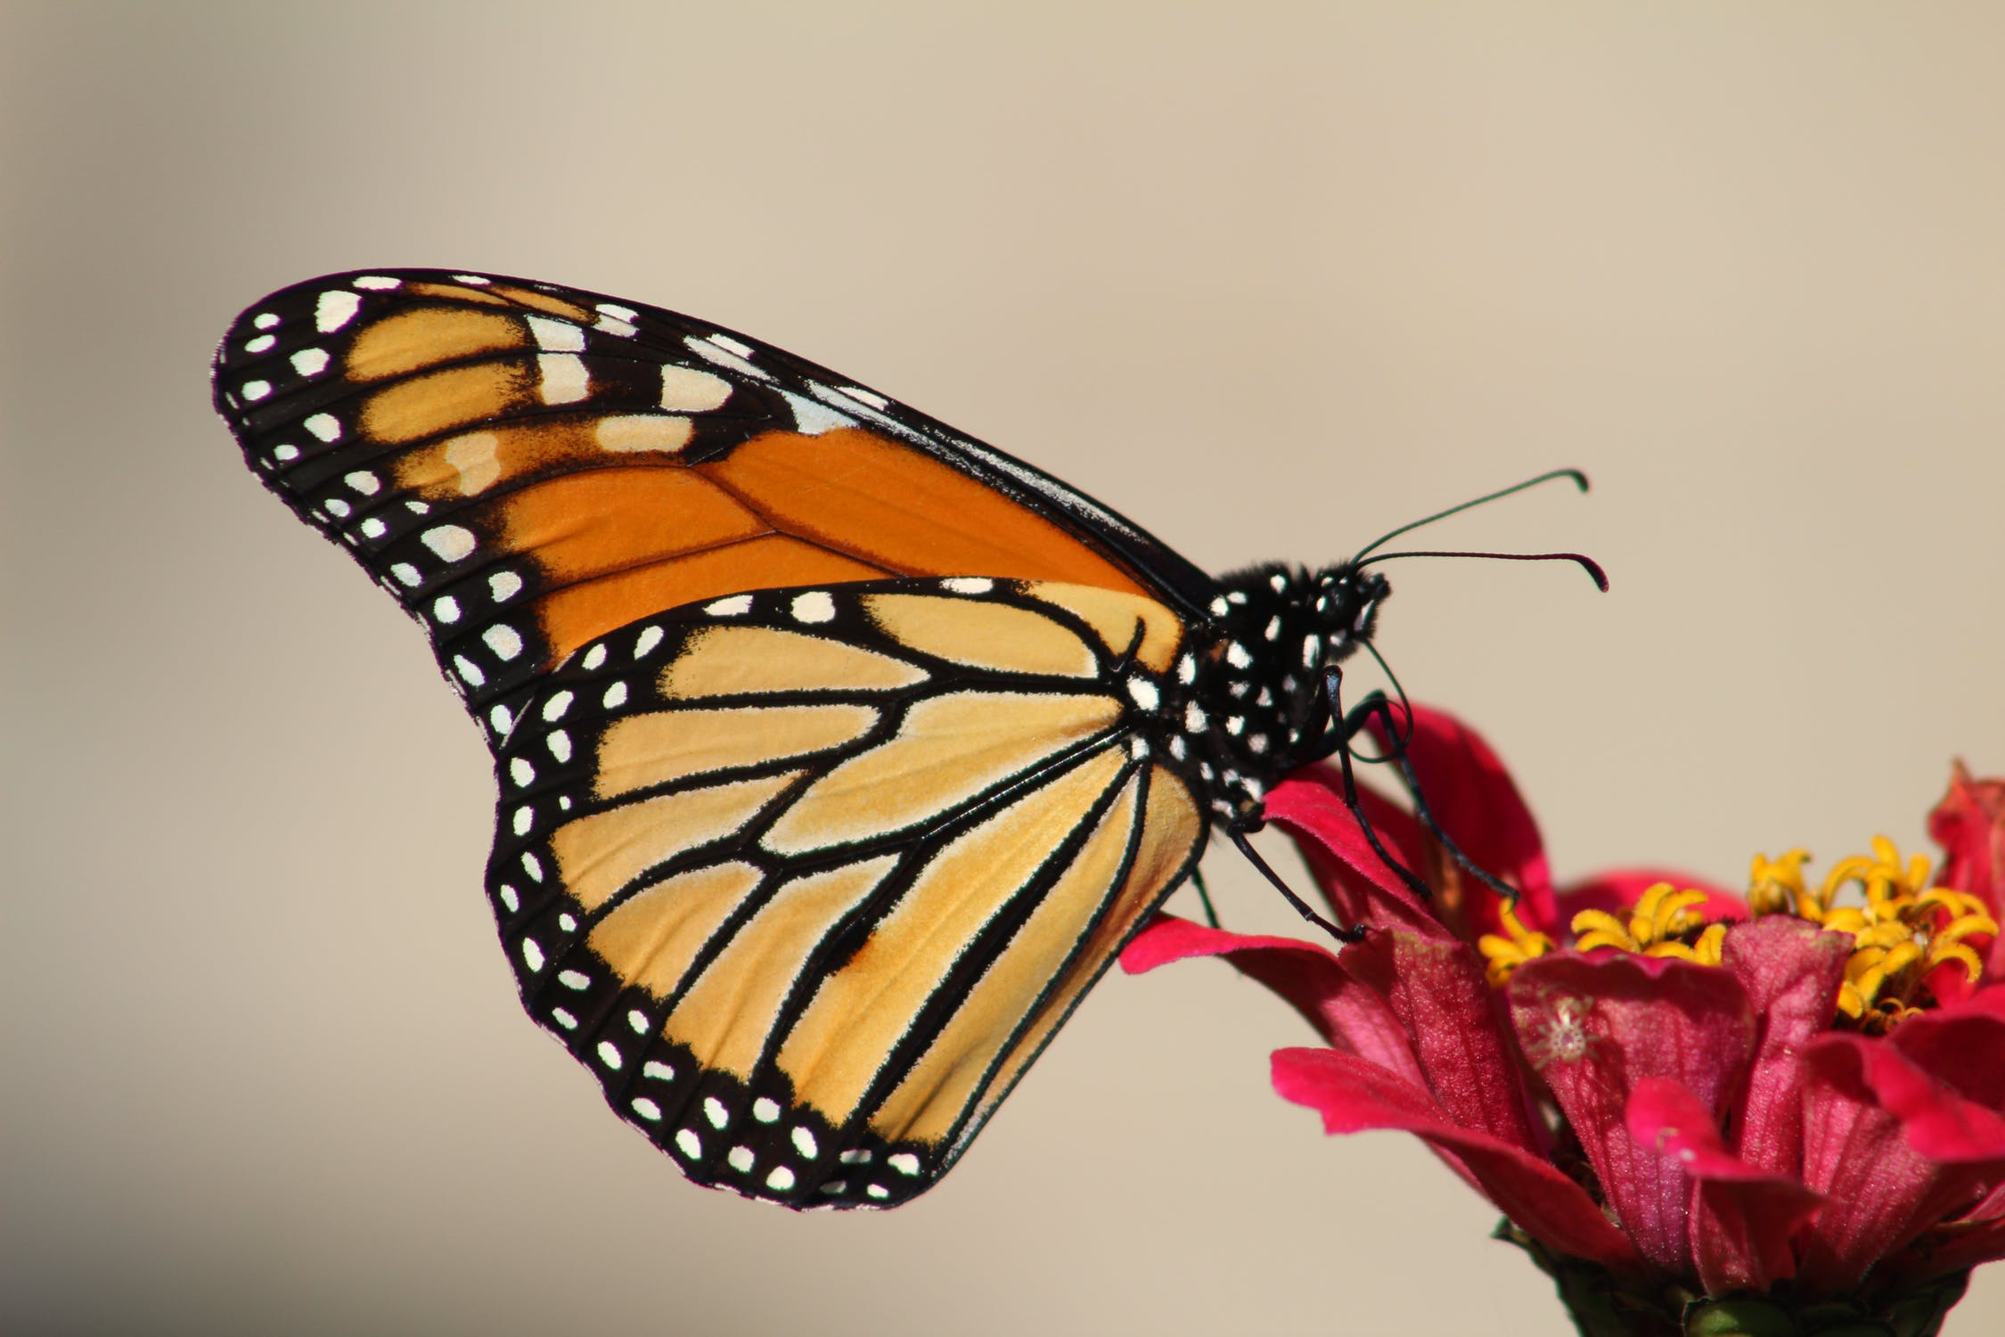

Thank you

Slide 21
Towards the 2030 Sustainable Development Goals
“For people, prosperity and equity”
Strategic objectives
Living In Harmony
with Nature
Climate Stability
Pollution Free Planet
Enabling Programmes
Digital Transformations
Science
Finance & Economic
Transformations
Foundational Programmes
Nature Action
Environmental Governance
Climate Action
Chemical & Pollution Action
MEAs
Science - Policy
Thematic Programmes
Climate Change
Biodiversity Loss
Pollution
Climate change
Biodiversity loss
Pollution
A Planetary and Human Crisis caused by
Unsustainable Consumption and Production

