Slide 1

PoW Budgets Proposal 2022-2023
Corporate Services Division 13 October 2020

Slide 2
Meeting Agenda
Budget Envelopes
Environment Fund Allocations
Wholistic View of Resources
Resource Mobilization Strategy

Slide 3
Budget Envelopes
Meeting Agenda

Slide 4
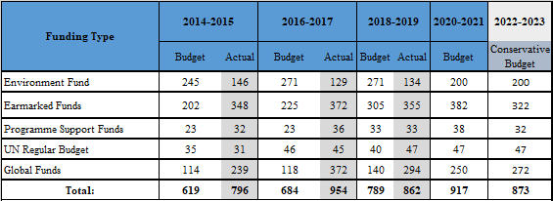
2022-2023
BUDGET ENVELOPES
Historical Trends
Internal factors
  Strategic Priorities
  Resource Mobilization
External factors
  MS Guidance
  COVID-19

Slide 6
Meeting Agenda
Environment Fund Allocations
How did we distribute the funds across the (sub/)programmes?

Slide 7
The allocation of Environment Fund is based on a review of core mandates and priorities while allowing flexibility to react to emerging issues and budget shortfalls.
Executive Direction & Management / Policy Making Organs
Programme Management & Support
Increased by 1% for a $14M requirement ➔ Increase considers reduction in PSC owing to foreseen decrease in earmarked resources & expected strengthening of UNEP’s accountability systems
Allocated the amount of $ 12M as compared to $11.2M in the 2020-2021 PoW. ➔ Increase of $400K mainly due to staff incremental costs

Slide 8
87% of EF budget is allocated to the Programme of Work & fund programme reserve
Action Pillars
Foundational
&
Enabling
The Environmental Governance & Science Policy foundational subprogrammes, and the Finance & Economic Transformations enabling subprogramme, are allocated an equal share of 13% each. Digital Transformations subprogramme is allocated 7%.
Equal allocation of 12% ($24 million) of its overall budget for each of the climate, nature, and chemicals & pollution action subprogrammes.

Slide 9
Action Pillars

Slide 10
Meeting Agenda
Wholistic View of Resources
Considering all funding sources and their associated target budgets,
how will the resources be broken across the (sub/) programmes?

Slide 11
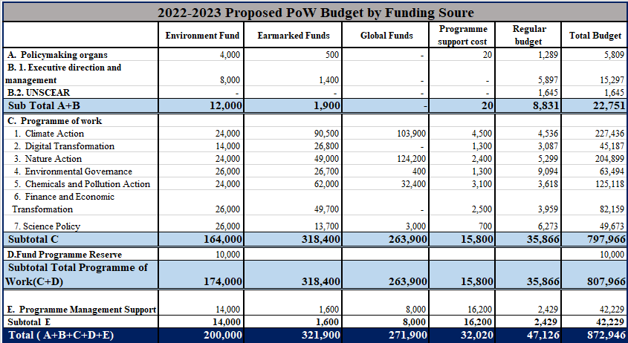

Slide 12
Overall Target Distribution of Resources
Across the Subprogrammes

Slide 13
EXECUTIVE DIRECTION & PROGRAMME MANAGEMENT BUDGET

Slide 14
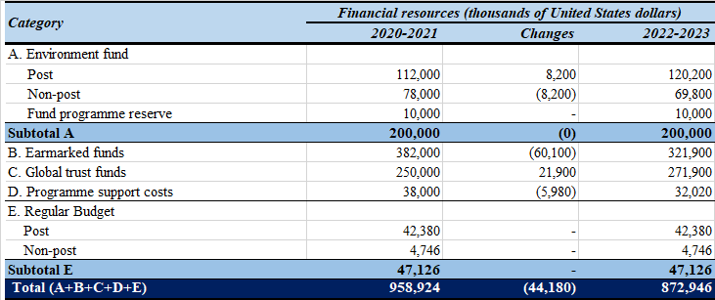
2020-21 & 2022-23 COMPARATIVE BUDGETS BY FUNDS

Slide 15
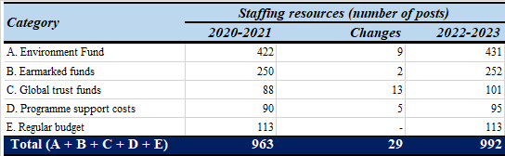
2020-21 & 2022-23 COMPARATIVE STAFFING COMPLEMENTS
Notes:
.

Slide 16
Meeting Agenda
Resource Mobilization
What were the main outcomes of the survey?
What are we doing?

Slide 17

UNEP on right track with strategy to increase and balance funding
      Wide support for actions needed to increase total core funding and number of MS that contribute to the Environment Fund:
        more info on Environment Fund (results, allocations, spending)
        more visibility of UNEP with decision makers / in capitals
        public appreciation & visibility of contributors to Environment Fund
        better explanation on benefits of core funding
        etc.
      To shift tightly earmarked funding to softly earmarked MS find the following important:
        provide options for thematic funding
        decrease programme support costs for softly earmarked funds
        more info on benefits of softly earmarked funds vs tightly earmarked funds (both for UNEP and for MS)
Resource Mobilization Survey - Key findings

Slide 18

Support for ‘fair share’/VISC as tool
      Large majority (85%) support ‘fair share’ as a tool
      82% agreed the tool is ‘fair’ -- it shares responsibility across membership
      43% say tool ‘not fair’ in their case (doesn’t consider latest situation)
      ‘Fair share’ easier to understand than VISC (67% agreed/12% disagreed)
      A majority (67%) agree that everyone should contribute their ‘fair share’ – 15% disagreed
      More information on ‘fair share’/VISC would be useful (51%)
Possible effect of COVID-19 on Member States’ funding of UNEP:
      13% respondents said their Government likely to increase funding
      66% respondents said their Government likely to maintain funding
      12% respondents said their Government likely to decrease funding
Resource Mobilization Survey - Key findings (Cont.)

Slide 19
New strategies for Resource Mobilization
UNEP is exploring and asking Member States to support
High quality Funding
Attracts loosely earmarked funding at the subprogramme level.
Long Term Agreements
Provides secure multi-year funding for the EF to cover the MTS period
Hybrid Agreements
Allows Members States to include their pledges for the Environment Fund into their current earmarked legal instruments and agreements.

Slide 20

Any Questions?
Sonja Leighton-Kone
Director, Corporate Services Division
Mobile No: +254-741-604-440
Email: sonja.leighton-kone@un.org
.
Thank you

