Slide 1

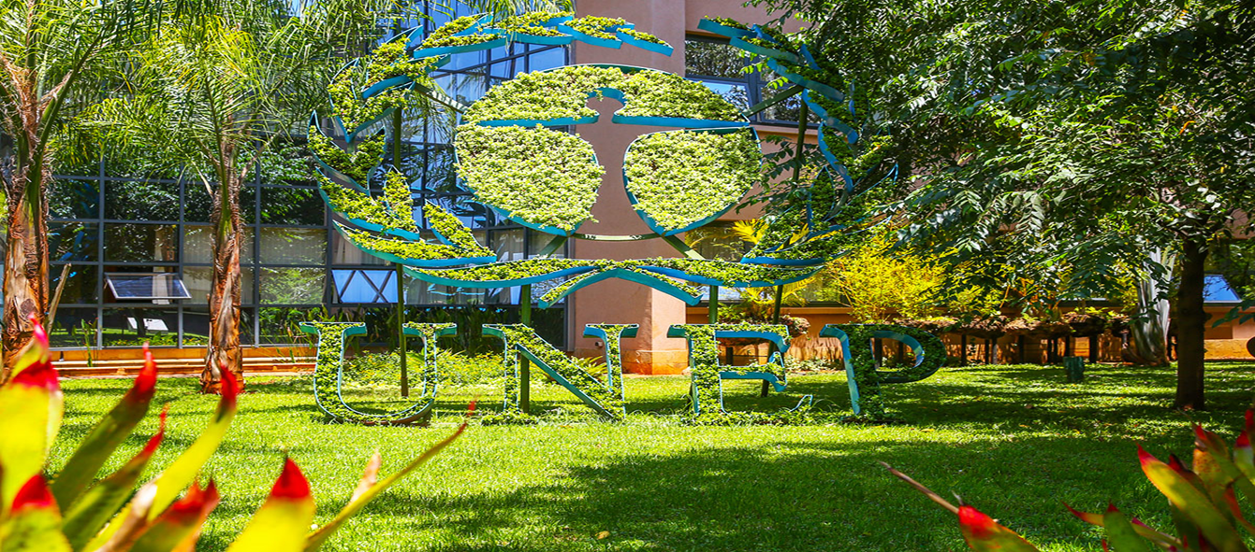
Preparation for the commemoration of the 50th anniversary of the creation of UNEP.

Slide 2

Background
On the basis of:
Consultations held with the CPR and UNEA/CPR Bureaus on 30 April, 2020, 9-10 June 2020, 14 July 2020, and 12-16 October
Decision by the UNEA Bureau on 8 October to organize a two-step UNEA-5
…the Secretariat has prepared a draft strategic plan for the commemoration of the 50th anniversary of the creation of UNEP for the period February 2021 – February 2022.
The CPR is invited to provide further guidance on the way forward, including with regard to:
The planned launch of the commemoration at the virtual meeting of UNEA-5 in February 2021.
The conclusion of the commemoration at the resumed session of UNEA-5 in February 2022.

Slide 3
Proposed Principles for UNEP@50
Launched and concluded at UNEP headquarters in Nairobi
Kick-off at the virtual session of UNEA-5 in February 2021
Conclusion in conjunction with the resumed session of UNEA-5 in February 2022
Focus on UNEP’s core mandates (science-policy interface and international environmental governance)
Take stock of, endorse or adopt the outcome of the consultation process under GA Resolution 73/333
A minimal environmental footprint
Different but interrelated with a possible UN high-level political meeting in Stockholm in 2022
Reinvigorate environmental multilateralism and strengthen UNEP

Slide 4
Proposed approach for the kick-off for UNEP@50
Kick-off part of the agenda for the virtual meeting of UNEA-5 in February 2021
Launch of the first UNEP “Global Assessments Synthesis Report” in advance of UNEA-5, as substantive backdrop for outreach activities in 2021/22
Launch of a UNEP@50 communication initiative and visual identity
Preparation of a UNEP@50 video
Decide, as part of a decision on the date and format of the resumed UNEA-5 in February 2022, to celebrate UNEP@50 either
  as part of the High-Level Segment of the resumed session of UNEA-5 in February 2022
  or as a Special Session of UNEA, organized back-to-back to the resumed session of UNEA-5, immediately after the closing

Slide 5
Proposed engagement and outreach activities between kick-off and conclusion of UNEP@50
Develop an outreach plan to give prominence to the UNEP@50 commemoration at relevant high profile multilateral environmental meetings and events
Celebrate and reflect on key achievements and to solicit views for a new course for UNEP´s future, in light of current and emerging trends, to be presented at the conclusion of UNEP@50
Support active engagement by the civil society and the general public to empower them to influence and feel ownership for UNEP@50
Tailor UNEP flagship reports and initiatives to UNEP@50
Undertake broad communication outreach activities to facilitated for external partners to support the campaign

Slide 6
Science-policy input for UNEP@50
Develop a Global Assessments Synthesis Report in time for the virtual meeting of UNEA-5
Develop a “legacy publication” be launched it at the conclusion of UNEP@50
The legacy publication will review the development of the global environmental science-policy interface since the creation of UNEP – including proposals on how to strengthening the environmental science-policy interface
It will build on
  (i) the Ad-hoc Global Assessment Dialogue, bringing together all major global scientific assessments to enhance synergies
  (ii) ongoing work on enhanced environmental governance, policy coherence and synergy across MEAs
An outline for the publication will be presented in early 2021

Slide 7
Proposed approach for the conclusion of UNEP@50
Include a new item in the agenda of UNEA-5, entitled “Commemoration of the creation of the United Nations Environment Programme in 1972”
Or - alternatively - convene a special session of UNEA back-to-back to the resumed fifth session under the Presidency of UNEA-6
Hold the commemoration for a period of maximum 2 days as part of the High-Level Segment, reflecting on key UNEP achievements and looking ahead towards future challenges and opportunities
Take stock of, endorse or adopt the outcome of the consultation process under GA Resolution 73/333

Slide 8

Thank you
Governance Affairs Office

