Slide 1
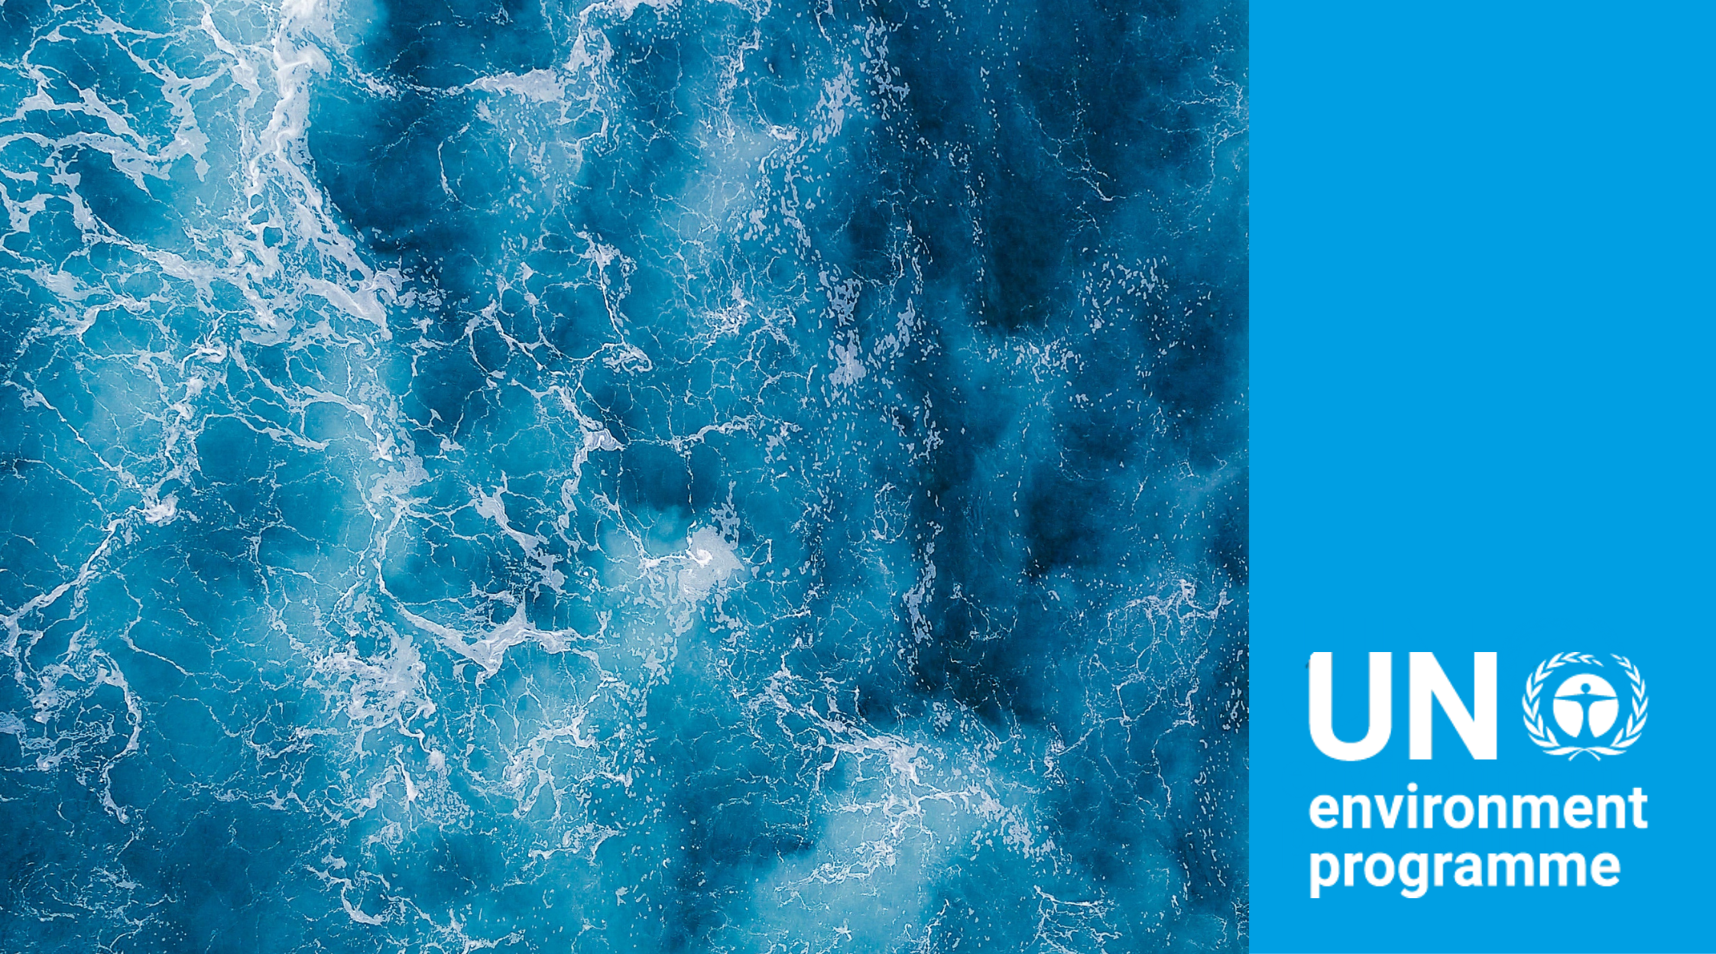
Implementing UNEP’s
Marine & Coastal Strategy
Committee of Permanent Representatives
Subcommittee Meeting
10 December 2020

Slide 2
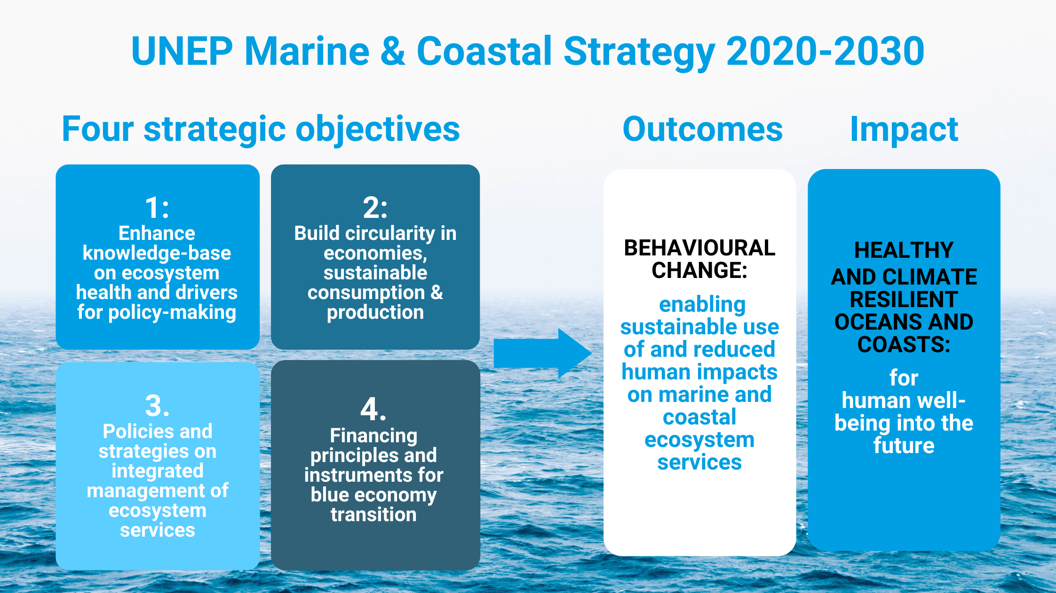
Notes:
SLIDE 2. AN OVERVIEW OF UNEP’S MARINE COASTAL STRATEGY- WHAT IS THE CHANGE WE WISH TO SEE?
UNEP’s Marine & Coastal Strategy was presented in UNEP/EA.4/INF/7, which was referred to in the political Declaration.
The Vision of the Strategy is that “Healthy and climate-resilient marine and coastal ecosystems underpin human well-being and benefit present and future generations”.
The strategy has been shared and made available to the CPR
The Strategy has 4 strategic objectives to deliver this overall vision:
Objective 1: Establish knowledge-base on marine and coastal ecosystems to inform policies on human activities affecting their functions
Objective 2: Build circularity in economies and promote sustainable consumption & production approaches to address marine pollution and resource use
Objective 3: Support policies and strategies enabling integrated management and sustainable use of marine and coastal ecosystem services
Objective 4: Innovate financing instruments and initiatives facilitating Sustainable Blue Economy transition
An overarching strategic question we ask ourselves: What is the change we want to see to achieve sustainable oceans? How do we generate the change that we need?

Slide 3
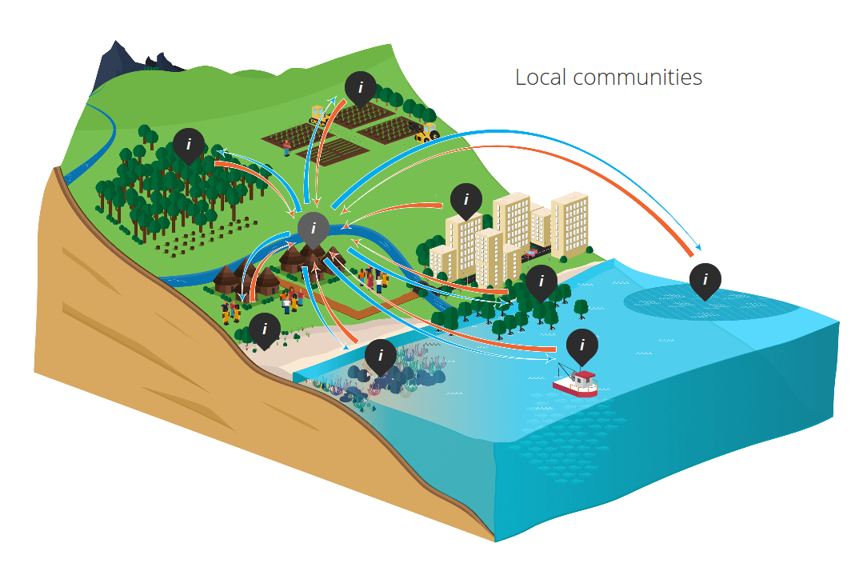
Oceans across UNEP’s work
UNEP SUB-PROGRAMMES
Climate change
Resilience to Disaster
Healthy and Productive Ecosystems
Environmental Governance
Chemical and Waste
Resource efficiency
Environmental Assessment
Integrated delivery of 2030 Agenda
SDG 1: Poverty
SDG 2: Food security
SDG 3: Human health
SDG 6: Water
SDG 8: Economic growth
SDG 12: Sustainable consumption
SDG 13: Climate change
SDG 14: Healthy Oceans
SDG 15: Life on land
Integrated landscape management
Poverty reduction,
access and
benefit-sharing
Integrated coastal
management
Addressing land-based pollution
Marine
Protected
Areas
Blue Carbon
Blue covid-19 recovery
Sustainable Blue Economies
Nature-based climate solutions
Notes:
SLIDE 3. UNEP’S MARINE AND COASTAL STRATEGY TAKES A HOLISTIC APPROACH TO SOLVE MARINE CHALLENGES, TACKLING BOTH MARINE AND LAND-BASED PRESSURE.
We work across boundaries, including:
Land-sea boundaries
Sector boundaries (environment, fisheries, tourism, health, etc)
It connects environmental-social-economic objectives and disciplines
As such, our marine work is cross-cutting in delivery of UNEP Medium Term Strategy and PoW. It contributes to most UNEP sub-programmes and supports achievement of many SDGs - and not only SDG14 but also poverty reduction, food security, human health, freshwater management, sustainable consumption & production, climate change and life on land.

Slide 4
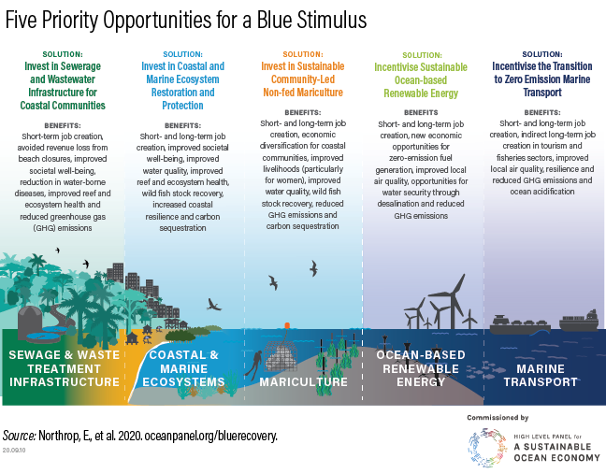
Investing in healthy oceans is a COVID-19 recovery solution
UNEP Marine & Coastal Strategy supports key ‘blue stimuli’ areas
Notes:
SLIDE 4: INVESTING IN HEALTHY OCEANS IS A KEY COVID-19 RECOVERY SOLUTION
A recent special report of the High-Level Panel on Sustainable Ocean Economy shows how investing in pollution management and in ocean and coastal ecosystem protection and restoration are useful ‘blue stimulus’ options for COVID-19 recovery.
Such investments are particularly relevant at this time for their potential to deliver short-term economic, social, health and environmental benefits for affected communities and sectors, while building longer-term social, economic and ecological resilience.

Slide 5
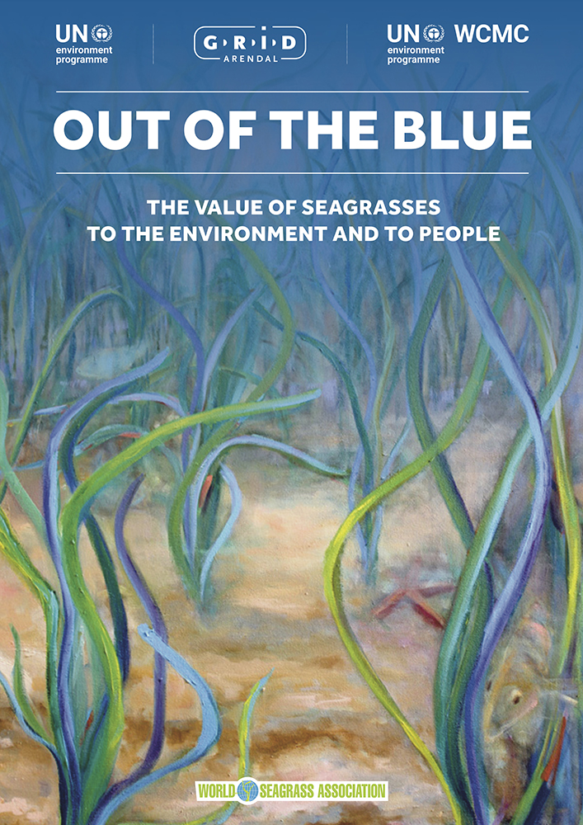
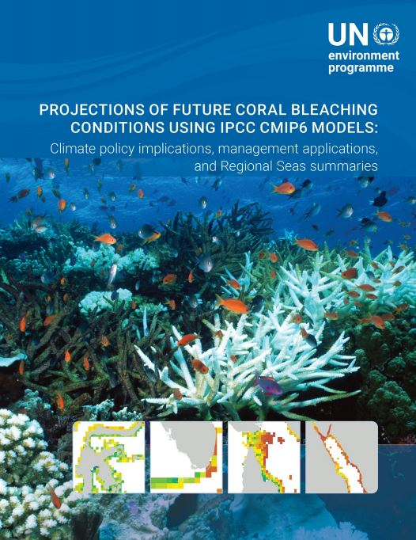
Strategic Objective 1: Establish knowledge-base on marine and coastal ecosystems to inform policies on human activities affecting their functions
Out of the Blue:
Assessing the value of seagrasses to the environment and to people
Coral bleaching futures:
Climate projections for marine spatial planning and
MPA network design
Notes:
SLIDE 5: UNEP’S MARINE WORK CAN DIRECTLY SUPPORT SUCH A BLUE COVID19 RECOVERY.
Let me give some examples under the four strategic objectives of the Marine Strategy:
Falling under Objective 1: which relates to establishing a knowledge base on these ecosystems to inform policies on how our activities affect their functions.
A new report, ‘Out of the Blue’: which estimates the value of seagrass ecosystems to the environment and people for policy-making.
Coral Bleaching Futures which provides: tools for down-scaled climate projection on coral reef bleaching to support marine spatial planning and MPA network design.

Slide 6


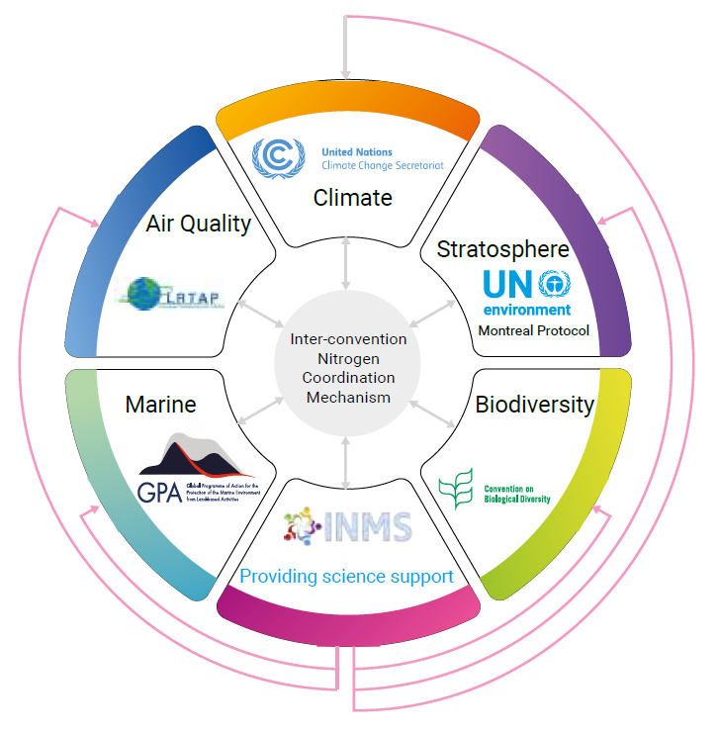
Strategic Objective 2: Build circularity in economies and promote sustainable consumption & production approaches to address marine pollution and resource use
Regional and National Action Plans on Marine Litter: Regional – 12 final, 4 draft; National inventories; legislation and advocacy
Fecal sludge management in Africa
Socioeconomics aspects, human and environmental health implications (Launched on World Toilet Day, 19 November 2020)
International Nitrogen Management System (INMS): Tools and methods, Quantification, Demonstration, Awareness raising; International Nitrogen Assessment report initiated (ready by 2022); Launch of South Asia Nitrogen Hub with UK support;
Notes:
Slide 6: UNEP’s long-running work on marine pollution is central for blue stimuli investments
12 marine litter Regional Action Plans have now been finalised, plus 4 more are in drafting. National marine litter inventories are ongoing in several countries.
New International Nitrogen Management System (INMS) is under development. It will provide tools for quantification, demonstration, awareness raising. An International Nitrogen Assessment report has been initiated (ready by 2022).
A new study on socio-economic aspects, human and environmental health implications of fecal sludge in Africa was launched on World Toilet Day, 19 November 2020.
We have launched an ambitions Sustainable Blue Economy Initiative:
It will enable decision-makers develop and implement sustainable blue economy pathways tailored local context and needs:
A UNEP-wide ‘Sustainable Blue Economy Coordination Group’ has been formed to support this cross-cutting work

Slide 7
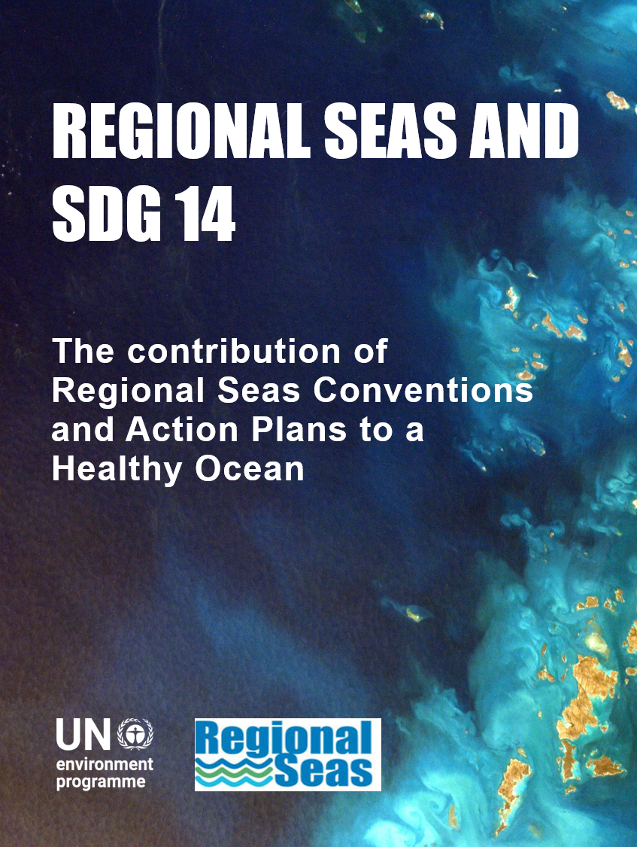
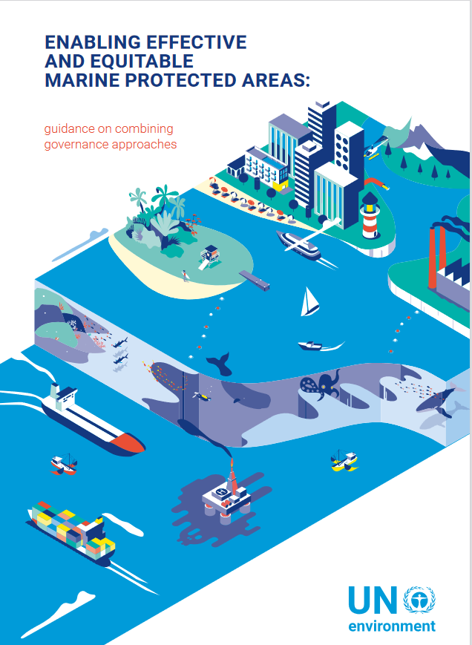
Strategic Objective 3: Support policies and strategies enabling integrated management and sustainable use of marine and coastal ecosystem services
Regional Seas
New Strategic Direction 2021-2024 and delivery of SDG 14
MPA Tools & Learning Platform
Enhancing design and implementation of marine protected areas
Notes:
Slide 7: We support ocean and coastal policy and management at national and regional levels
A forthcoming report showcases Reginal Seas roles and contributions achievement of SDG 14: ‘Life Under Water’
A new MPA Toolbox & Learning Platform is under preparation to support countries in design and implementation of effective marine protected areas. In turn, this will support achievement of an ambitious ocean protection agenda.
Development of new Strategic directions 2021-2024 for the Regional Seas Programme is under way, informed by the mandates of the Regional Seas conventions and action plans, relevant UNEP strategies, policies and processes.
The process provides a valuable opportunity to raise visibility and recognition of the Regional Seas as a dynamic implementation platform for MEAs and other relevant international instruments. The Strategic directions will also highlight areas of work where the regional level plays an important role in communicating national needs to the international policy processes and decision-making fora and vice versa.

Slide 8
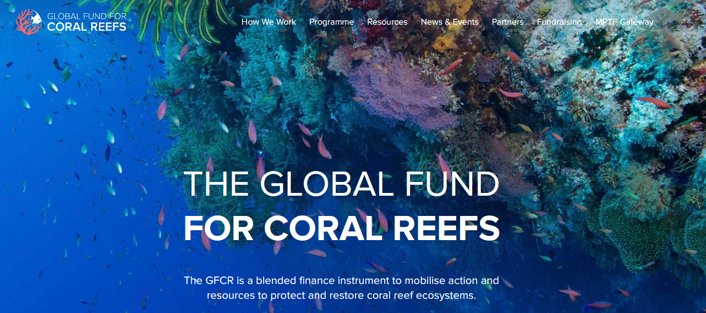
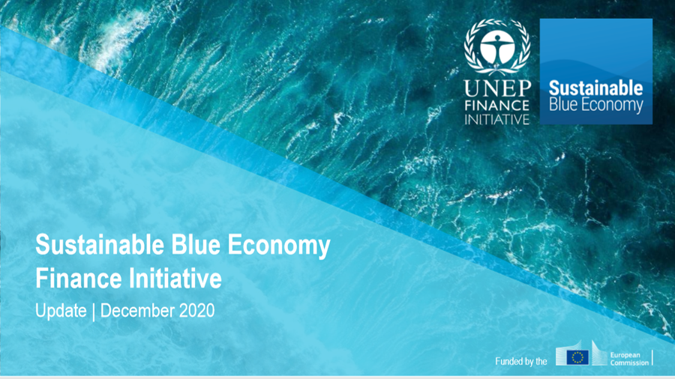
Strategic Objective 4: Strategic Objective 4: Innovate financing instruments and initiatives facilitating Sustainable Blue Economy transition
New UN Multi-Partner global Trust Fund for Coral Reefs
New finance instrument improving health and sustainability of coral reefs while empowering local communities and enterprises
Sustainable Blue Economy Financing Principles
Operational guidance on application and disclosure and ‘Community of Practice’ of financial institutions
Notes:
Slide 8: UNEP plays a leading role in unlocking financing for ocean management:
In September, we launched a first UN Multi-Partner global Trust Fund for Coral Reefs in collaboration with a range of influential partners. It provides an innovative instrument improving the phealth and sustainability of coral reefs, while empowering local communities and enterprises
UNEP Marine and Freshwater Branch works closely with UNEOP Financing Initiative to develop operational guidance on 14 ‘sustainable blue economy financing principles’ and a ‘Community of Practice’ among financial institutions.

Slide 9


FUTURE DIRECTIONS: Supporting ocean synergies and innovation
UN Decade on Ecosystem Restoration
Tools, demonstration and communication on solutions for coastal ecosystem conservation and restoration
UN Decade on Ocean Science for Sustainable Development
Science-based policy advice and innovative solutions for healthy oceans
Decision-support frameworks linking social-economic-environmental disciplines
Building back better!
Notes:
Slide 9: Supporting ocean synergies and innovation
As we look ahead, two important processes will kick-off in January:
UN Decade on Ecosystem Restoration (co-lead by UNEP and FAO) will support tools, demonstration and communication on solutions for coastal ecosystem conservation and restoration.
UN Decade on Ocean Science for Sustainable Development will support science-based policy advice and innovative solutions for healthy oceans. This includes decision-support frameworks linking social-economic-environmental disciplines.
UNEP will actively pursue collaboration and synergies across the two Decade – working with countries and many partners - to deliver transformative solutions to support a blue COVID19 recovery.

Slide 10
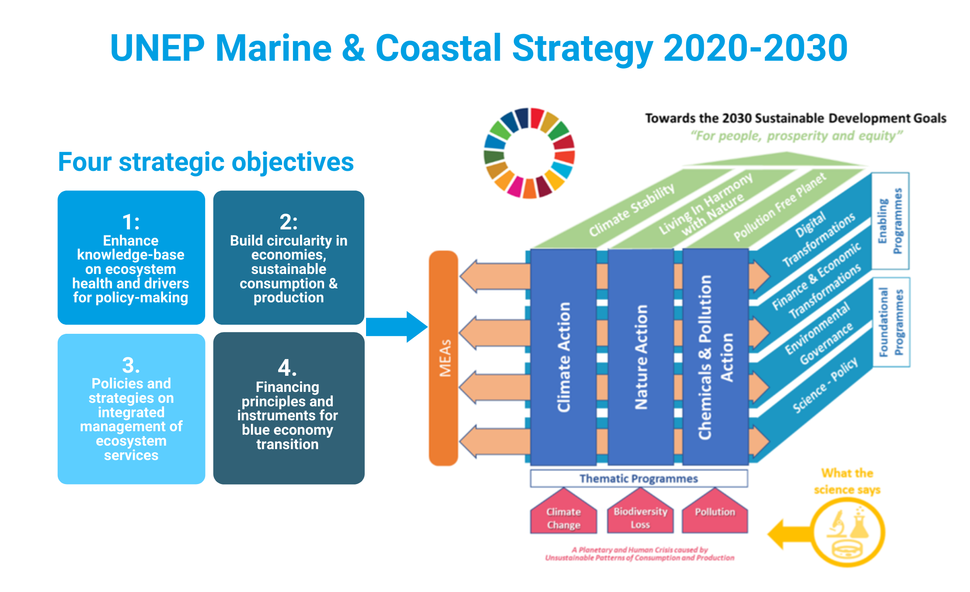
Notes:
Slide 10: UNEP’s Marine and Coastal strategy will guide specific actions to deliver the new Medium-Term Strategy 2022-2025 and its 3 main outcomes:
Achieving Climate Stability
Living in Harmony with Nature
A Pollution free planet
In doing so, the Strategy will provide a focus of cross-cutting work through the four Foundational and Enabling Programmes:
Environmental Governance
Science-Policy Interface
Digital transformation
Finance and Economic Transformation
We look forward to hearing your feedback and guidance on the current work and direction of UNEP’s marine and coastal work – and we stand ready to work with you all to develop a strong response to current planetary challenges.
Thank you.

Slide 11
