Slide 1
Update on UNEP engagement in One Health collaboration
Committee of Permanent Representatives Subcommittee Meeting
Nairobi, Kenya 22 April 2021

Slide 2
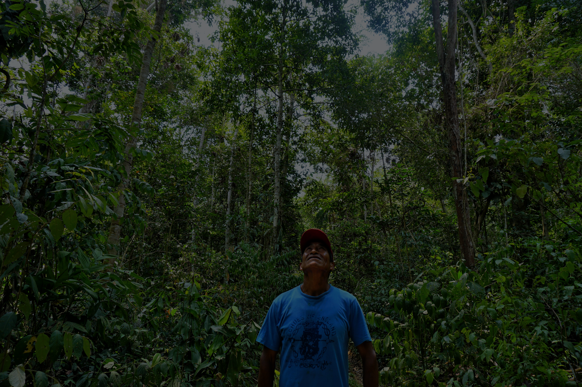


      One Health
  an approach to
  designing and implementing programmes, policies, legislation and research in which multiple sectors communicate and work together to achieve better public health outcomes
  (WHO, 2017)
  Holistic and interdisciplinary approach working with the
  human–animal–environment
  interface
  (Lerner & Berg, 2017)
  Photo: Yoly Gutierrez,CIFOR (CC BY-NC-ND 2.0)

Slide 3


UNEP Membership in the Tripartite Alliance on One Health
  UNEP’s added value: network expertise
  Status: UNEP joining the Tripartite Alliance on One Health between FAO, OIE and WHO
Tripartite Priority Areas
Internal
External
scientific, legal and policy expertise including regional offices and multilateral environmental agreements
environment and wildlife ministries and donors, non-governmental organizations, research institutions and private sector partners
INITIAL (2010) | EXPANDED (2018)
antimicrobial resistance rabies zoonotic influenza | integrated food safety and security early warning and surveillance systems emerging, remerging and neglected infectious diseases high-priority zoonotic diseases international standards on responsible and prudent use of antimicrobials

Slide 4
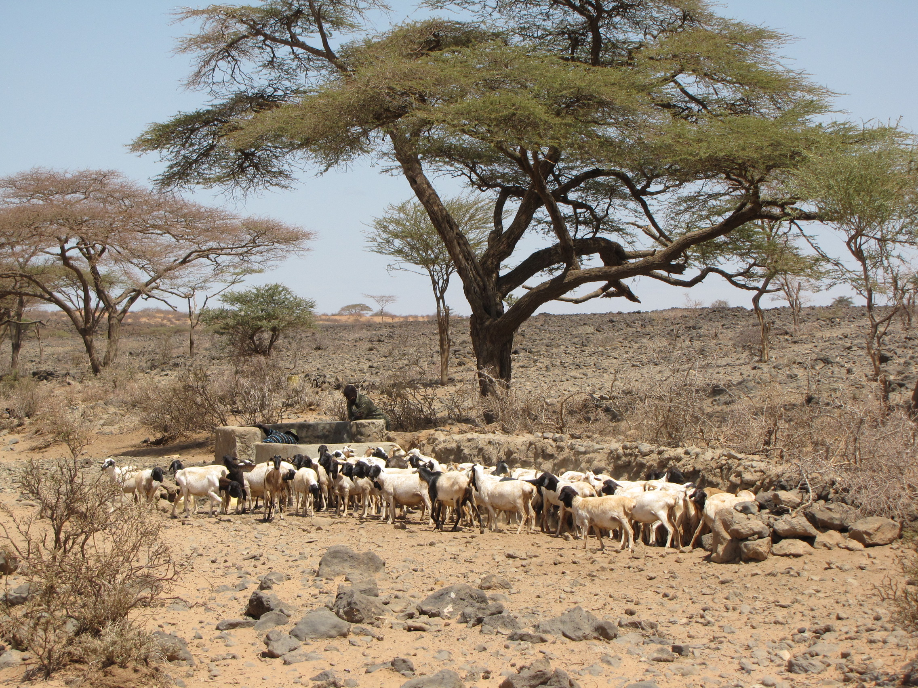
High-Level Expert Panel on One Health
Goal: collect, distribute and publicize reliable scientific information on the links between human, animal and environmental health
Initial focus: reducing risks of zoonotic pandemics
Collaborators: UNEP, FAO, OIE and WHO
Status: joint call for experts and ToR launched on 29 March
Photo: EU Civil Protection and Humanitarian Aid (CC BY-NC-ND 2.0)

Slide 5

Development of a New Programme of Work
Poor understanding of the role of the environment with respect to human and animal health
Institutional barriers and silos between disciplines, forms of knowledge and perspectives impede effective system collaboration
Goal: strengthen the environmental dimensions of One Health approaches
Approach: series of consultations with internal and external stakeholders
Results: 4 underlying challenges in One Health approaches
Contribution to MTS 2022-25 subprogrammes
  Nature Actions
  Climate Actions
  Chemical and Pollution Actions
Status: concept under development
Existing processes and systems to facilitate integrated approaches to environmental, wildlife, livestock and human health are inadequate
Vast inequities among stakeholders with respect to representation, influence, capacity, and infrastructure prevent some stakeholders from contributing to and benefiting from One Health approaches

Slide 6

Questions?
Doreen L. Robinson Chief for Wildlife Ecosystems Division UNEP doreen.robinson@un.org
United Nations Avenue, Gigiri PO Box 30552 – 00100 GPO Nairobi, Kenya | www.unep.org

