Slide 1

WORLD ENVIRONMENT DAY

Slide 2
World Environment Day - Theme
Pakistan to host World Environment Day 2021 in partnership with the UN Environment Programme (UNEP).
This year’s observance of World Environment Day will be on the theme of ‘ecosystem restoration’ and focus on resetting our relation with nature.
It will also mark the formal launch of the UN Decade on Ecosystem Restoration 2021 – 2030.

Slide 3
Government of Pakistan is planning a very inclusive programme for celebrations of World Environment Day with contributions from:
UN Organizations/ International Platforms
Ministries
Departments at Sub-National
Highest Offices at Political Level
Programme is being finalized.

Slide 4
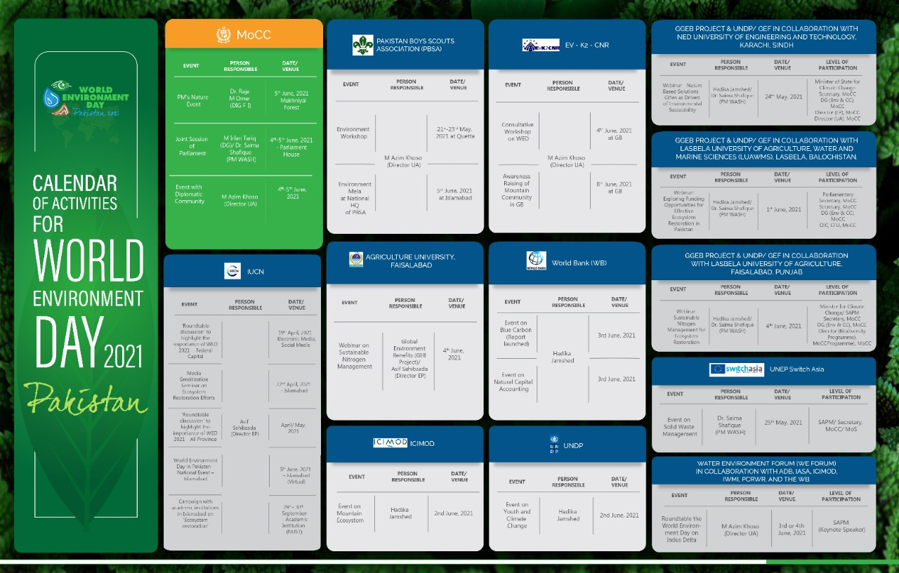
Calendar of Activities

Slide 5
Calendar of Activities
Sr. No. | Organization | Event | Date/ Venue | Person Responsible
1 | Ministry of Climate Change (MoCC) | PM's Nature Event | 5th June, 2021 - Makhniyal Forest | Dr. Raja M Omer (DIG F-I)
 |  | Joint Session of Parliament | 4-5 June, 2021 - Parliament House | M Irfan Tariq (DG)/ Dr. Saima Shafique (PM WASH)
 |  | Event with Diplomatic Community | 1-2 June, 2021 - Islamabad | M Azim Khoso (Director UA)
2 | GGEB Project & UNDP/ GEF in collaboration with NED University of Engineering and Technology, Karachi, Sindh. | Webinar - Nature Based Solutions - Cities as Drivers of Environmental Sustaiability | 24th May, 2021 | Hadika Jamshed/ Dr. Saima Shafique (PM WASH)
 | GGEB Project & UNDP/ GEF in collaboration with Lasbela University of Agriculture, Water and Marine Sciences (LUAWMS), Lasbela, Balochistan. | Webinar: Exploring Funding Opportunities for Effective Ecosystem Restoration in Pakistan | 1st June, 2021
 | GGEB Project & UNDP/ GEF in collaboration with Lasbela University of Agriculture, Faisalabad, Punjab | Webinar: Sustainable Nitogen Management for Ecosystem Restoration | 4th June, 2021
3 | UNDP | Event on Youth and Climate Change | 2nd June, 2021 | Hadika Jamshed
4 | UNEP - Switch Asia | Event on Solid Waste Management | 25th May, 2021 | Dr. Saima Shafique (PM WASH)
5 | World Bank (WB) | Event on Blue Carbon (Report launched) | 3rd June, 2021 | Hadika Jamshed
 |  | Event on Natural Capital Accounting | 3rd June, 2021

Slide 6
Calendar of Activities
Sr. No. | Organization | Event | Date/ Venue | Person Responsible
6 | Asian Development Bank | Event on Pakistan Clean Air Programme/ Air Pollution | 3rd June, 2021 | Hadika Jamshed
7 | Water Environment forum (WE Forum) in collaboration with ADB, IASA, ICIMOD, IWMI, PCRWR, and the WB. | Roundtable the World Environment Day on Indus Delta | 3rd or 4th June, 2021 | M Azim Khoso (Director UA)
8 | ICIMOD | Event on Mountain Ecosystem | 2nd June, 2021 | Hadika Jamshed
9 | Agriculture University, Faisalabad | Webinar on Sustainable Nitrogen Management | 4th June, 2021 | Global Environment Benefits (GEB Project)/ Asif Sahibzada (Director EP)
10 | GLOF | Event on Glaciers, Mountains | 2nd June, 2021 | Dr. Raja M Omer (DIG F-I)

Slide 7
Calendar of Activities
Sr. No. | Organization | Event | Date/ Venue | Person Responsible
11 | IUCN | ‘Roundtable discussion’ to highlight the importance of WED 2021 - Federal Capital | 19th April, 2021 - Islamabad | Asif Sahibzada (Director EP)
 |  | Media Sensitization Seminar on Ecosystem Restoration Efforts | 22nd April, 2021 - Islamabad
 |  | ‘Roundtable discussion’ to highlight the importance of WED 2021 – All Province | April/ May, 2021
 |  | World Environment Day in Pakistan – National Event – Islamabad | 5th June, 2021 - Islamabad (Virtual)
 |  | Campaign with academic institutions in Islamabad on ‘Ecosystem restoration’ | 29th- 30th September - Academic Institution (NUST)
12 | EV - K2 - CNR | Consultative Workshop on WED | 4th June, 2021 at GB | M Azim Khoso (Director UA)
 |  | Awareness Raising of Mountain Community in GB | 8th June, 2021 at GB
13 | Pakistan Boys Scouts Association (PBSA) | Environment Workshop | 21-23 May, 2021 at Quetta | M Azim Khoso (Director UA)
 |  | Environment Mela at National HQ of PBSA | 5th June, 2021 at Islamabad

