Slide 1


PREPARING FOR REMOTE MEETINGS WITH INTERPRETATION
Guidelines for speakers
Notes:
Hello, and welcome to this short introduction to our virtual meeting with remote simultaneous interpretation, or RSI. Since this may be the first time for some of you using an RSI platform, here are some guidelines to ensure the best experience possible for all participants. Please meet these guidelines before you take the floor, as this will provide you with the best connection, sound and video. It will also help protect participants’ and interpreters’ hearing.
If you do not follow these guidelines, it is likely your message will not be received in full.

Slide 2
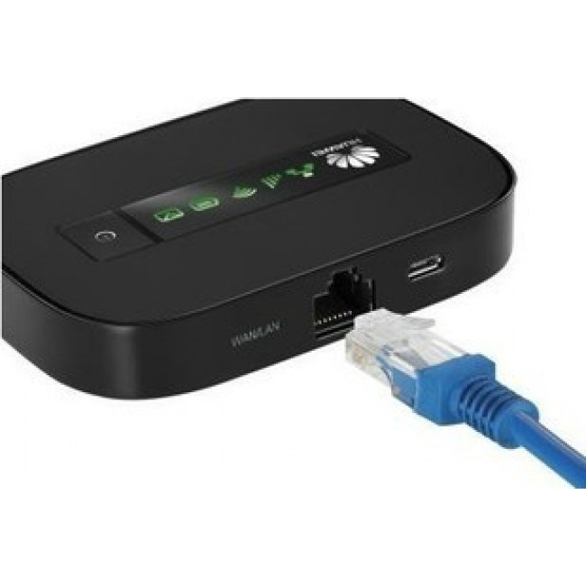
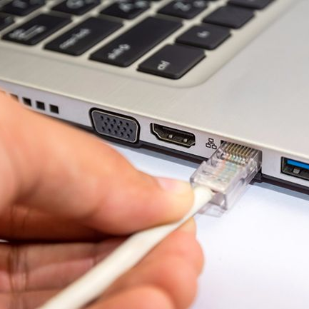
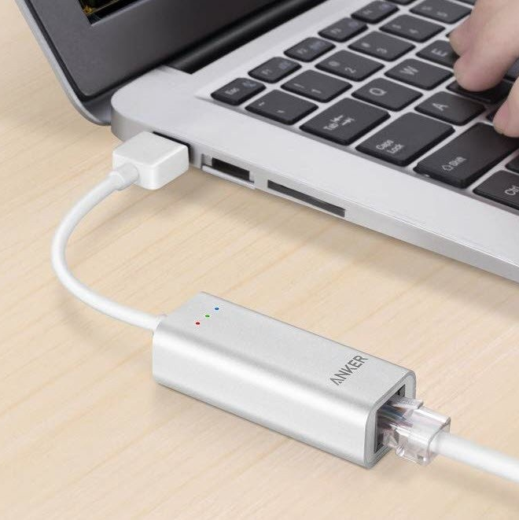
CONNECT ON A COMPUTER WITH AN ETHERNET CABLE
No tablets or smartphones!
If you have internet, you have an Ethernet port on your modem
Ethernet cables can be sourced easily and cheaply
Connection, sound and video much more stable
Fewer connection issues
Reduces sound and video issues for listeners and interpreters
Notes:
The first guideline is to always use a laptop or desktop computer and plug this directly into your modem with an Ethernet cable. This will greatly improve your connection speed and stability, and reduce the risk of your sound and video cutting out.
Do not use mobile phones or tablets as they are not powerful enough.
Do not use wifi connections as they are unstable.

Slide 3
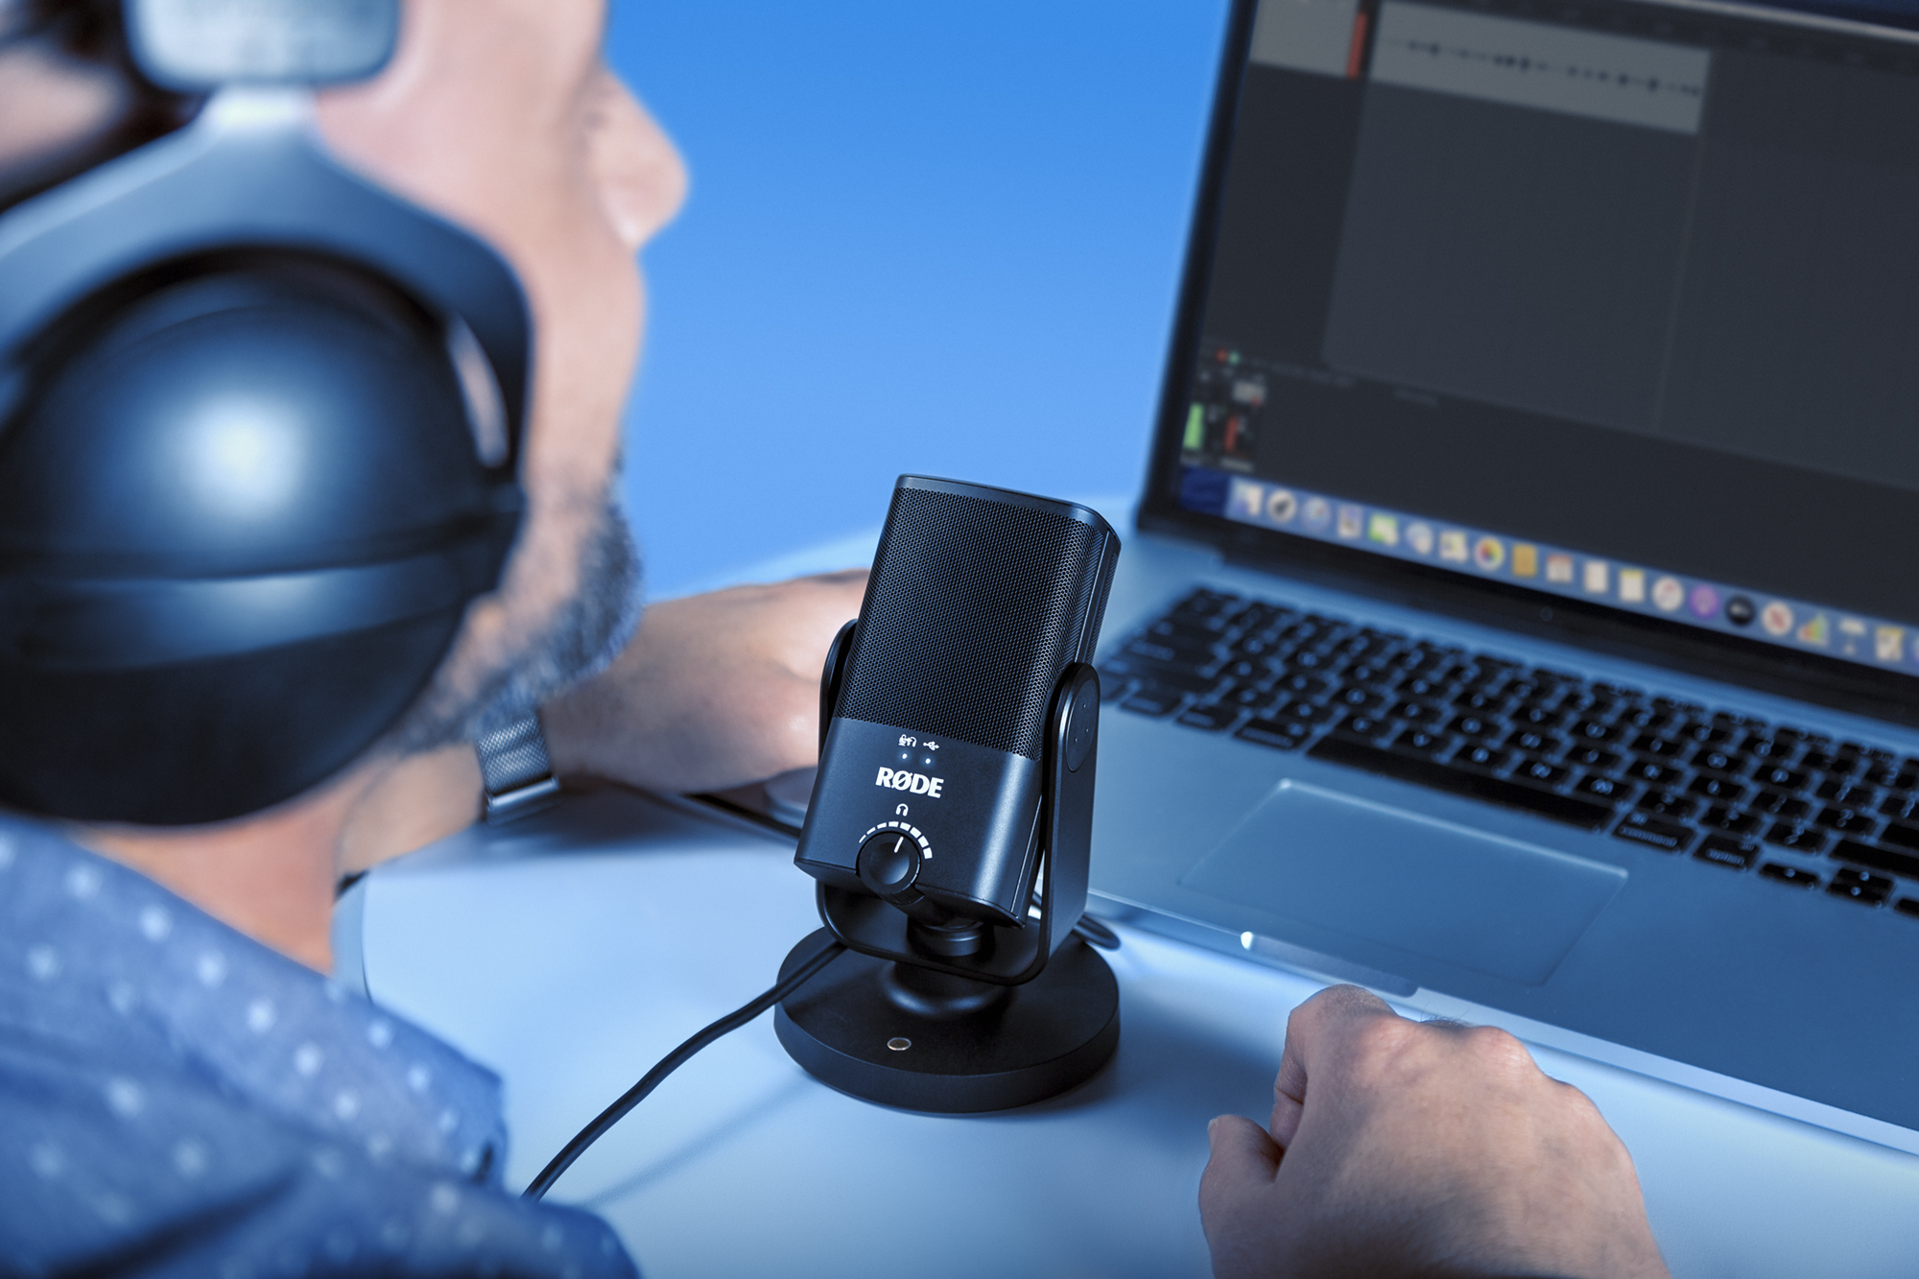
USE A PROPER SETUP
WITH AN EXTERNAL MICROPHONE
This is essential to provide good sound for all delegates and interpreters
A USB stand-alone microphone is the best option
Provides crisp, clear and safer sound
Do not use your computer’s in-built mic
Notes:
The second guideline is to use a high-quality external microphone when taking the floor.
A good quality stand-alone USB microphone, like the one pictured here, is the best option.
If listening to proceedings through speakers, make sure to plug in separate monitoring headphones when taking the floor to prevent feedback loops.

Slide 4
MICROPHONE TIPS
Below are some tips on what to look for in a good microphone and what to avoid
1
2
3
What to look for
Possible options
To avoid
Wired connection
Stand-alone mic with cardioid pick-up
Lapel mic is a more complex option
Best option - stand-alone mic:
Razer Siren Mini USB
Rode NT-USB
Lapel: RØDE Lavalier Go + Sabrent Aluminium Stereo 3D Sound Adapter
Sennheiser SC165, Logitech H340 and Logitech H390
Earbuds with integrated mic, integrated laptop mic
Some headsets (e.g. Sennheiser SC-260) can be a temporary solution but often distort sound for noise cancellation purposes
Notes:
Here are some tips on what to look for in a microphone, with some possible options. Feel free to take a screenshot or ask for these guidelines to be sent to you.
A wired connection is essential.
Plug-and-play USB stand-alone mics are easy to set up and use – look for a cardioid pick-up pattern, which picks up sound from a small area directly in front of the mic and not background noise.
Do not use the computer’s in-built mic, earbuds, or bluetooth mics. Some high-quality headsets can be a provisional option, but these usually distort sound for noise cancellation purposes, so should be avoided.

Slide 5

VIDEO IS ESSENTIAL
All speakers should turn on their video when taking the floor, with no exceptions.
Video is essential for interpreters, to pick up all non-verbal cues and body language.
If the connection is not fast enough for video, then a better connection should be found before the actual meeting, or risk not being interpreted.
The speaker should be framed with face and hand gestures visible, not be backlit.
Notes:
Please turn on your video. It helps other participants feel less alienated, and interpreters rely a lot on non-verbal visual cues and body language. Make sure your face, upper body and hand gestures are clearly visible, with your light source in front of you, not behind you.

Slide 6
SETTING UP
Find some peace and quiet
1
2
3
Find a quiet space
Switch off and plug in
Test!
Find a quiet environment indoors and set up your speaking station well in advance of the meeting.
Switch off any other applications running on your computer.
Switch off all sound notifications on your computer and other devices.
Keep all other devices away from your microphone.
Plug in your laptop.
Set mic level to 95%.
Test your setup during dry runs, sound checks, etc. well in advance.
Troubleshoot with meeting organisers, technicians and platforms to resolve issues.
Set up in full and test again right before the meeting starts!
Notes:
When setting up, find a quiet room in your house or office, switch off all other applications on your computer and sound on all other devices, and plug your computer in to ensure optimal performance. In your computer’s settings, set your microphone level to 95%.

Slide 7
DURING MEETINGS
1
2
3
Avoid extraneous noise
To be heard clearly
We are here to help
Turn your mic off when you finish speaking
Avoid touching microphones or shuffling papers close to microphones – this can be extremely painful for interpreters and listeners
Speak at a slow, measured pace
Speak directly into the microphone
Flag any issues with the platform and meeting organiser so they can be resolved asap
Notes:
During the meeting, please speak slowly and clearly, directly into your microphone, and avoid touching the microphone or shuffling papers close to it, and remember to mute when you have finished speaking.

Slide 8

FINAL REMARKS
A FEW FINAL COMMENTS ON RSI
Quality online meetings require impeccable sound and video.
Communicating in remote meetings is much more difficult than for in-person meetings.
There is a risk of auditory health issues for everyone, so protect your ears and those of others by following these guidelines.
Even if all these guidelines are followed, unexpected issues may come up and the interpreting team may still need to suspend interpretation.
Notes:
Please do bear these guidelines in mind for this and future meetings – communication in RSI meetings is challenging for all participants, and renders interpretation much more difficult. Poor sound also carries a risk of serious auditory health issues. Unfortunately, there is always a risk interpretation may have to be suspended if the sound is not good enough – please bear with us as we are doing our best.

Slide 9
Thank You
Notes:
Thank you for your time.

