Slide 1

^{Proposed themes for}
^{UNEA3}

Slide 2
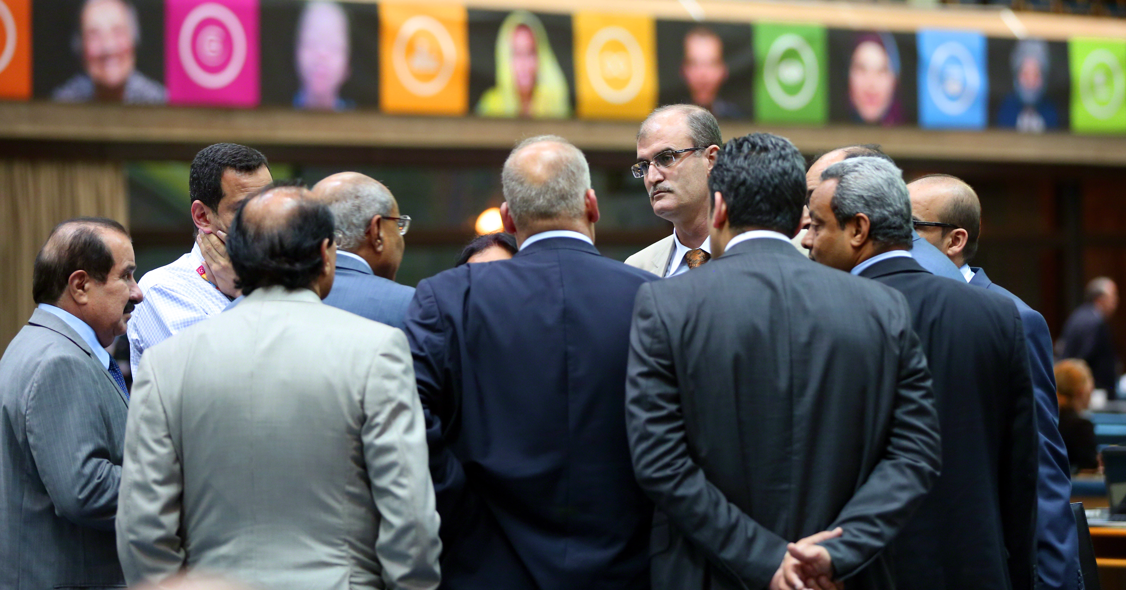
^{Principles for selection}

Slide 3
^{Principles for selection}
Three proposals for the UNEA III theme have been prepared for consideration. Each has merit. As previously agreed, it is recommended that the following principles are used to guide selection:
Scope: Will this theme lead to tangible and specific global solutions and connect to the global SDGs and the themes of the HLPF?
Outcomes: Will it result in an outcome meaningful and appealing to the world?
Viability: What is UN Environment’s own capacity to follow through and implement the UNEA III agenda?
Visibility: How will it raise the profile of UN Environment Assembly?
Collaboration: Will it result in global partnerships?

Slide 4
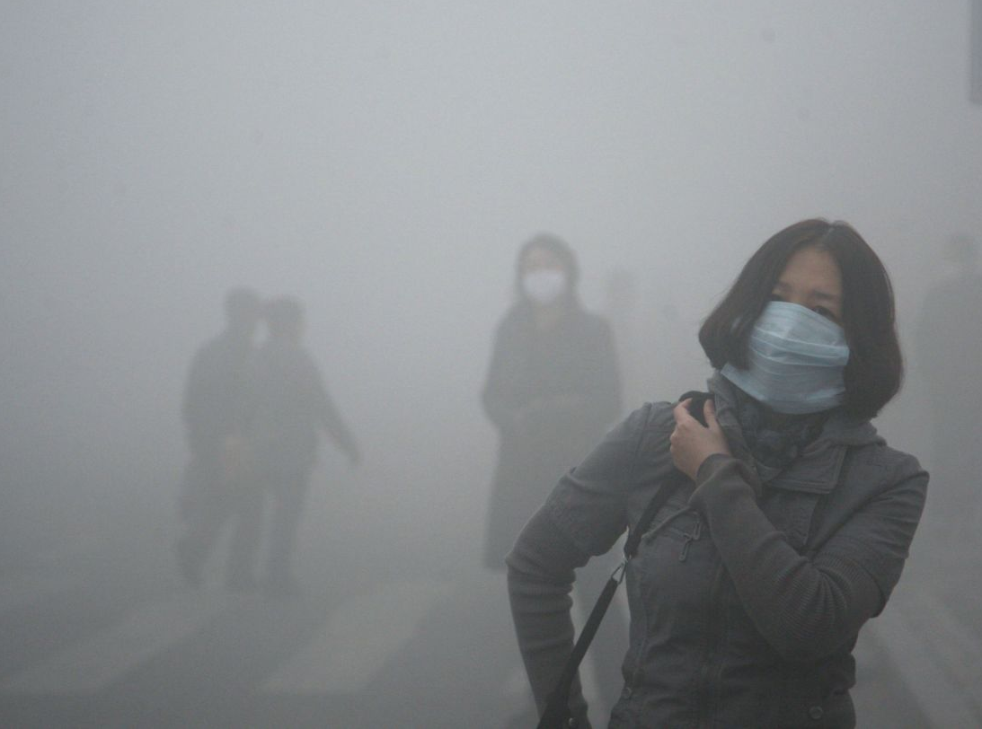
Pollution Free Planet: Delivering a deal to detoxify the world

Slide 5
^{Pollution Free Planet:}
Delivering a deal to detoxify the world
^{Rationale:}
Impact: Pollution is killing our biosphere, harming 100 million people* and threatening the very future of our planet Action is needed urgently and no single intergovernmental forum exists to deliver action on this.
Momentum: Both UNEA II and SDGs made strong commitments to act. UNEA III would look at holistic progress on this front and assess the gap to implementation. Cuts across several sectors and addresses several Goals at once.
* World Health Organization. "Climate change and health." 2014. Web Accessed April 25, 2015.

Slide 6
^{Pollution Free Planet:}
Delivering a deal to detoxify the world
^{Outcome:}
Inspiration: Bring in leaders from government, civil society, and industry to show what is working.
Engagement: Invite major private sectors to attend (energy, plastic sector)
Action: Agreement on a new global “Pollution Plan” that commits governments and invite non-state actors to action on this issue including specific action on issues such as air quality, marine litter and black carbon.

Slide 7
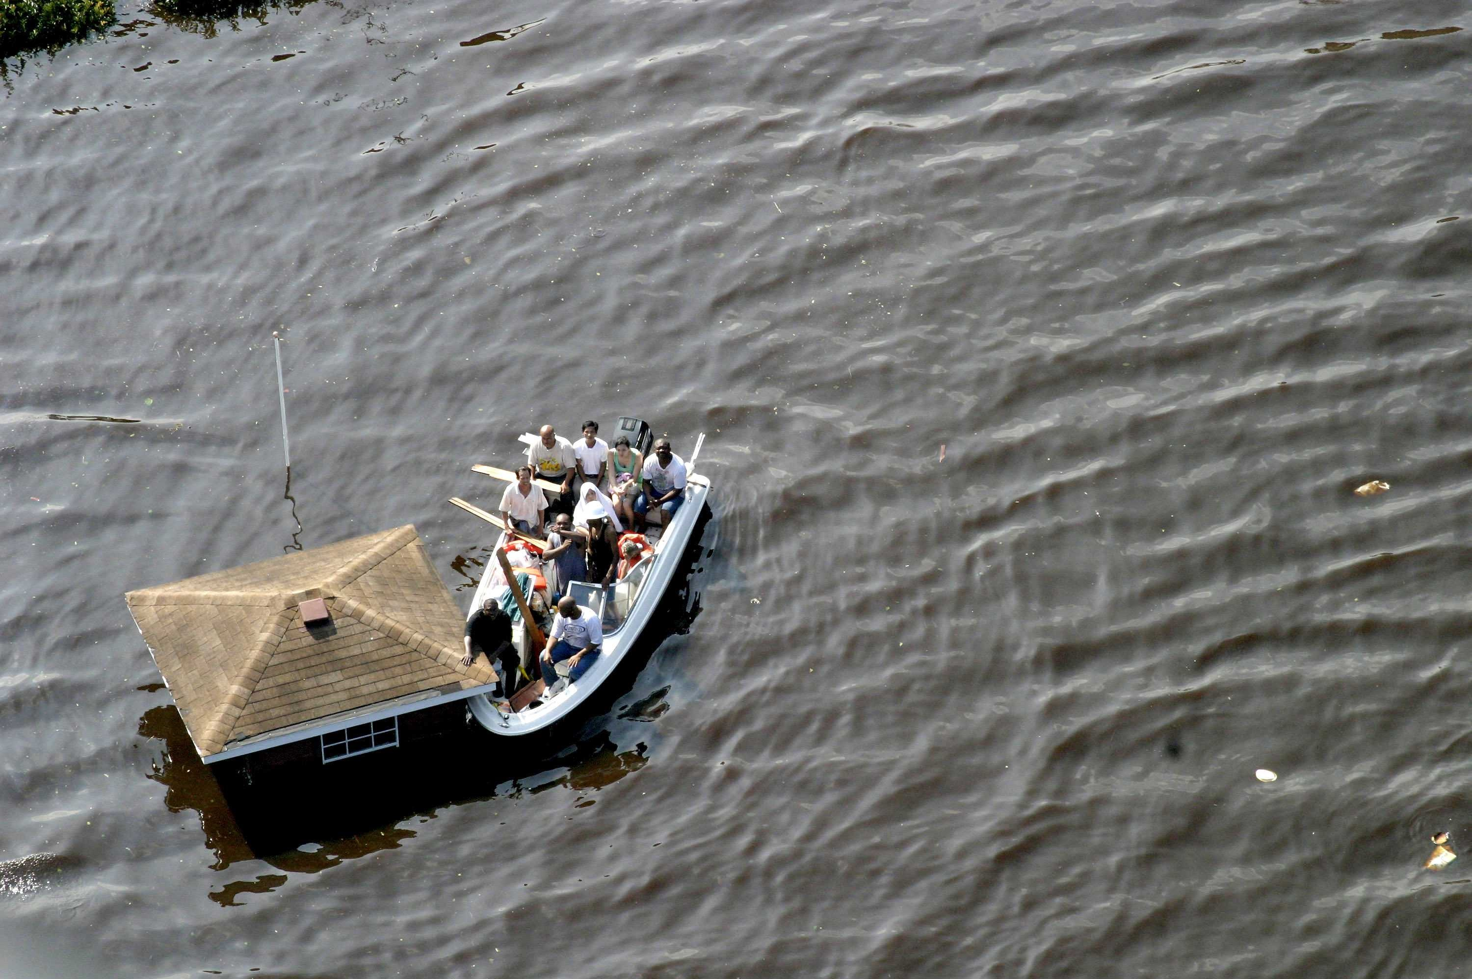
Tomorrow’s World: How to prepare the planet for 3 degrees and 9 billion

Slide 8
^{Tomorrow’s World:}
How to prepare the planet for 3 degrees and 9 billion
^{Rationale:}
Impact: Scarcity as a result of population increase and a potential 3 degree future has to force the world to prepare for what is to come with increasing pressures on ecosystems, agriculture, and water resources.
Rising risks: New hazards will emerge that will require systems change in preparing for the crises to come (e.g. floods and epidemics or drought and famine).
Preparing before the risk arises: A UNEA III would help the world address the important and share best practice on how government’s and private sector are working on this issue.

Slide 9
^{Tomorrow’s World:}
How to prepare the planet for 3 degrees and 9 billion
^{Outcomes:}
Inspiration: Scientists to play a large role in sharing with Government’s likely scenarios and interventions required to increase resilience to the shocks to come.
Engagement: Insurance industry, youth and private sector to play a key role in laying out how they see the risks and recommendations for change.
Action: Using the best available science, the UN Environment would prepare, in consultation with Member States, a Global Scenario and Action Plan on the actions and investments needed to keep a safe operating space in a 2050 Planet. (please edit as appropriate).

Slide 10

Nature for All: How to create harmony for People and the Planet

Slide 11
^{Nature for All:}
How to create harmony for People and the Planet
^{Rationale:}
Impact: Whether it’s farming or protecting the future of major wildlife species, pressure on nature is at its peak and new thinking is required for a sustainable relationship between people and the planet.
Progress on biosphere targets: Assess where world is at in terms of it’s Aichi Targets (Marine Protected Areas and Forests) and to see what more needs to be done to hit the target of protecting 50% by 2050.

Slide 12
^{Nature for All:}
How to create harmony for People and the Planet
^{Outcomes:}
Inspiration: Assessing the impact of protection to date, how communities are faring and understanding “what is working” on this front.
Engagement: Bringing together landowners, youth, ecologists and private sector leaders from forestry, energy and water to participate in this discussion; the struggle over space, habitat, land
Action: New commitments stating the ethical principles on the relationship between Humanity and Nature with new proposals and incentives to create harmony between communities and nature that would support the world hitting 50% protected areas by 2050.

Slide 13

^{Conclusion}
What should the Environment Assembly focus its efforts on?

